Slide 1
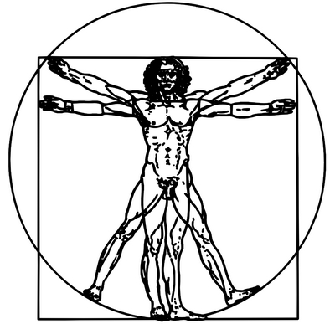
Elena is
presenting
“Anatomy/
Medicine”.
AIИAMOЯ iohoɿoᗡ

Slide 2
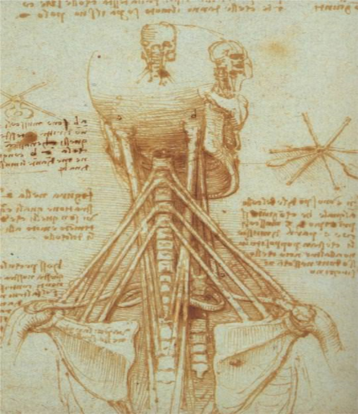
Leonardo’s fascination with anatomical studies reveals a prevailing artistic interest of the time. In his own treatise Della pittura (1435; “On Painting”), theorist Leon Battista Alberti urged painters to construct the human figure as it exists in nature, supported by the skeleton and musculature, and only then clothed in skin. Although the date of Leonardo’s initial involvement with anatomical study is not known, it is sound to speculate that his anatomical interest was sparked during his apprenticeship in Verrocchio’s workshop.

Slide 3
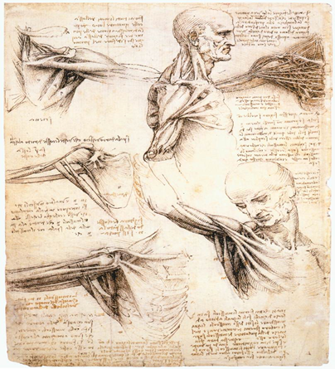
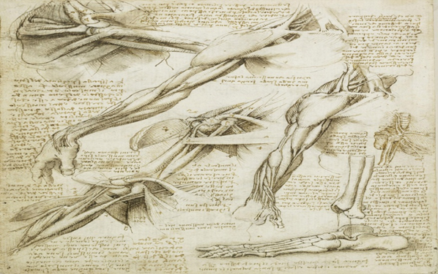
Leonardo’s early anatomical studies dealt chiefly with the skeleton and muscles; yet even at the outset, Leonardo combined anatomical with physiological research. From observing the static structure of the body, Leonardo proceeded to study the role of individual parts of the body in mechanical activity. This led him finally to the study of the internal organs; among them he probed most deeply into the brain, heart, and lungs as the “motors” of the senses and of life.

Slide 4
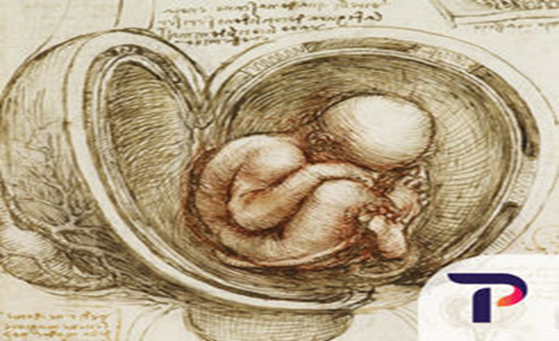
Even without decoding the thyroid’s purpose, Da Vinci had done plenty to forward medical knowledge with his amazing art and insatiable inquisitiveness. Amusingly, Da Vinci may not even have been aware of the significance of his thyroid drawings. For all his brilliance, Da Vinci lacked a formal education beyond an elementary level. That obviously didn’t hold his intellect back, but it did present one small stumbling block: the scientific literature of the time was written almost exclusively in Latin, a language he could not read. It seems entirely possible that this genius did not know, then, that he was the first to define the thyroid as an organ.

Slide 5
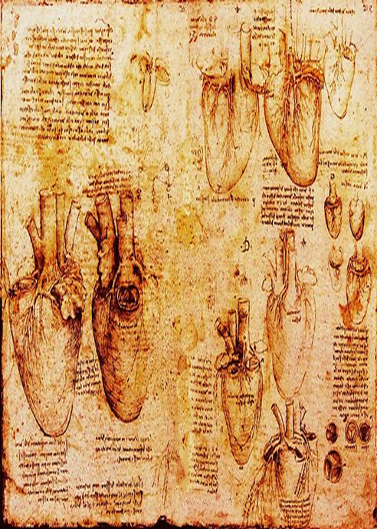
Da Vinci’s drawings stand out for their brilliance, beauty, and scientific accuracy to this day, although he died in 1519 before he had a chance to publish them as part of a planned treatise on human anatomy. In fact, they almost went entirely unseen by anyone: after his passing, his anatomical drawings were lost for 259 years. They were ultimately found in the Windsor Castle of London, where they are proudly displayed today as part of the Royal Library.

