Slide 1
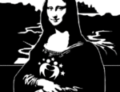
ANATOMY
ƎᗡOƆ IƆИIV Aᗡ

Slide 2
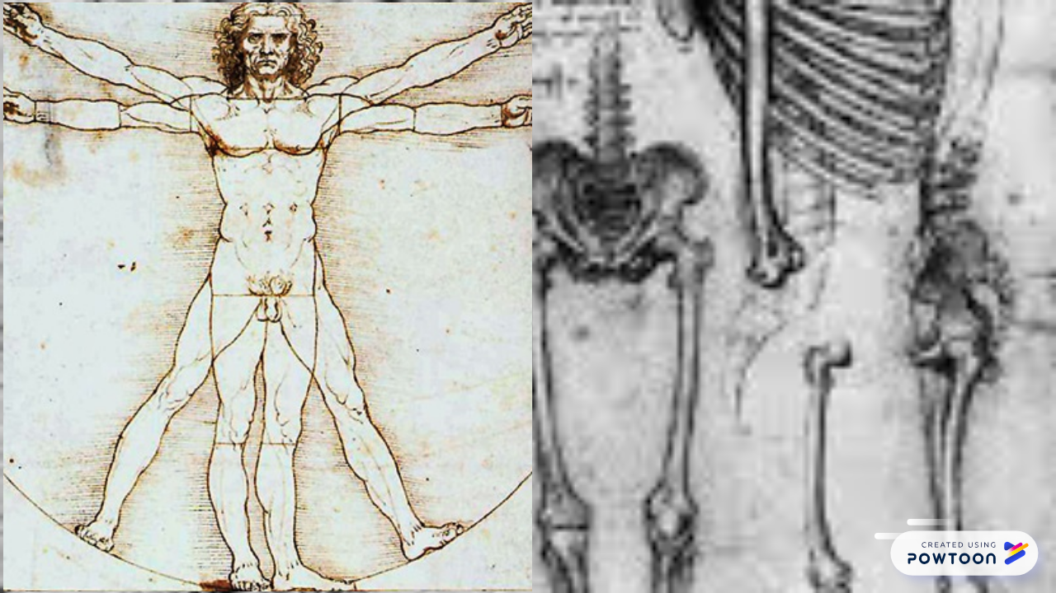

Slide 5
Kristian Brajer
7-B form
Khust Specialized school 3
Ukraine

