Slide 1
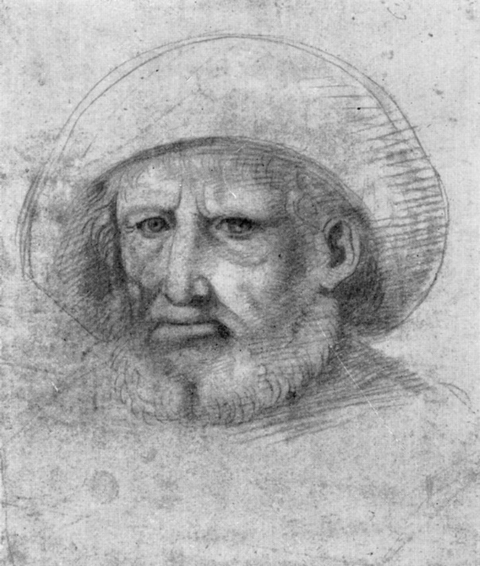
Leonardo Da Vinci
All people know the sculpture, the artist, the scientist. When Leonardo Da Vinci was born, his father was 25 years old. Puro Da Vinci died at 77 years old (in 1504)

Slide 2
Leonardo was immediately recognized by his father, but after the birth he was immediately sent with his mother to the village of Ankhiz. 4 years he was taken to his father’s family where he received his primary education reading, writing, mathematics, the Latin.

Slide 3
During his life he had four wives and was the father of ten sons and two daughters. Leonardo’s mother has almost nothing to know. In his biographies some kind of “young peasant” Katerina is mentioned most often. In the age of rebirth, the illegitimate were often treated the same way as legally born children.

Slide 4
One of the features of the Leonardo Da Vinci is his handwriting: Leonardo was left handed and wrote from right to left turning the letters so that the text was easy to read with the help of a mirror, but if the letter was addressed to someone he wrote traditionally.

Slide 5
Спасибо за просмотр!

