Slide 1
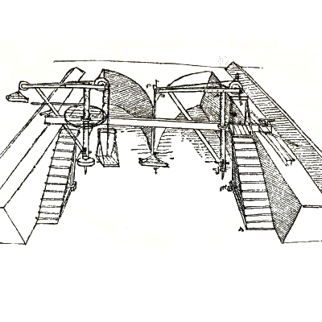
Andreea is
presenting
“Civil
engeneering”.
AIИAMOЯ iohoɿoᗡ

Slide 2
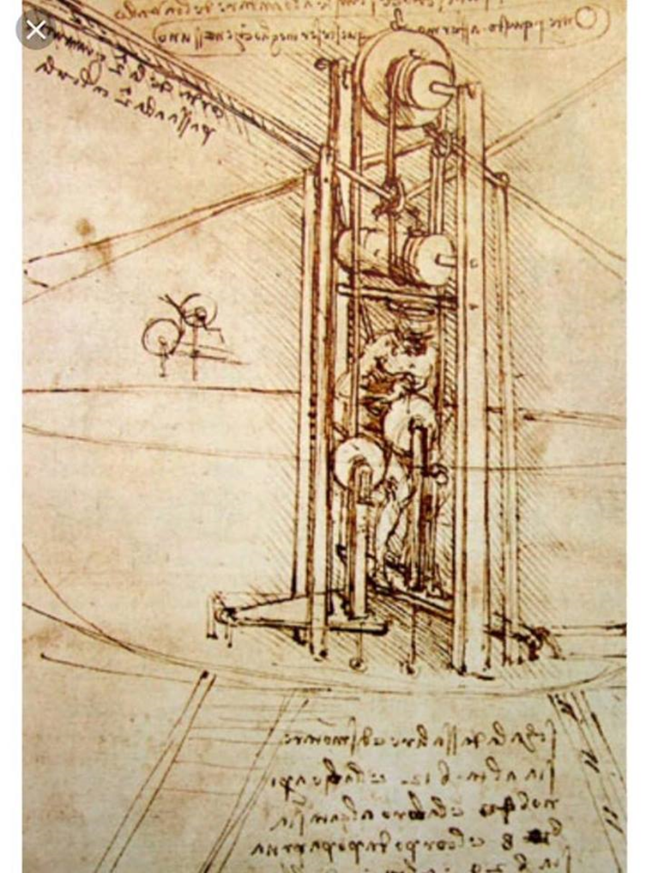
Leonardo may be best known as a painter, but he also did a great deal of original thinking about technical problems faced by civil and structural engineers. Although he lacked a formal education, Leonardo's fascination for engineering led him to look hard at basic engineering theory. He was interested in economy of structural design, and developed new theories on the behaviour of arches and beams.

Slide 3
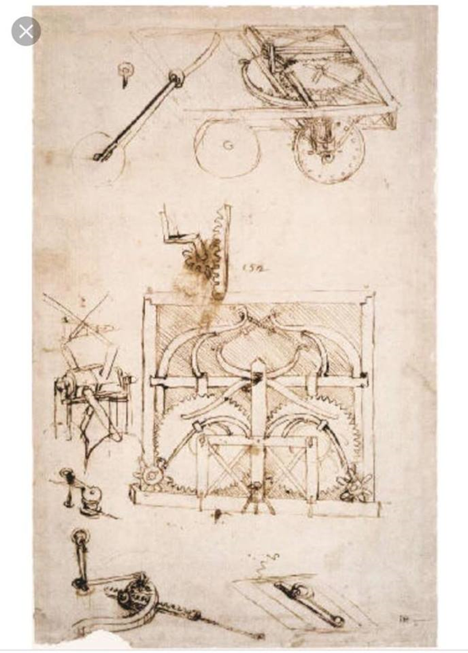
He even got involved in town planning while working in the court of Ludovico Sforza, the ruler of Milan. In 1483 the city was struck by a plague and he came up with plans for new townships incorporating extra wide streets to avoid traffic congestion.
Leonardo's interest in civil engineering also spilled over into mechanics. His manuscripts show numerous drawings of excavating cranes for digging canals and locks as well as designs for military equipment ranging from machine guns and catapults.

Slide 4
He even got involved in town planning while working in the court of Ludovico Sforza, the ruler of Milan. In 1483 the city was struck by a plague and he came up with plans for new townships incorporating extra wide streets to avoid traffic congestion.
Leonardo's interest in civil engineering also spilled over into mechanics. His manuscripts show numerous drawings of excavating cranes for digging canals and locks as well as designs for military equipment ranging from machine guns and catapults.

Slide 5
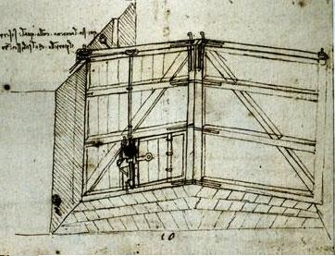
Leonardo's more ambitious projects were never built. One, a navigational canal linking Florence with Pisa and the sea did get started at the end of the 15th century. It was eventually abandoned in 1504 after frequent military attacks ordered by Pisa's rulers, who were opposed to the project.

