Slide 1
Olivia and carmen present : LOCOMOTION

Slide 2
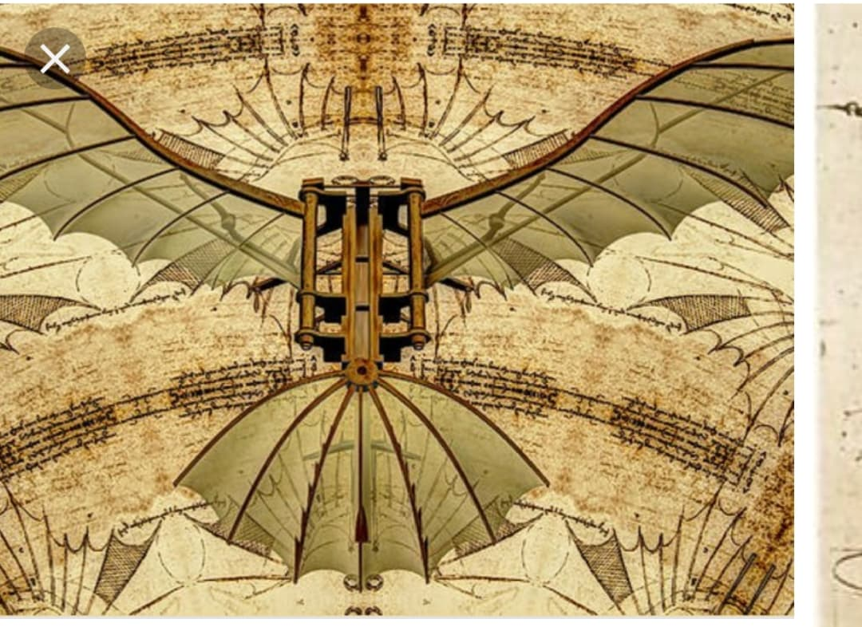
Of Leonardo da Vinci’s many areas of study, perhaps this Renaissance man’s favorite was the area of aviation. Da Vinci seemed truly excited by the possibility of people soaring through the skies like birds. One of da Vinci’s most famous inventions, the flying machine (also known as the "ornithopter") ideally displays his powers of observation and imagination, as well as his enthusiasm for the potential of flight. The design for this invention is clearly inspired by the flight of winged animals, which da Vinci hoped to replicate. In fact, in his notes, he mentions bats, kites and birds as sources of inspiration.

Slide 3
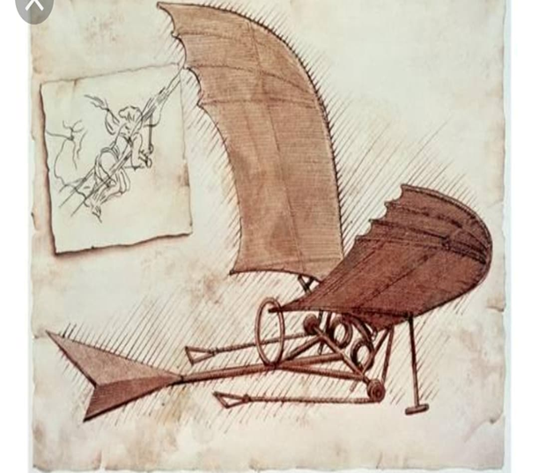
Da Vinci's hundreds of journal entries on human and avian flight suggest he longed to soar through the air like a bird. In fact, his designs for a so-called flying machine — carefully sketched out in his notebooks — were modeled after the anatomy of birds and bats. Da Vinci's designs featured a pair of enormous wings connected to a wooden frame, inside of which an intrepid pilot could lie facedown and move the wings up and down by turning a crank that moved a series of rods and pulleys. Unfortunately, da Vinci never built the device, but even if he had, it likely wouldn't have been a success. The machine had no engine, so it's unclear how it would get off the ground. And even if da Vinci flew his machine off a high cliff, it's unlikely that he would have returned to Earth in one piece. The world would have to wait another 400 years or so for a machine that could really fly. It wasn't until 1903 that brothers Wilbur and Orville Wright made their first successful flight in a powered aircraft.

