Slide 1
Inventions of Leonardo da Vinci
Posted by: Rybitskaya Valeria

Slide 2
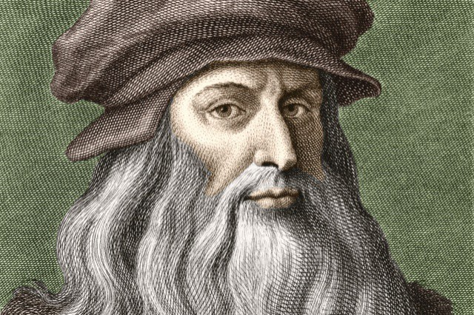
Leonardo di Ser Piero da Vinci is an Italian artist, scientist, inventor, writer, musician, one of the greatest representatives of the art of the High Renaissance. The artistic legacy of Leonardo is not quantitatively large, and a number of his works are lost or badly damaged. However, his contribution to world artistic culture is extremely important, even against the background of the cohort of geniuses that the Italian Renaissance gave.

Slide 3
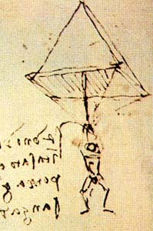
One of the great inventions of da Vinci is the parachute. Being enchanted by the idea of ​​a flying man, he conceived his parachute as a means for drifting through the air. Its pyramidal structure was draped with fabric. As da Vinci wrote in his notes, such a device would allow a person to "fall from any height without any injuries and damages." The twenty-first century naturalists who implemented the da Vinci plan recognized that it works exactly as it predicted.

Slide 4
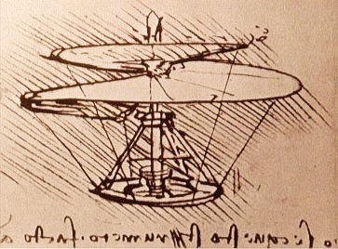
Another of Leonardo’s inventions is the air screw. The da Vinci propeller is probably the coolest project ever found in his notebooks. He would work on the principle of a modern helicopter. The flying machine looked like a huge spinner. The "blades" of the helicopter were made from flax. If you unleash them quickly enough, they could create cravings, an aerodynamic phenomenon that allows airplanes and helicopters to fly. Air would create pressure under each of the blades, thereby raising the flying machine into the sky.

Slide 5
Thank you
for attention!

