Slide 1
Leonardo da Vinci
Kolybatko Maria

Slide 2
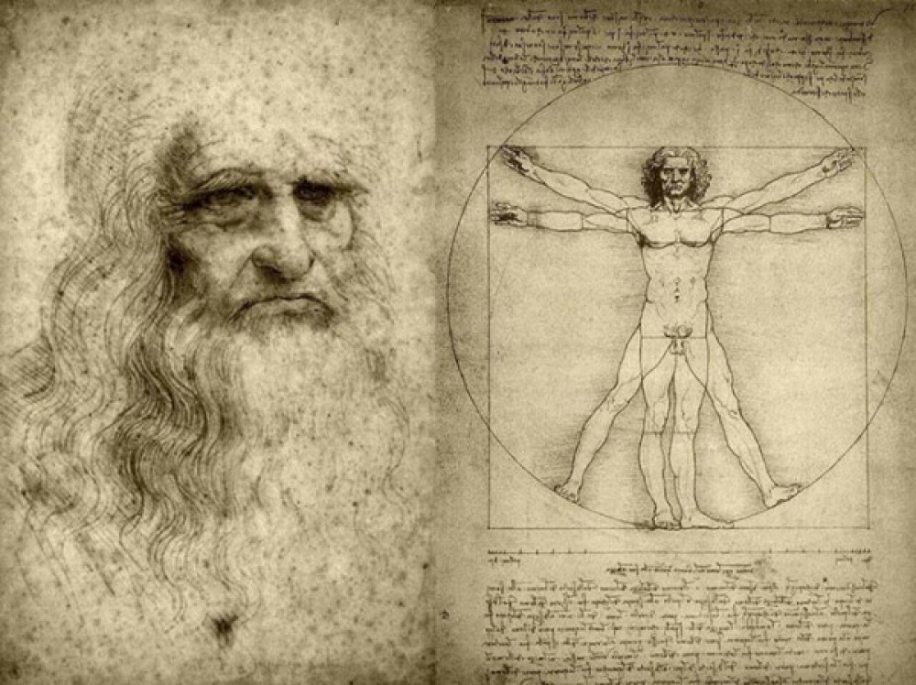

Slide 3
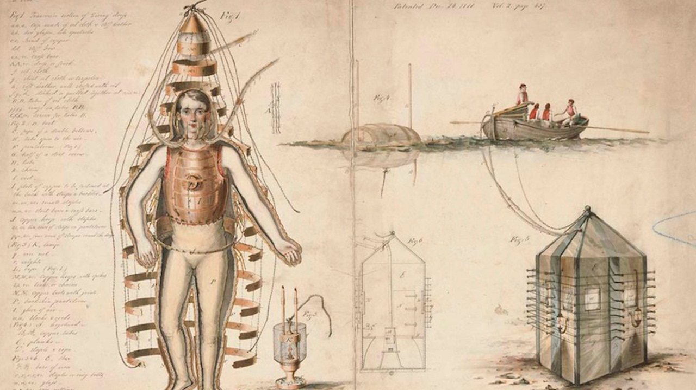
Da Vinci was very fond of water, and it is not surprising that in order to explore the underwater world, he needed a device that allows him to breathe underwater. An inquisitive mind coped with this task, and the first scuba was invented by the famous Italian. Leather was used for the manufacture of the “diver” suit, glass lenses made it possible to look around, and for too much delight from the beauties of the underwater world, a bag was provided to straighten the natural need. Air was supplied by specially fixed reed tubes.

Slide 4
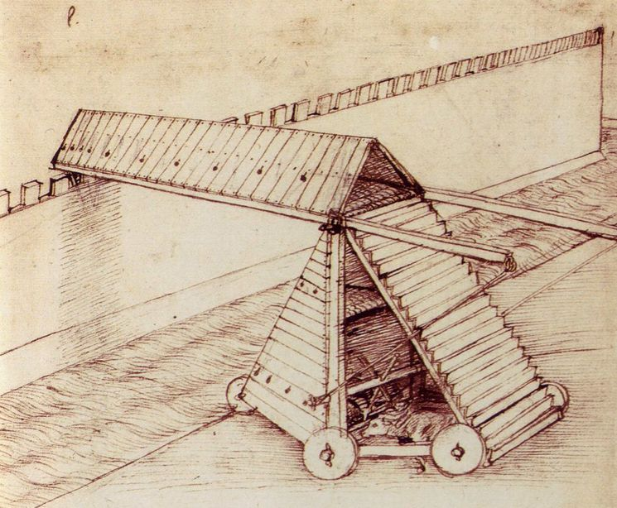
He was very close to military-technical ideas. The first tanks were born in the imagination of the scientist, and he strongly advocated the idea of creating a chariot covered with sheets of armor. The semicircular shape would resist the onslaught of the enemy, and the gun, which the tank should be equipped with, could adjust the firing angle with the help of a reinforced lifting unit.

Slide 5
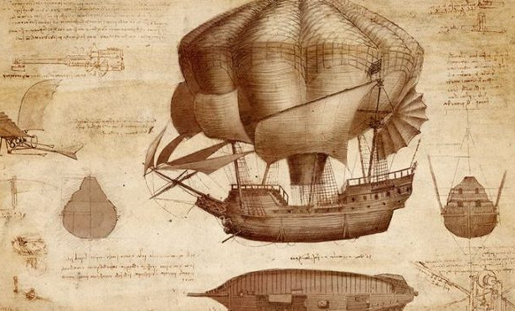
All his life Leonardo dreamed of the sky. He considered the impossibility of flying in the clouds to be a terrible injustice and worked in every way to eliminate it. Among the drawings and sketches that have come down to our days, there is a model of a device for flight, which is considered to be the prototype of a helicopter. The lack of modern materials used in aircraft manufacturing, in the military industry, greatly complicated the work of the scientist, but he was looking for options among what was available to him.

Slide 6
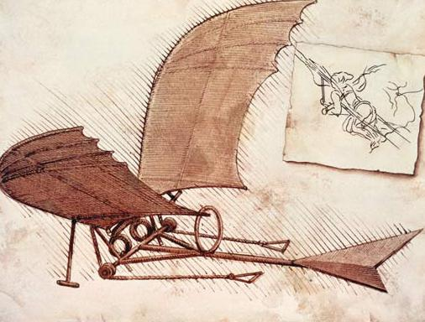

Slide 7
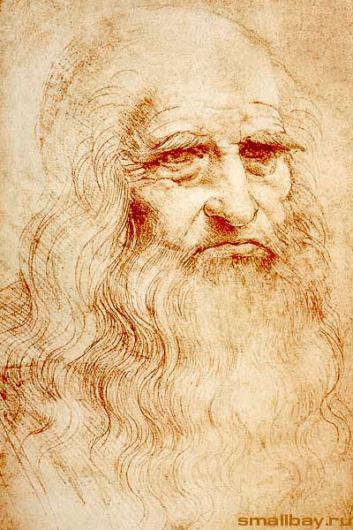
Thanks for attention

