Slide 1
Anton Chuikov
Lozova, Ukraine

Slide 2
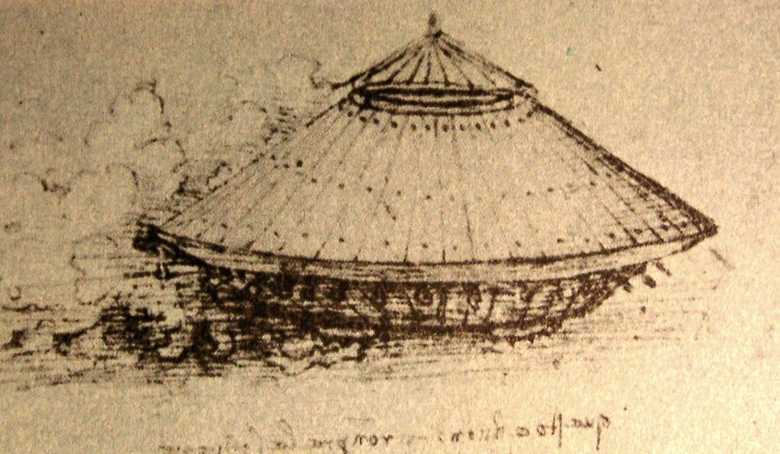
Tank of Leonardo Da Vinci

Slide 3
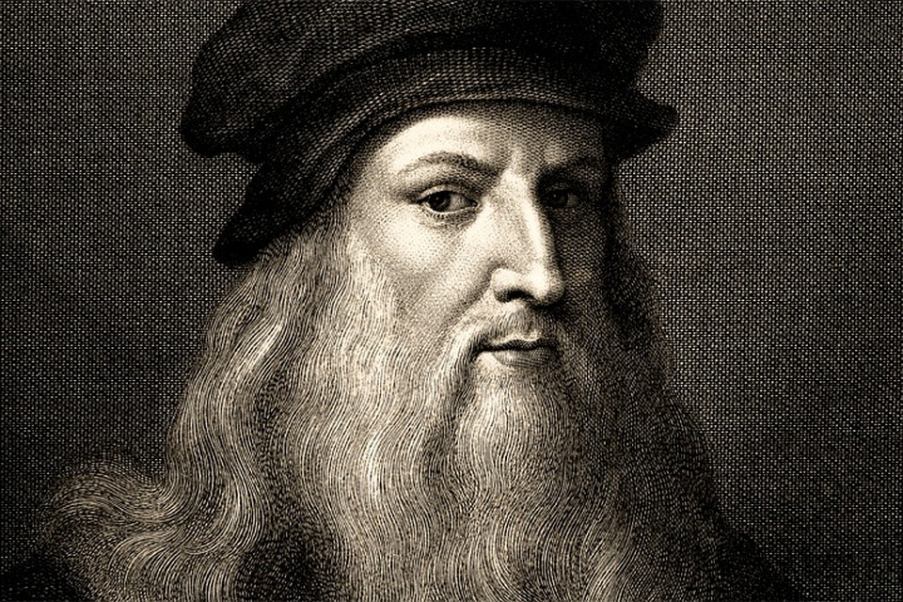
Leonardo Da Vinci was an outstanding artist and engineer of the 15th century. At that time, this person predicted the appearance of various technologies and even created their first blueprints.

Slide 4
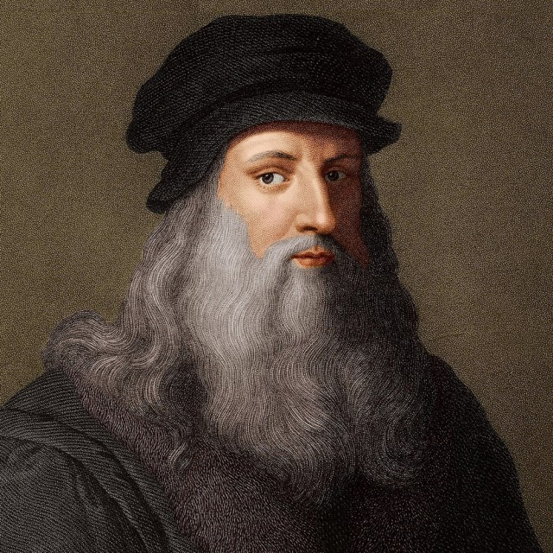
Leonardo hated wars and did not like to create weapons, but when he really needed money, he created weapons and sold his designs.

Slide 5
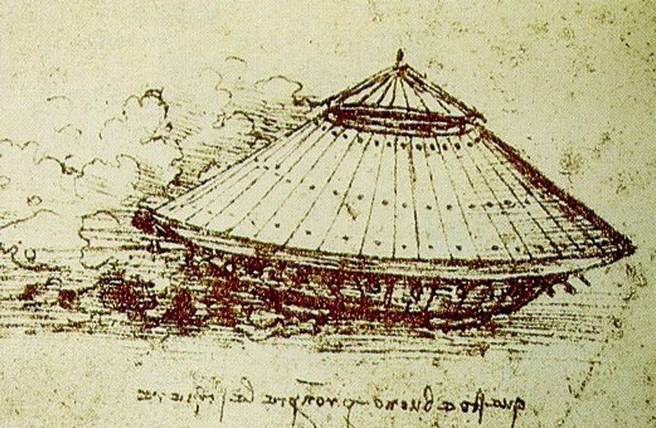
One of his war machines become the prototype of tank.

Slide 6
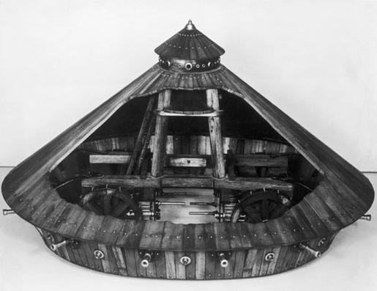
Da Vinci's armored vehicle was a conical shell inspired by a tortoise shell. The coating had to be made of wood and reinforced with metal plates that add to the thickness. Tilt angle will deflect enemy fire. The car was equipped with two large internal handles that were controlled by four strong men. The car was equipped with a variety of light guns, located on the perimeter.

Slide 7
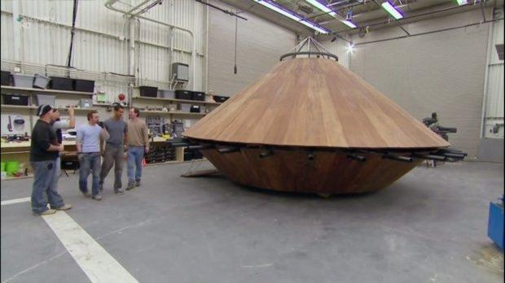
The vehicle was intended to intimidate the enemy, and not to be used as a serious military weapon. Due to the impressive size of the car, he will not be able to move around the terrain. The project could hardly be applied and implemented in the 15th century. Around 2010, a group of engineers recreated the Leonardo car, based on the original design. The transfer error has been fixed.

