Slide 1
Bianca is
presenting
“Means of
locomotion”.

Slide 2
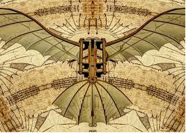
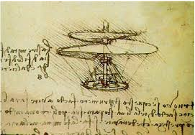
1.Flying Machine
Of Leonardo da Vinci’s many areas of study, perhaps this Renaissance man’s favorite was the area of aviation. It was this interest that inspired his most famous invention – the flying machine.
2.Helicopter (Aerial Screw)
Though the first actual helicopter wasn’t built until the 1940s, it is believed that Leonardo da Vinci’s sketches from the late fifteenth century detailed a predecessor to the modern-day flying machine .

Slide 3
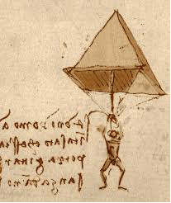
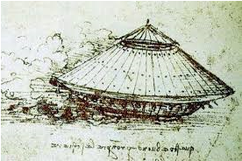
3.Parachute
Though credit for the invention of the first practical parachute usually goes to Sebastien Lenormand in 1783, Leonardo da Vinci actually conceived the parachute idea a few hundred years earlier .
4.Armoured Car
The precursor to the modern tank, Leonardo da Vinci's armored car invention was capable of moving in any direction and was equipped with a large number of weapons.

Slide 4
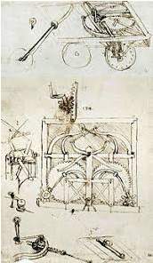
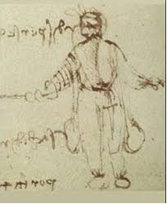
5.Scuba Gear
In his lifetime, da Vinci designed many inventions dealing with water – perhaps, most notably, scuba gear.
6.Self-Propelled Cart
Before motorized vehicles were even a glimmer in someone's eye, Leonardo da Vinci designed a self-propelled cart capable of moving without being pushed.

