Slide 1
Malyushkin Kirill From: Lozova School 12

Slide 2
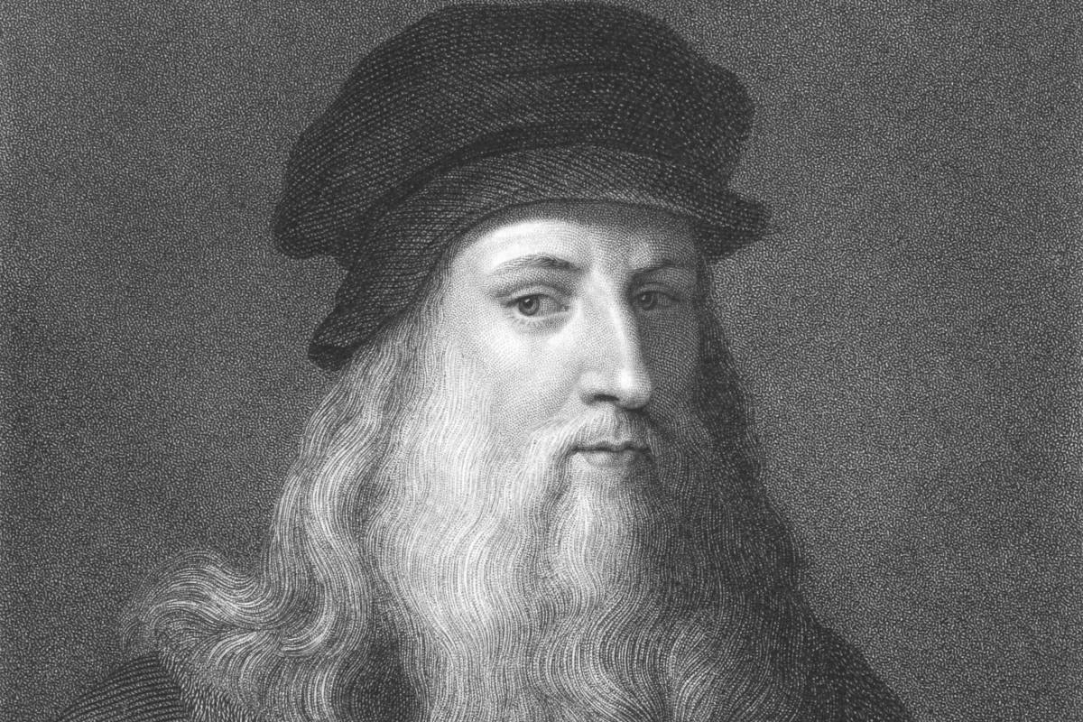
Leonardo da Vinci
Machine gun
Invention

Slide 3
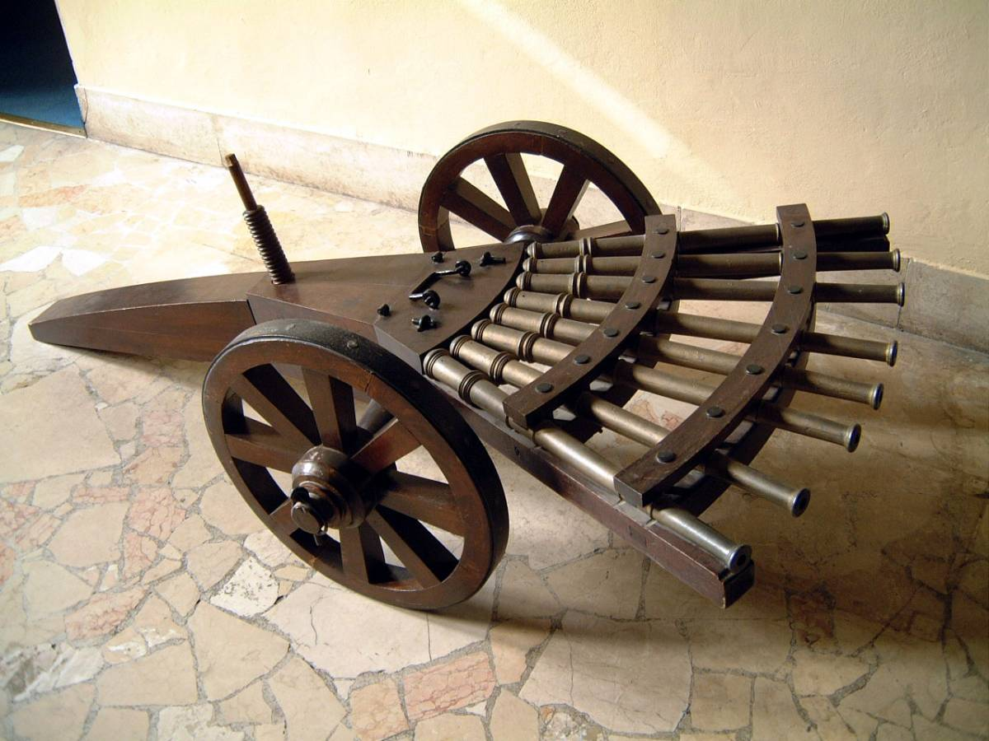
Machine gun
One of the most famous inventions of da Vinci, ahead of his time, is considered to be a machine gun. Although the design of Leonardo is more correct to call a multi-barreled instrument. Da Vinci had several projects of volley fire. His most famous invention in this area is the so-called “organ-shaped musket”. The design had a rotating platform, on which were placed three rows of muskets (arquebus) of eleven trunks. The da Vinci machine gun could have only made three shots without reloading, but they would be enough to defeat a large number of enemy soldiers.

Slide 4
The main drawback of the design was that such a machine gun is extremely difficult to reload, especially in combat conditions. Another variant of the multi-barreled gun suggested the location of a large number of muskets as a fan. The guns were directed in different directions, increasing the radius of the lesion. Like the previous development, the “fan” tool for increasing mobility was supposed to be equipped with wheels.

