Slide 1
Mihaela And anca present : anatomy

Slide 2
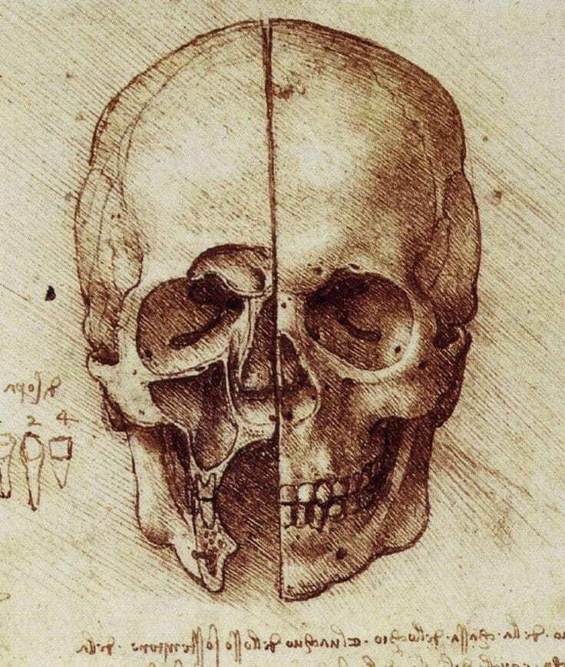
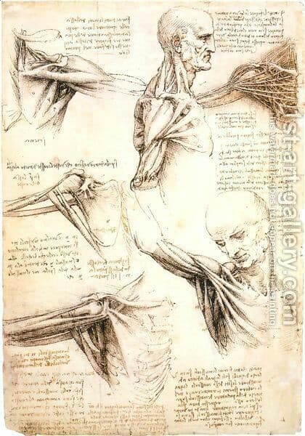
Leonardo da Vinci, was one of the most accomplished anatomists. His master, Andrea del Verrocchio, insists on the need to study human anatomy. Thus, Leonardo becomes the creator of modern anatomical iconography and topographic anatomy. Studying and dissecting over 30 bodies , makes detailed observations. As a result, we have left over 750 planes representing bones, muscles, organs, and even sections through the brain; the fetus in the uterus, the antagonistic muscles of the eye, the inside of the heart. He first made cross sections and injected the cavities with hot wax to keep their shape cut. On the edge of the drawings, the artist adds detailed explanations.

Slide 3
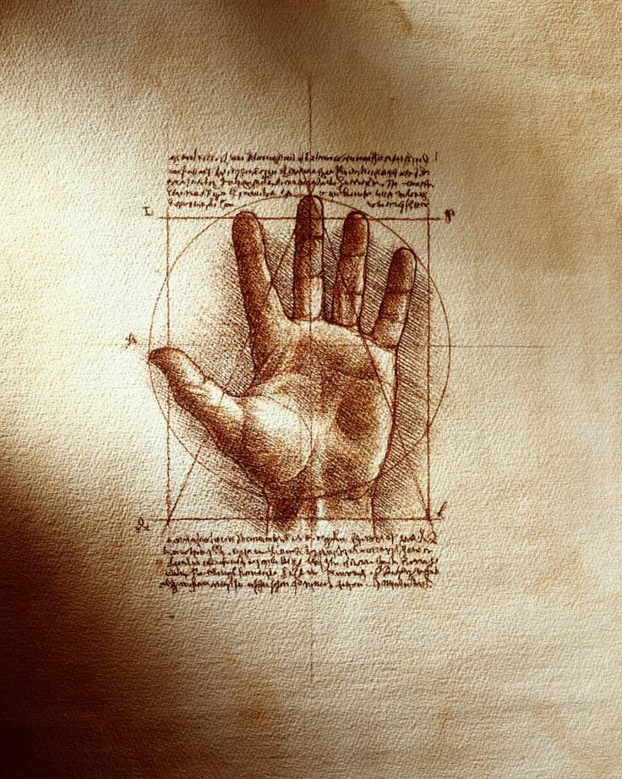
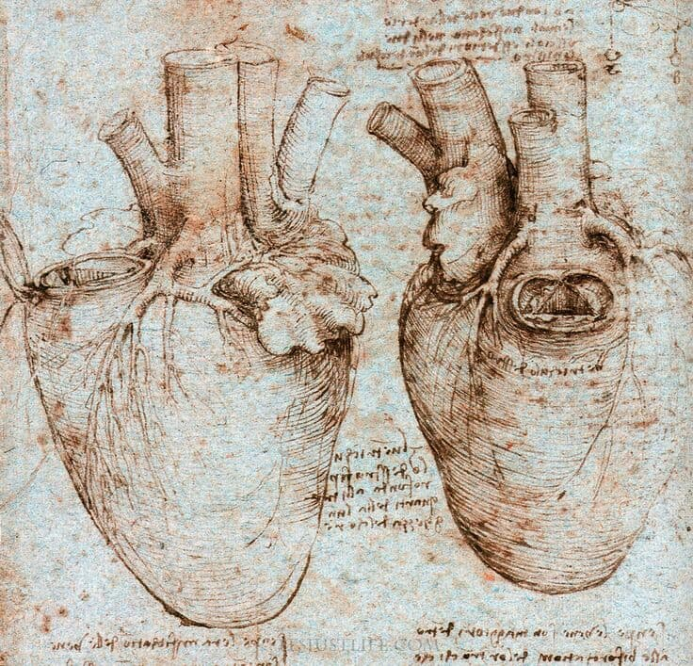
Anatomical studies and drawings Leonardo’s fascination with anatomical studies reveals a prevailing artistic interest of the time. In his own treatise Della pittura (1435; “On Painting”), theorist Leon Battista Alberti urged painters to construct the human figure as it exists in nature, supported by the skeleton and musculature, and only then clothed in skin. Although the date of Leonardo’s initial involvement with anatomical study is not known, it is sound to speculate that his anatomical interest was sparked during his apprenticeship in Verrocchio’s workshop, either in response to his master’s interest or to that of Verrocchio’s neighbor Pollaiuolo, who was renowned for his fascination with the workings of the human body. It cannot be determined exactly when Leonardo began to perform dissections, but it might have been several years after he first moved to Milan, at the time a centre of medical investigation. His study of anatomy, originally pursued for his training as an artist, had grown by the 1490s into an independent area of research. As his sharp eye uncovered the structure of the human body, Leonardo became fascinated by the figura instrumentale dell’ omo (“man’s instrumental figure”), and he sought to comprehend its physical working as a creation of nature. Over the following two decades, he did practical work in anatomy on the dissection table in Milan, then at hospitals in Florence and Rome, and in Pavia, where he collaborated with the physician-anatomist Marcantonio della Torre. By his own count Leonardo dissected 30 corpses in his lifetime.

