Slide 1
ALICE MANZHULA

Slide 2
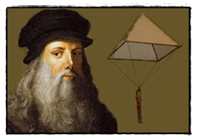
PARACHUTE "TENT" by LEONARDO DA VINCI
To open a cycle of articles on the history of engineering, one would like a description of the invention of the old Leonardo Da Vinci (the same one, who spoke with various hints about the essence of Mary Magdalene in Brown’s famous novel). So, it turns out that this very Leonardo could not only intrigue around the church to weave, but also generated thoughts that were embodied in many modern devices.

Slide 3
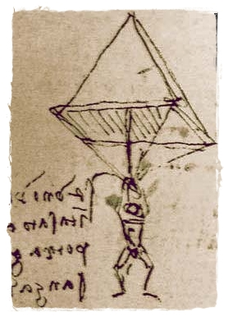
WHY THEN DO HISTORIANS CONSIDER THAT DA VINCI THE INVENTOR OF THE PARACHUTE?
The fact is that in his manuscripts he first described the exact dimensions of the device for safe descent from a great height. In his work “On the Flying and the Movement of Bodies in the Air” of 1485 (according to other information, 1483 and 1495) the following record was made to the drawing:

Slide 4
LEONARDO’S WORDS
“If a person has a tent of starched linen, 12 cubits wide and 12 meters high,” he wrote, “then this person can rush from any height without danger to himself.”

Slide 5
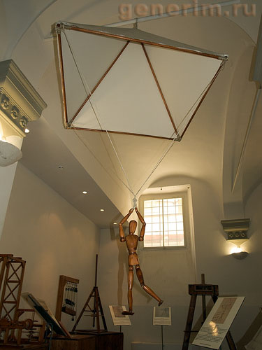
THE GREAT INVENTION OF DA VINCI
This was the first technical design of the parachute. Leonardo came to such a discovery after numerous observations of falling cardboard figures of various shapes.
There is a curious legend about the invention of Leonard's parachute and hang glider from the Hudson Hawk movie. About lifetime experiments with a parachute Leonardo da Vinci is not known. But, to tell the truth, if you remember what materials the great master had for his invention, hardly anyone would want to jump with him.

