Slide 1
War machines
ƎᗡOƆ IƆИIV Aᗡ
Ivan Chumak, Vlad Marutsan
Form 7-B
Khust Specialized school 3
Ukraine

Slide 2
Leonardo da Vinci
15 April 1452 – 2 May 1519. Leonardo da Vinci or simply Leonardo, was an Italian polymath of the Renaissance whose areas of interest included invention, painting, sculpting, architecture, science, music, mathematics, engineering, literature, anatomy, geology, astronomy, botany, writing, history, and cartography. He has been variously called the father of paleontology, ichnology, and architecture, and he is widely considered one of the greatest painters of all time. Sometimes credited with the inventions of the parachute, helicopter, and tank, he epitomized the Renaissance humanist ideal.

Slide 3
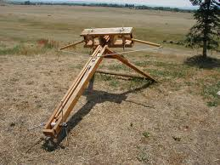
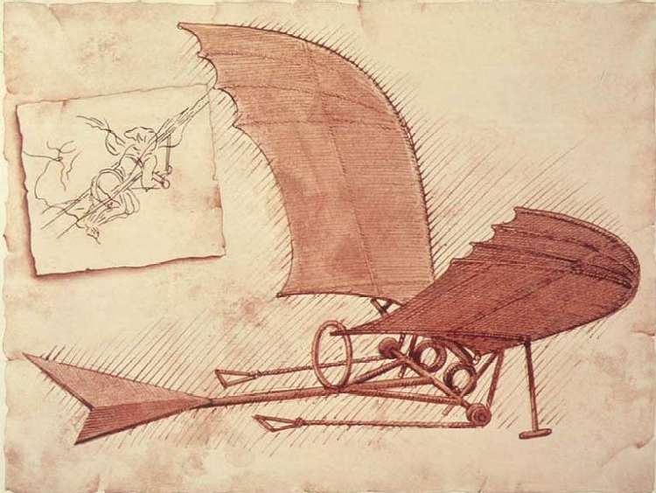
War machines

Slide 4
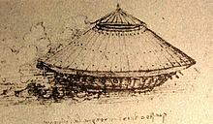
Tank
Sometimes described as a prototype of modern Tanks, da Vinci's armored vehicle represented a conical cover inspired by a turtle’s shell. The covering was to be made of wood and reinforced with metal plates that add to the thickness. Slanting angles would deflect enemy fire. The machine was powered by two large inside cranks operated by four strong men. The vehicle was equipped with an array of light cannons, placed around the perimeter.
The gears of the design were located in a reversed order, making the vehicle unworkable. This is thought by some sources to have been a deliberate mistake by Da Vinci as a form of security, in case his design was stolen and used irresponsibly.
The vehicle was designed to intimidate the enemy rather than to be used as a serious military weapon. Due to the vehicle's impressive size, it would not be capable of moving on rugged terrain. The project could hardly be applied and realized in the 15th century.
Around 2010, a group of engineers recreated Leonardo’s vehicle, based on the original design. The mistake in gearing was fixed.
It was believed it was made in the 1490s.

Slide 5
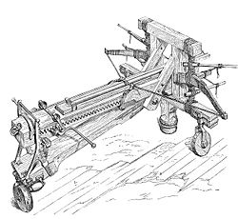
Catapult
A catapult is a ballistic device used to launch a projectile a great distance without the aid of explosive devices-particularly various types of ancient and medieval siege engines. In use since ancient times, the catapult has proven to be one of the most effective mechanisms during warfare. In modern times the term can apply to devices ranging from a simple hand-held implement (also called a "slingshot") to a mechanism for launching aircraft from a ship.

Slide 6
THE END
To be continued

