Slide 1
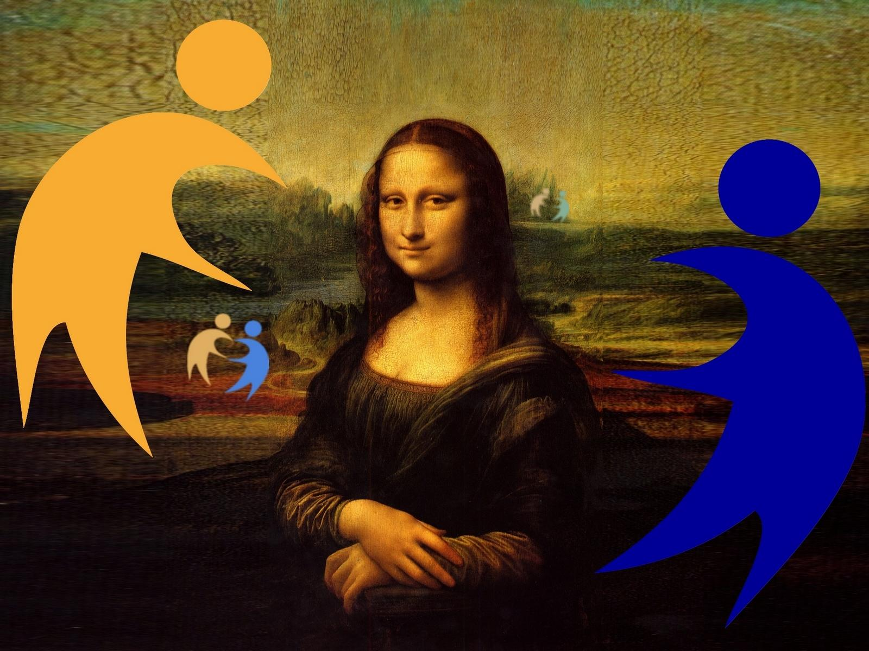

Slide 3
The image is large
The edges of the image are sharp. The colors are bright.

Slide 4
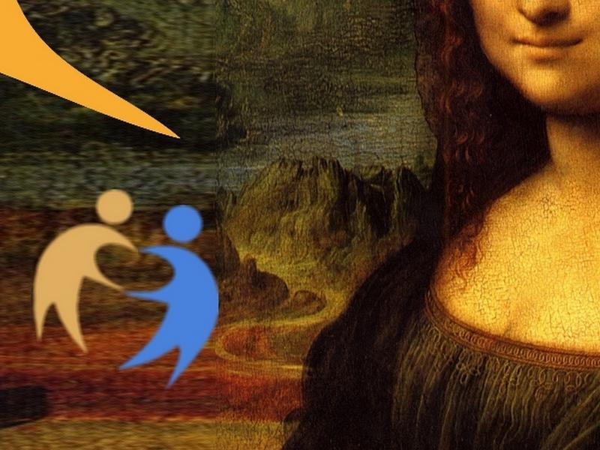
The image is smaller.
The image is blurred.
The colors are less bright.

Slide 5
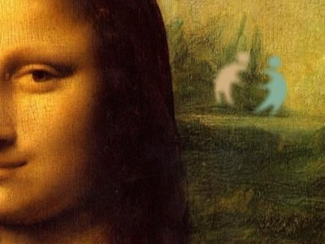
The image is even smaller.
The image is even blurred.
The colors are still less bright, gray-blue

Slide 6
Presentation by Jacques G (Lafrançaise)
Credits image: https://commons.wikimedia.org/wiki/File:Mona_Lisa,_by_Leonardo_da_Vinci,_from_C2RMF_retouched.jpg

