Slide 1
Raluca presents : Civil engineering

Slide 2
Civil engineering Leonardo’s Civil Engineering Inventions are no less astounding than his mechanical inventions or his Machines of War. Some of his most recognizable civil engineering inventions include the canal lock, the rotating bridge, water pumps, the bucket-wheel excavator, a rudimentary crane, his ideal city and many more. Bridges In 1502, the Sultan of the Ottoman Empire came to Rome to hire a team of civil engineers to design a bridge to stretch across the Golden Horn at Istanbul. Da Vinci offered his services to the Sultan, modeling a structure in his notebook that represented a beautiful synergy of creative artistry and civil engineering . The bridge would have spanned 276 meters of water and the arch would have been high enough for a ship with sails to pass under In 2001, inspired by Da Vinci’s design, an artist in Norway named Vebjorn Sand decided to construct his bridge. Da Vinci’s bridge design stands today over a highway in Norway as a monument to his genius . Da Vinci also influenced later bridge builders with his method of bending wooden beams into arches.

Slide 3
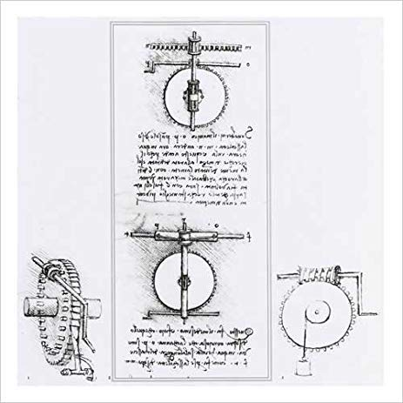
He devised a technique of notching timber to prevent splitting and interlocking bent and notched beams to create a bearing arch. More than 300 years later, Swiss bridge builders used Da Vinci’s method in their arched wooden bridges. Another important engineering idea that Da Vinci can be credited for is the gated canal. His desire to provide Florence with a waterway to the sea led him to the invention of the canal and locks to control water levels although James Watt is credited with inventing the modern steam engine, Da Vinci had designed a much simpler form of Watt’s engine that operated by flywheel and crank. As Watt struggled with inventing a working steam engine in the mid 18th century, he worked with complicated transmission systems because engineers feared that a simple crank-and-rod motion would not work with the irregular stroke of the steam piston. Once again the answer to a more modern dilemma was contained within Da Vinci’s drawings. Leonardo also worked on a system for lifting heavy loads, which incorporated what is now known as the worm gear.

