Slide 1

Leonardo da Vinci. Anatomy.
Oksana Harastey
7-B eTwin team
Khust Specialized school №3
Ukraine

Slide 2
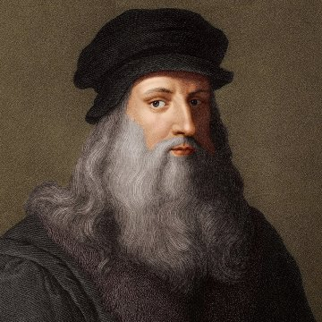
Leonardo di ser Piero da Vinci (April 15, 1452, Ankiano village, near the town of Vinci, near Florence - May 2, 1519, the Clos-Luce castle, near Amboise, Touraine, France) is a great Italian artist and scientist.

Slide 3
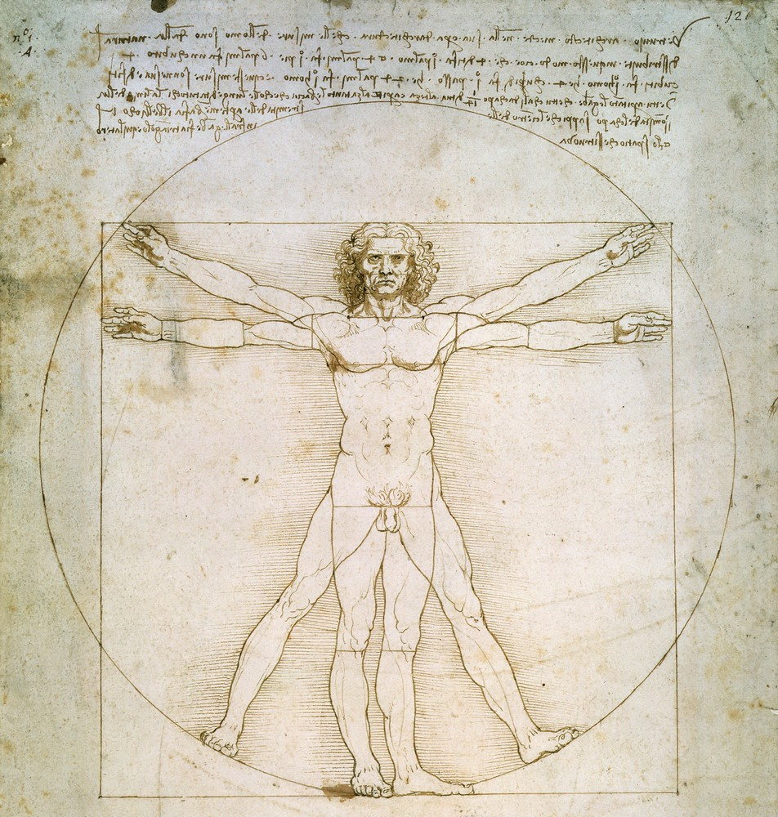
Throughout his life, Leonardo collected and accumulated a comprehensive knowledge of man, anatomy and physique, movements and behavior, mental states and their expression in appearance. An analysis of the artist’s handwritten heritage allows researchers to assume that he was preparing materials for a sort of human encyclopedia. Among the anatomical studies of Leonardo, a detailed plan of the alleged grandiose work was discovered, which was supposed to include information about all stages of human life - from the prenatal period to old age

Slide 4
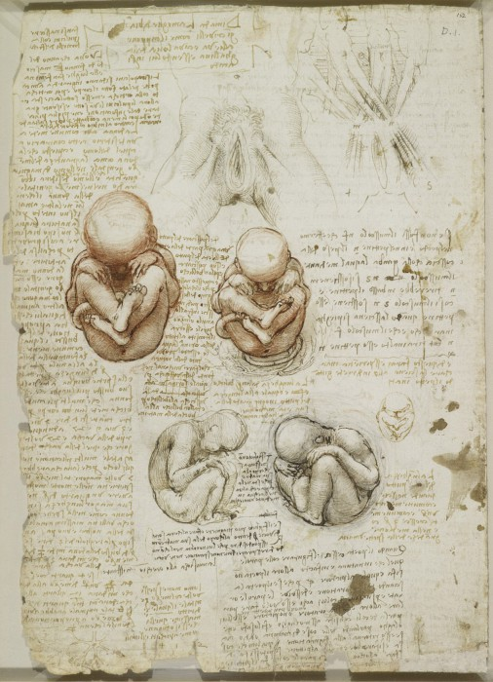
Studying the structure of the human body, Leonardo attached great importance to comparative anatomy - "A description of a man that covers those of a similar type, like a baboon, a monkey, and many others. Write a separate treatise describing the movements of four-legged animals - among which who in childhood also walks on four legs .... Picture the legs of a bear and a monkey and other animals, with what they differ from a person’s feet, and also place some bird’s feet. simian and the like ... Use this description for the treatise ". But, according to the researchers, Leonardo da Vinci made a mistake characteristic of his time, finding too much, so to speak, exactly the same in animals and humans.

Slide 5
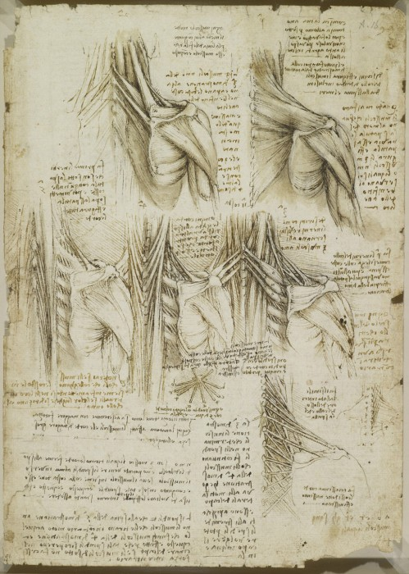
In the creation of anatomical drawings Leonardo adhered to a strict sequence. "Before you make the muscles, draw instead threads that show the positions of these muscles, which will end at the point of attachment of the muscles to their bones. And this gives a more convenient concept if you want the muscles to depict everything, one over the other. But if you will do it differently, your drawing will be confused. " Being fascinated by mechanics and trying to accurately convey the movements of a person, Leonardo da Vinci paid much attention to studying the muscular system and the structure of the skeleton: "Nature cannot make animals move without mechanical tools ...". Perhaps this can explain why Leonardo rendered images of the muscles of the arms, legs, and neck with such scrupulousness. For the same reason, probably, the images of the internal organs and, in particular, the brain are given schematically. In the comments to his notes, he points to the functions of the peripheral nerves, highlighting the motor and sensory portions.

Slide 6
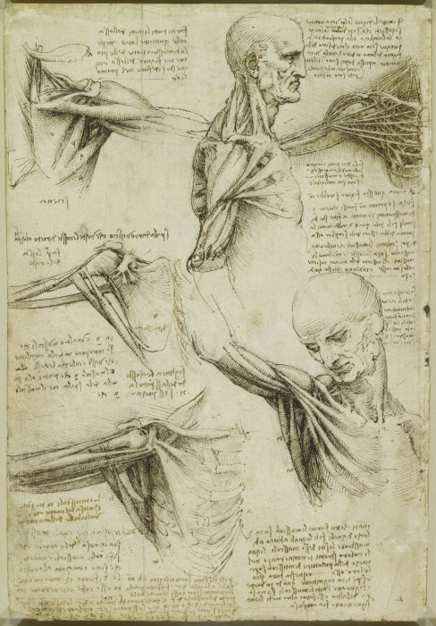
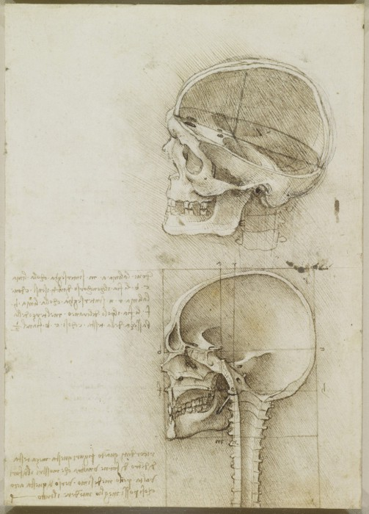
Being engaged in the preparation of peripheral nerves, the study of the relationship of nerve trunks and muscles, Leonardo tried to imagine their spatial and functional relationships.

Slide 7
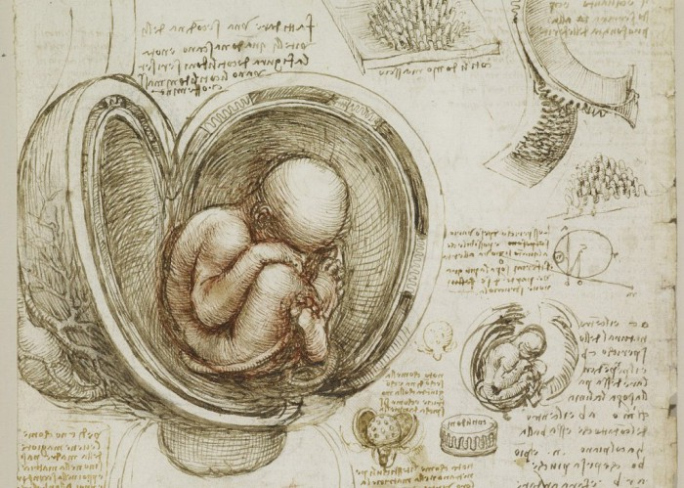
Leonardo's writings are diaries or workbooks. The master did not have time to completely transform and systematize his manuscripts. All Leonardo records are accompanied by brilliant drawings.

Slide 8
Thank you for your attention!

