Slide 1
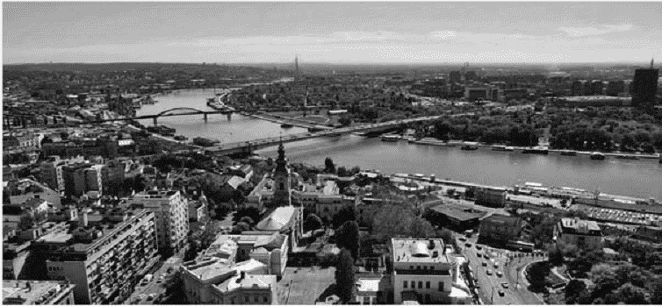
HISTORICAL DEVELOPMENT OF HOTELS IN SERBIA

Slide 2
Opening a hotel
From 1857. to 1868. the center of Belgrade moved on the Terazije,
so Casina, the Balkan and Paris were built in the area.On the other side Kalemegdan opened hotels Serbian King, Serbian Crown and National.
As the city expanded,so did hotels,depending on need.At that time, Macedonia, Žirovni venac on the Zeleni venac. Venice on the Sava port, Thessaloniki and Orient near the newly built railway station and Slavia, which opened in a separate part of the city. In 19th century hotels were built in different styles.
Paris and the Serbian crown are in the romantic style, while the Grand Hotel, the last one built in the 19th century.

Slide 3
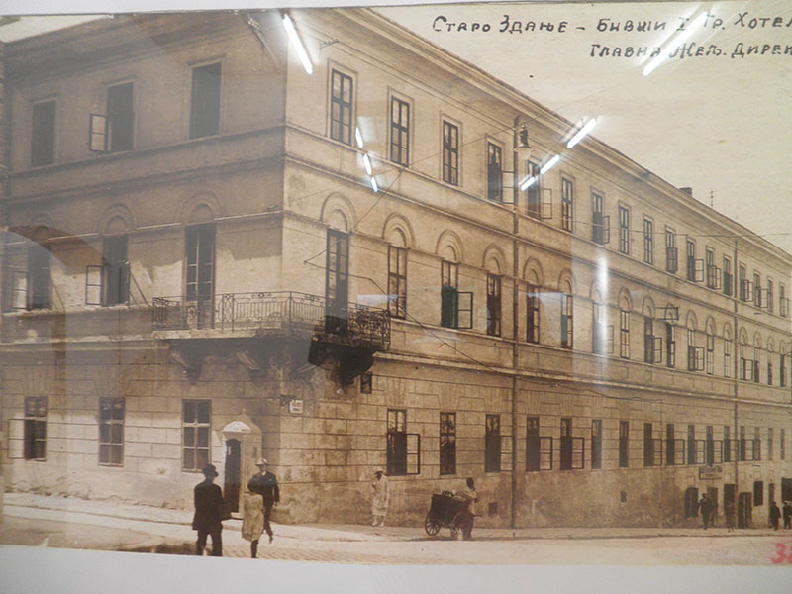
First hotel in Belgrade
During the 19th century, 24 hotels were built in Belgrade, most in the center.
The first hotel in Belgrade began to be built by Prince Mihailo Obrenovic in 1841 on the corner of the present streets of King Petar and Gracanicka, where Cincar Han once stood.
The hotel, then called Deer Code, was completed in 1843 and was named after the bronze deer head that hung above the entrance.
It was later renamed the Old Building .

Slide 4
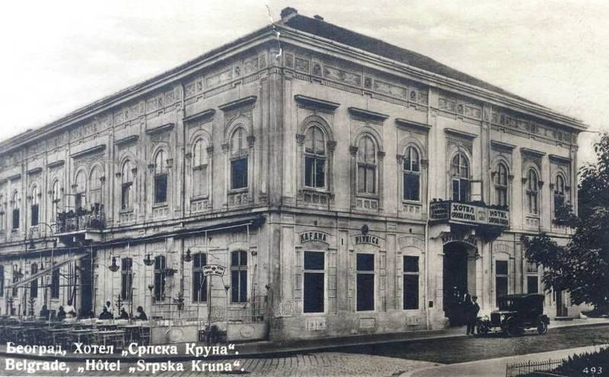
Second hotel in Belgrade
The second Kruna Hotel was built in 1846 as the court of Prince Alexander Karadjordjevic, and became a hotel in 1856. It was located on the corner of Uzun Mirkova and today's Student Square.
ten years later, the Hotel "Serbian Crown" was built, which is said to have been so named in a spell by the Turks who protested against the Serbian authorities because of the hotel's name, but the Serbian government did not respond. the hotel was located at the beginning of Knez Mihailova Street, across from Kalemegdan, where the Belgrade City Library is today

Slide 5
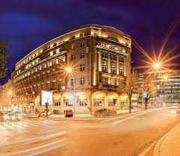
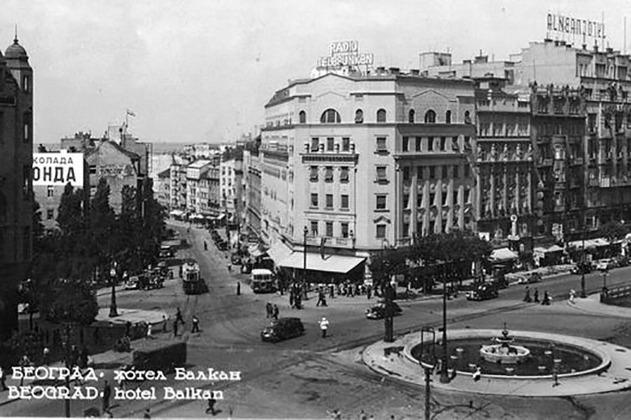
Hotel Balkan before renovation
Hotel Balkan after renovation

Slide 6
Hotels today
Today, hotels are being built whose style does not rely on the location or tradition of the area in which they are created but has a universal character. the facades of the hotel buildings that are being erected in Belgrade today are designed as a kind of advertising billboards and strive to attract potential guests with their expressionism, creating the impression of luxury and exclusive content.

Slide 7
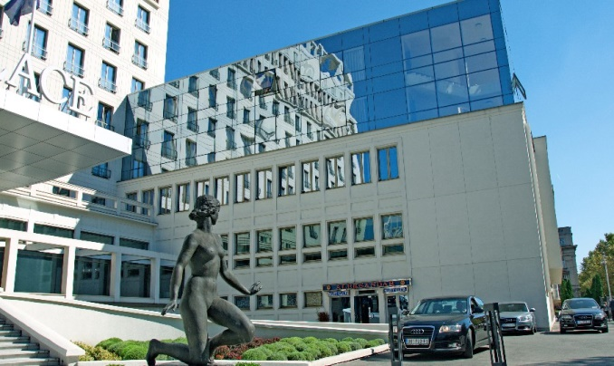
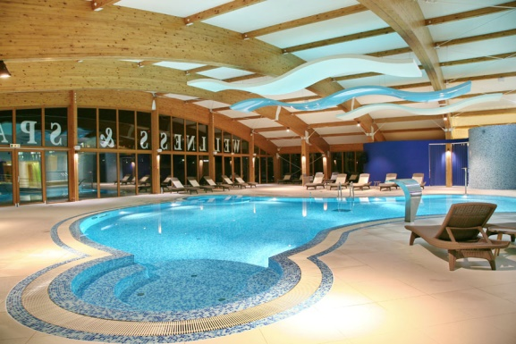
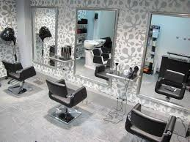
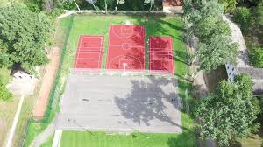
Additional services
In addition to basic hotel services, accommodation, food, drinks, there are also additional services such as massage, wellness, spa, sports services, hair salons, swimming pools, playrooms, doctor's…

