Slide 1
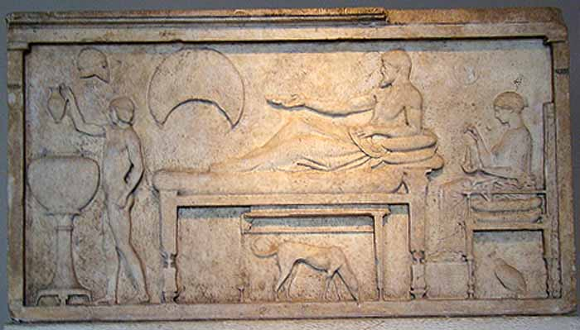
Ιn ancient Greece hospitality (filoxenia) means love for the stranger .
.

Slide 2
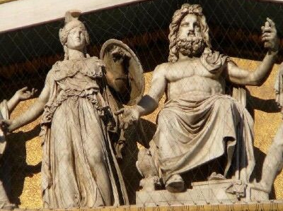
.
Zeus and Athena were the gods that protected tourism .

Slide 3
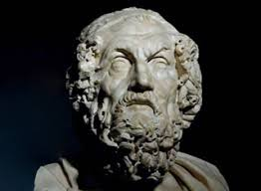
.
Homer in his writings mentions cases of hospitality . Hospitality was cumpolsory and free.

Slide 4
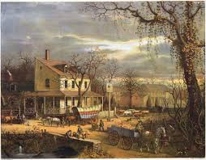
The first form of hotel was the "panthohio", inn .
.

Slide 5
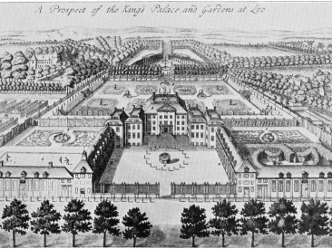
In the Roman Times , the "diversorii" existed.
.

Slide 6
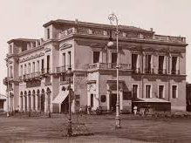
The first hotel of Greece was built in 1828. It was called "the London Hotel" and it was located in Nafplio.
.

