Slide 1
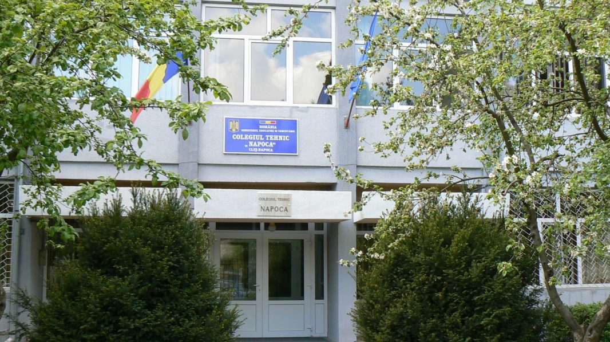
COLLEGE OF TOURISM services “NAPOCA”
Taberei Street, no. 3
Phone Number: 0264/562588
Fax: 0246/425775
Email: colegiulnapoca@yahoo.com
Website: www.colegiul-napoca.ro

Slide 2
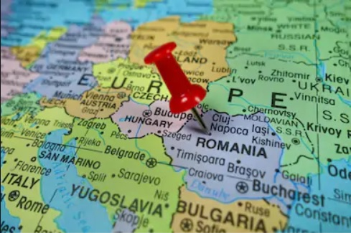
LOCATION

Slide 3
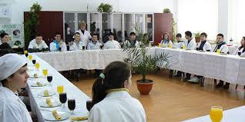
SHORT PRESENTATION
College of Tourism Services “Napoca” has a number of over 500 students, attending both day and night classes and a well-prepared and motivated team of teachers, with important results in their specialties and various extra curricular activities.
Students are taught and trained as Tourism technicians and the professional classes as Hotel workers.

Slide 4
MISSION AND VISION
The College of Tourism Services "Napoca" is a school that offers quality services and suitable environment for a proper education and professional training, with dedicated staff, promoter of the fundamental values of Romanian and European culture, of self confidence, of cultivating a positive attitude towards work, tolerance and respect for the European democracy.
The College of Tourism Services "Napoca“ aims to provide, to young people and adults from Cluj County and other counties of NV Region, educational and professional training in Tourism by stimulating career development and increase the area's economical and social potential through a high rate of graduates into the labor market.

Slide 5
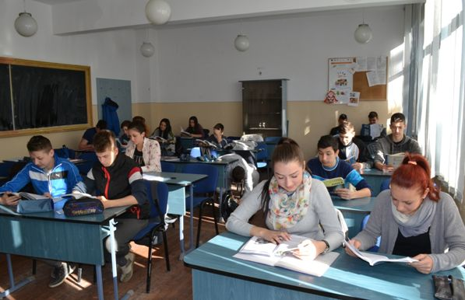
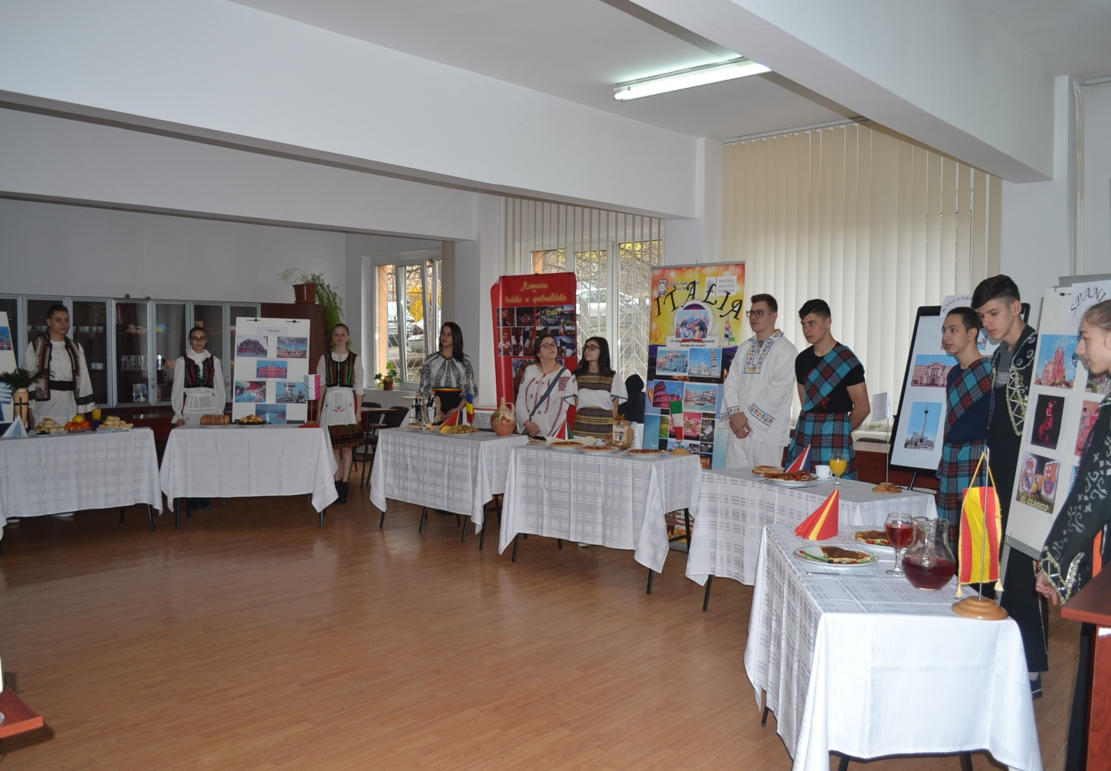
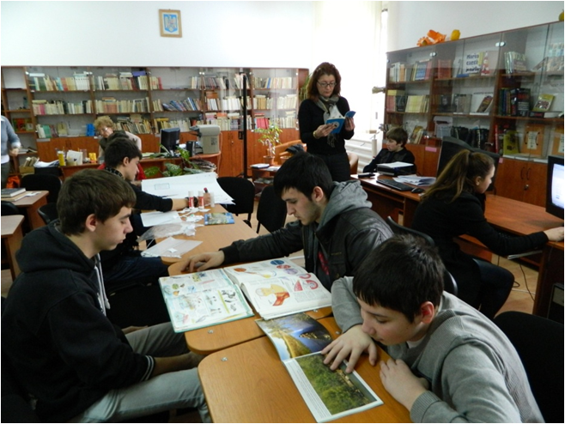
Facilities over 20 newly-furnished classrooms

Slide 6
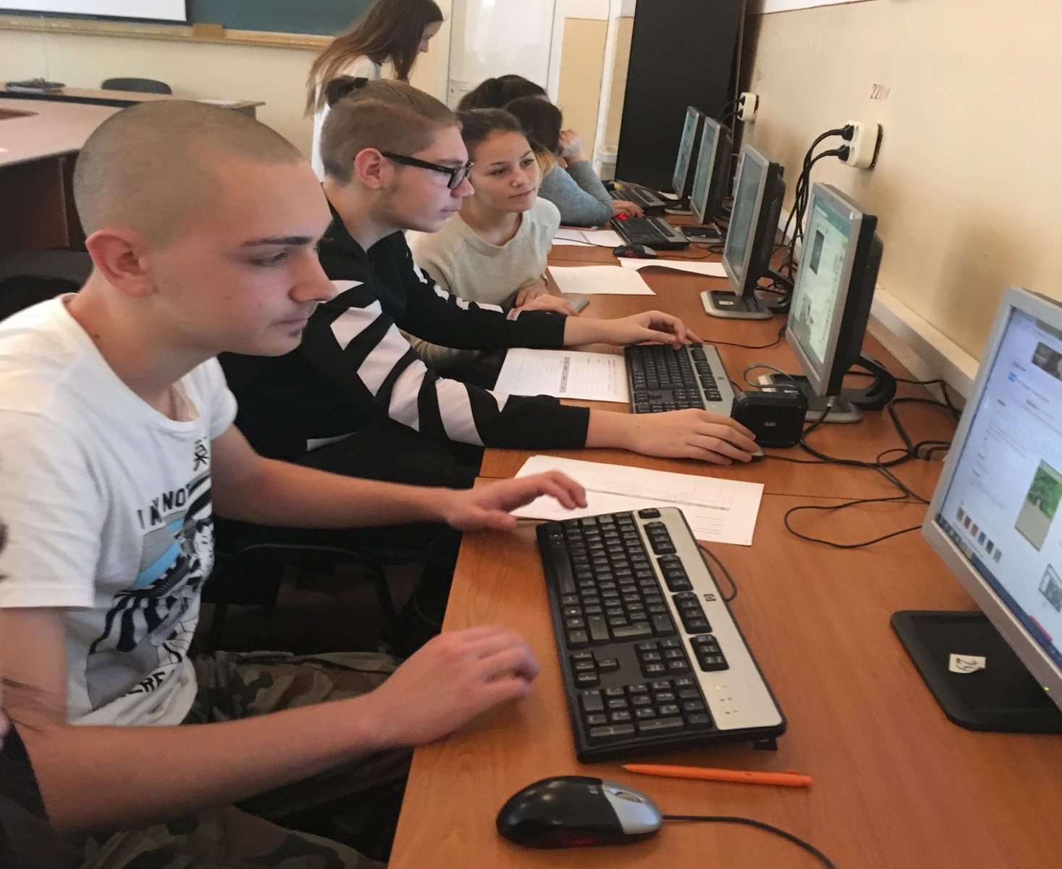
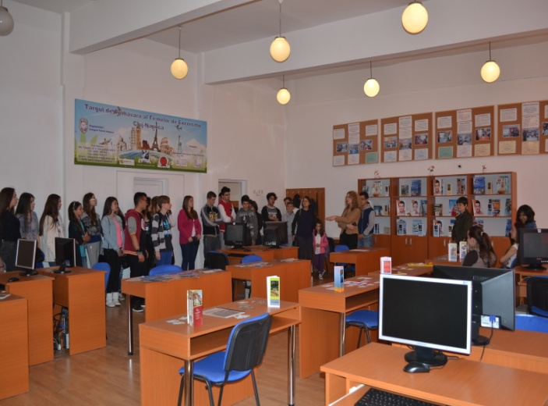
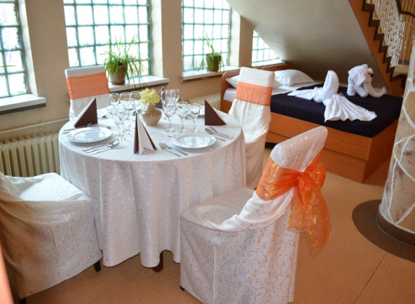
Facilities school workhouses

Slide 7
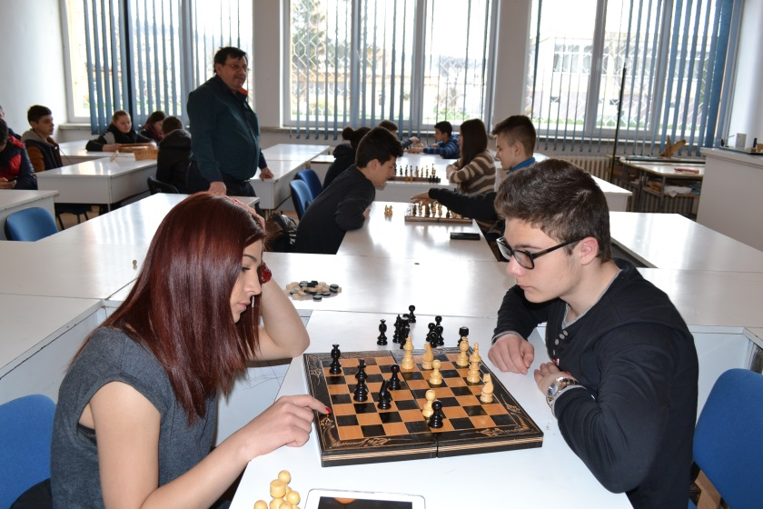
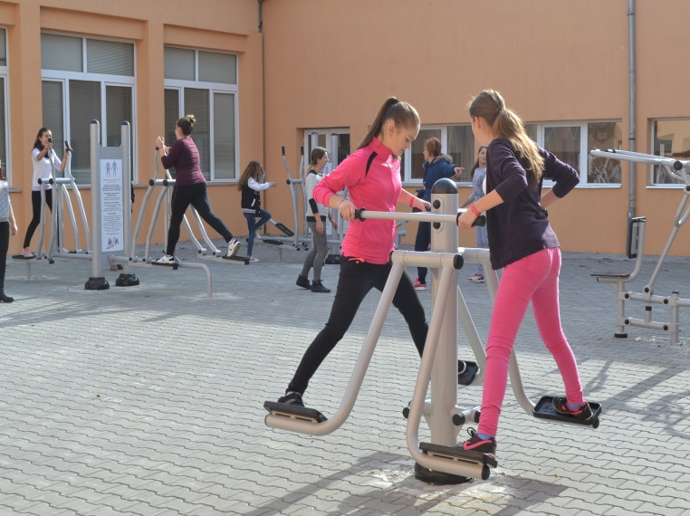
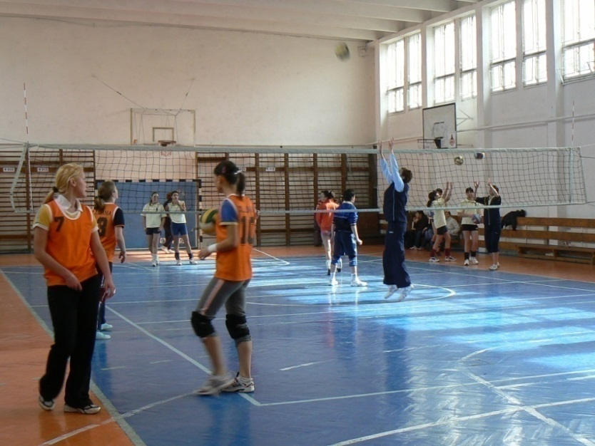
Sport facilities

Slide 8
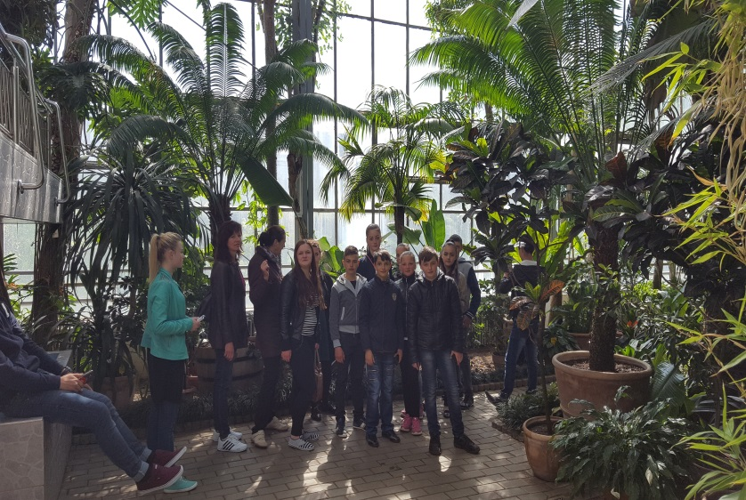
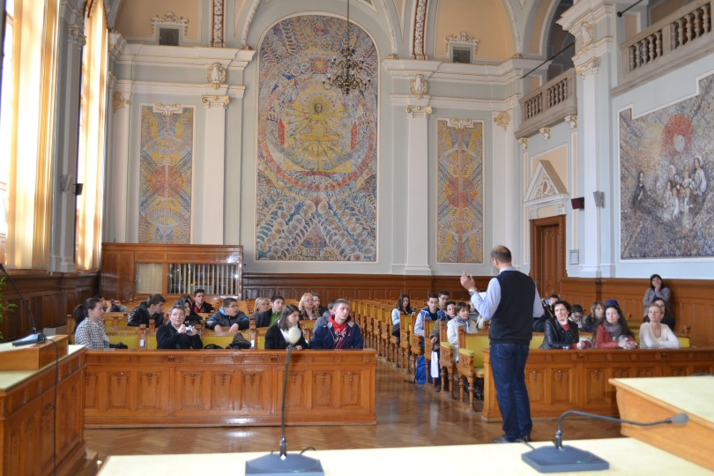
school projects Be a tourist guide for a day!

Slide 9
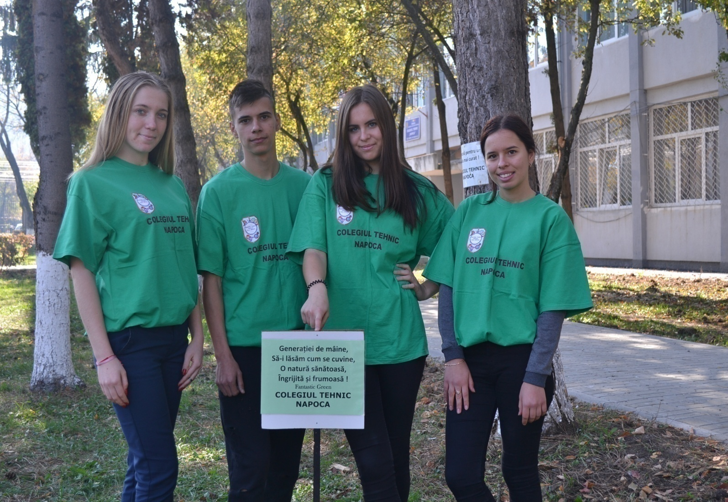
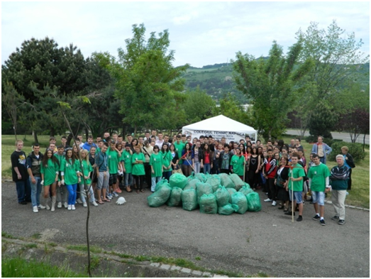
environmental protection projects “Love a clean CLUJ!”

Slide 10
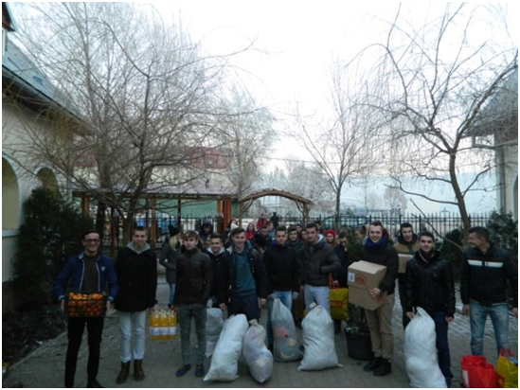
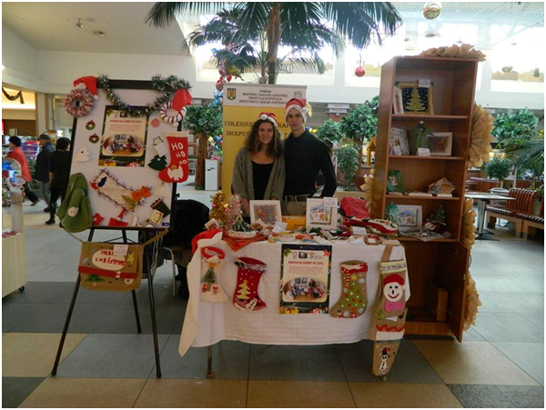
school projects Charity Project "Help us to help!"

Slide 11
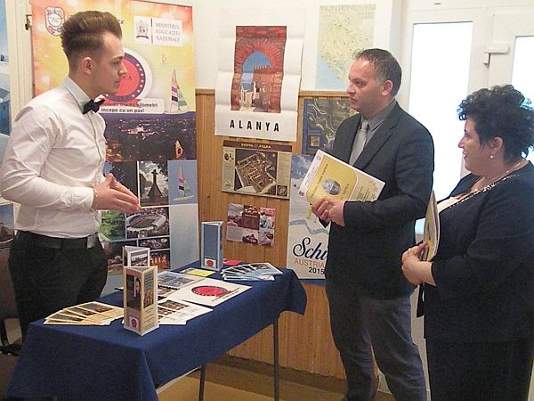
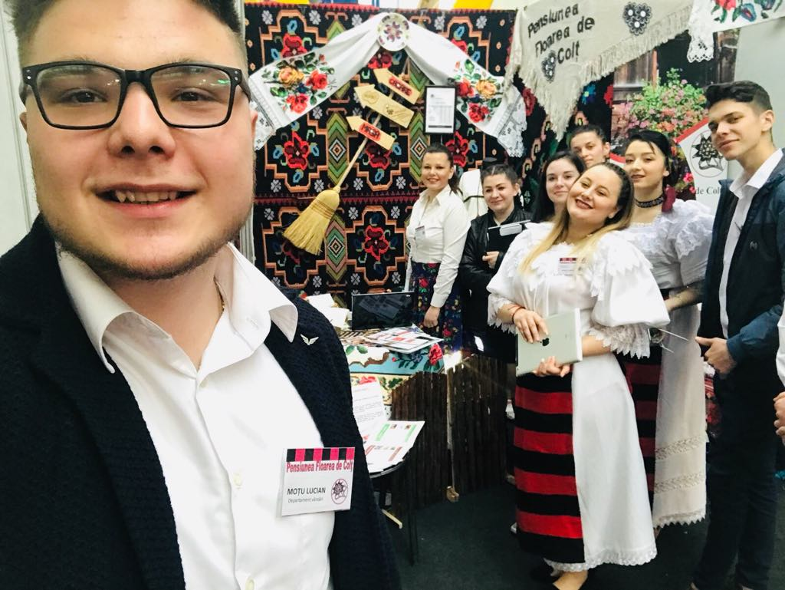
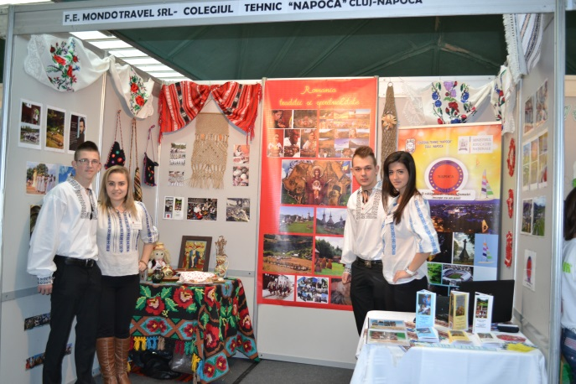
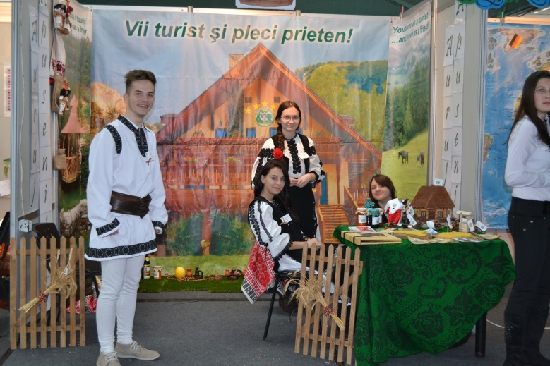
school projects The Spring Fair of Training Firms

Slide 12
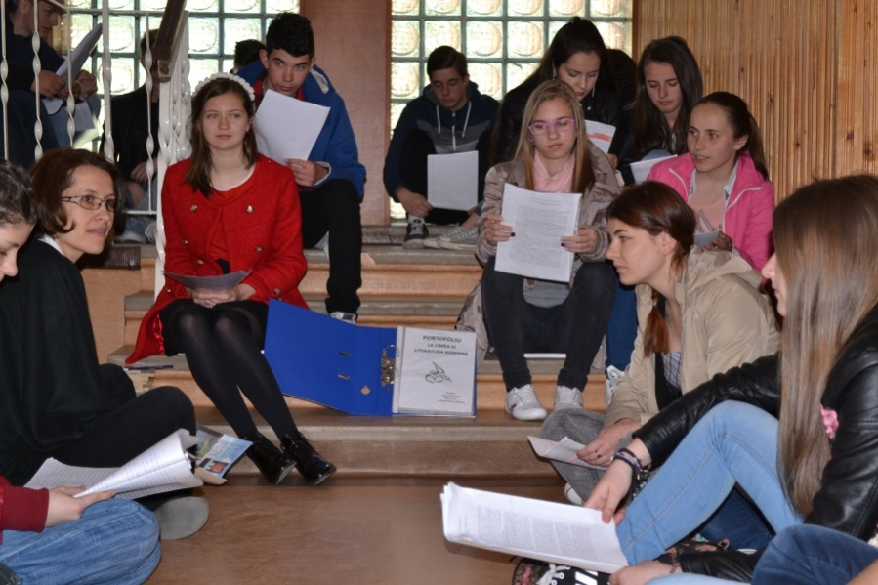
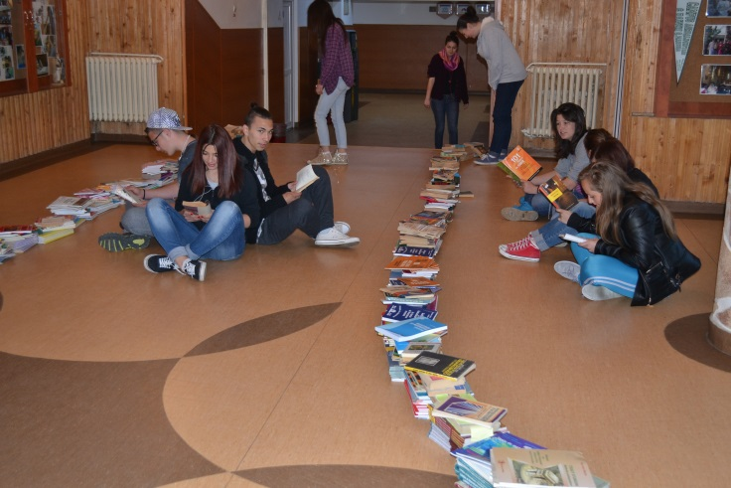
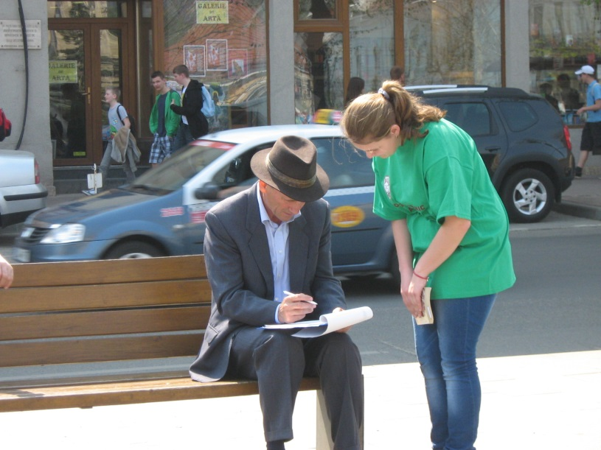
school projects Open gates for reading

Slide 13
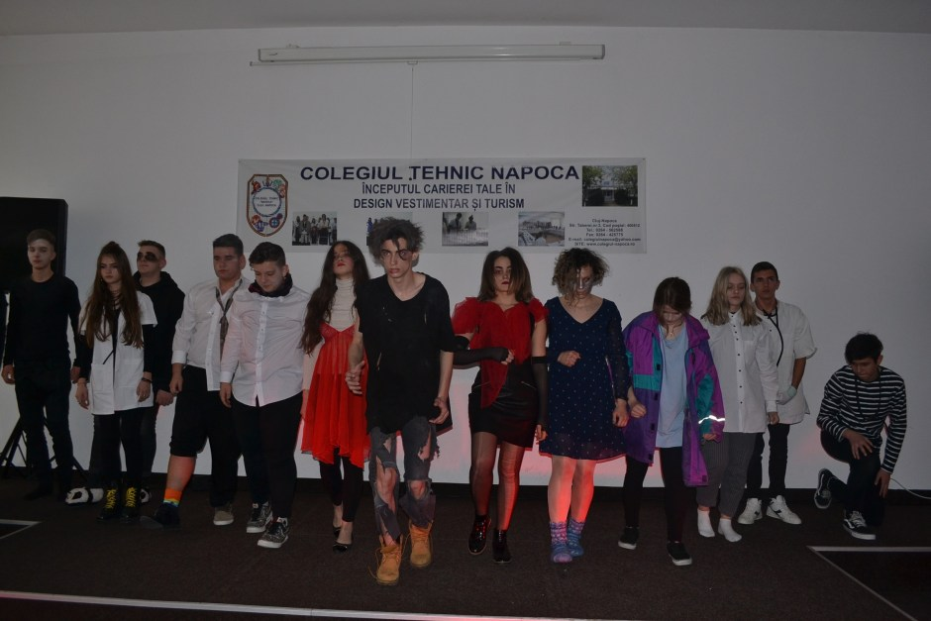
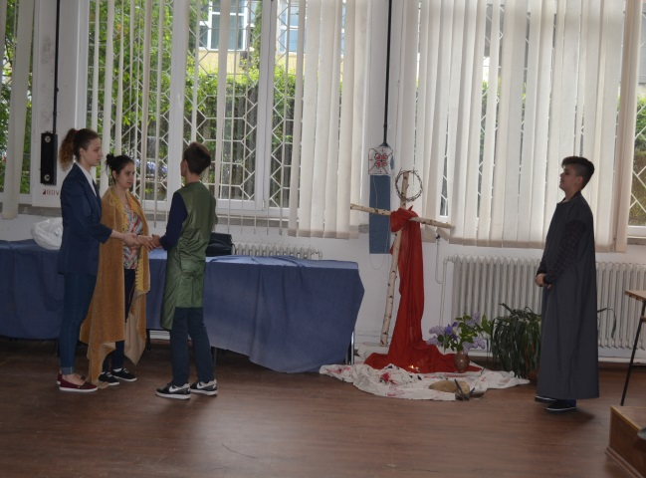
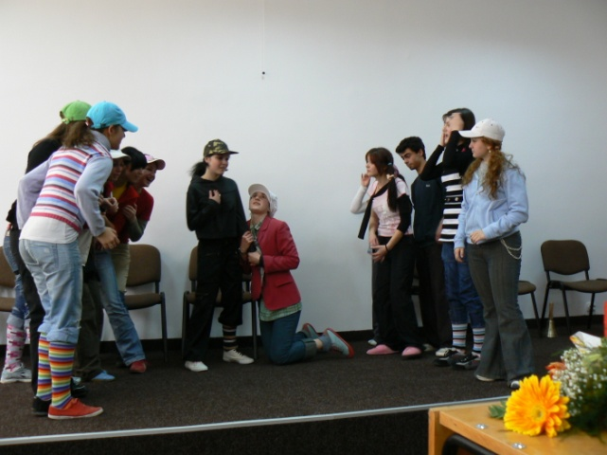
Drama group

Slide 14
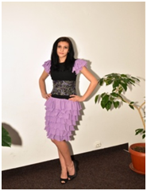
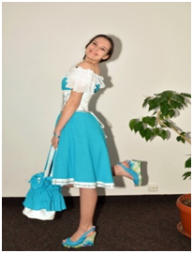
LEONARDO DA VINCI EUROPEAN project “Developing youngsters’ skills of design, production and sales (marketing) with innovative methods by benefiting from different cultural elements”

Slide 15
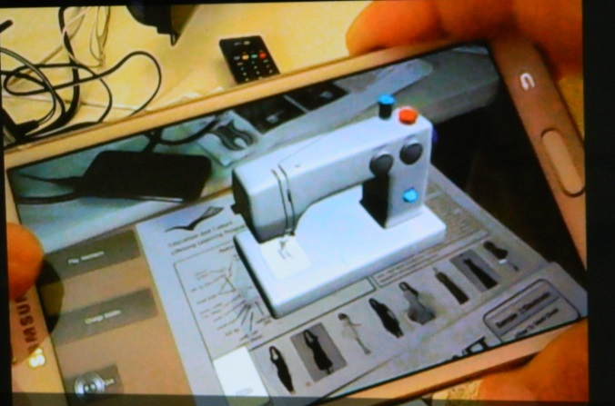
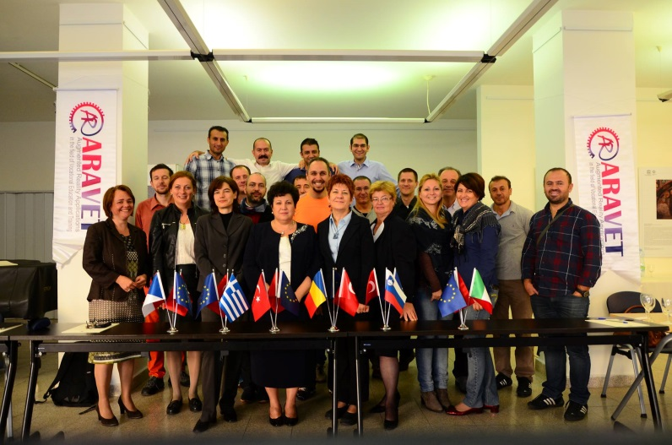
LEONARDO DA VINCI EUROPEAN project Augmented Reality Applications in the field of Vocational Education and Training”(ARAVET)

Slide 16
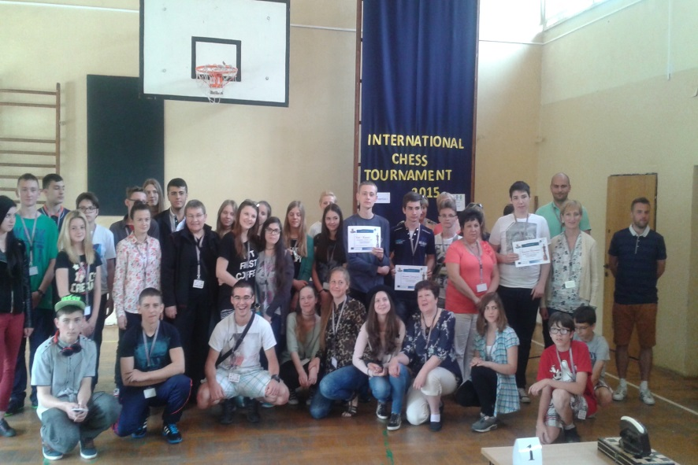
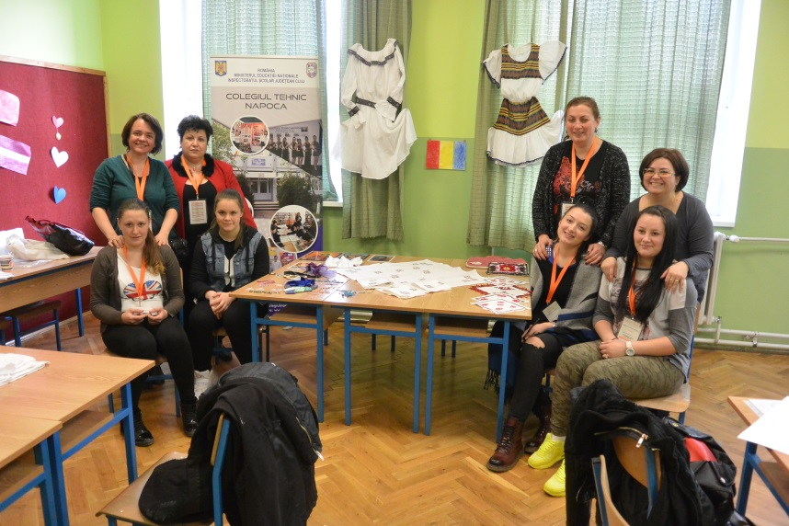
Erasmus+ projects “Let’s Break the Ice with School” 2014-2016 Key Action 2 – Strategic Partnerships between schools only

Slide 17
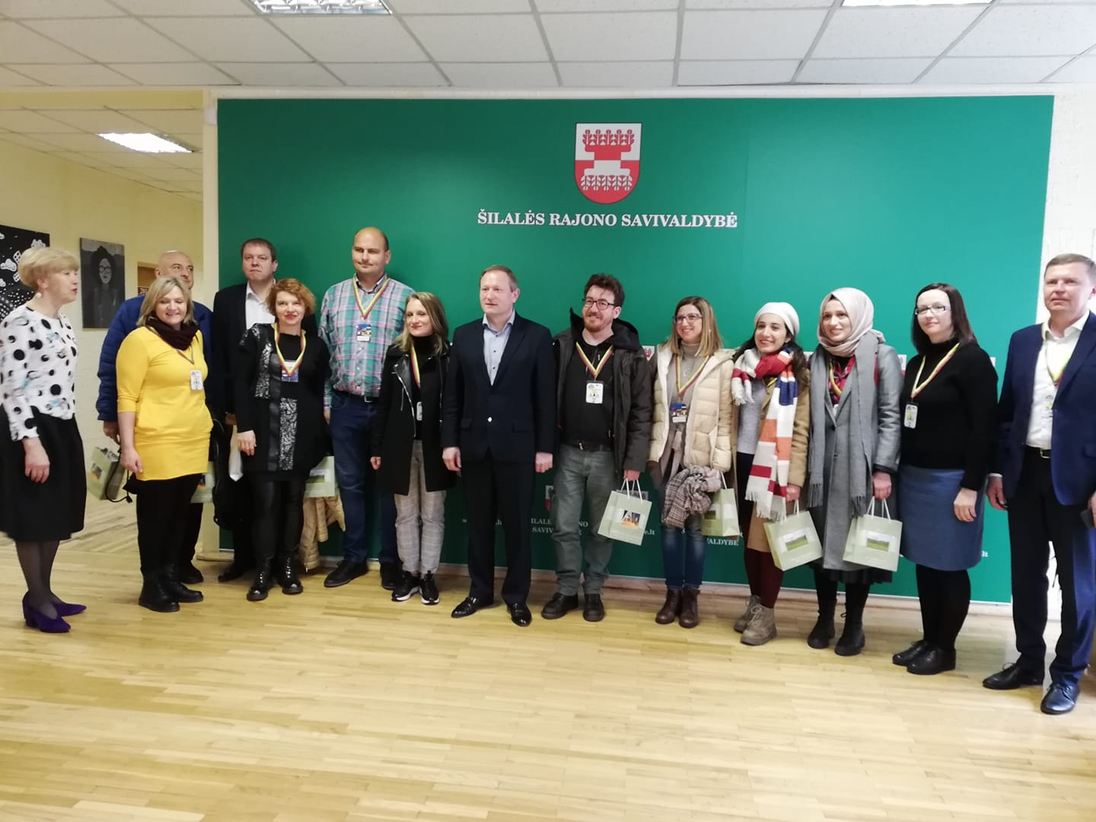
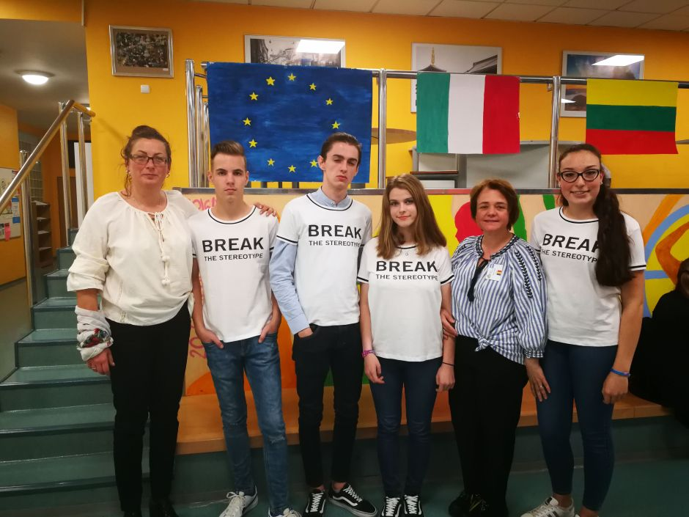
Erasmus+ project “Take out stereotyping out of your life” No 2017-1-LT01-KA2019-035186 KA2 Strategic Partnership

Slide 18
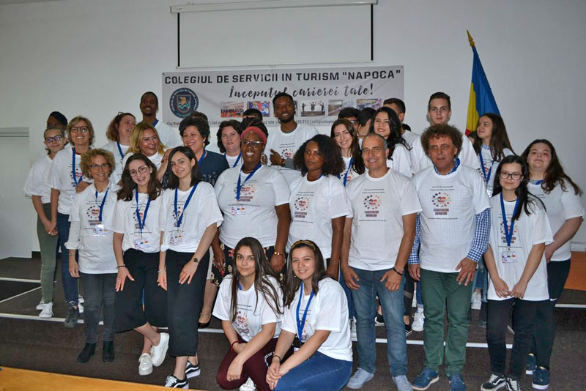
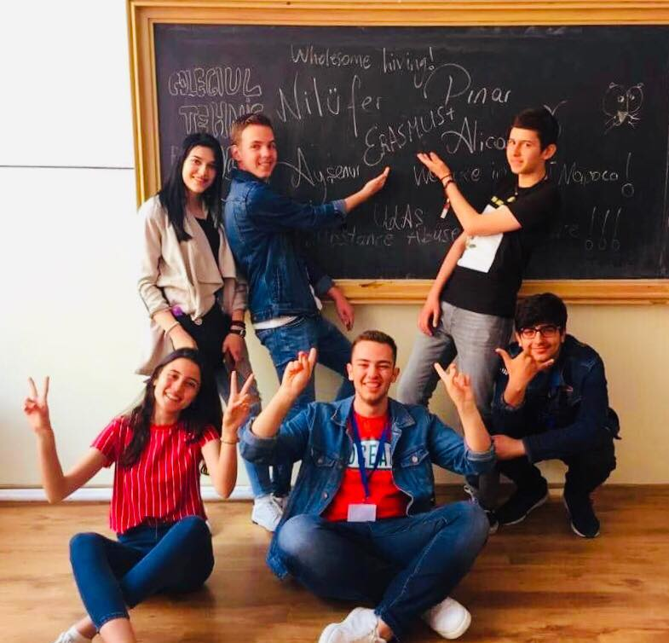
ERASMUS+ project 2018-1-UK01-048203 Wholesome Living substance abuse is self abuse

Slide 19
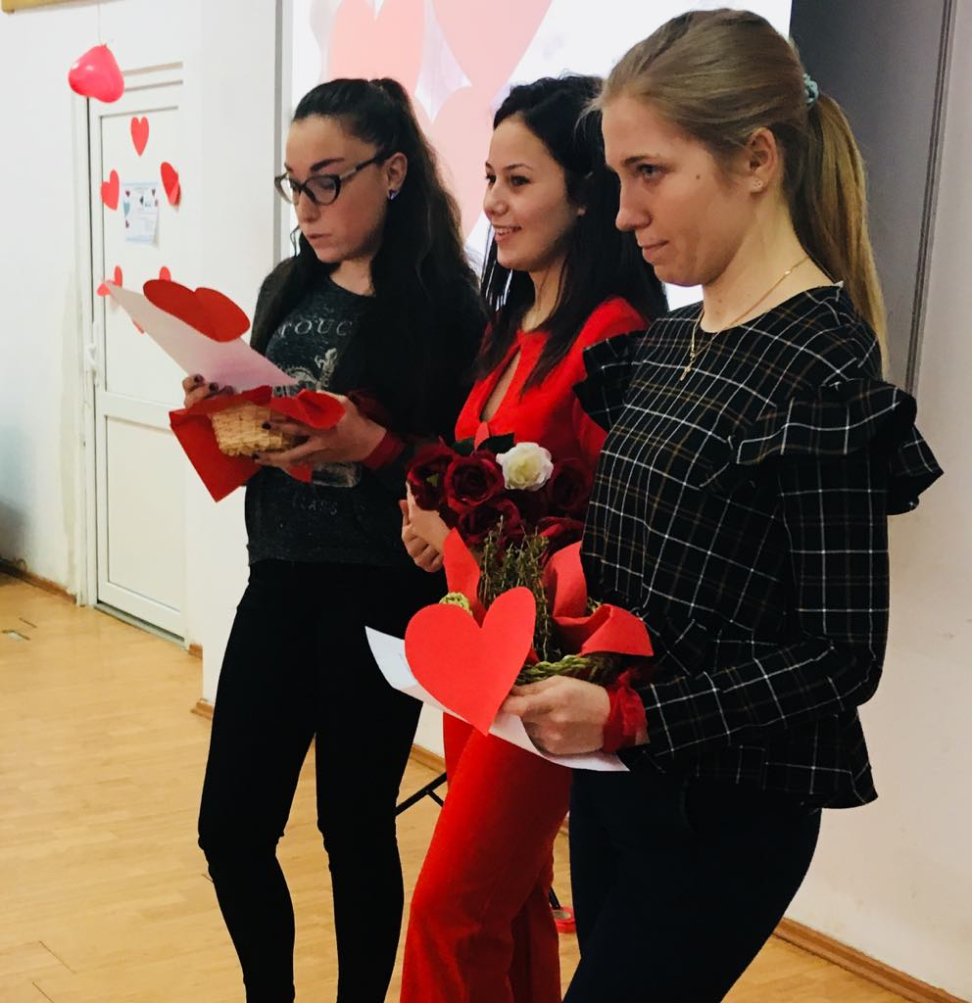
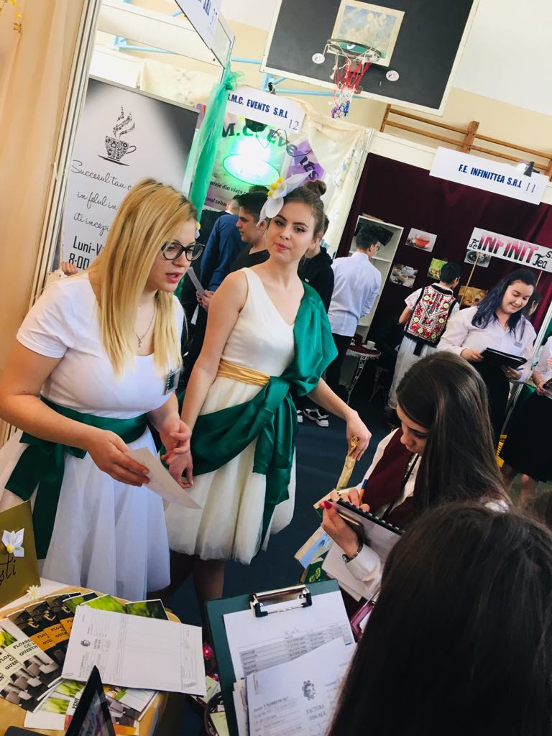
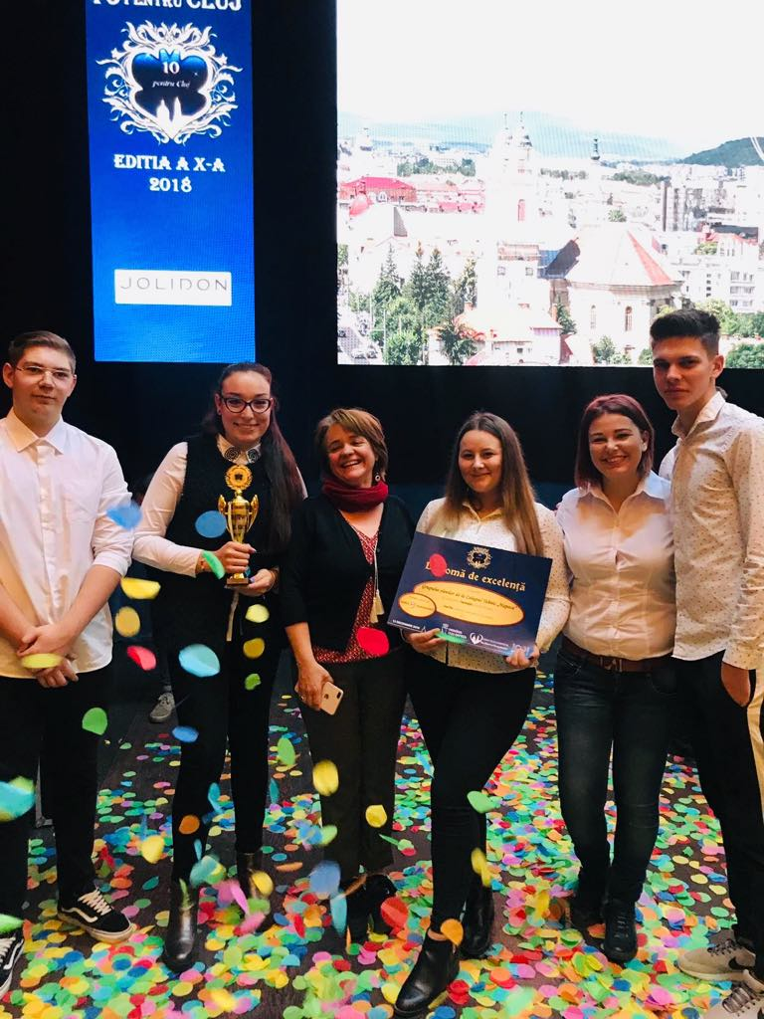
Students’ testimonials
“Trading in Bucharest it was useful for our development” Andreea Codreanu
“A memorable event it was the award ceremony “10 for Cluj” Andreea Petrule
“Unforgettable Valentines day in collaboration with the Hungarian school from Nyiregyhaza”
Natalia Ipatii

Slide 20
Thank you for your attention!

