Slide 1
„eTwinning Live“ event „EDL Croatia – Lithuania“
24-09-2020

Slide 2
LABAS HELLO

Slide 3
AČIŪ THANK YOU

Slide 4
VISO! BYE!

Slide 5
MAMA MUM

Slide 6
MOKYKLA SCHOOL

Slide 7
EUROPA EUROPE

Slide 8
Valio!! Hurray!!

Slide 9
trys, penki three, five

Slide 10
Kroatija Croatia

Slide 11
Lietuva Lithuania

Slide 12
ĄŽUOLAS OAK

Slide 13
Mano vardas yra... My name‘s...

Slide 14
Kiek tau metų? How old are you?

Slide 15
Malonu susipažinti. Nice to meet you.

Slide 16
Aš tave myliu... I love you...

Slide 17
Kiek kainuoja...? How much is it..?

Slide 18
Ką tu mėgsti? What do you like?

Slide 19
Aš esu mokinys. I‘m a student.

Slide 20
Aš esu mokinys. I‘m a student.

Slide 21
Ar galiu jums padėti? Can I help you?

Slide 22
What is the capital city of Lithuania?

Slide 23
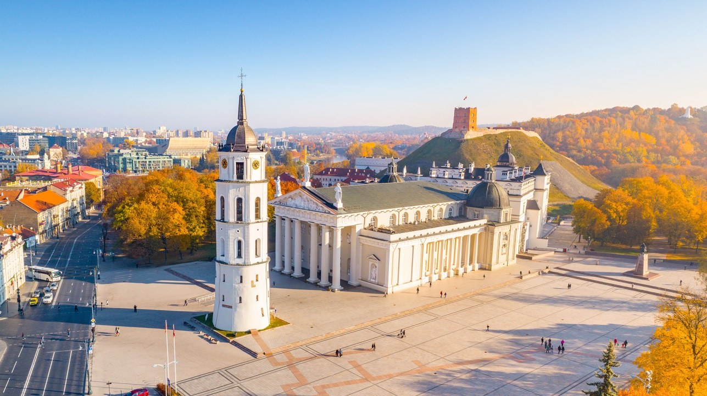
VILNIUS

Slide 24
What‘s the most popular sport in LT?

Slide 25
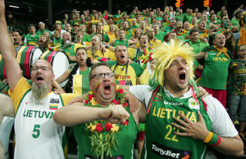
Basketball

Slide 26
What group of languages does the Lithuanian language belong to?

Slide 27
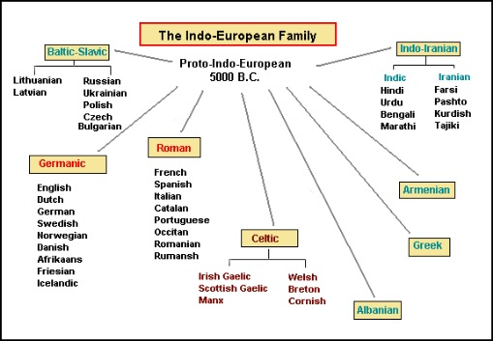

Slide 28
Indo-European group of languages

Slide 29
Hvala vam! Ačiū!

