Slide 1
LITHUANIA - HRVATSKA
European Day of Languages

Slide 2
ZDRAVO

Slide 3
HELLO

Slide 4
KAKO SI?

Slide 5
HOW ARE YOU?

Slide 6
PRIJATELJ

Slide 7
FRIEND

Slide 8
NEBO

Slide 9
SKY

Slide 10
RIJEKA

Slide 11
RIVER

Slide 12
LJUBAV

Slide 13
LOVE

Slide 14
MJESEC

Slide 15
MOON

Slide 16
SUNCE

Slide 17
SUN

Slide 18
PAS

Slide 19
DOG

Slide 20
MAČKA

Slide 21
CAT

Slide 22
PTICA

Slide 23
BIRD

Slide 24
GRAD

Slide 25
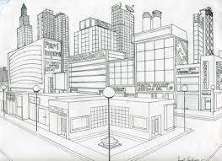
CITY

Slide 26
SELO

Slide 27
VILLAGE

Slide 28
ŠKOLA

Slide 29
SCHOOL

Slide 30
UČENIK

Slide 31
STUDENT

Slide 32
UČITELJ

Slide 33
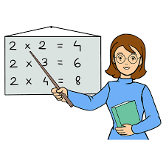
TEACHER

Slide 34
MORE

Slide 35
SEA

Slide 36
ŠKOLJKA

Slide 37
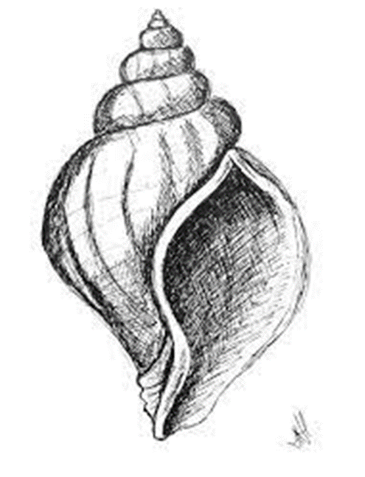
SHELL

Slide 38
BICIKL

Slide 39
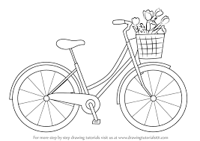
BICICLE

Slide 40
AUTO

Slide 41
CAR

Slide 42
AVION

Slide 43
PLANE

Slide 44
LOPTA

Slide 45
BALL

Slide 46
KAPA

Slide 47
HAT

Slide 48
RUKAVICE

Slide 49
GLOVES

Slide 50
IGRA

Slide 51
GAME

Slide 52
KNJIGA

Slide 53
BOOK

Slide 54
LJULJAČKA

Slide 55
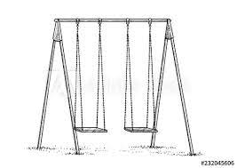
SWING

Slide 56
KUHAR

Slide 57
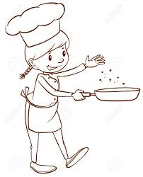
CHEF

Slide 58
JABUKA

Slide 59
APPLE

Slide 60
THANK YOU

