Slide 1
Preparing drawings for the logo contest
Ioanna Georgiadou, with my 6th Graders 28th Primary School of Thessaloniki-Greece

Slide 2
“A Journey through the water”

Slide 3
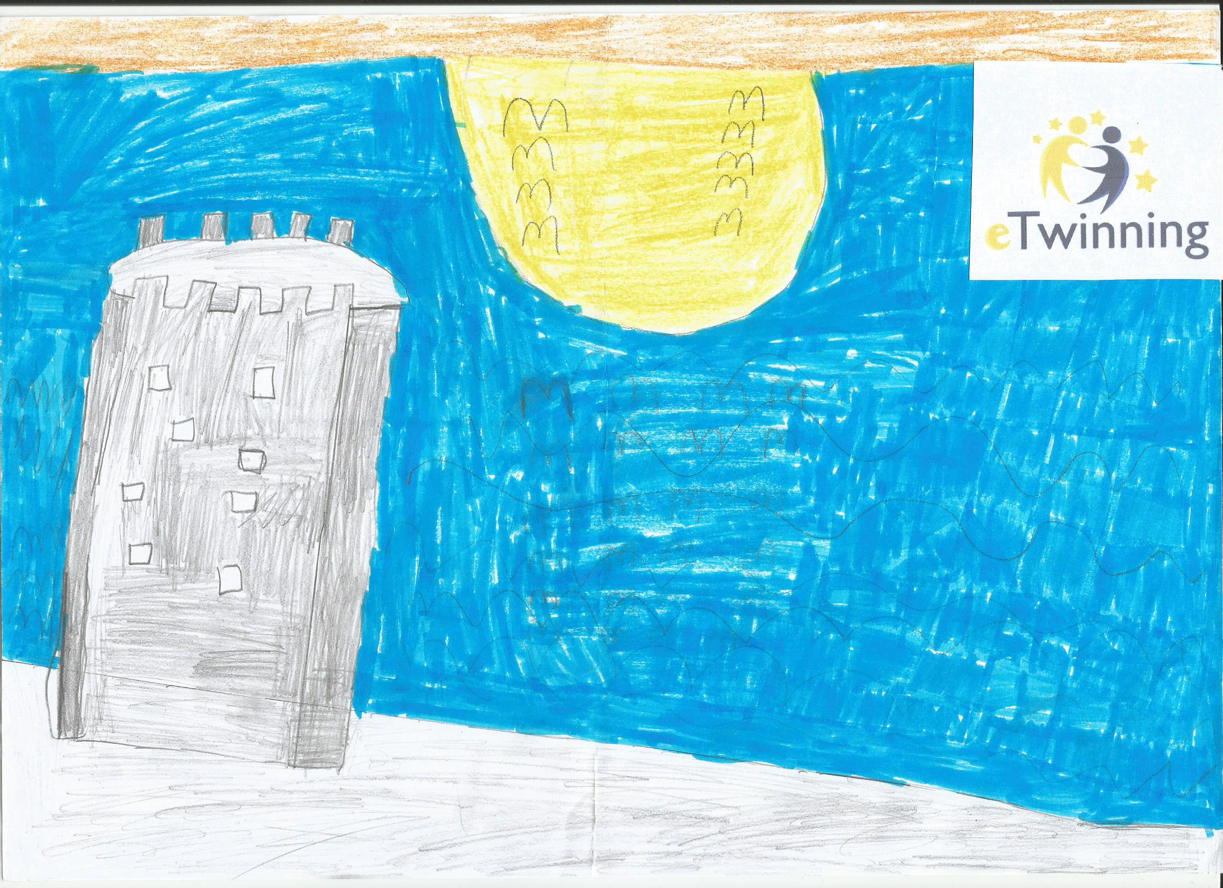

Slide 4
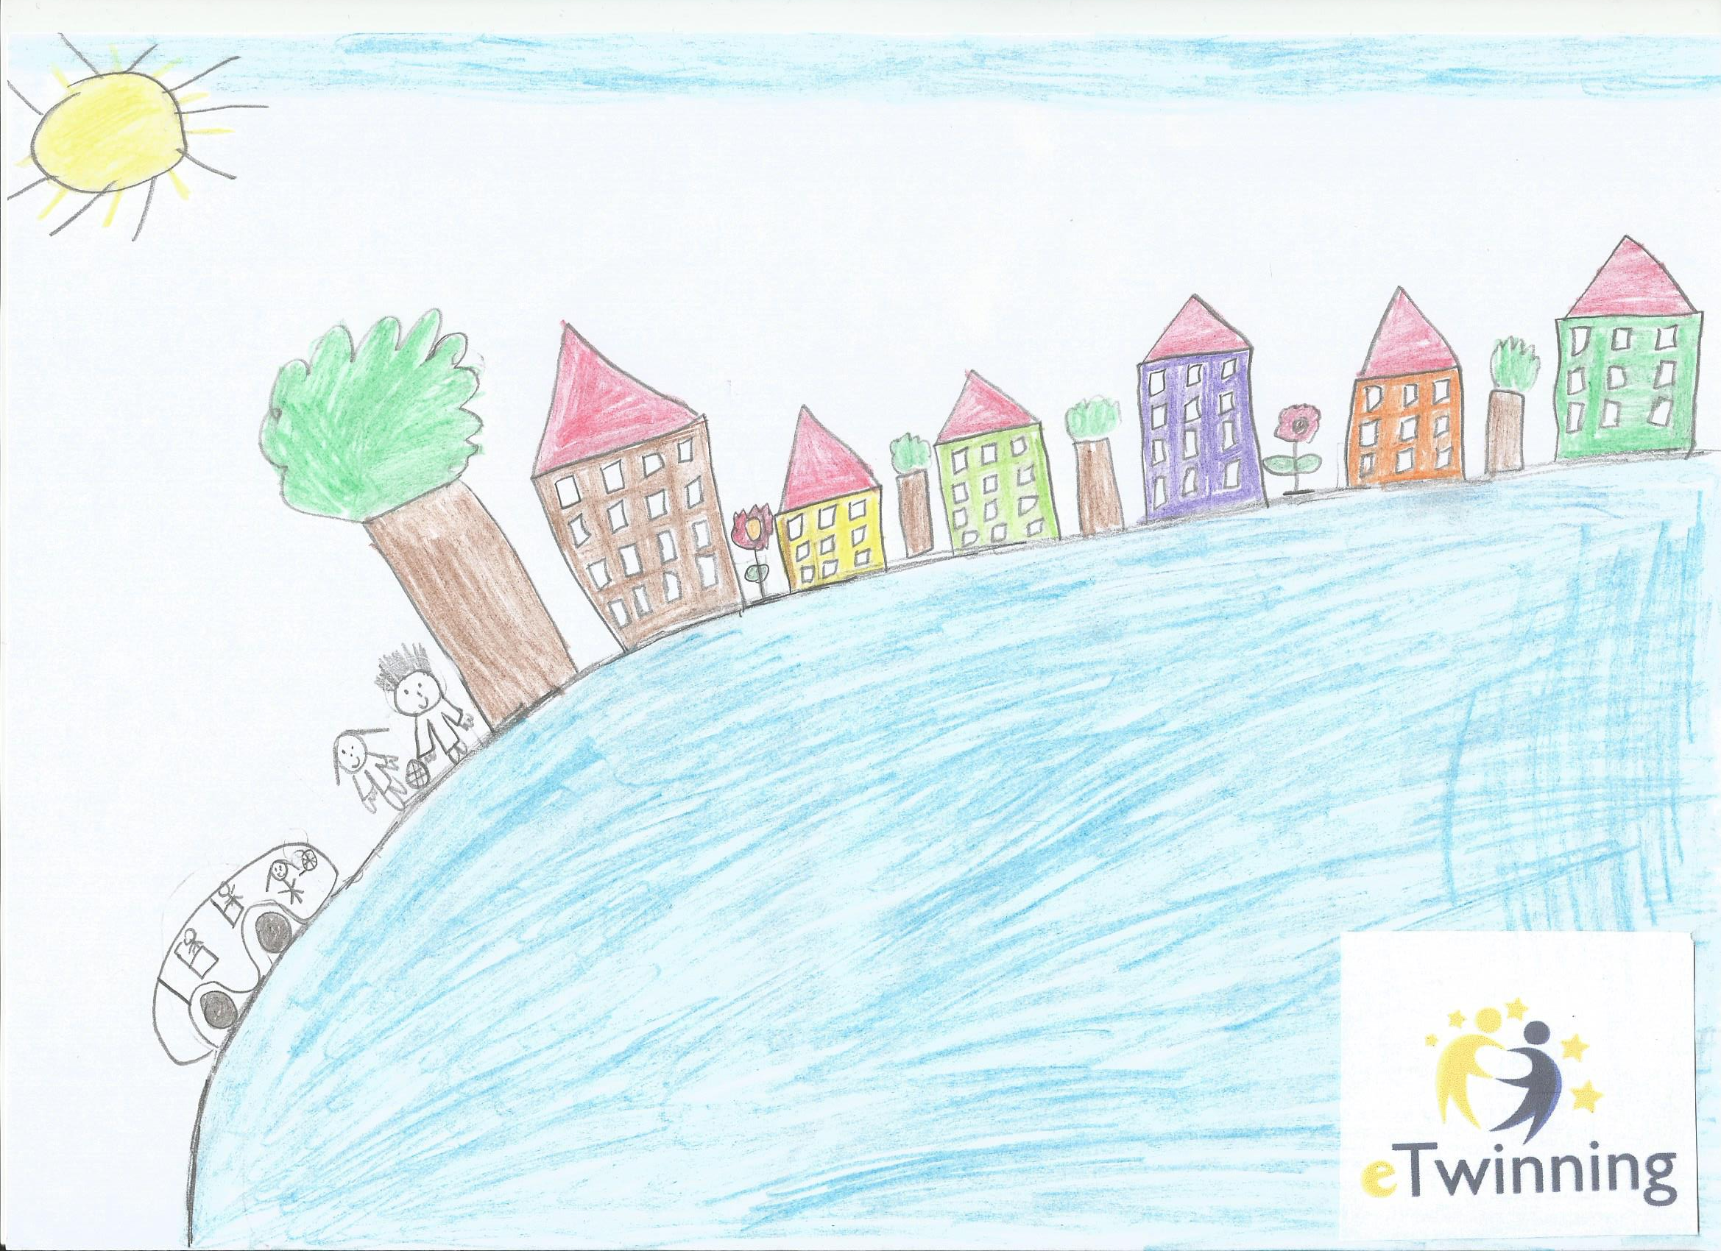

Slide 5
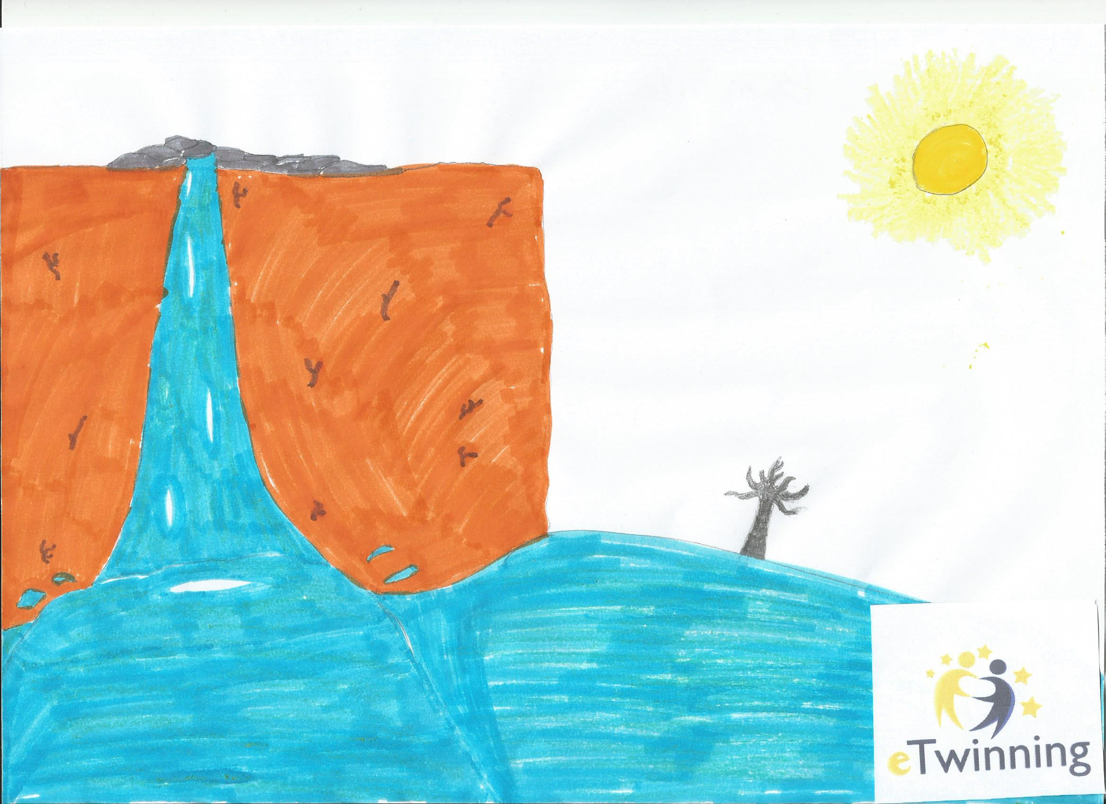

Slide 6
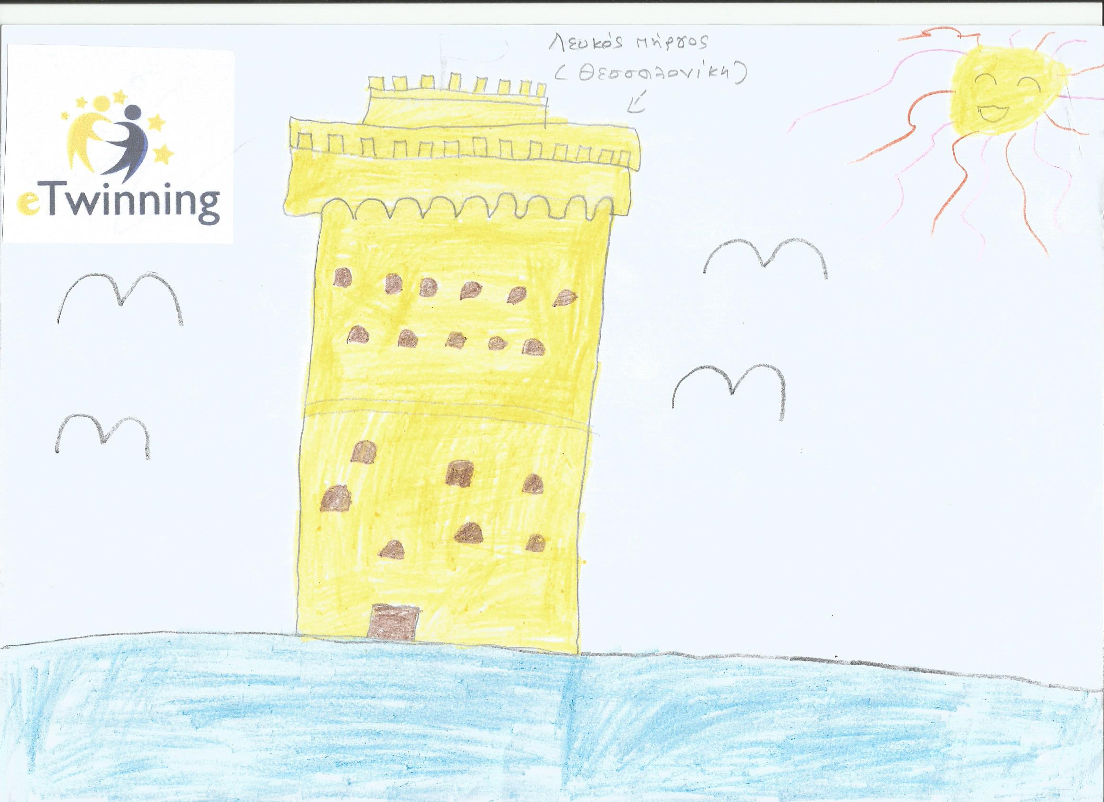

Slide 7
