Slide 1
A Journey Through the Water Project Evaluation of Parents’ Post-Survey (2021)

Slide 2
Overall Results
The aim of this study is evaluating the result of survey which parents answered before ending of the Project.
289 parents, whose children participated in this eTwinning project, have completed the survey.
2 general outcome can be deducted from the results. They are;
Participants liked the project,
Participants would recommend eTwinning projects to other parents.

Slide 3
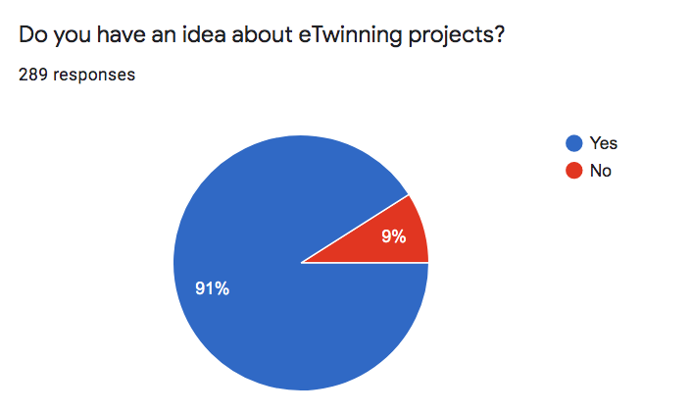
Do you have an idea about eTwinning projects?
We have asked parents if they have and idea about eTwinning projects. 289 parents answered the question and
91% of them said ‘Yes’ , while the rest 9% said ‘No’.

Slide 4
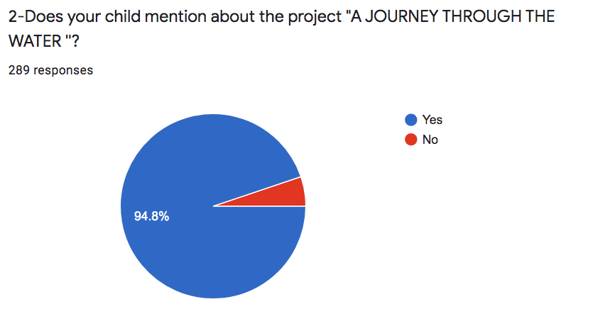
Does your child mention about the project "A JOURNEY THROUGH THE WATER ''?
We have asked parents: Does your child mention about the project "A JOURNEY THROUGH THE WATER’’?
289 parents answered the question and 94.8% said ‘Yes’ 5.2% ‘No’.

Slide 5
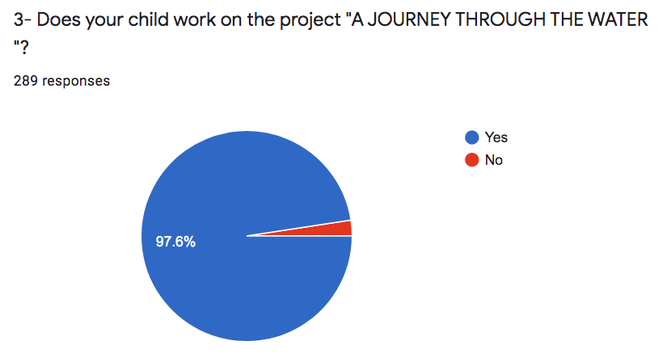
Does your child work on the project "A JOURNEY THROUGH THE WATER "?
We have asked to parents if their child worked on the Project ’’A Journey Through the Water’’. 289 parents answered the question and 97.6% ‘Yes’ , 2.4% ‘No’.

Slide 6
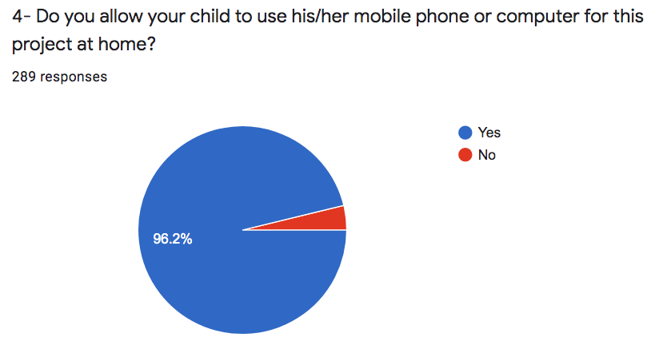
Do you allow your child to use his/her mobile phone or computer for this project at home?
We have asked parents that if they allowed their child to use his/her mobile phone or computer for this project at home. 289 parents answered the question and 96.2% of them said ‘Yes’ , 3.8% of them said ‘No’.

Slide 7
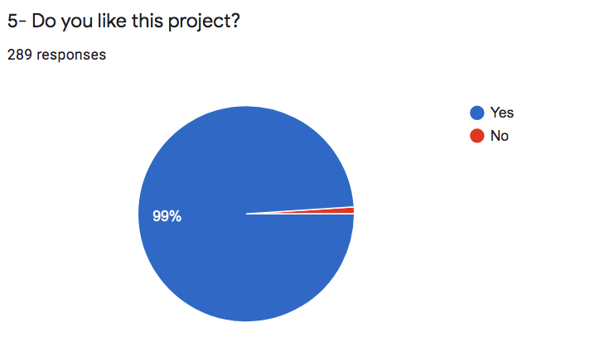
Do you like this project?
We have asked to parents if they liked this project. 289 parents answered the question and 99% ‘Yes’ , 1% ‘No’.

Slide 8
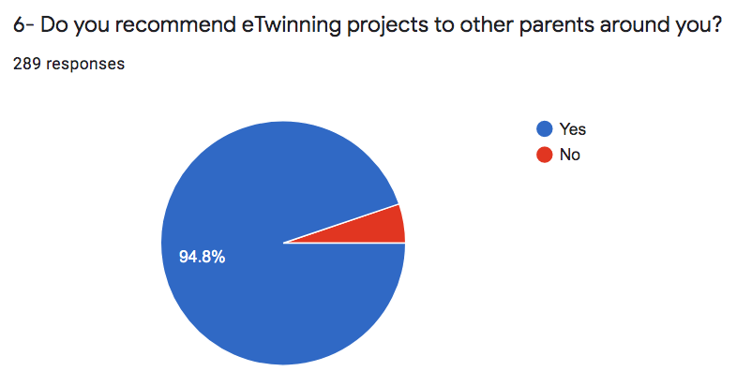
Do you recommend eTwinning projects to other parents around you?
We have asked to parents ’’Do you recommend eTwinning projects to other parents around you?’’
289 parents answered the question and 94.8% said ‘Yes’ , however 5.2% said ‘No’.

Slide 9
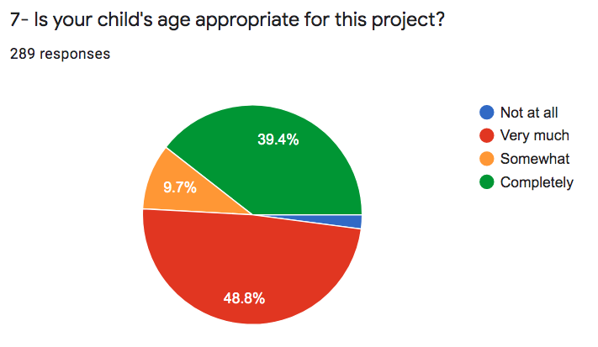
Is your child's age appropriate for this project?
We have asked to parents if their child’s age appropriate for this project. 289 parents answered the question and 48.8% ‘Very much’ , 39.4% ‘Completely’ , 9.7% ‘Somewhat’ , 2.1% ‘Not at all’.

Slide 10
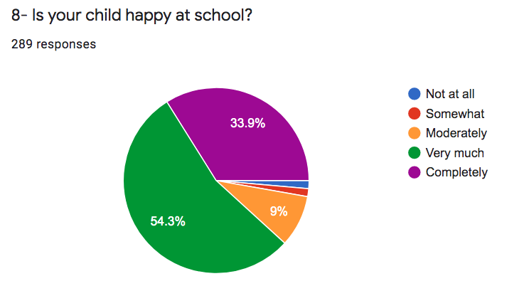
Is your child happy at school?
We have asked to parents if their child happy at school. 289 parents answered the question and 54.3% ‘Very much’ , 33.9% ‘Completely’ , 9% ‘Moderately’ , 1.4% ’Somewhat’ , 1.4% ‘Not at all’.

