Slide 1
Sign language
Die Unterstützung der Europäischen Kommission für die Erstellung dieser Veröffentlichung stellt keine Billigung des Inhalts dar, welcher nur die Ansichten der Verfasser wiedergibt, und die Kommission kann nicht für eine etwaige Verwendung der darin enthaltenen Informationen haftbar gemacht werden.

Slide 2
Sign languages (also known as signed languages) are languages that use the visual-manual modality to convey meaning. Sign languages are expressed through manual articulations in combination with non-manual elements. Sign languages are full-fledged natural languages with their own grammar and lexicon. Sign languages are not universal and they are not mutually intelligible with each other, although there are also striking similarities among sign languages.

Slide 3
History
One of the earliest written records of a sign language is from the fifth century BC, in Plato's Cratylus, where Socrates says: "If we hadn't a voice or a tongue, and wanted to express things to one another, wouldn't we try to make signs by moving our hands, head, and the rest of our body, just as dumb people do at present?’’

Slide 4
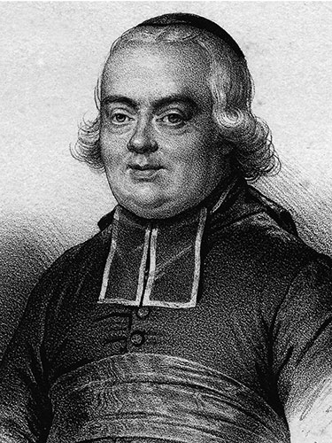
Pedro Ponce de León (1520–1584) is said to have developed the first manual alphabet.
In 1620, Juan Pablo Bonet published Reducción de las letras y arte para enseñar a hablar a los mudos which is considered the first modern treatise of sign language phonetics
In 1680, George Dalgarno published Didascalocophus in which he presented his own method of deaf education
The earliest known printed pictures of consonants of the modern two-handed alphabet appeared in 1698 with Digiti Lingua , a pamphlet by an anonymous author who was himself unable to speak.
In 1755, Abbé de l'Épée founded the first school for deaf children in Paris

Slide 5
Relationships with spoken languages
There is a common misconception that sign languages are somehow dependent on spoken languages. Similarities in language processing in the brain between signed and spoken languages further perpetuated this misconception. Hearing teachers in deaf schools are often incorrectly referred to as "inventors" of sign language. Instead, sign languages, like all natural languages, are developed by the people who use them, in this case, deaf people, who may have little or no knowledge of any spoken language.

Slide 6
Spatial grammar and simultaneity
Sign languages exploit the unique features of the visual medium, but may also exploit tactile features . Spoken language is by and large linear; only one sound can be made or received at a time. Sign language, on the other hand, is visual and, hence, can use a simultaneous expression, although this is limited articulatorily and linguistically. Visual perception allows processing of simultaneous information.

Slide 7
Deaf communities and deaf culture
When Deaf people constitute a relatively small proportion of the general population, Deaf communities often develop that are distinct from the surrounding hearing community. These Deaf communities are very widespread in the world, associated especially with sign languages used in urban areas and throughout a nation, and the cultures they have developed are very rich.

Slide 8
Use of sign languages in hearing communities
On occasion, where the prevalence of deaf people is high enough, a deaf sign language has been taken up by an entire local community, forming what is sometimes called a "village sign language“ or "shared signing community".Typically this happens in small, tightly integrated communities with a closed gene pool. Famous examples include:
Martha's Vineyard Sign Language, United States
Al-Sayyid Bedouin Sign Language, Israel
Kata Kolok, Bali
Adamorobe Sign Language, Ghana
Yucatec Maya Sign Language, Mexico
In such communities deaf people are generally well integrated in the general community and not socially disadvantaged, so much so that it is difficult to speak of a separate "Deaf" community.

Slide 9
Thank You
Katherine Bubova, 9th ‘’d’’

