Slide 1
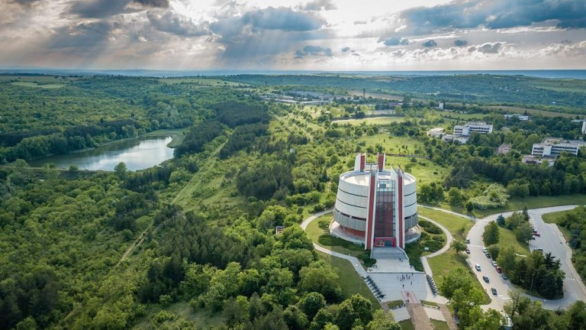
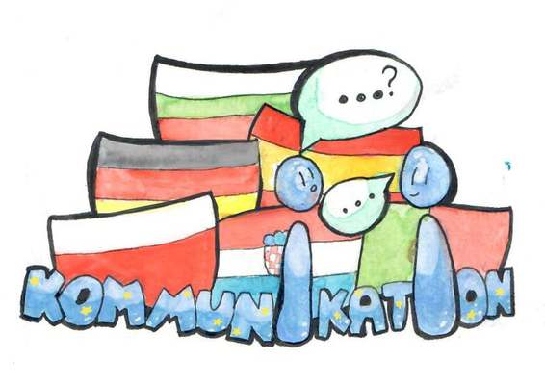
Bulgaria, Pleven and our Foreign Language School

Slide 2
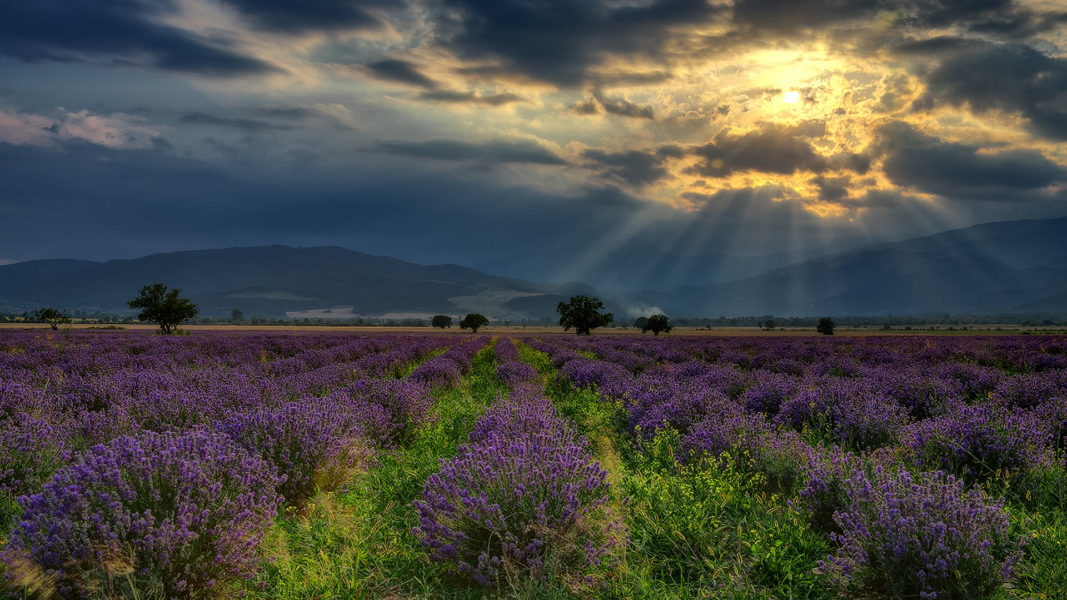
Bulgaria

Slide 3
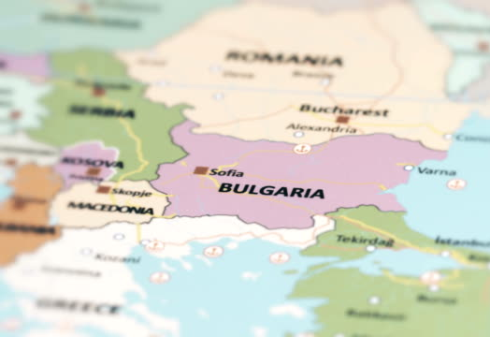
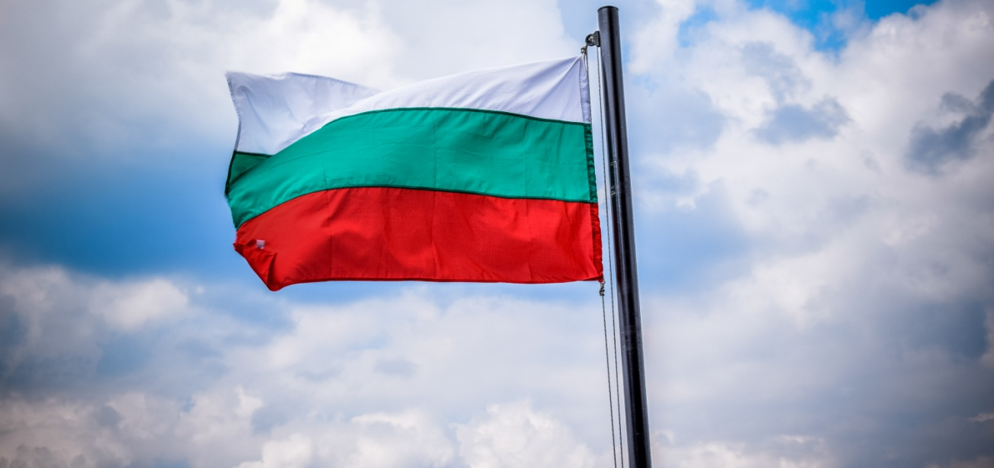
Our country - Bulgaria
A country with beautiful nature and rich history
Bulgarian borders - Romania, Serbia and Northern Macedonia, Turkey and Greece and the Black Sea
Bulgarian flag - three horizontal colors: white, green and red

Slide 4
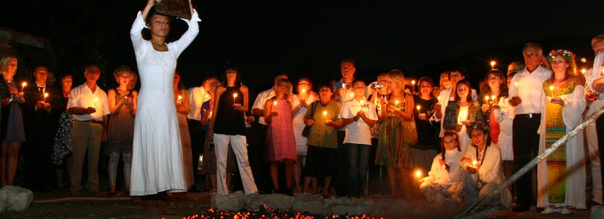
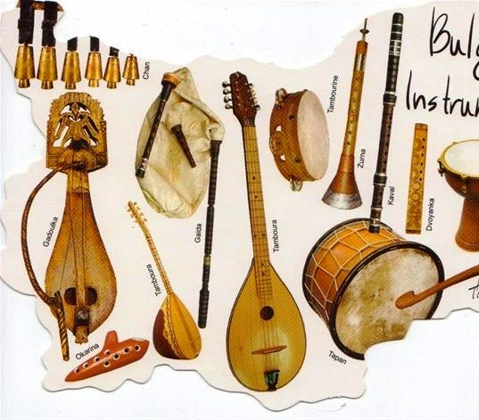
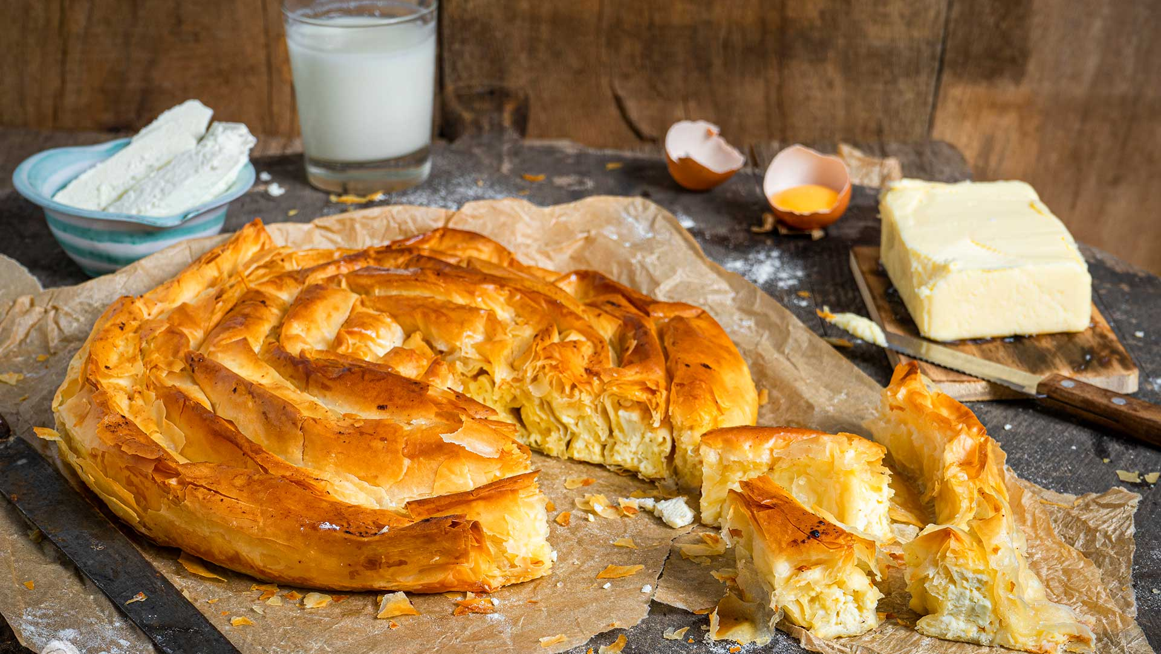
The cuisine and traditions of Bulgaria
Traditional meals
Music
Fire dance
Rose picking
Rose oil

Slide 5
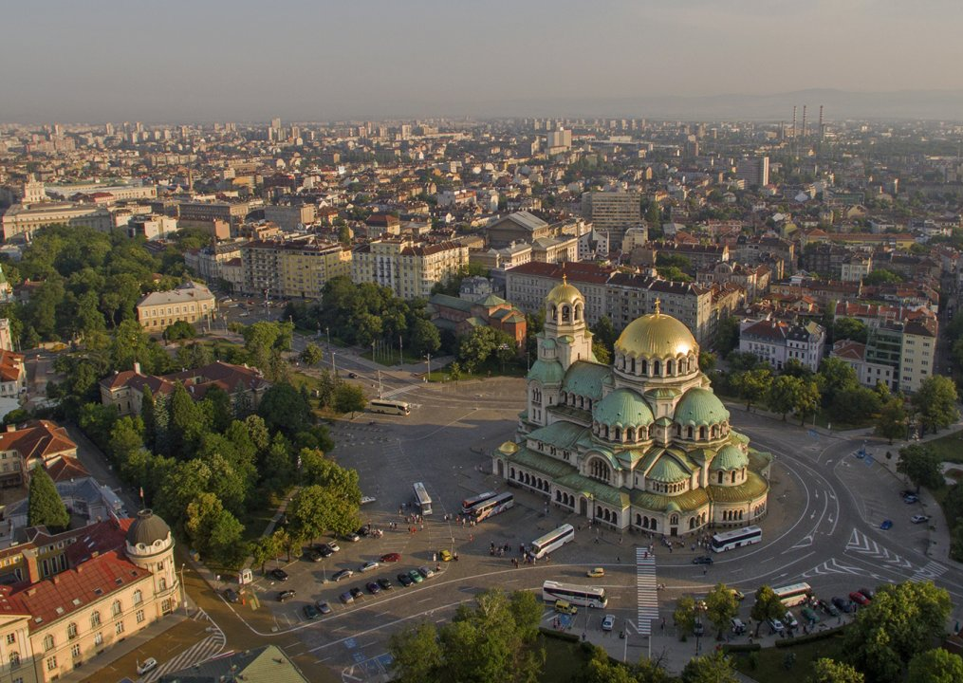
Capital
Sofia
political, cultural and economic center
other beautiful cities

Slide 6
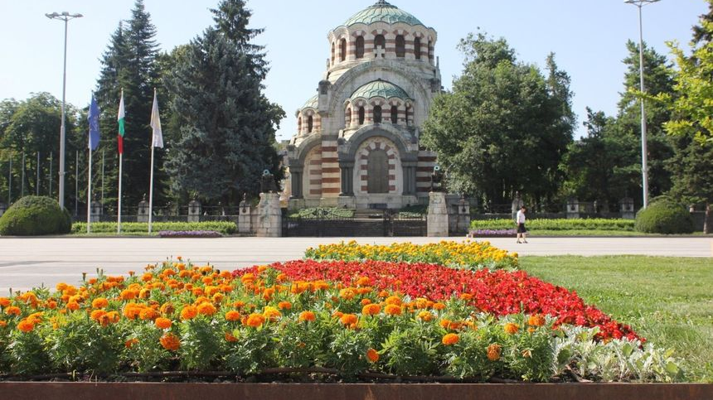
Pleven

Slide 7
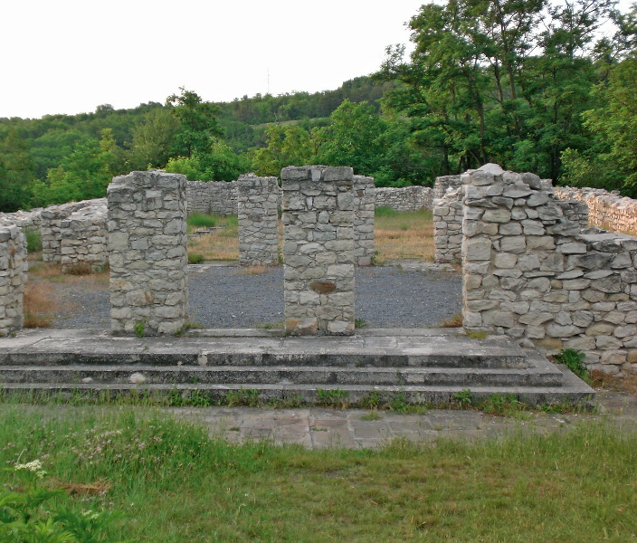
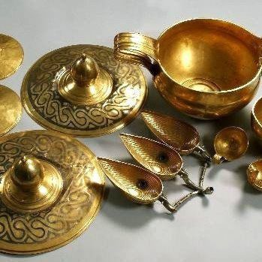
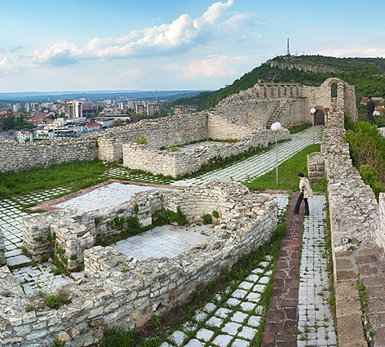
Ancient history
The largest gold treasure in Bulgaria (Valchitran)
Administrative, military and religious buildings

Slide 8
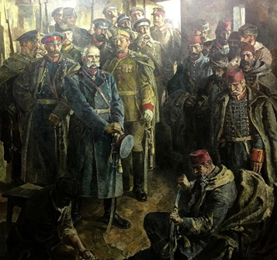
Russo-Turkish Liberation war
The war that led to the liberation of some Bulgarians from Ottoman rule and the creation of the Third Bulgarian State
A siege, which was the bloodiest battle in the whole war
Osman Pasha's sword handed to Russian generals as a sign of respect and capitulation
Many monuments and mausoleums (the Panorama; the mausoleum of St. George the Victorious

Slide 9
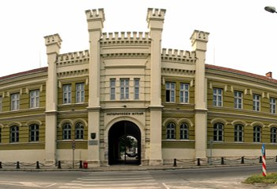
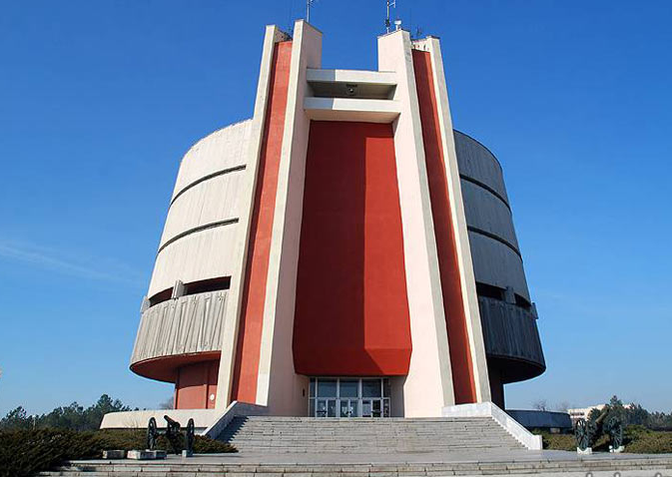
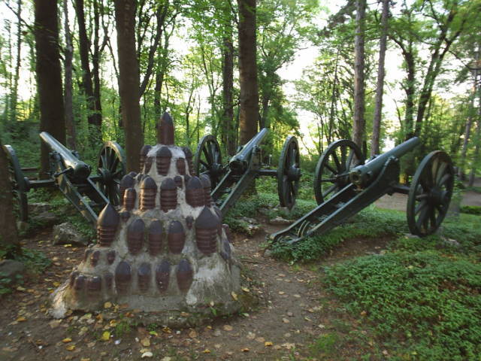
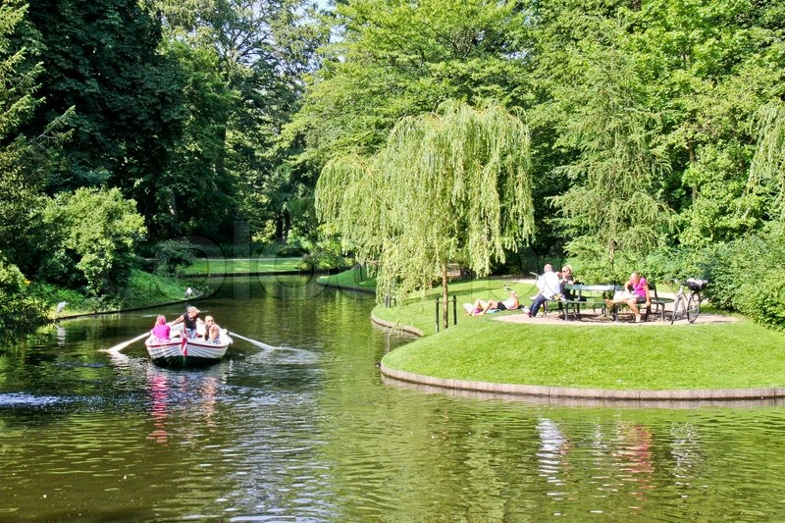
Pleven as a modern city
The medical center of northern Bulgaria
Skobelev Park
Kaylaka Park
Pleven Regional Historical Museum

Slide 10
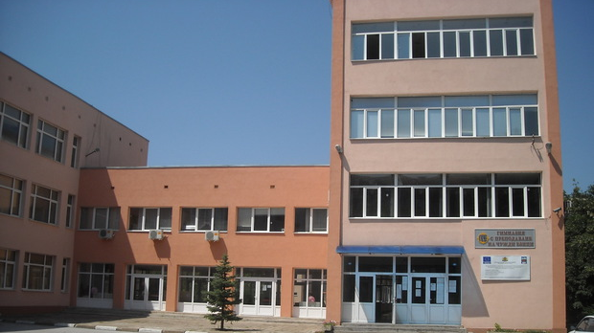
Foreign Language School

Slide 11
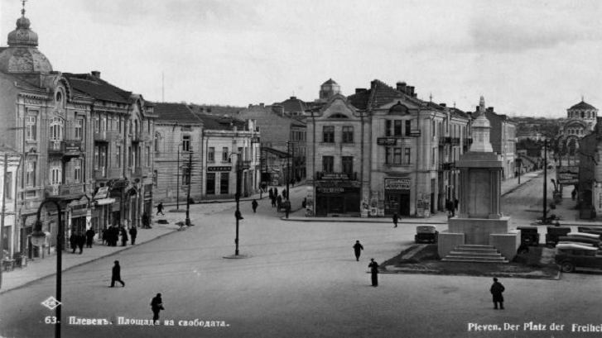
History
founded by Emanuil Vaskidovich
in the school year 1849/1850
in 1963 - High School with Russian language teaching
since 1982, the school has been associated with UNESCO

Slide 12
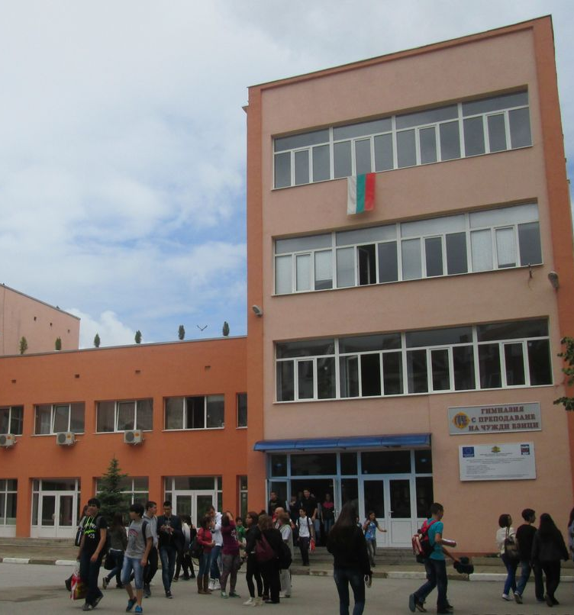
In Modern Times
from the 1986/1987 school year - intensive study of English, German, French and Spanish
from the school year 2021/2022 - Profiled High School with foreign language teaching (PGPCHE) "Dimitar Dimov"
educates students from VIII to XII class

Slide 13
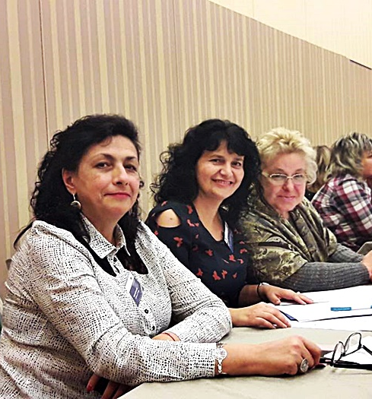
Achievements
many first and second places in numerous Olympiads and competitions
lots of activity history in many European projects
a German certificate exam centre and intensive courses in many European languages

Slide 14
Thank you for your attention!

