Slide 1
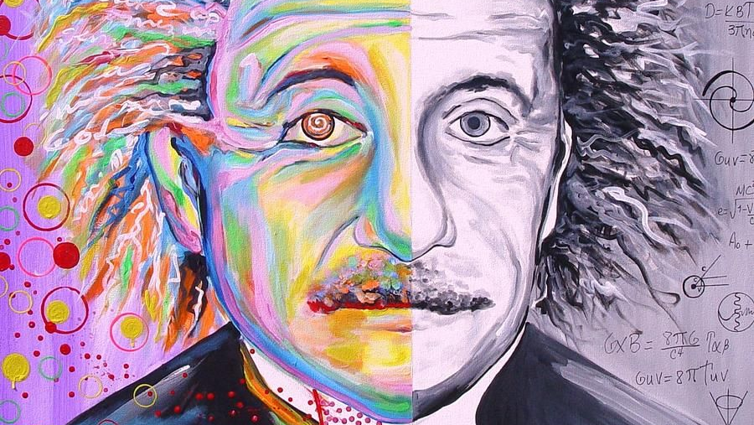
Communication through science and art

Slide 2
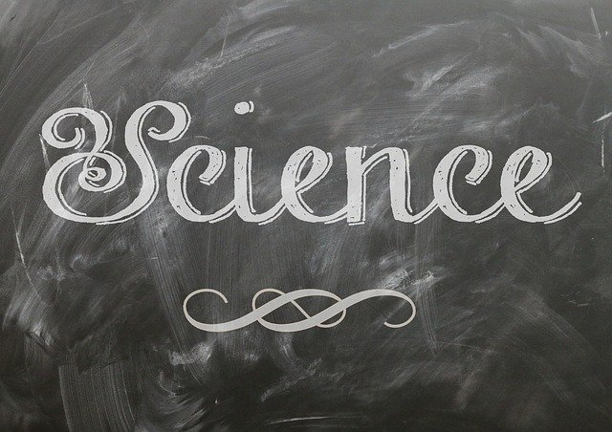
Contents of the workshop
1.The first task - Make a sentence of words that are made up of the symbols from the periodic table!
2.The second task – Make your own planet!

Slide 3
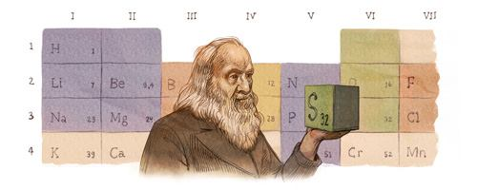
What will be the task today?
Hello, today I will show you shuffled words of a phrase, which is written with symbols from the Mendeleev table, as well as I will give you the names of the elements.

Slide 4
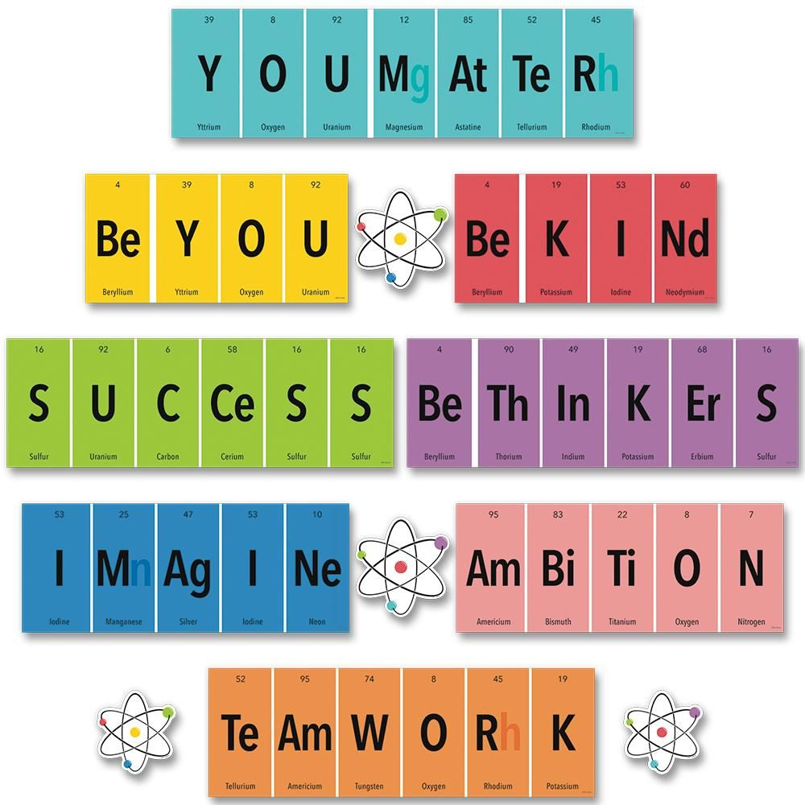
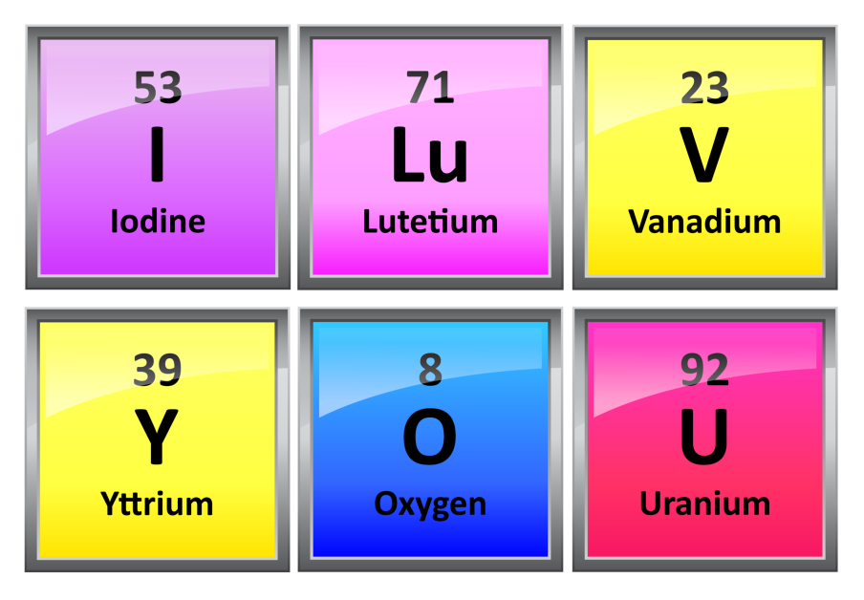
Examples!!!
made from
element symbols.
Words

Slide 5
The words for the task!!!
WIThOU𝜏- Tungsten,Iodine,Thorium,Oxygen,Uranium,Tau
a-Alpha Particle
No-Nobelium
Isaac Newton
BOID-Boron,Oxygen,Lepton,Deuterium
gReAt-gluon,Rhenium,Astatine
e−VEr-Electron,Vanadium,
Erbium
gUEsS-Gluon,Uranium,Einstenium,Sulfur
DISCoVErY-Deuterium,Iodine,Cobalt,
Vanadium,Erbium,Yttrium
WAs-Tungsten,Arsenic
maDe− -Mass,Alpha Particle,Deuterium,Electron

Slide 6
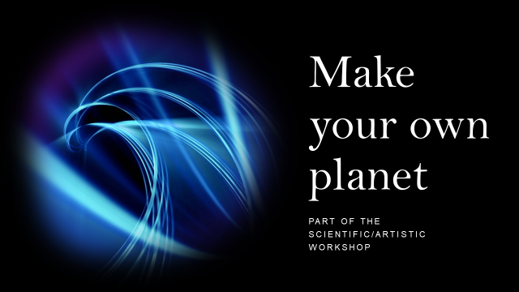

Slide 12
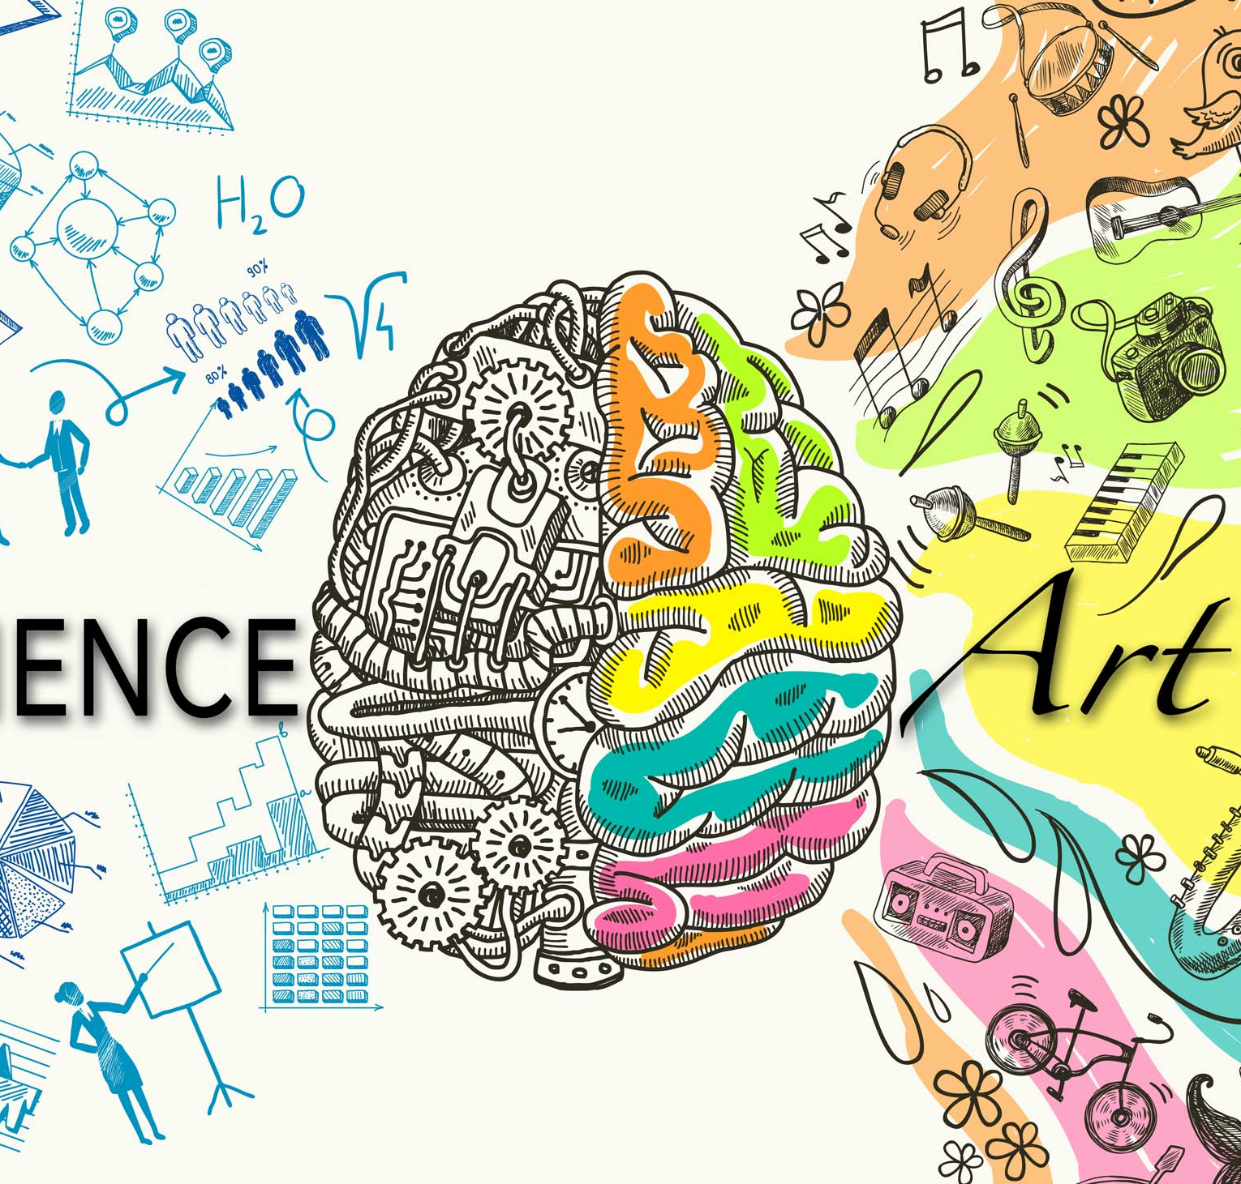
Thank you for your attention and good luck with your tasks! Now is your time to create and have fun with science at the same time!

