Slide 1
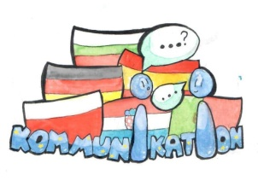
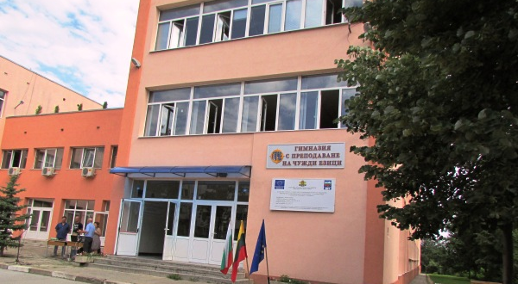
CLOTHING IN "DIMITAR DIMOV" LANGUAGE SCHOOL

Slide 2
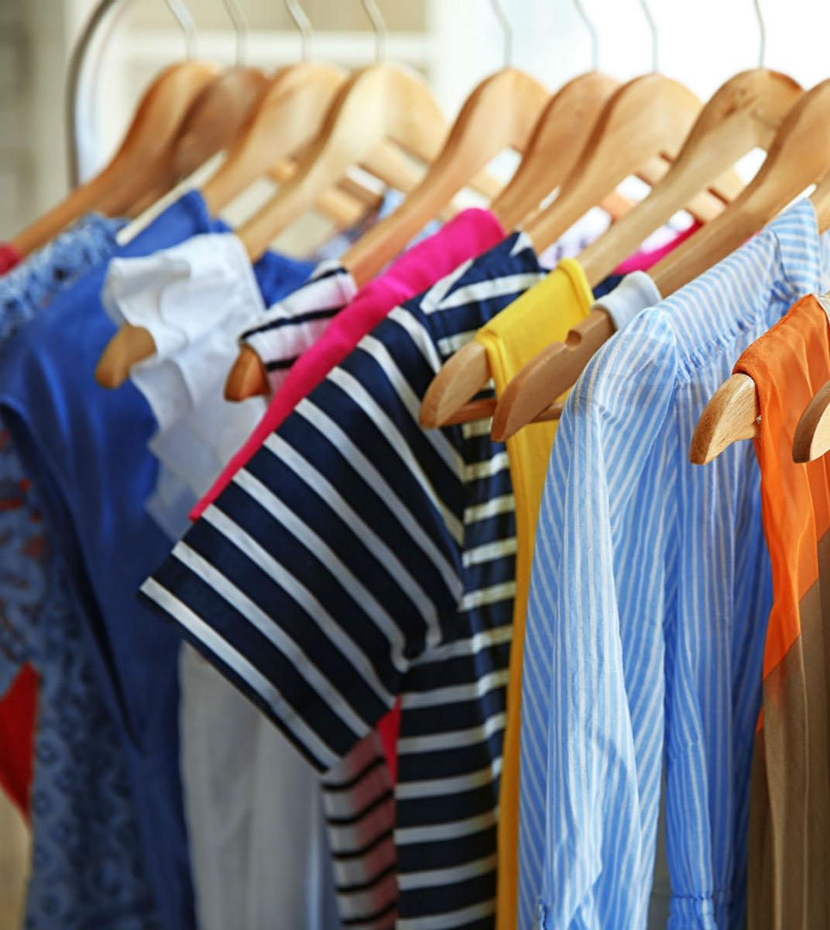
What is the typical clothing in our school?
In "Dimitar Dimov" language school everybody can wear whatever they want. We don't have uniforms, but we have to dress more appropriately when we have foreign visitors.

Slide 3
FLAGBEARERS
These are the flagbearers.
On important days of our school, for example the first or the last day of school, they wear white shirts with black bottoms, black shoes and white gloves.

Slide 4
This is Tsvetoslav. His style is somewhat sport-ish but also elegant at the same time. He wants to feel good and look good in his clothes.

Slide 5
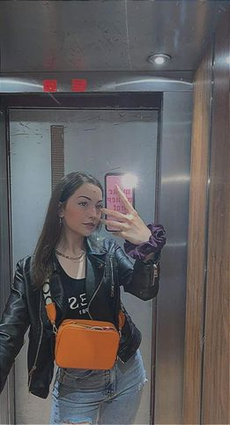
This is our classmate Ivayla. She usually dresses classy and stylish or as some might say "dress to impress".

Slide 6
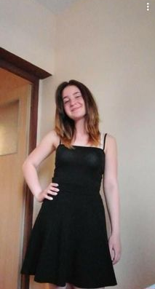
This is our friend Ivona. She is like a beam of sunshine. She likes wearing skirts and crop tops and her style can be defined as soft.

Slide 7
This is Denitsa, who is one of our classmates, in her casual daily outfit.

Slide 8
In our city one could see many styles such as "Old School". These are our friends Alex and Tsetsi who present the so called old school vibe.

Slide 9
THANK YOU FOR YOUR ATTENTION!
Made by Boyana Petsova and Nadezhda Ivanova

