Slide 1
RENEWABLE ENERGY AND RECYCLING IN lATVIA

Slide 2
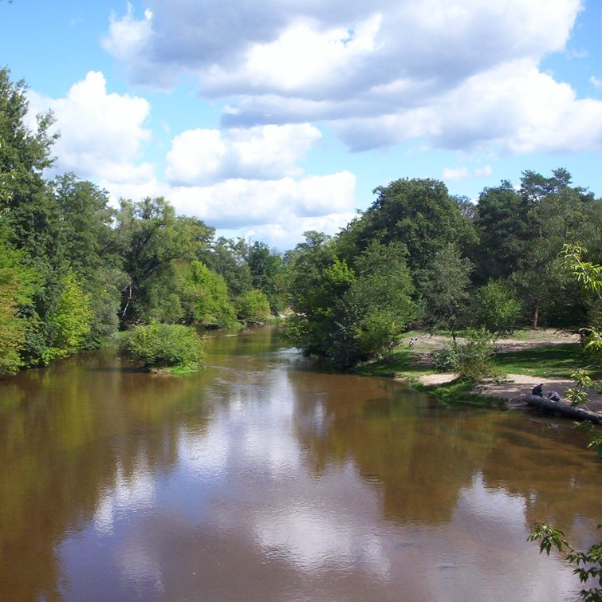
Why go for energy saving and green
energy
Climate and energy
Local employment
Replace energy import; Improves import -
export balance. Energy prices rise
Decreases external energy dependency. Energy
efficiency improves
Decentralised energy generation is believed to be
more progressive in the context of climate change
This Photo by Unknown author is licensed under CC BY-SA.

Slide 3
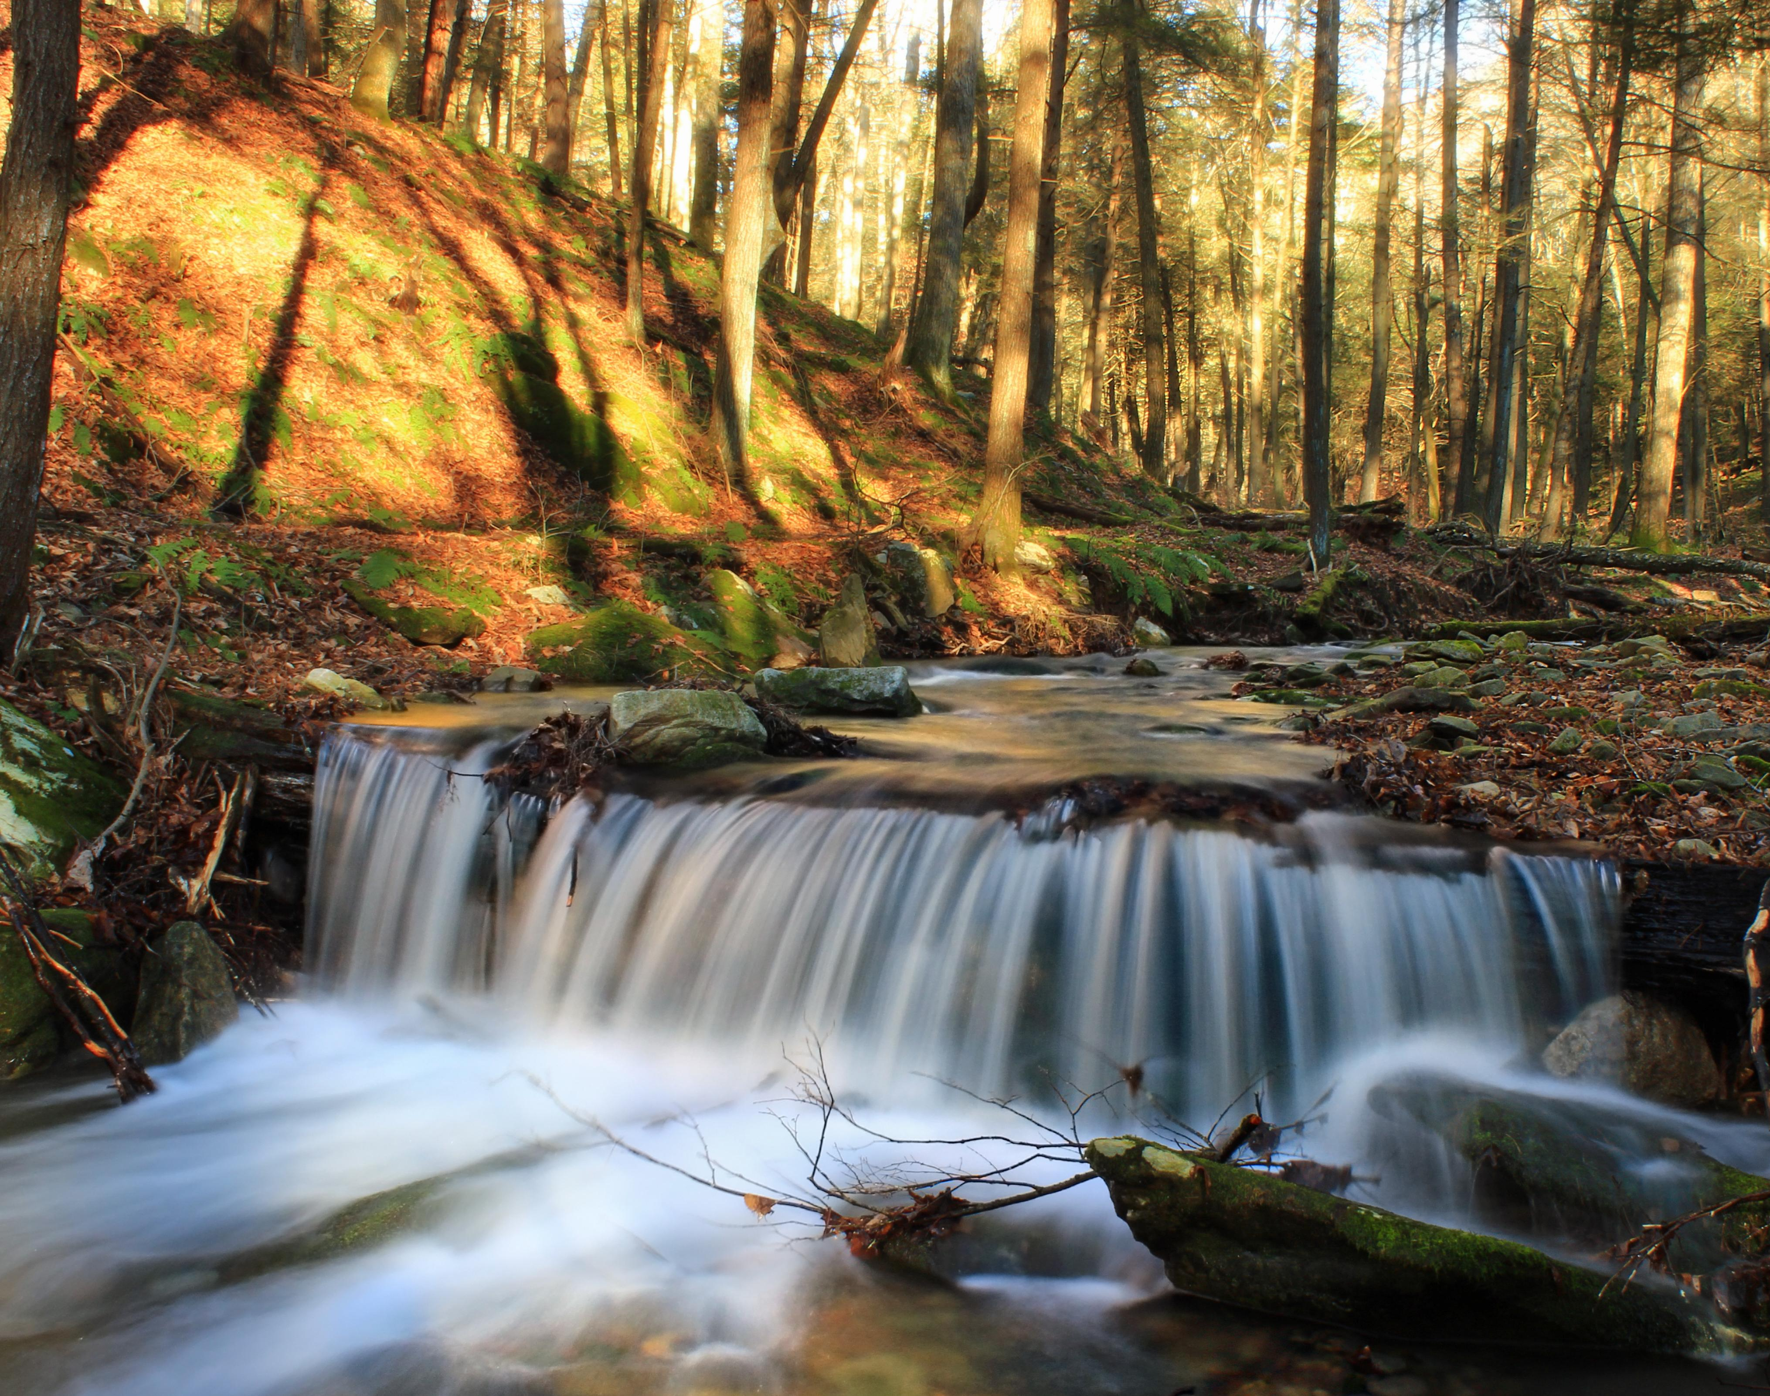
Share of energy from renewable sources in the EU MEMBER STATES
The highest share of renewables in the EU is in Sweden (53.9%), Finland (39.3%) and Latvia (37.6%), says Eurostat. This means that Latvia has almost reached its target of 40% in 2020.

Slide 4
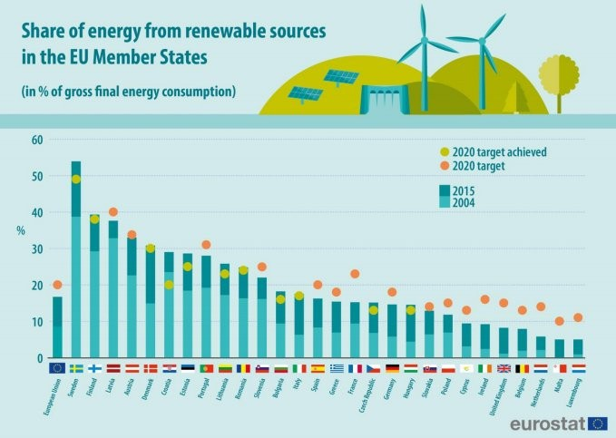

Slide 5
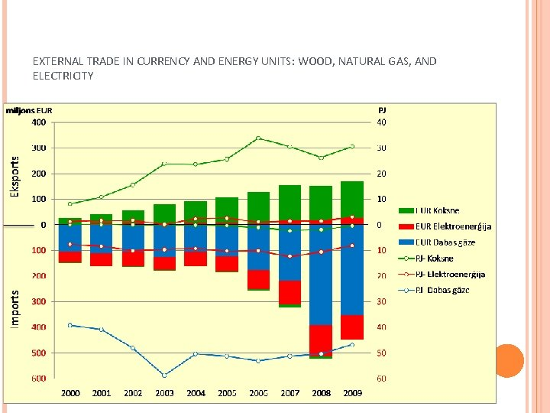

Slide 6
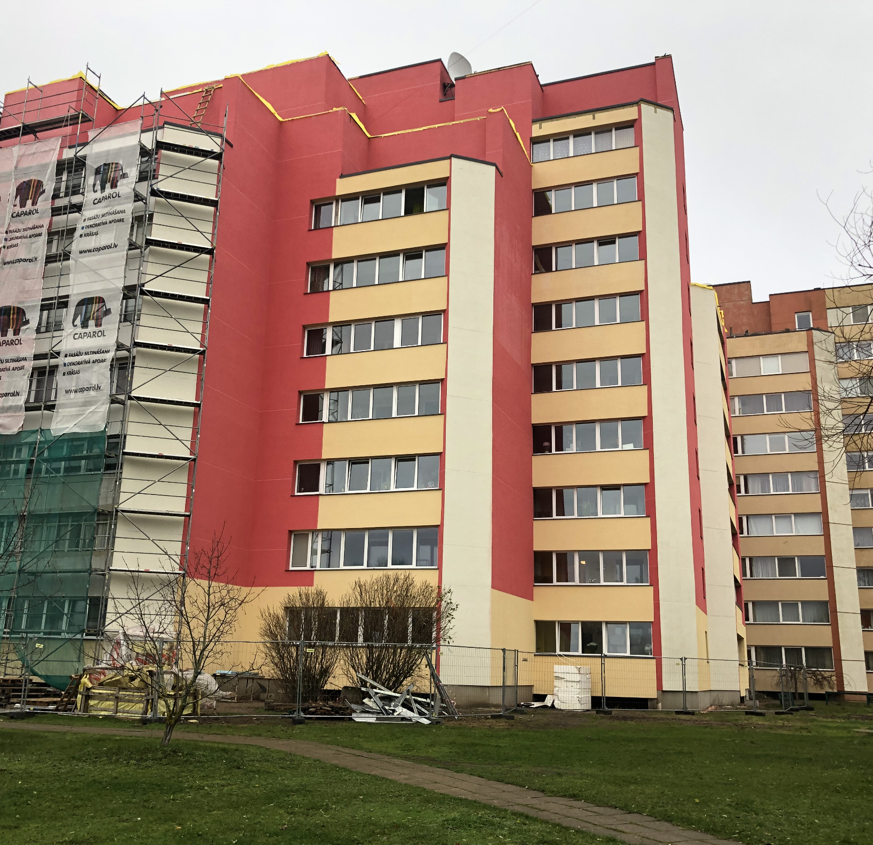
RENOVATION
93.8% of Latvia residents live in the houses built before 1990.
To decrease impact on climate many options are available:
one can renovate building,
decrease electricity bills,
grow own food, store it in cellar,
install a solar collector,
sort waste,
introduce composting,
use recycled paper, etc

Slide 7
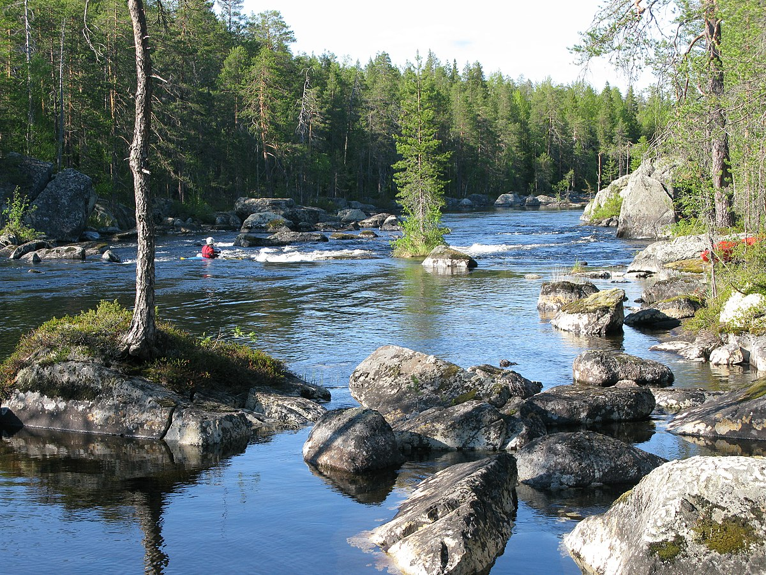
Latvia's ren goals
Biomass (woodchip, straw, reeds) co-generation
Energy efficiency activities – buildings, network, equipment (water boilers, fridges, etc.)
Transport: biogas, hybrid cars, electric cars.
REN support of private persons(including solar energy in private houses and micro-generation).
Economic measures – cellars, collectors small investment energy efficiency measures.
This Photo by Unknown author is licensed under CC BY-SA.

Slide 8
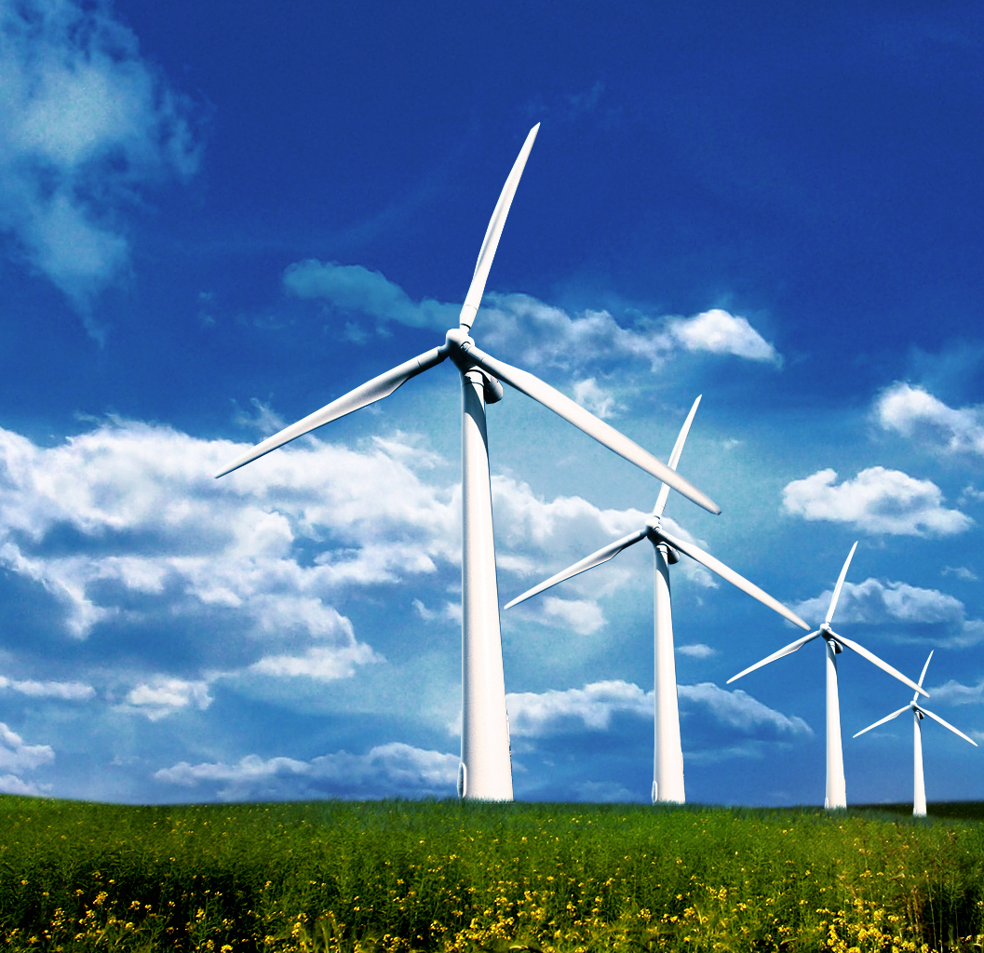
WIND POWER
At the end of 2018, total wind power capacity installed in Latvia was 66 MW, and wind energy constituted a mere one per cent of the final electricity demand in Latvia in 2018. Estonia and Lithuania, by contrast, have installed over 310 and 530 MW of wind capacity respectively.
Even though all three Baltic nations have signed up to the EU’s recently-agreed goal of carbon emissions’ neutrality by 2050, Latvia has a long way to go in transforming its energy system if it is to reach this objective. While Latvia’s draft National Energy and Climate Plan plans to increase its total onshore and offshore wind power capacity to at least 800 MW over the next 10 years, little progress has been made.
This Photo by Unknown author is licensed under CC BY-NC-ND.

Slide 9
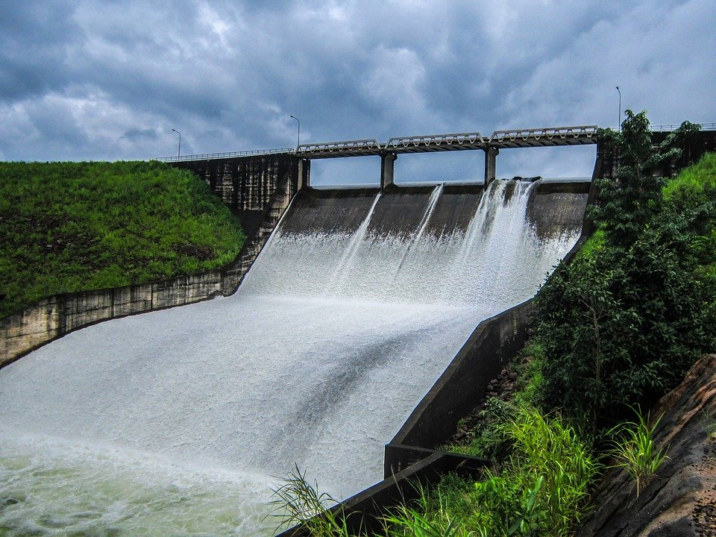
Main sources in electricity production: hydro and natural gas
Approximately one third of electricity in Latvia is produced using large hydropower plants on the Daugava river, approximately one third is produced by large combined heat and power (CHP) plants in Riga and the rest is imported.

Slide 10
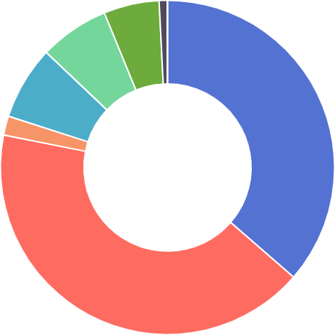
Daugava hydro
Thermal
Wind
Cogeneration (up to 10MW)
Biomass
Biogas
Small hydro
Solar
Electricity production in Latvia, 2018

Slide 11
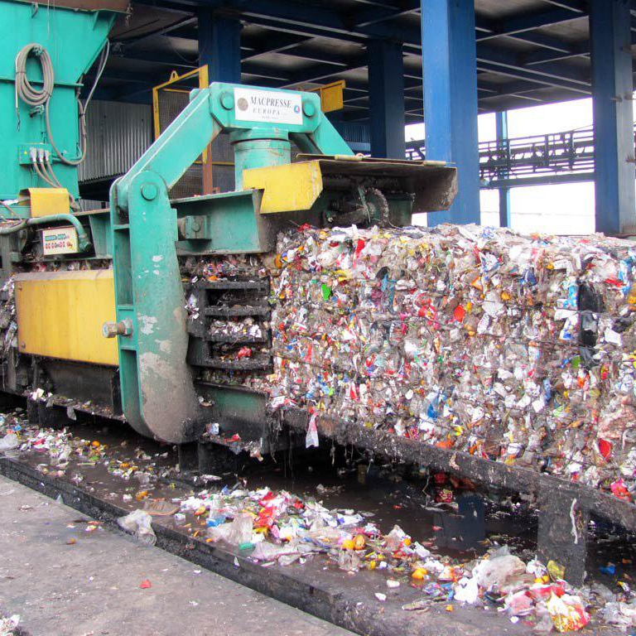
RECYCLING IN LATVIA
Recycling waste
Recyclable materials, such as PET bottles, glass bottles and jars, paper and cardboard, electrical appliances, batteries and other man-made waste, have a certain life cycle, just like people or other living organisms.
This Photo by Unknown author is licensed under CC BY.

Slide 12
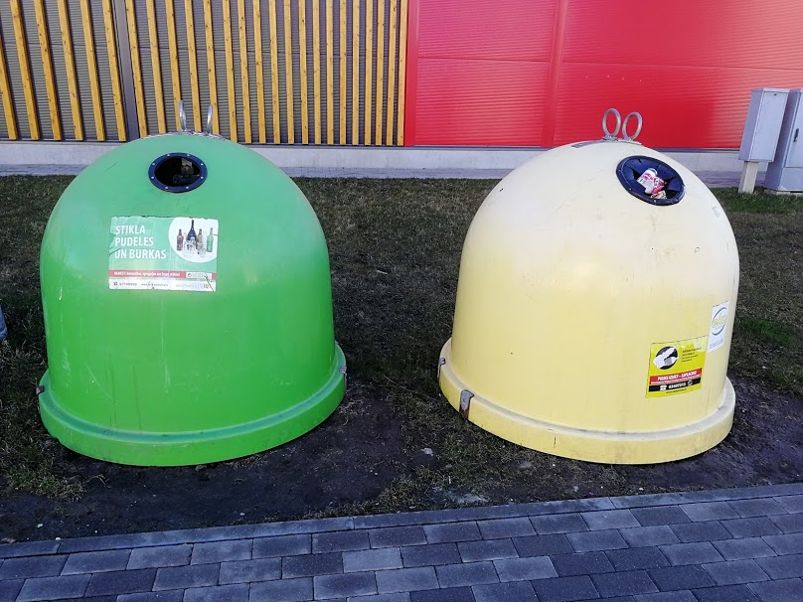
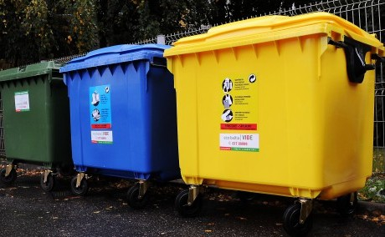
SORTING OF WASTE
Recycling of plastic, glass jars and bottles, paper, electrical appliances, batteries, car tires and accumulators is held in Latvia.

Slide 13
Rate of municipal waste by waste operations in the Baltic Sea region countrieS in 2016
COUNTRY | TREATMENT | LANDFILLED | INCINERATION | RECYCLING | COMPOSTING
GERMANY | 100% | 1% | 51% | 29% | 19%
ESTONIA | 91% | 11% | 53% | 28% | 3%
LATVIA | 89% | 72% | 0% | 17% | 11%
LITHUANIA | 95% | 31% | 18% | 26% | 25%
POLAND | 100% | 36% | 20% | 28% | 16%
FINLAND | 100% | 3% | 55% | 29% | 13%
SWEDEN | 100% | 1% | 50% | 33% | 16%

Slide 14
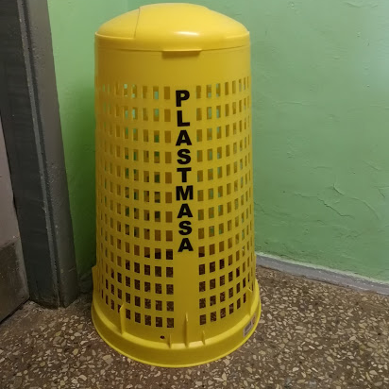
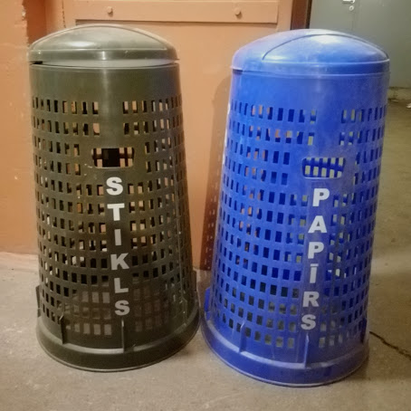
Recycling at schools
Schools in Latvia take an active part in sorting out the waste.
Paper, plastic and glass are collected in special bins.
Liepaja School 7:
yellow bins - plastic
green bins - glass
blue bins - paper.

Slide 15
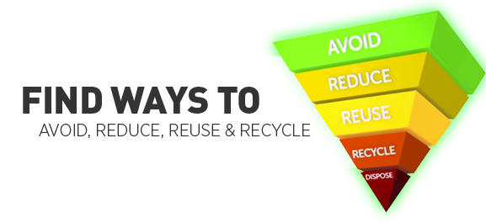
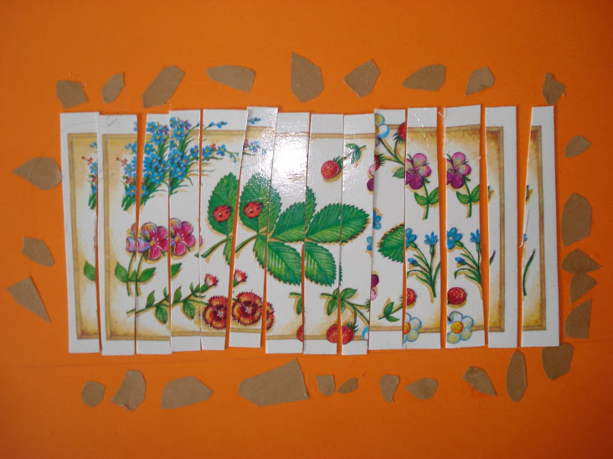
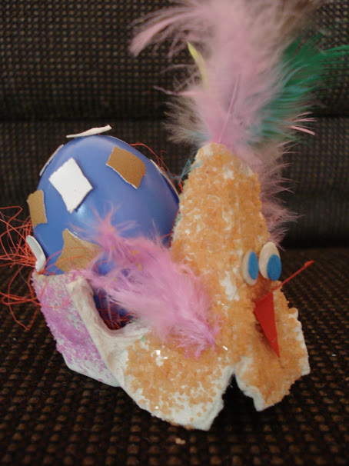
REUSING AT SCHOOL
At the Art lessons children make some crafts reusing already used items. They learn to reuse and to create something new out of old things.

Slide 16
Thank you for attention!

