Slide 1
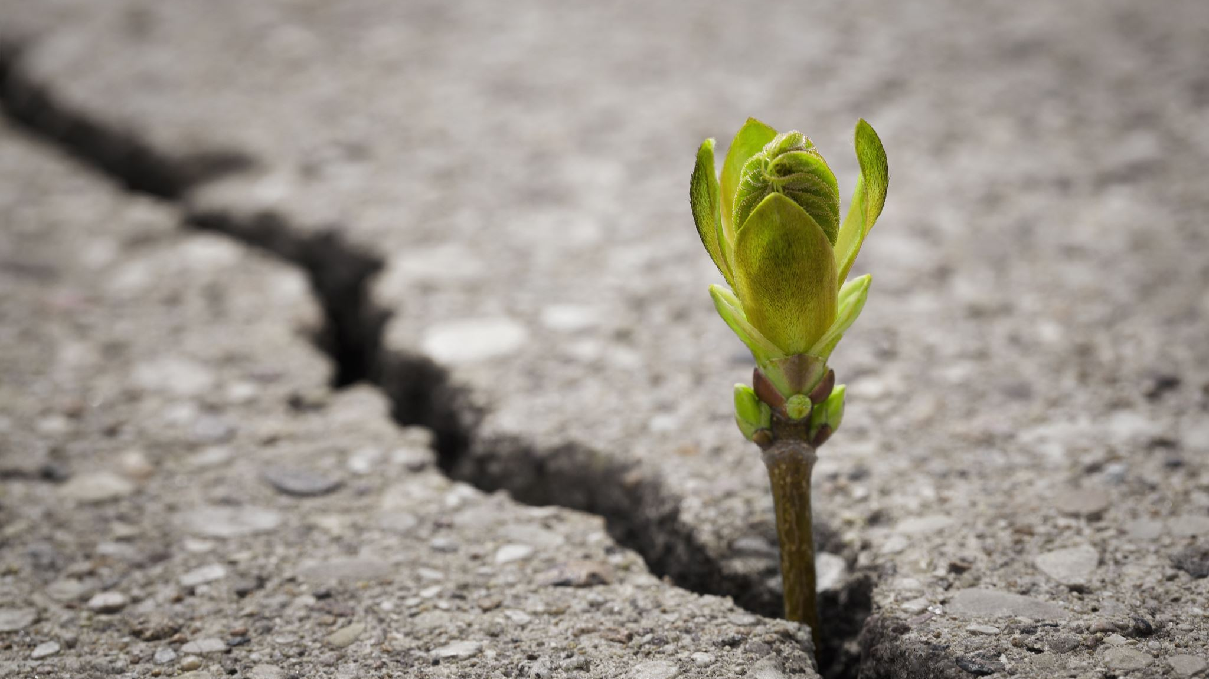
Recycling and renewable energy in Poland
To zdjęcie, autor: Nieznany autor, licencja: CC BY-SA

Slide 2
Increased demand for energy and pollution of the environment result in growing interest in new technologies of acquiring energy from natural sources. Experts warn that with the current consumption of energy, non-renewable resources may be used up as soon as 2040.

Slide 3
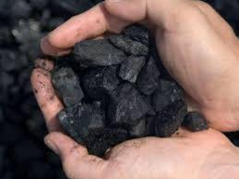
Poland lies on coal. Therefore, 80% of its electricity comes from coal. Coal resources are substantial but 85% of it lie so deep in the ground that its exploitation is unprofitable and dangerous. Gas and oil come mainly from import which makes Poland dependent on fixed prices from foreign suppliers.

Slide 4
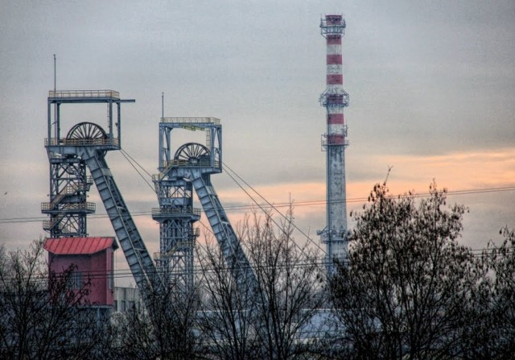
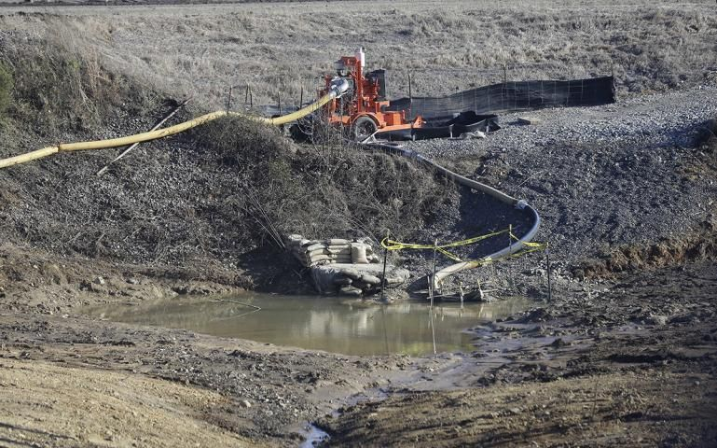
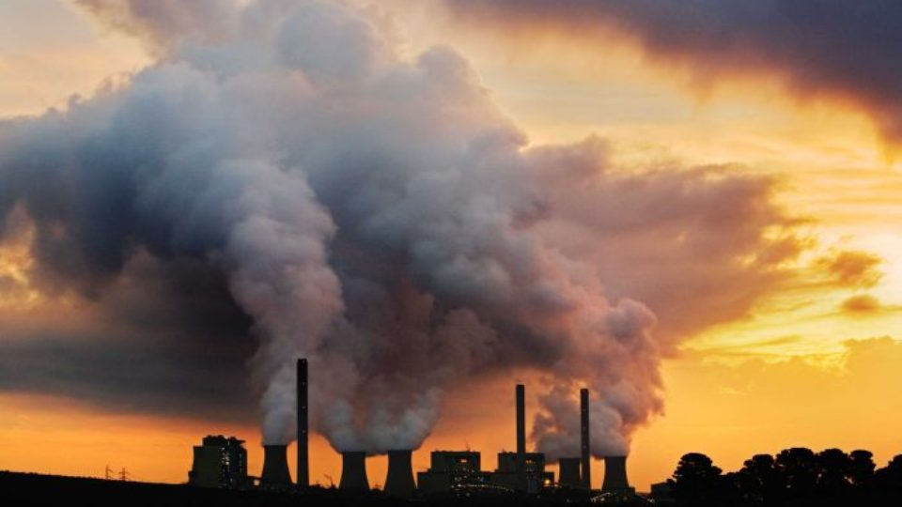
The disadvantages of using
coal in power generation are: ​• Emission of carbon dioxide
into the atmosphere during
power generation ​
• Limited reserves ​
• Negative impact on the natural environment (e.g., acid rains) ​
• Degradation of landscape ​
• Emission of dust ​

Slide 5
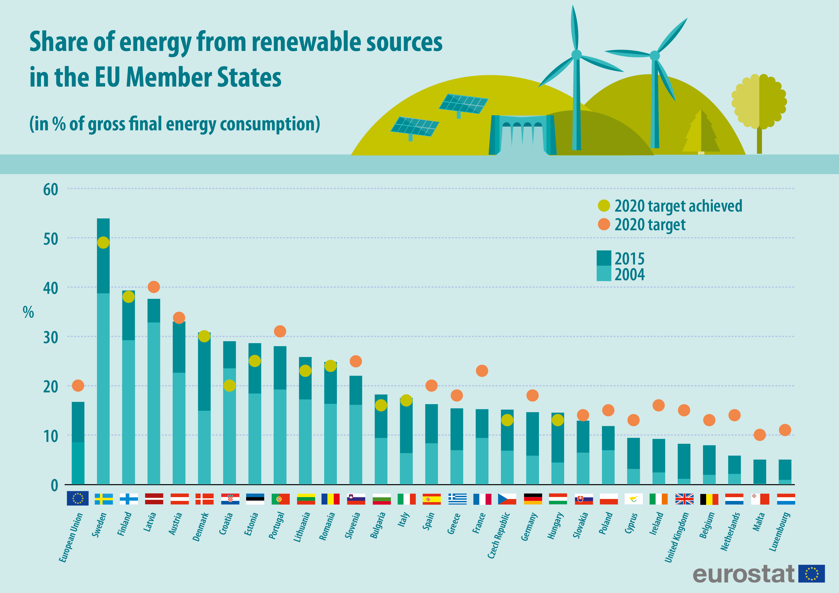
The National Renewable Energy Action Plan commited Poland to generate at least 15% of its energy from renewables by 2020.

Slide 6
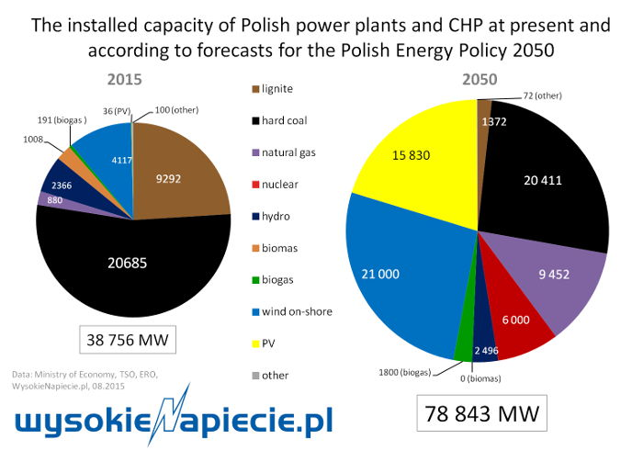
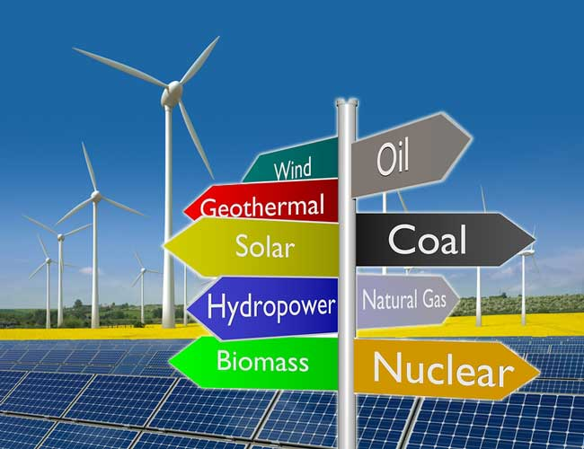
The most important renewable energy sources in Poland are biofuels, liquid and solid, and wind energy. The structure of Poland's renewable energy sources and their developmental trends are presented in the chart.

Slide 7
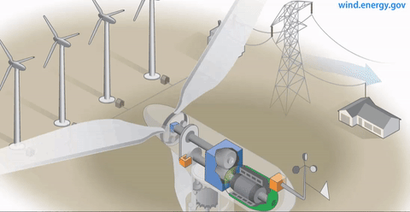
WIND
13 January 2021 the Senate has passed the “Offshore Wind Act” without amendments. The regulations contained in this Act, lay a foundation for development of wind farms in the Polish part of the Baltic Sea. It will support Poland’s transition towards a low-carbon economy over the coming decades. The first wind farms developed under this stage could start generating electricity as early as 2025 launching investment projects worth approximately PLN 130 billion. It will help mitigate the negative consequences of the slowdown caused by the pandemic. It will not only be a direct cash injection for the economy, but also tax revenues for the central budget and for municipalities, tens of thousands of new jobs and an opportunity to build a strong industry around the sector, including revival of Polish shipyards and ports

Slide 8
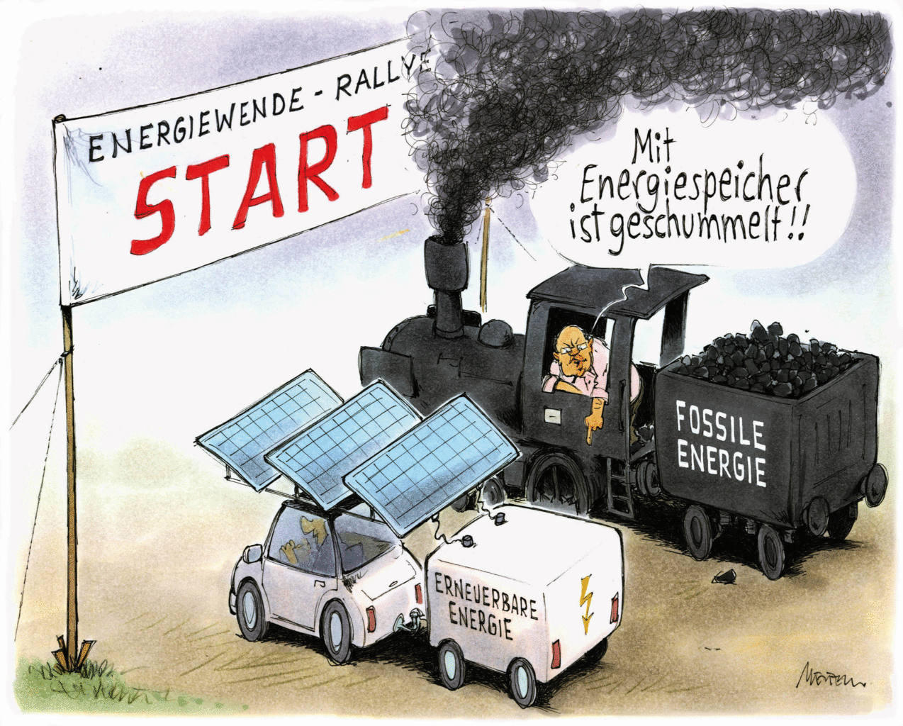
PHOTOVOLTAIC
Photovoltaic is growing the fastest among all renewable energy sectors in Poland.
Polish photovoltaics has now prosumer and diffuse character. It results from the citizens' interest in energy production on their own, available support programs and friendly legal regulations, among other tax breaks.
In the years 2021-2022 PV farms will be put into operation. In 2022 and 2023, the share of PV farms in the total installed power will be equal to the share of micro-installations. The PV market will change from a typically prosumer one, just as it is now, on sustainable one between professional PV power plants and prosumers.
To zdjęcie, autor: Nieznany autor, licencja: CC BY-SA

Slide 9
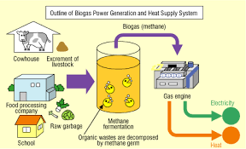
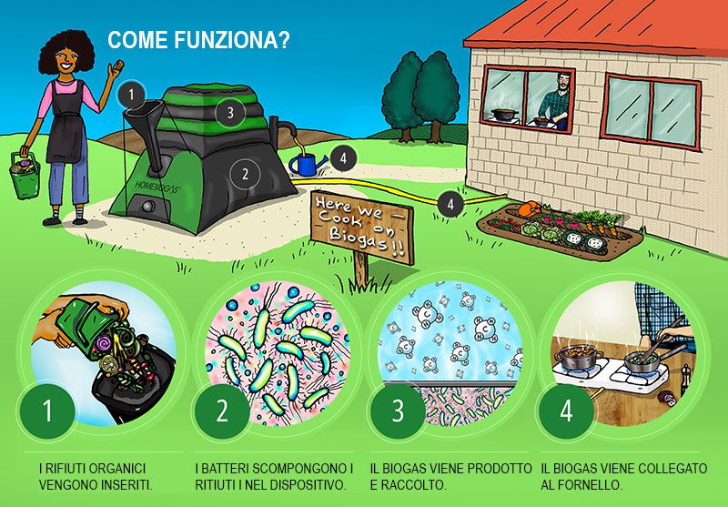
Agricultural biogas plants in particular, supported by a new energy auction, are expected to drive biogas growth in Poland. Total natural gas consumption in Poland is 17.66 billion m3, waste-based biogas can substitute 11% of this. Of the 347 landfills accepting municipal waste, 303 capture landfill gas, though only around 100 produce energy from it. Landfill gas is primarily released directly into the atmosphere or flared. There are also 1,978 illegal dumps in Poland. Therefore, there is huge potential in the waste management sector for reduction in landfill gas emissions and conversion of this gas into energy. There is an estimated potential of 5 billion m3 of biogas in Poland, of which 1.7 billion m3 could come from agricultural waste products.

Slide 10
RECYCLING
Until recently municipalities in Poland could have different bin colours for recycling. In 2020 rules became standardised.
- Blue is for paper
- Green is for glass
- Yellow for metal and plastic materials
- Brown for biodegradable waste
- Black for mixed waste

Slide 11
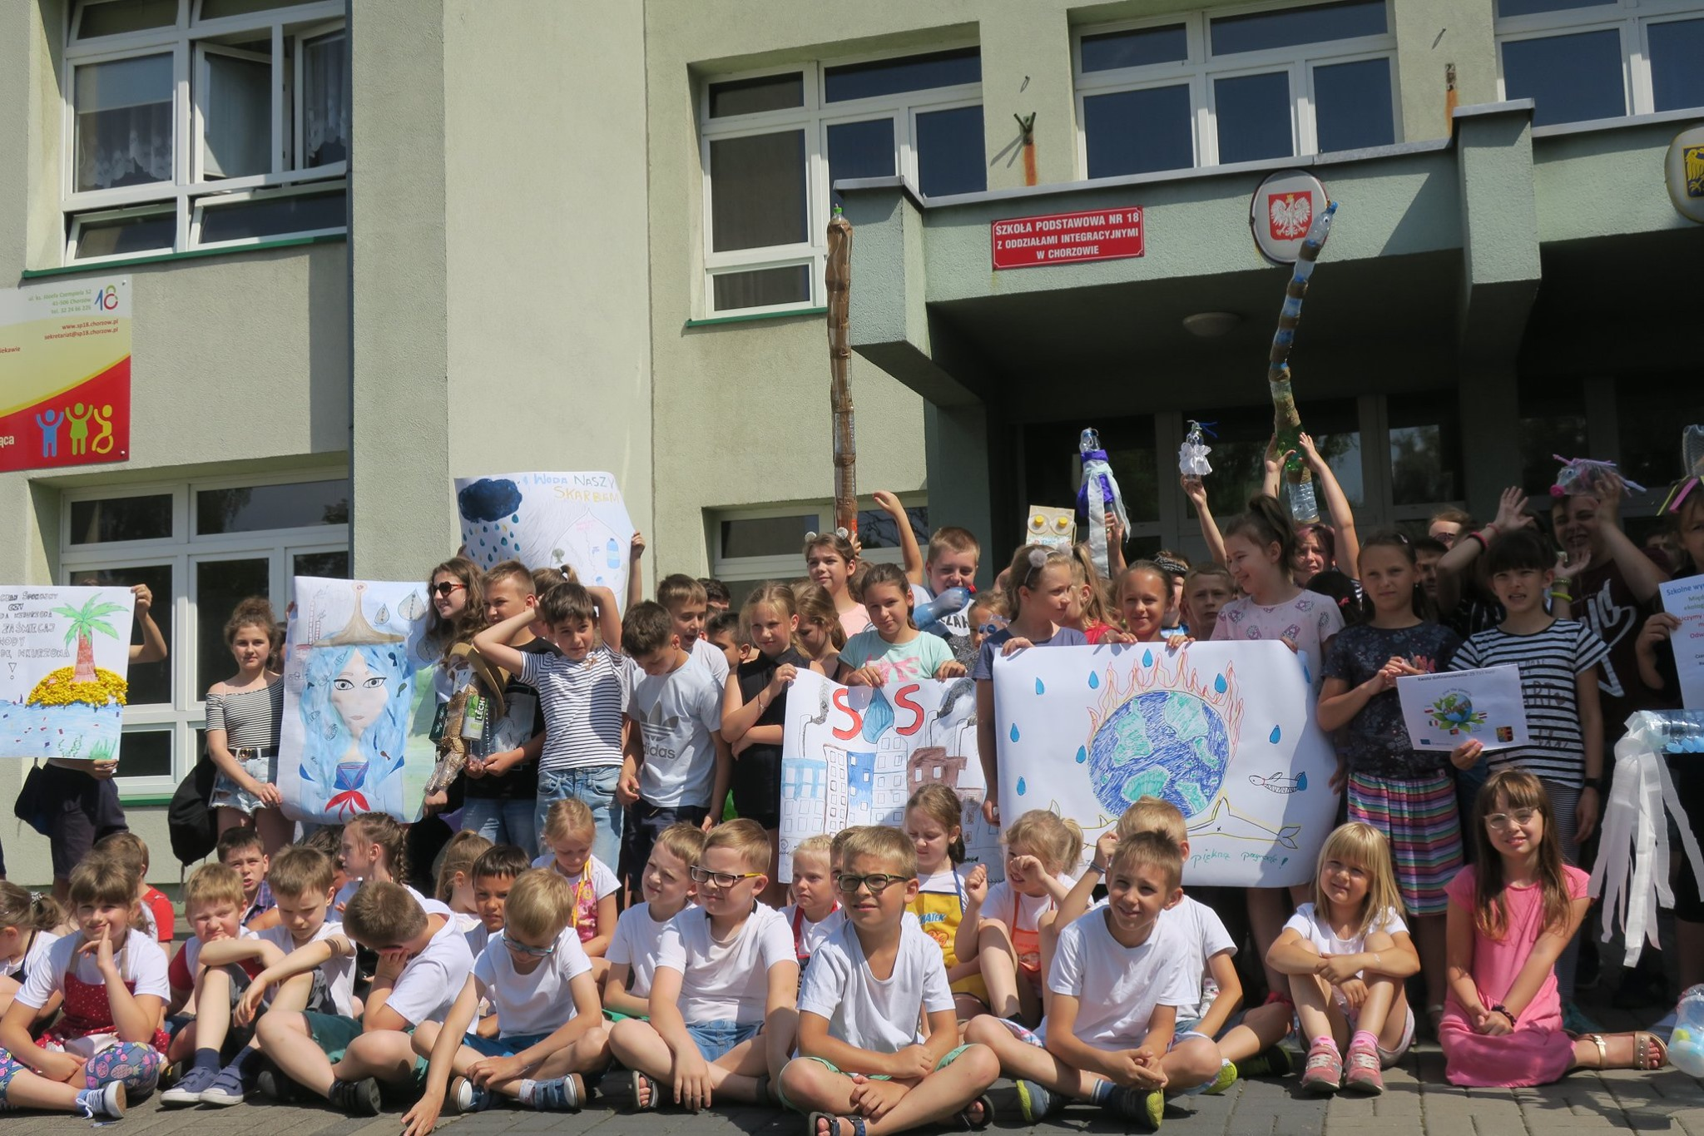
The idea of recycling is quite new in Poland, therefore we still have to raise awareness of the issue.
There are recycling bins at schools (our school in the picture) and talks about the importance of recycling and its impact on the environment.

Slide 12
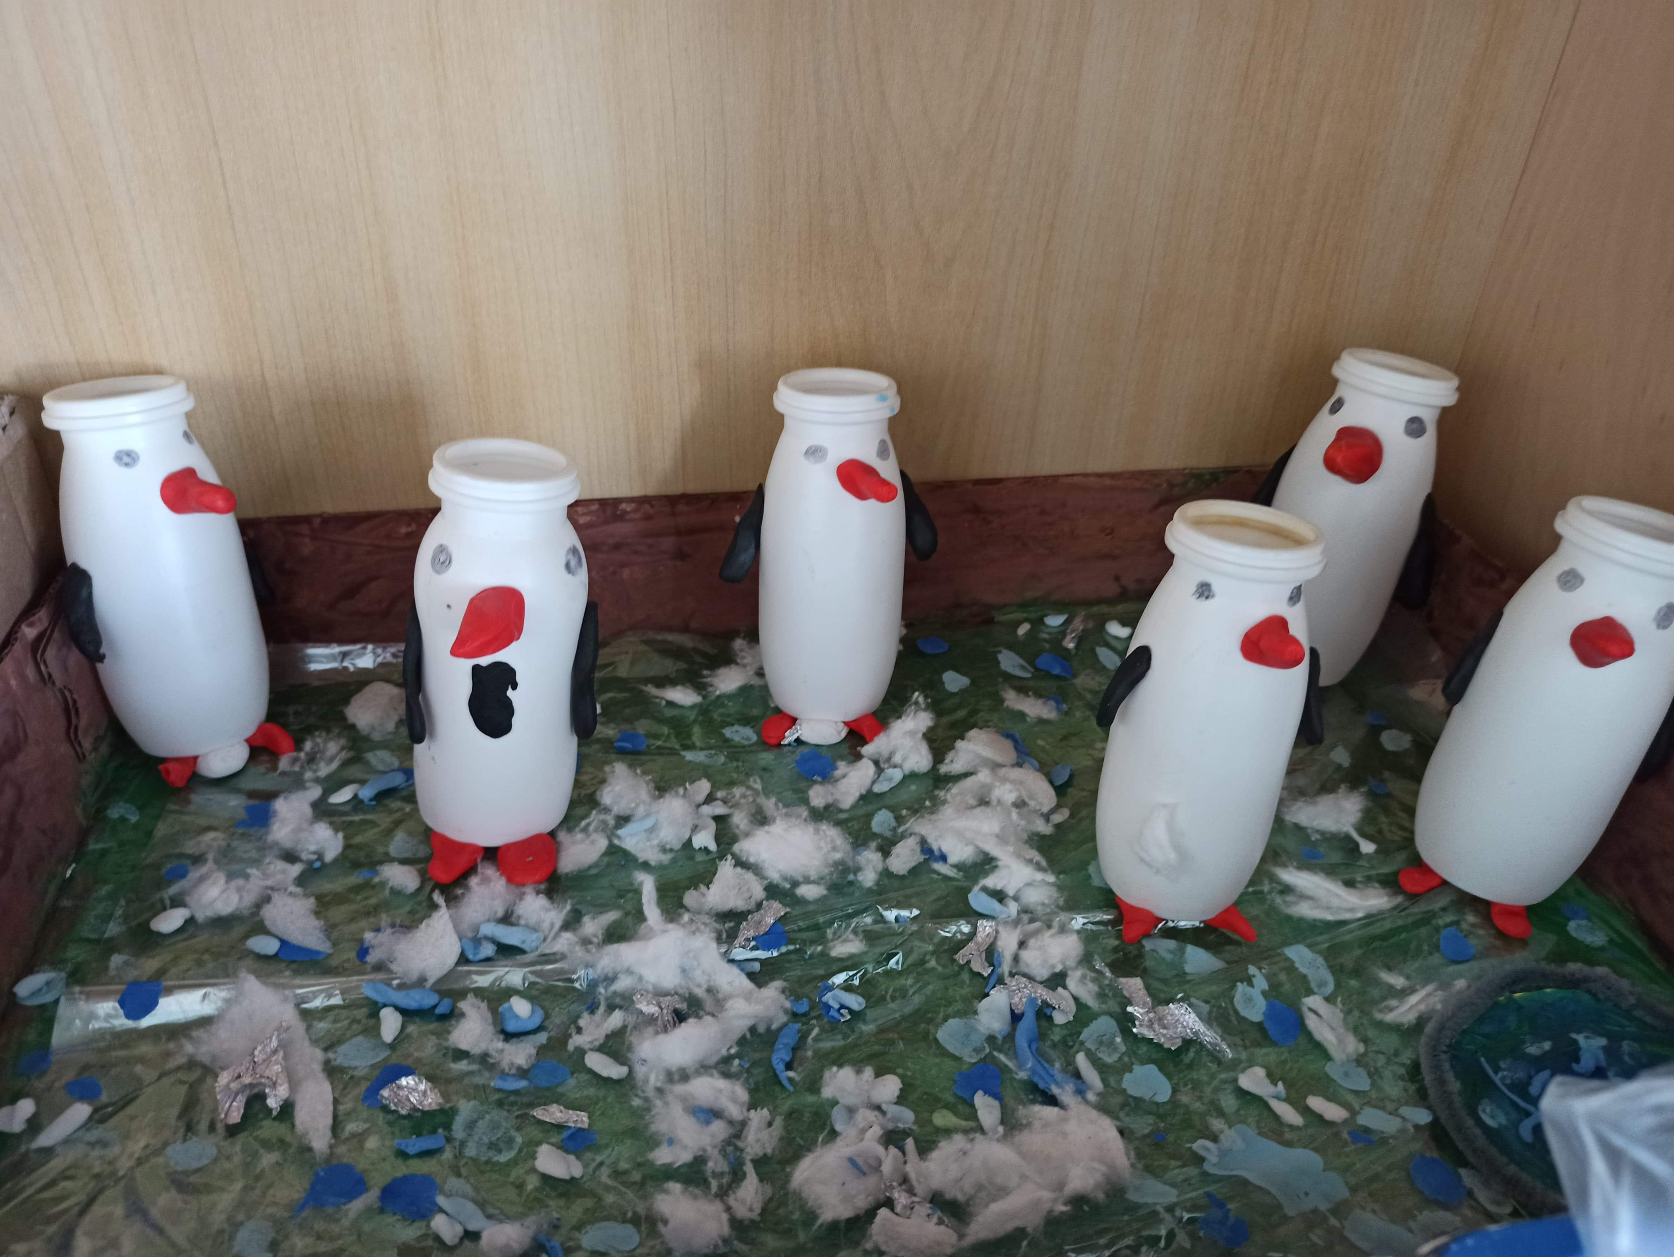
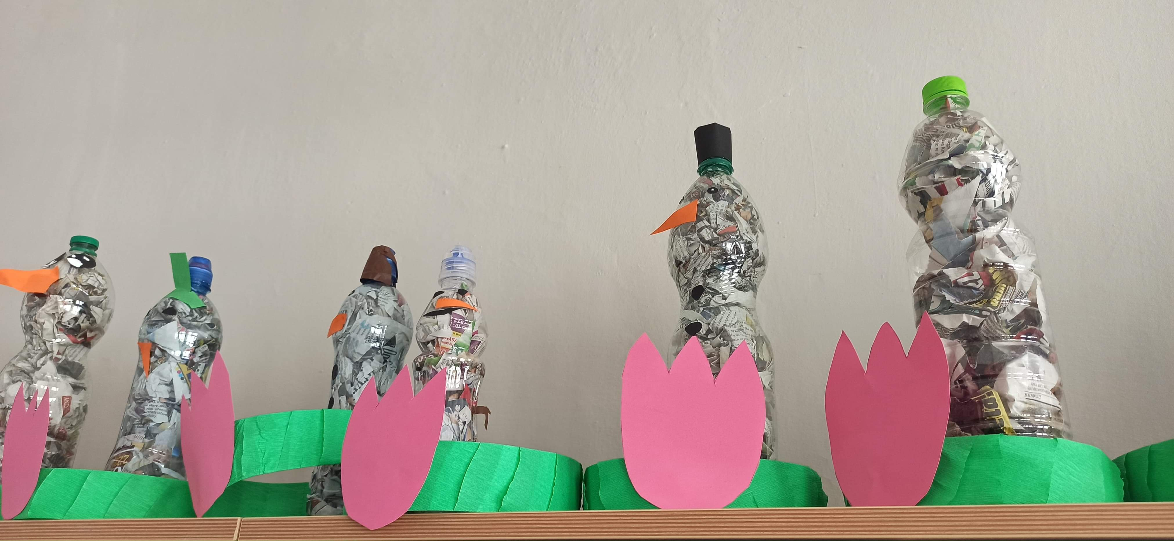
There are also projects showing students ways of reusing waste. It helps them understand how important recycling is and also boosts their creativity.
(students' projects in the pictures)

Slide 13
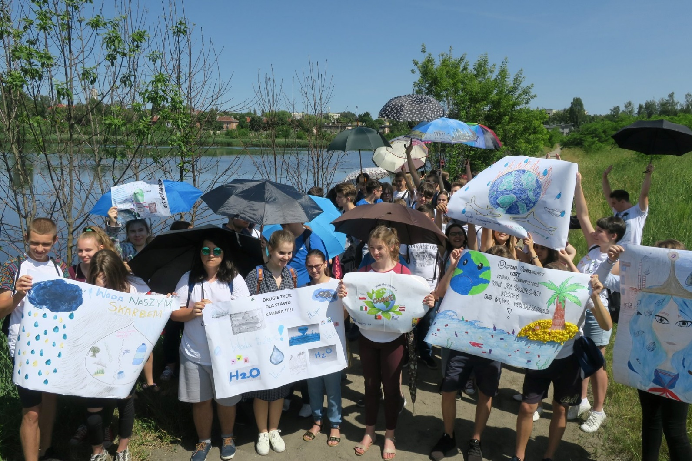
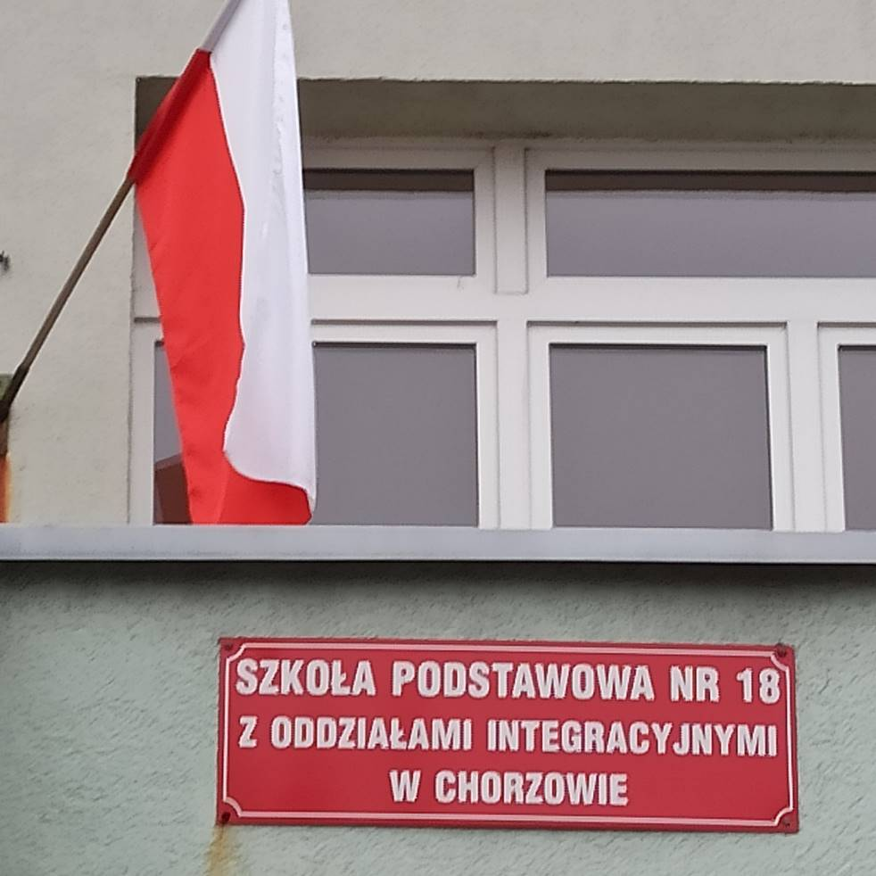
Thank you for your attention.

