Slide 1
WOMEN
AND THE
WORKPLACE

Slide 2
Survey carried out with 50 people, working women and men réalisé auprès de 50 personnes, in Longwy (F) and around, between April and June 2019.

Slide 3
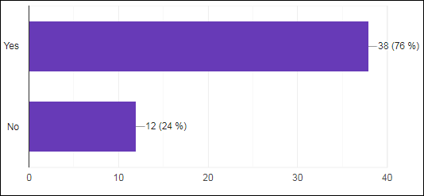
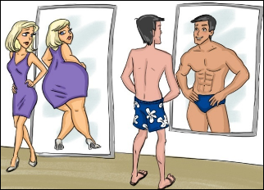
1- Should jobs be adapted to men and women according to their physical capacity?

Slide 4
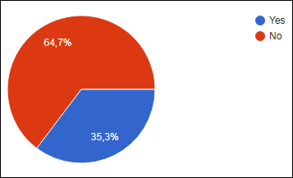
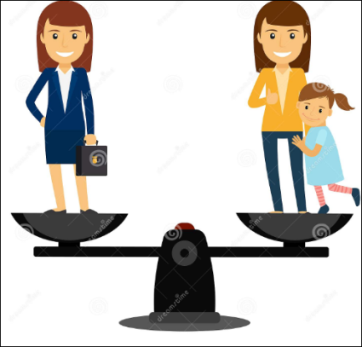
2- Do you think that women should choose between family and career ?

Slide 5
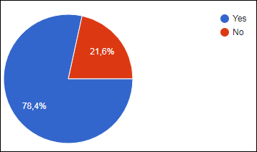
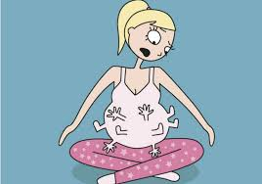
3- Should a pregnant woman have the same opportunities when it comes to being hired as a new employee ?

Slide 6
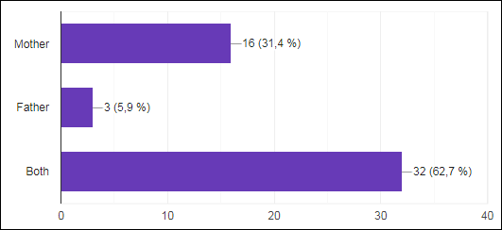
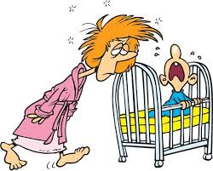
4- Who should take parental leave ?

Slide 7
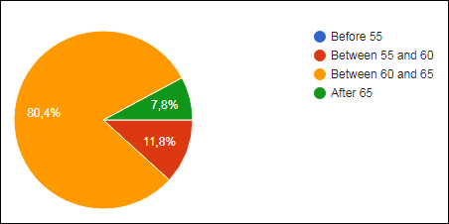
5- At what age do women retire in your country ?

Slide 8
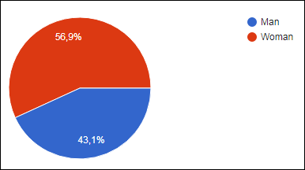
6- Is your boss a man or a woman ?

Slide 9
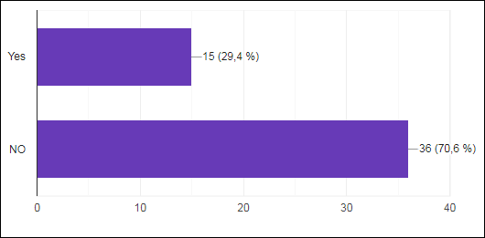
7- Are women too kind and sensitive to have leadership positions at the workplace?

Slide 10
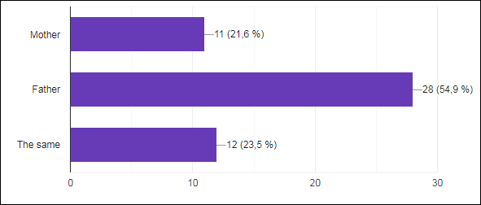
8- Who earns more money in your family ?

Slide 11
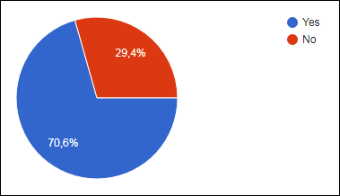
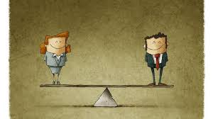
9- Do you know some women who earn as much as their male colleagues ?

Slide 12
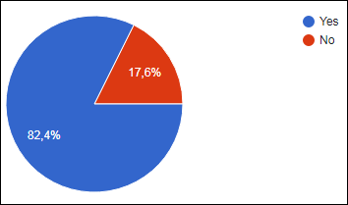
10- Should the salary be the same for men and women ?

