Slide 1
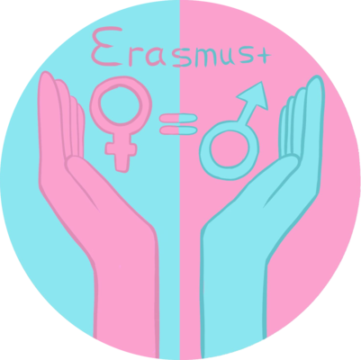
Escola Secundária Dr. Mário Sacramento
Survey Results
Portugal

Slide 2
The survey was applied electronically to 50 people, of different ages, in the first two months of 2019
These are the results:

Slide 3
The first set of questions had to do with household chores and their division at each house.
Traditionally, society ‘assigned’ these roles to women even after they had started working outside the houses.
Is this the social aspect we have at the moment?
Let’s check!

Slide 4
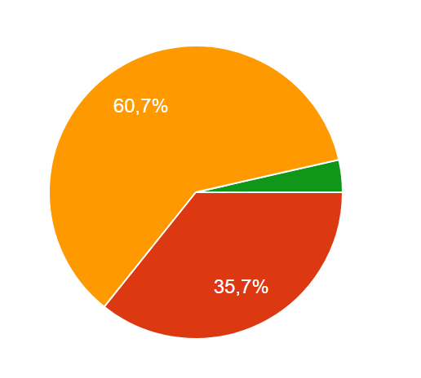
1. Who is the person who is usually responsible for the household chores?
The large majority of the respondents answered that both parents usually do the chores at home
This shows that there has been a great cultural shift in this particular aspect and that men have been assuming a more relevant role in the domestic sphere

Slide 5
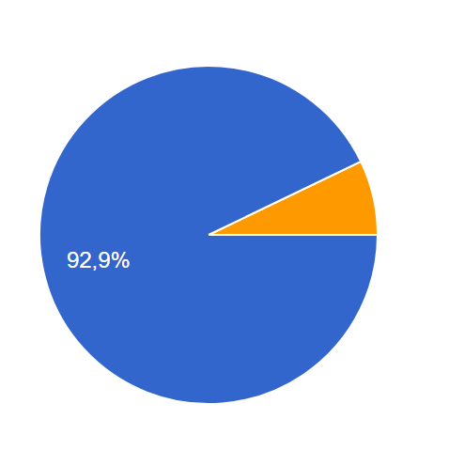
2. Do you think that men should help women doing the household chores?
Almost all respondents answered that men should help doing the chores at home
This shows that in terms of mentality there has been a huge evolution and that men are no longer ‘forbidden’ to do domestic work

Slide 6
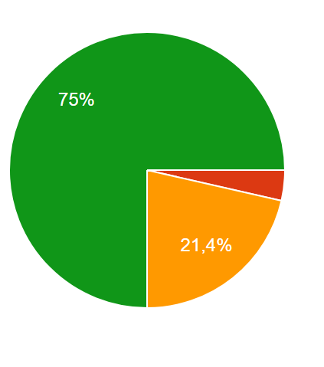
3. Which household chore do men mostly do?
Can you guess?
¾ of the respondents say that men do the cooking
Nobody said that men took care of the clothes and only one that men did the ironing
Men are becoming more and more active at home and are doing more and more chores…next step: Clothes! ☺

Slide 7
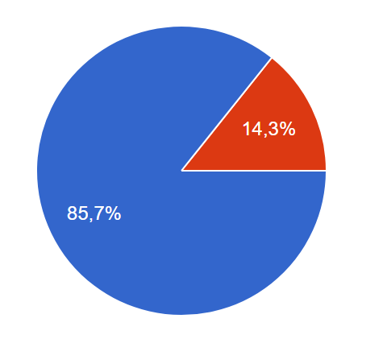
4. Do men help women to take care of the children?
Of course!
That is what our respondents say…but a small proportion still says no!!!!!
Men have become aware that they also play a very important role as parents and that they should be more present and active in their children’s lives from a very young age…

Slide 8
The second set of questions deals with the issue of marriage, relationships and health
We live in a world where information is at the tip of our fingers: we have access to almost everything about every single aspect of life
But…
Are we using that access to information in the right way?
Let’s see…

Slide 9
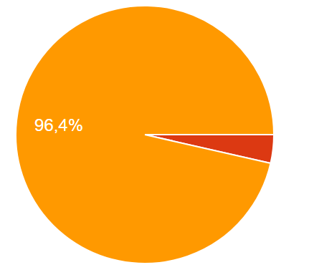
5. How many contraceptive methods do you know?
As we can see, almost all respondents answered that they knew 3 or more methods
This result shows that our access to information is reflected in the knowledge that we possess…of course, that does not mean that the information is used correctly…

Slide 10
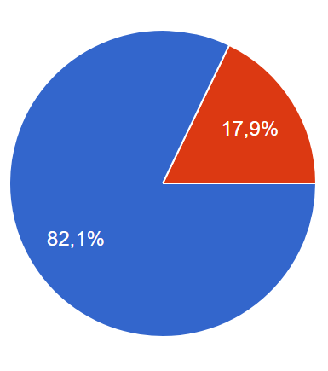
6. Should there be an agreement between man and woman regarding abortion?
More than ¾ of the respondents state that such an agreement should exist
This result shows that both men and women see themselves as responsible for birthing and parenting and that is no longer an exclusively female decision

Slide 11
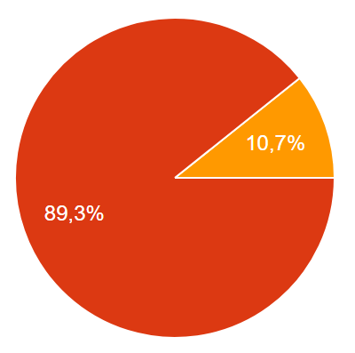
7. How old, in average, are women when they get married?
Most respondents answer that women get married between the ages of 20 and 30 but none answers that they marry before the age of 20
This result reflects a shift in the cultural outlook of personal relationships as women are perceived to be getting married a little older, mostly after graduating and being employed

Slide 12
The third set of questions deals with the issue of violence against women
Unfortunately, this issue has always been present in Portuguese cultural mindset and society and the current reports in the media make it more visible
However…
Are the Portuguese evolving in this respect?
Let’s see…

Slide 13
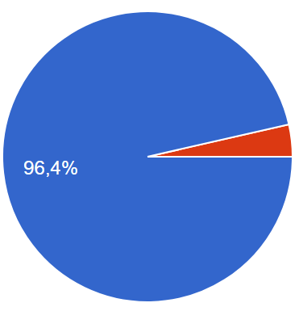
8. Is psychological violence as bad as physical violence?
Not surprisingly the overwhelming majority of the respondents agree that psychological violence is as bad as physical
This result reflects a greater awareness from society in this respect, as it is perceived that violence against women can be perpetrated in several ways

Slide 14
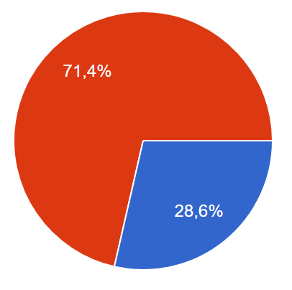
9. Do you know anyone who has been, or still is, a victim of domestic violence?
Only a quarter of the respondents stated that they knew someone who suffered or that still suffered from domestic violence
This result might be a little deceiving because we only know what others want us to know….but hopefully the fact is that domestic violence might be getting more and more scarce nowadays

Slide 15
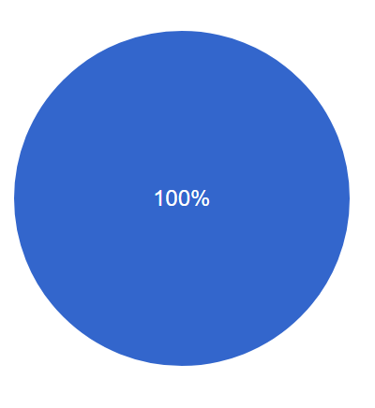
10. Should women who are victims of domestic violence get counselling?
Of course!
Everybody said YES!
This result reflects the understanding that the consequences of domestic violence go way beyond what we see…

Slide 16
Conclusions:
Portuguese society has grown aware of gender equality and is trying gradually to transport that evolution into the household;
Even though women are still perceived as more responsible for the chores at home, men are perceiving that division as something natural rather than imposed;
Men are embracing parenthood and family life as part of their routine and not something that is exclusively female;
Domestic violence is a ‘bad weed’ in personal relationships and should be eradicated.

