Slide 1
Woman And Family
Presentation of Survey.

Slide 2
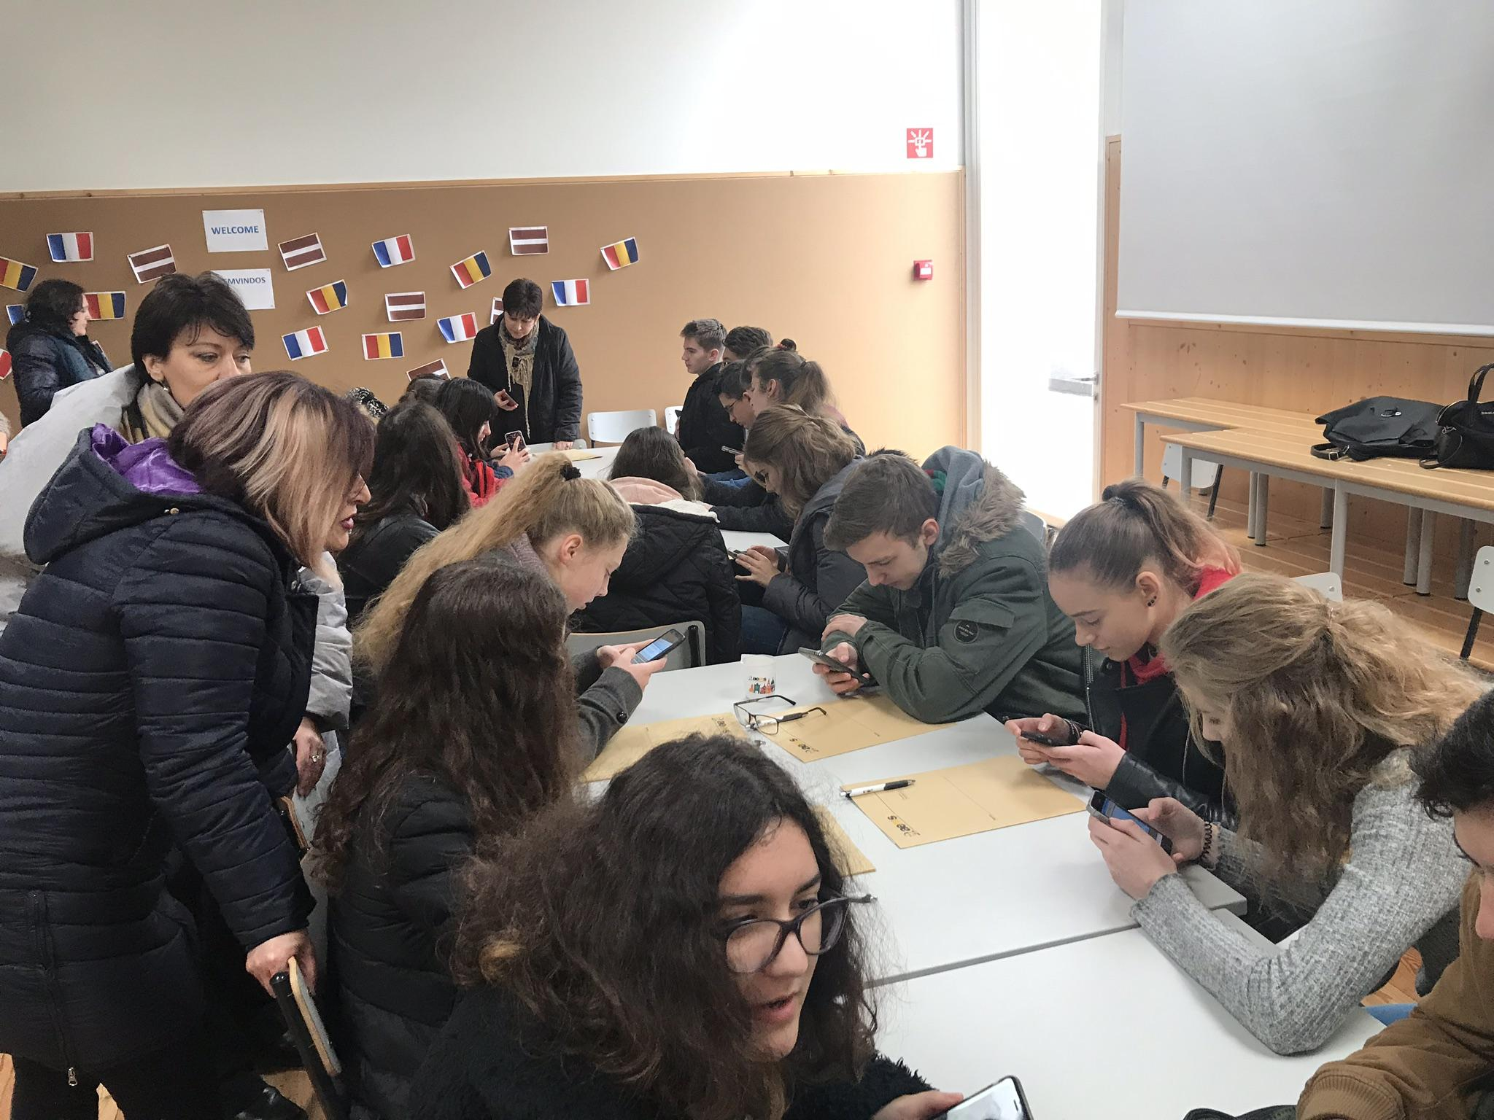
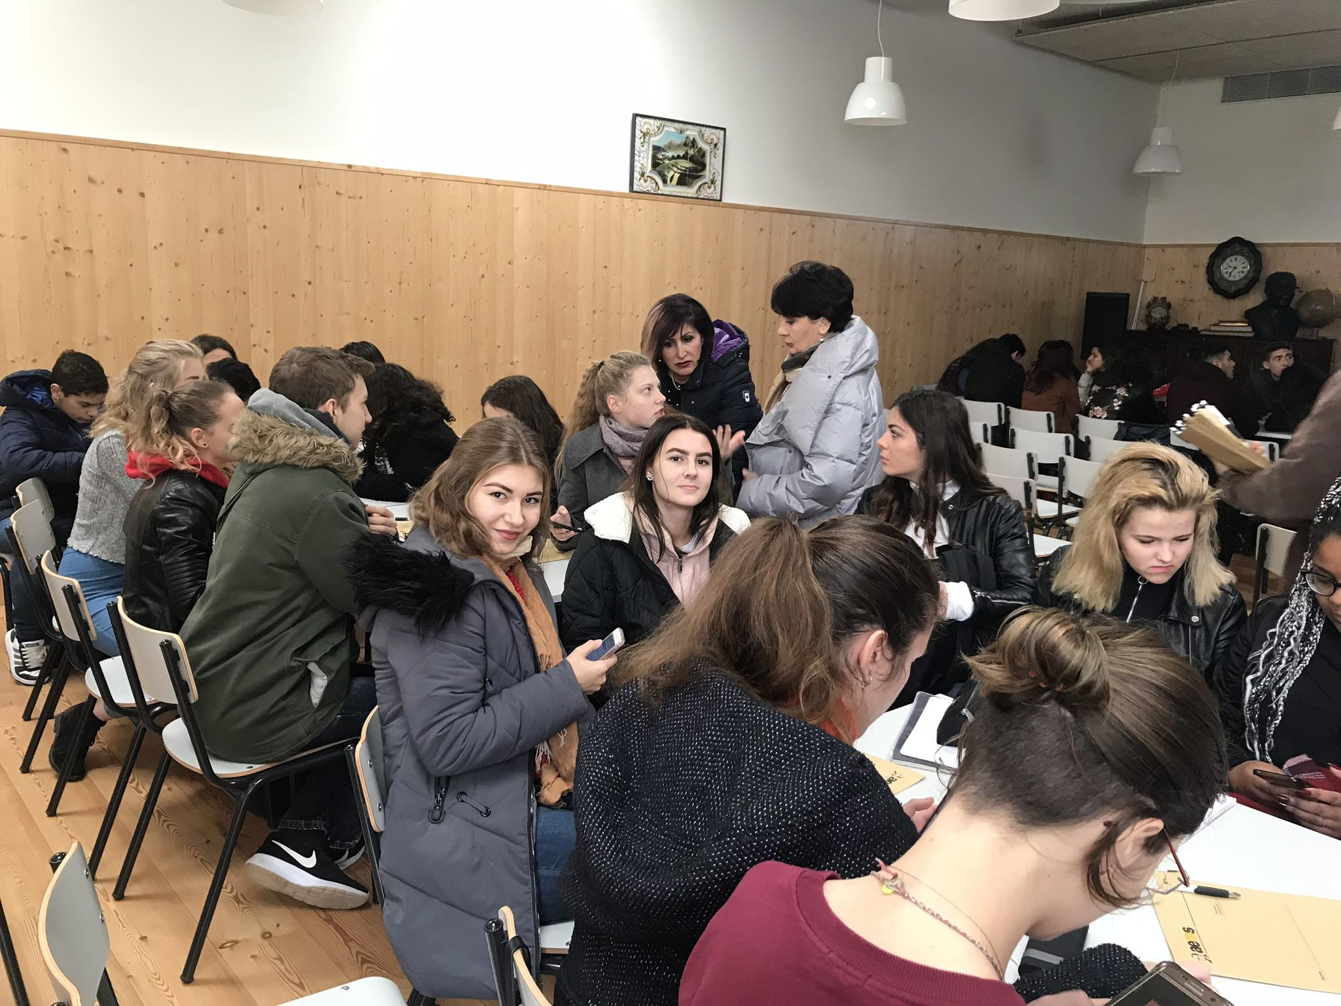
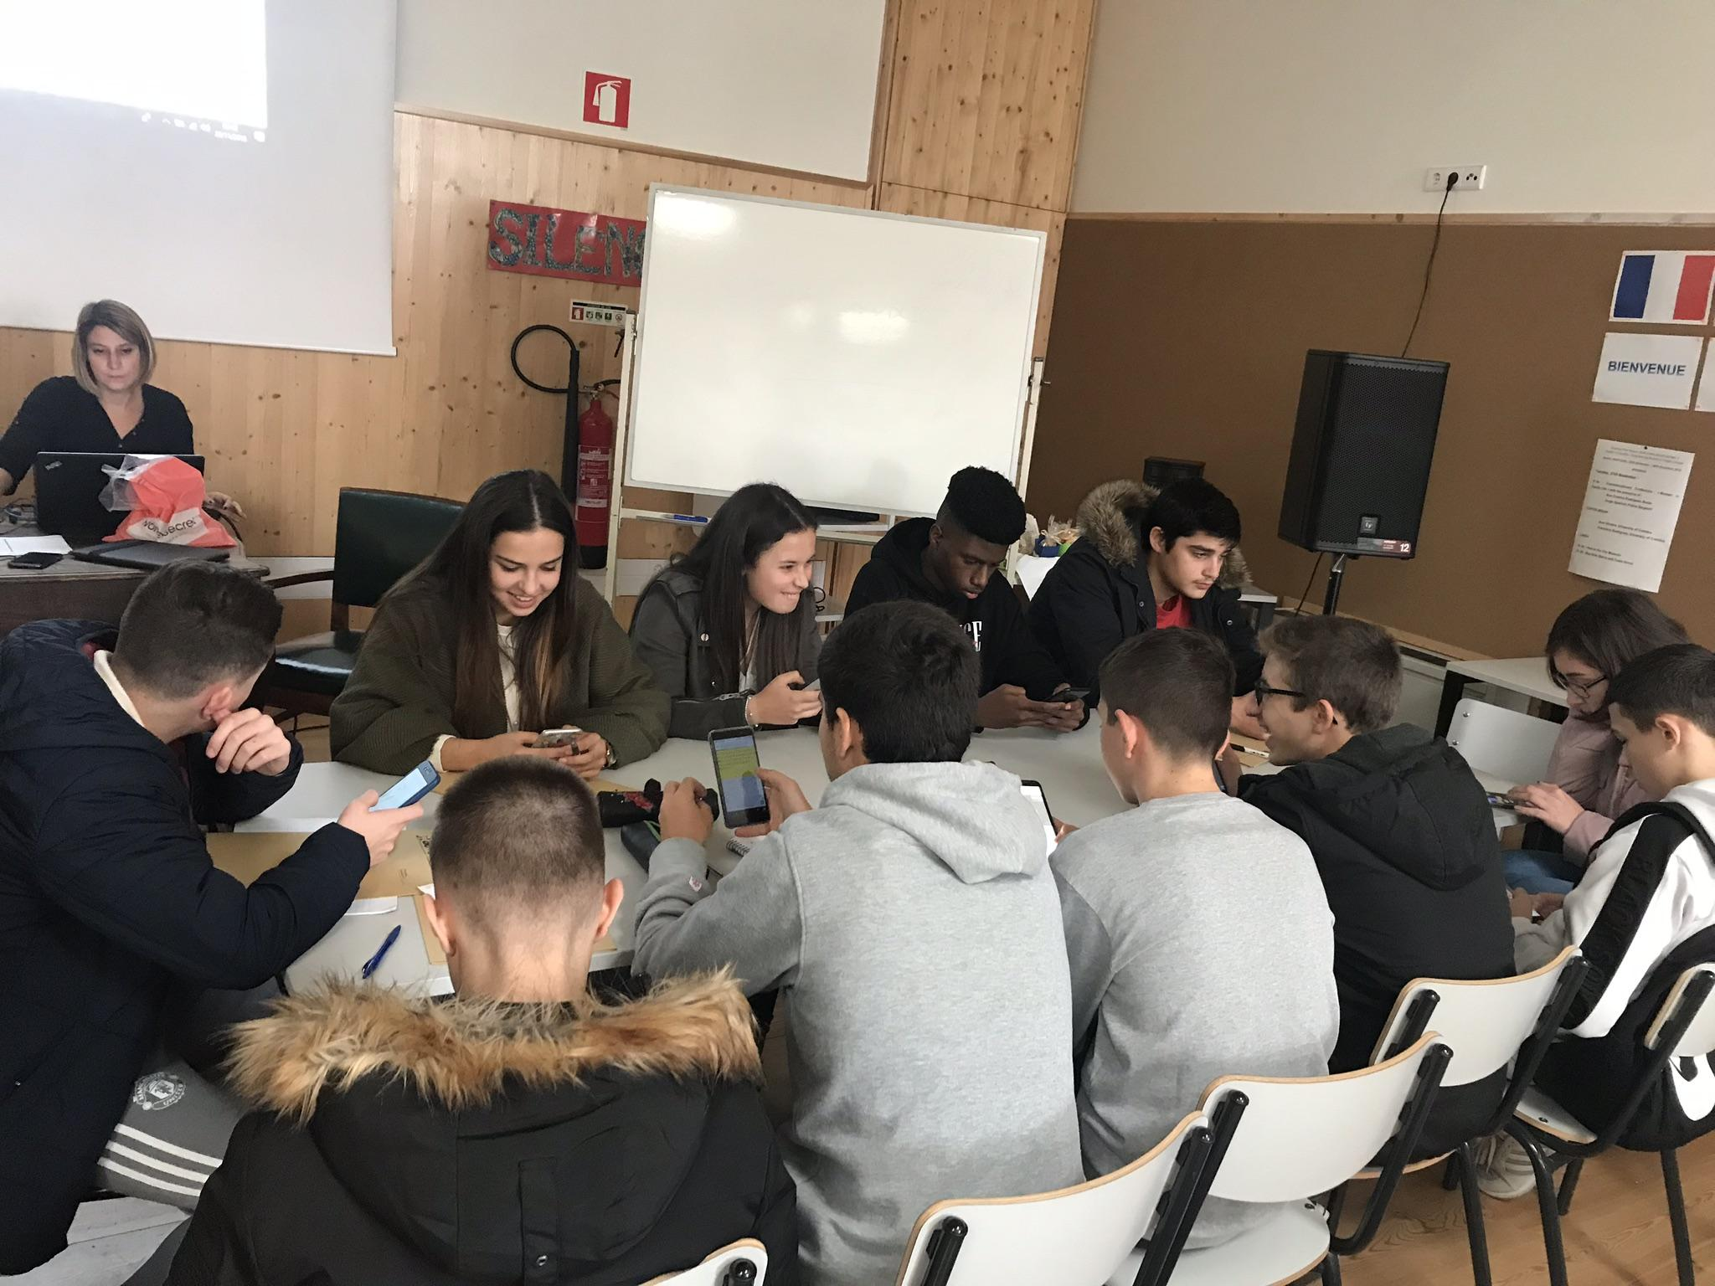

Slide 3
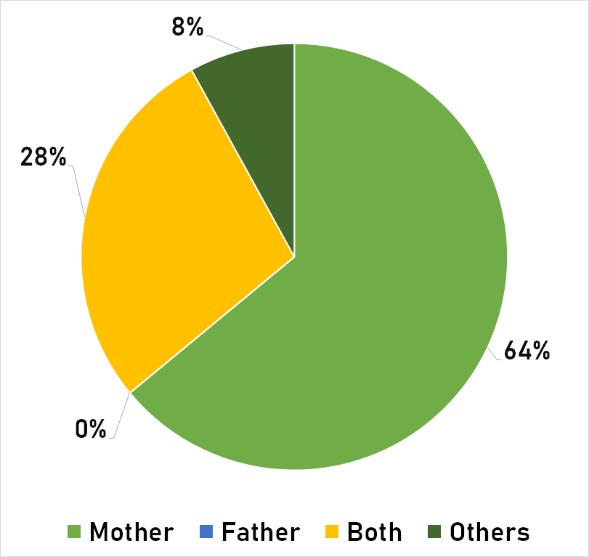
“Who usually does the housework in your house?”

Slide 4
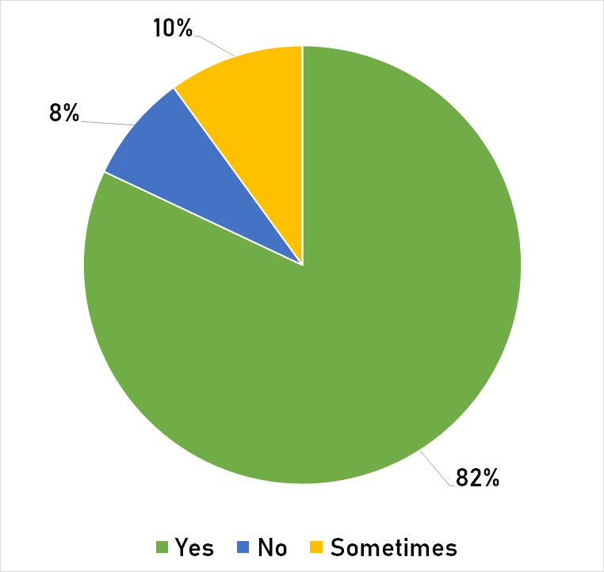
“Do you think men need to help women with the housework?”

Slide 5
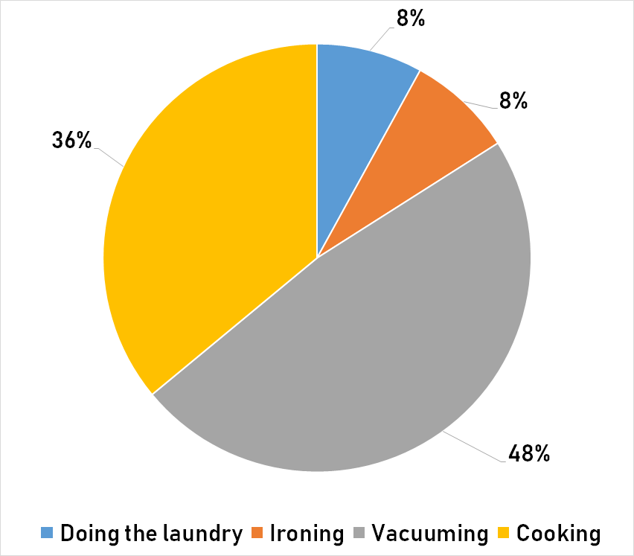
“What type of housework do men in your country?”

Slide 6
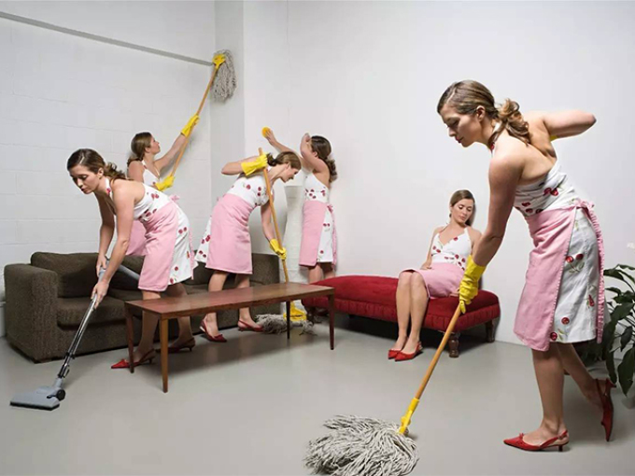

Slide 7
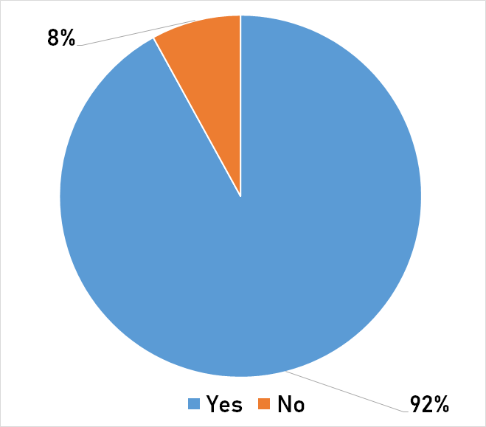
“Do men help women raising the kids in your country?”

Slide 8
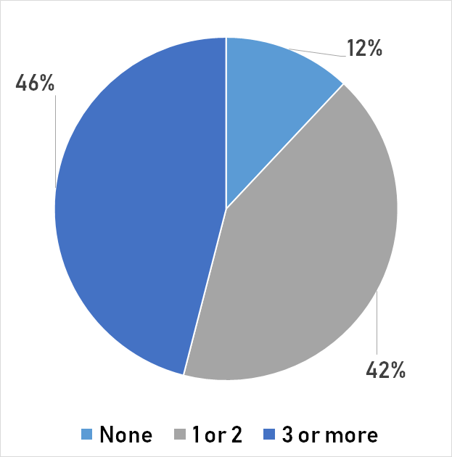
“Contraceptive methods”

Slide 9
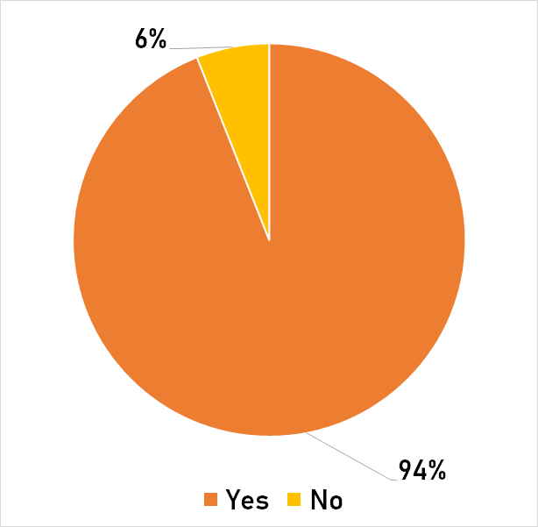
“Should there be a mutual agreement between men and women when it comes to abortion?”

Slide 10
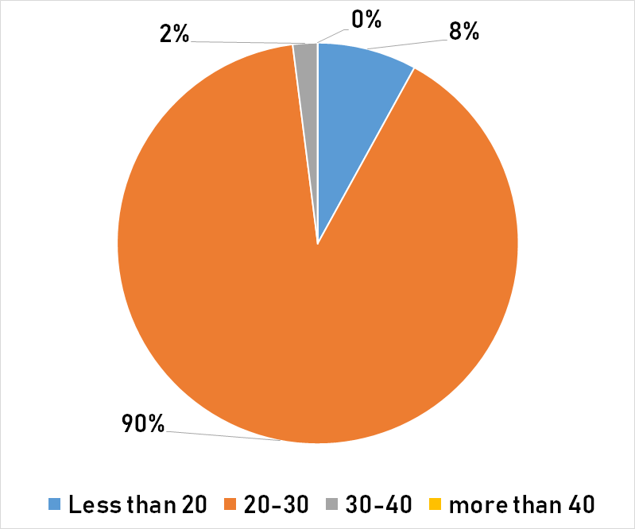
“What is the average age women get married in your country?”

Slide 12
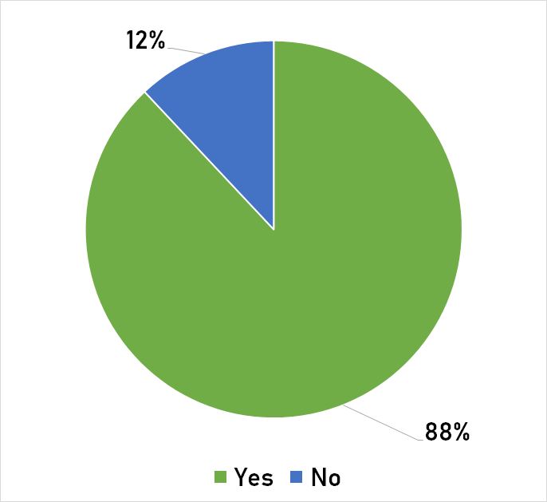
“Do you think that psychological violence is as bad as physical violence?”

Slide 13
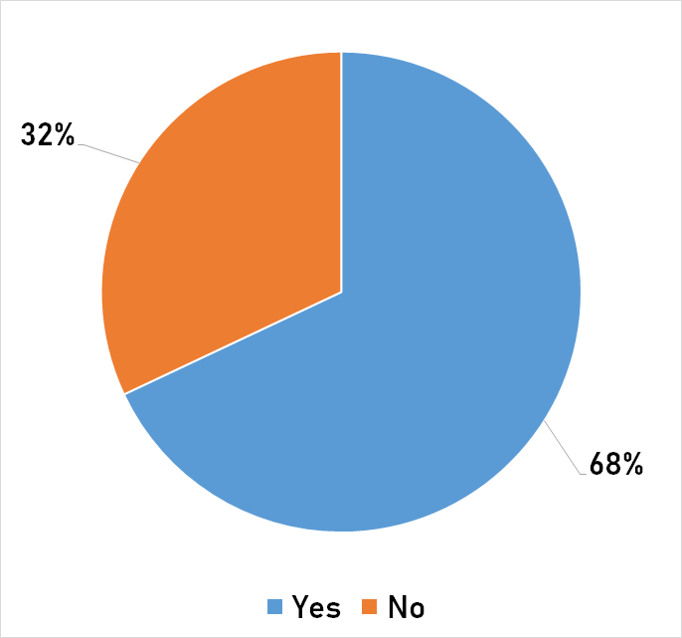
“Do you know anyone who has been a victim of domestic violence?”

Slide 14
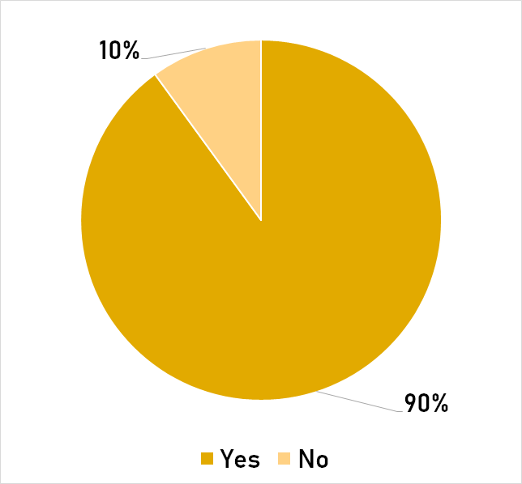
“Should victims of domestic violence get psychological help?”

Slide 15
