Slide 1
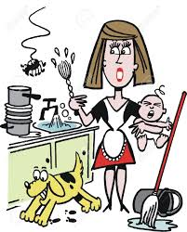
WOMEN AND THE FAMILY
IN FRANCE

Slide 2
Survey carried out with 50 people, from all ages, women and men, in Longwy (FR) and around, between January and March 2019

Slide 3
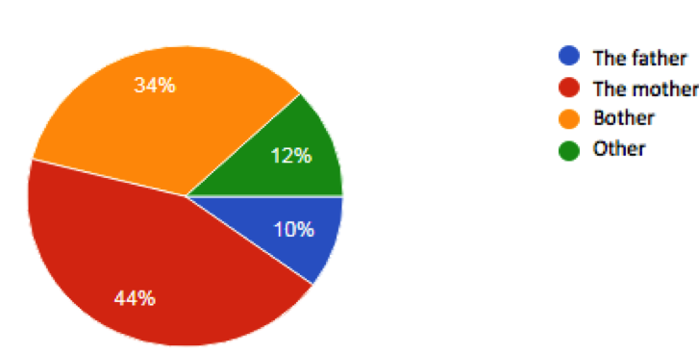
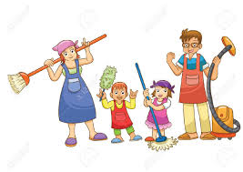
1) Who usually does the housework at home?
As we could expect, the results show that the mothers mostly do the housework at home. However, in 1 case out of 3, in a more egalitarian way, both parents share the chores. More rarely, in 1 case out of 10, only the fathers get to it (are they fathers living alone without their ex-partner?) In 12% of the cases, other people do it: cleaning “women”? children?

Slide 4
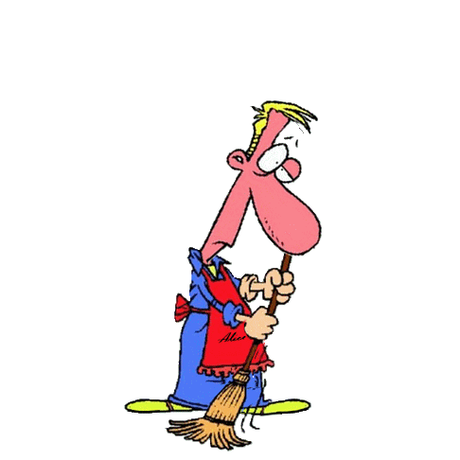
It’s a relief! Everybody thinks that men should help women with the chores. However with a nuance for some of them, who answer that this help must be done “sometimes”, which tends to mean “not always” or “not for anything”!?
2) Do you think that men should help women with the chores?

Slide 5
As we could expect it, men cook. It is indeed a chore but which can also be considered as a creative and noble activity. Men “pilot” the vacuum cleaner quite often too. However, as regards washing the clothes and ironing them, it is very rare. A small effort, gentlemen!
3) What type of housework do men do?

Slide 6
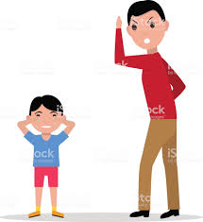
For the most part, the people who were asked consider that the mothers are helped by the fathers in the children’s education. But for 10%, this is not true. In this case, it means that women have the complete charge of their offspring.
4) Do men help women raising the kids?

Slide 7
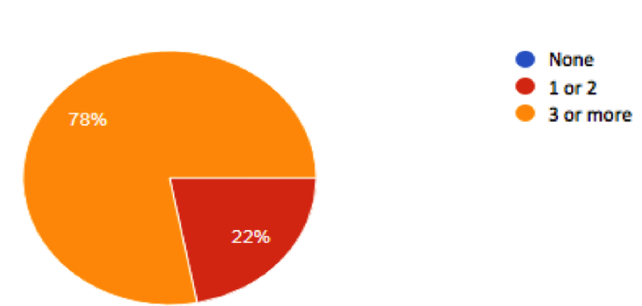
5) How many contraceptive methods are you familiar with?
3 persons in 4 know at least three contraceptive methods. That’s good, but it is necessary to know how to use them well!

Slide 8
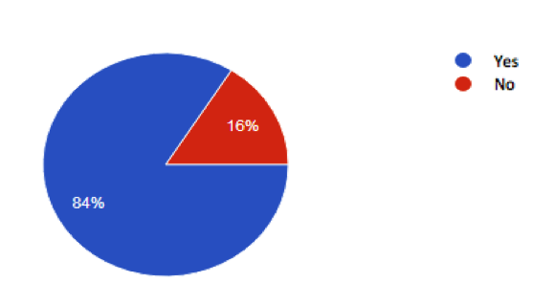
6) Should there be a mutual agreement between men and women when it comes to abortion?
For the most part, the answer is yes. It’s the couple who decides. Among the people who answered no, some of them explained that is there was a disagreement between the man and the woman, the final choice should be given to the woman, who is the master of her body.

Slide 9
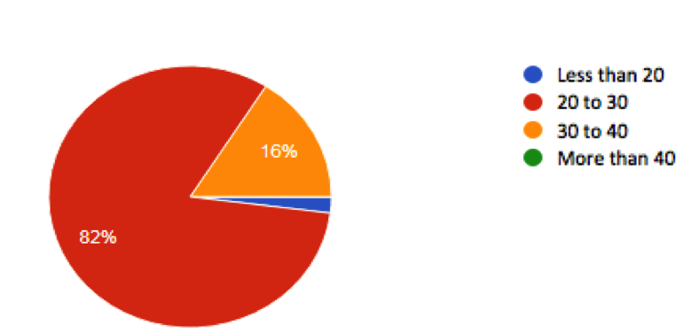
7) What is the average age women get married?
People think what woman get married between 20 and 30 in France, which is false. The average age is 35 for women and 38 for men. Since 2006, marriage has been forbidden to underage people, especially to avoid forced marriages.

Slide 10
Almost everybody thinks that psychological violence is as harmful as physical violence: threats, humiliations, intimidations, insults are true weapons of submission and domination.
8) Do you think that psychological violence is as bad as physical violence?

Slide 11
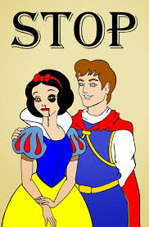
The survey shows that one person in two knows around him/her a person victim of domestic violence, most often a woman. We must denounce that!
9) Do you know anyone who has been a victim of domestic violence?

Slide 12
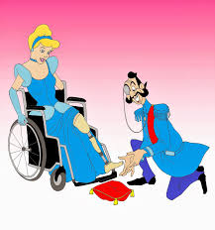
The result is clear. Everybody thinks that psychological help is necessary for women who are victims of domestic violence: to let them talk, to support them, to make them understand that’s it’s not their fault if they are beaten or insulted by their partner.
10) Should women who are victims of domestic violence get psychological help?

