Slide 1
Gender in equality
Results of the Portuguese survey

Slide 2
Index
Results
The survey was applied to 218 individuals
The survey focused on culture and sports
Conclusions

Slide 3
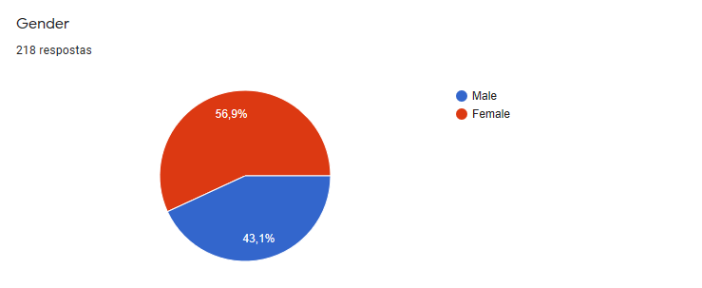
Gender distribution
124 answers were given by women
94 answers were given by men
Since the numbers are very close, we can consider that there the results show gender equality

Slide 4
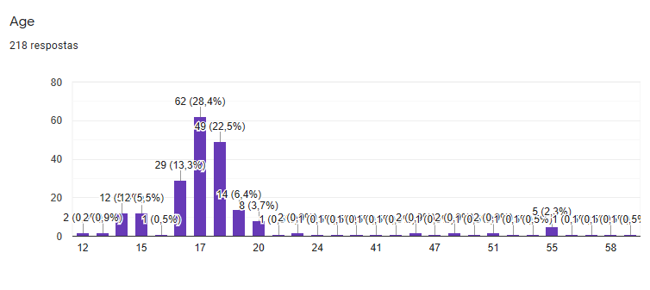
Age distribution
The majority of individuals who answered the survey are aged betwen 15 and 20
The results will reflect the opinion of a younger generation

Slide 5
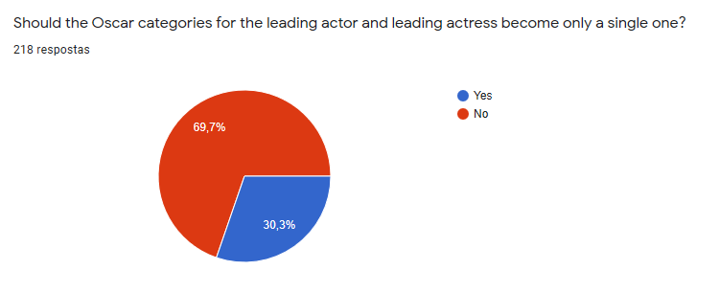
Question number 1
Most people think the Oscar categories should be divided by gender
This may not show gender inequality; it may represent a habit that has ingrained in society due to the traditional division by the Academy

Slide 6
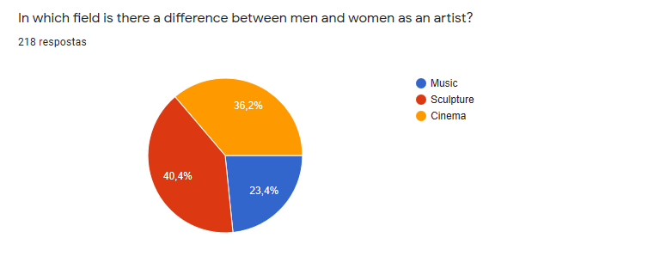
Question number 2
The results show that there is a difference between men and women in each of the fields analysed

Slide 7
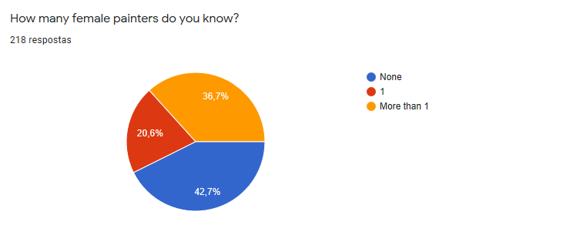
Question number 3
93 individuals are not familiar with female painters, which can mean that women are less recognised or popular in this field

Slide 8
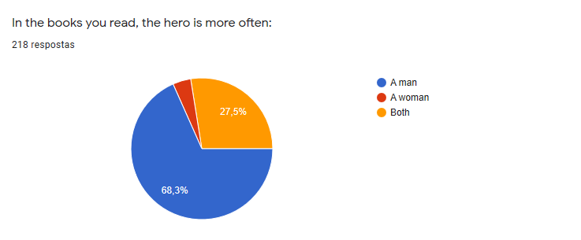
Question number 4
This result shows the biggest inequality of the survey
We can conclude that in most canonical books the hero is a man

Slide 9
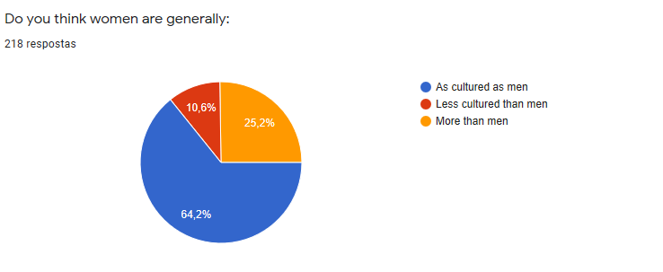
Question number 5
The results show gender equality
Most people think women are as cultured as men

Slide 10
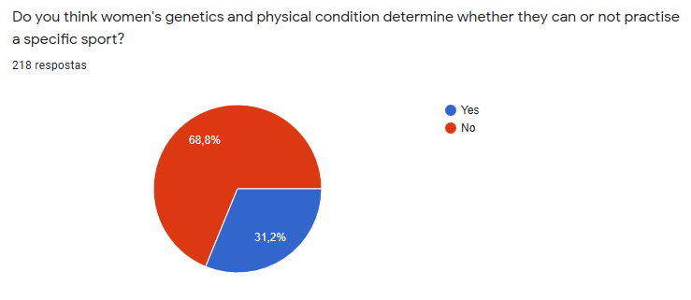
Question number 6
No is the most common answer, which shows a cultural openness and equity of access to sports

Slide 11
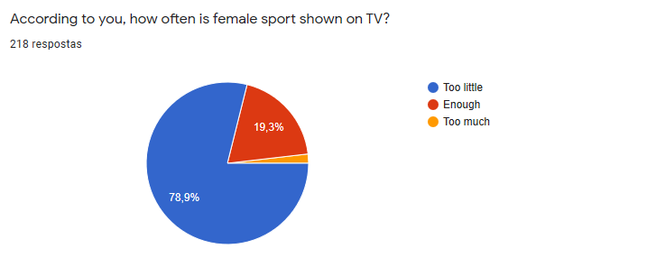
Question number 7
Msot people feel that female sports are not shown enough
This answer shows gender inequality on the part of television

Slide 12
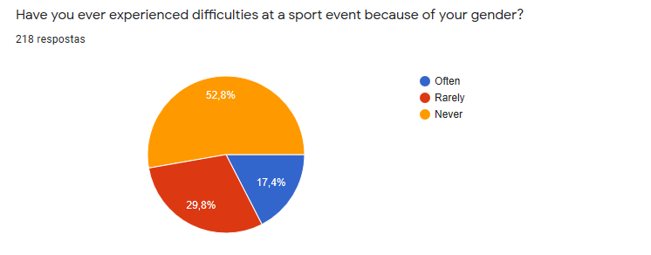
Question number 8
The most common answer is no
Gender doesn´t affect sports for the majority of the individuals; it is mostly a case of ability or inability

Slide 13
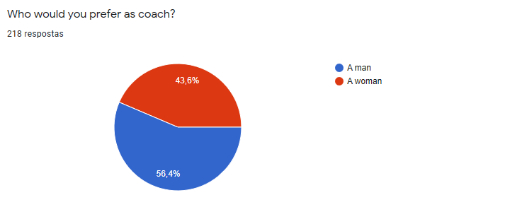
Question number 9
The answer is influenced by the sport played by the respondents
The percentage is close, so we can consider that there´s equality

Slide 14
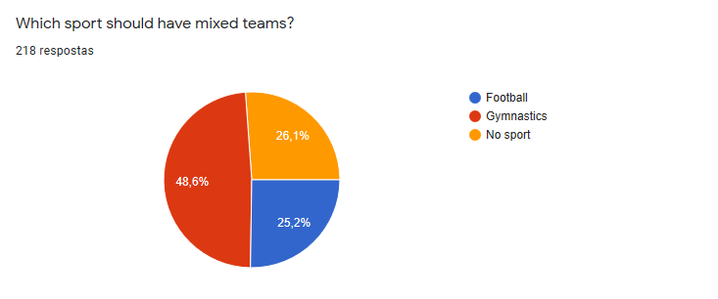
Question number 10
106 people answered gymnastics, which is the highest number; it is also one of the sports which we usually associate to both male and female athletes.

Slide 15
Conclusion
The responses showed, in general, that people reveal gender equality in these issues
The majority of the individuals who answered the survey were aged betwen 15 and 20, so the results reflect the opinion of a younger generation
The individuals showed awareness towards this specific issue in culture and sports
The results show a certain progress since the differences betwen men and women are becoming less visible

