Slide 1
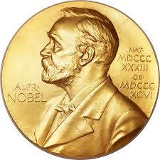
Polish NOBLE prize LAUREATEs

Slide 2
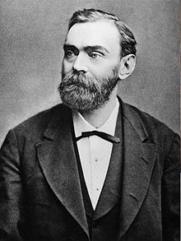
Nobel prize
The Nobel Prize recognizes special achievements in various fields.

Slide 3
NOBEL LAUREATEs IN PEACE
Lech Wałęsa
Szimon Peres
Menachem Begin
Józef Rotblat

Slide 4
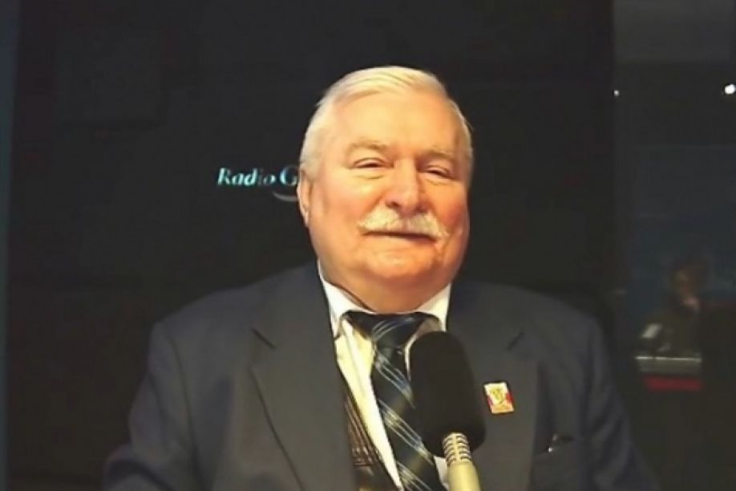
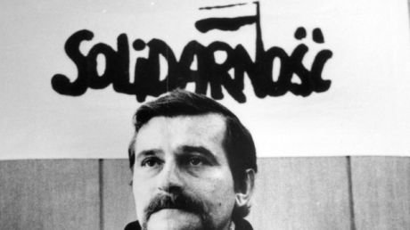
Lech Wałęsa
He was a president of the Polish Republic, founder and first chairman of ,,NSZZ Solidarność”
Lech Wałęsa took part in organizing a strike in Stocznia Gdańska
He is considered a patriot fighting communism

Slide 5
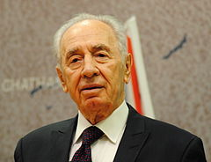
Szimon peres
Szimon Peres was born in Poland but he lived in Izrael
He was Prime Minister of Izrael
He received the Nobel Prize for peace talks, the result was the so-called „Oslo agreement’’

Slide 6
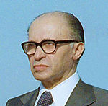
Menachem begin
Menachem Begin lived most of life in Izrael.
He founded the party Herut (Freedom) and became its first chairman.
He was awarded the Nobel Peace Prize for his signing of the Israeli peace treaty

Slide 7
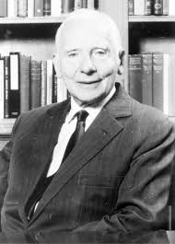
Józef rotblat
Józef Rotblat was a physicist of Jewish origin
He was a founder and leader of the scientific movement and the founder of the first atomic bomb
He received the Nobel Peace Prize for eliminating nuclear weapons

Slide 8
Nobel laureateS in literature
Henryk Sienkiewicz
Władysław Reymont
Issac Singer
Czesław Miłosz
Wisława Szymborska

Slide 9
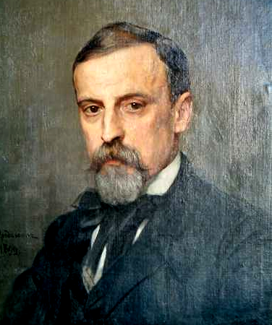
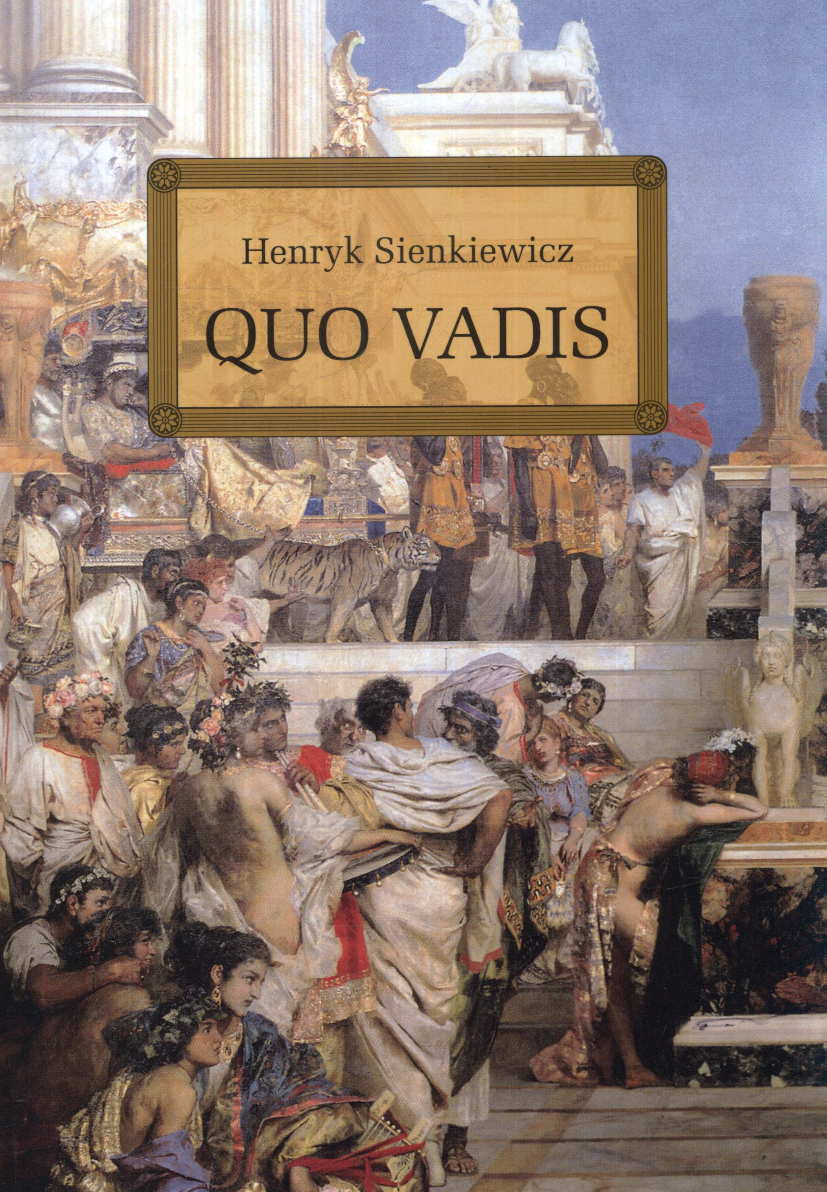
Henryk Sienkiewicz
Henryk Sienkiewicz was a Polish journalist, novelist and Nobel Prize laureate
He is best remembered for historical novels, especially for his internationally know best-seller Quo Vadis

Slide 10
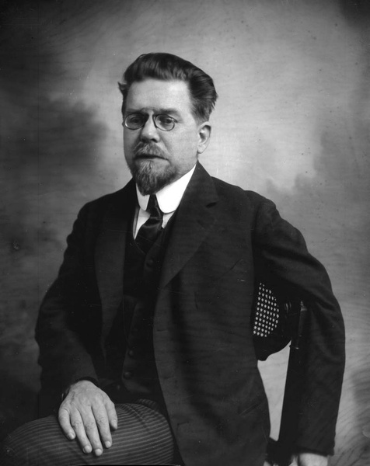
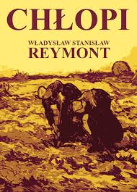
Władysław reymont
Władysław Reymont was a novelist and the 1924 laureate of the Nobel Prize. His best-known work is the award-winning four-volume novel Chłopi. Reymont’s literary output includes about 30 extensive volumes of prose.

Slide 11
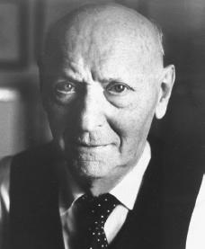
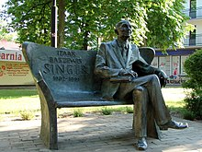
Isaac BASHEVIS singer
He was a Polish writer, awarded the Nobel Prize in 1978. The Polish form of his birth name was Icek Hersz Zynger. He used his mother's first name in an initial literary pseudonym, Izaak Baszewis, which he later expanded.
Isaac Bashevis Singer's Bench in Biłgoraj

Slide 12
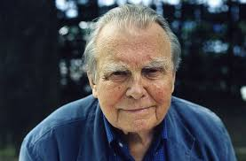
Czesław miłosz
Czesław Miłosz was a poet, prose writer, translator and dyplomat
He lived in times of World War II
His Captive Mind became a classic of anti-Stalinism.

Slide 13
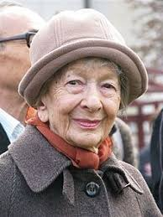
Wisława szymborska
She was poet, essayist, translator and recipient of the 1996 Nobel Prize.
Szymborska was also a deeply personal poet who explored the large truths that exist in ordinary, everyday things.

Slide 14
Nobel LaureateS in Physics And chemistry
Georges Charpark
Roald Hoffman
Albert Abraham Michelson
Maria Skłodowska Curie
Isidor Rabi

Slide 15
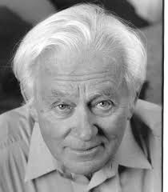
Georges Charpark
Georges Charpark was born in the Polish-Jewish family. Nobel laureate in Physics in 1922.He was a member the French Communist Party. In 1992 received the Nobel Prize for lecture in the field develop detectors.

Slide 16
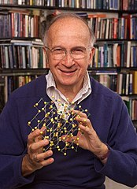
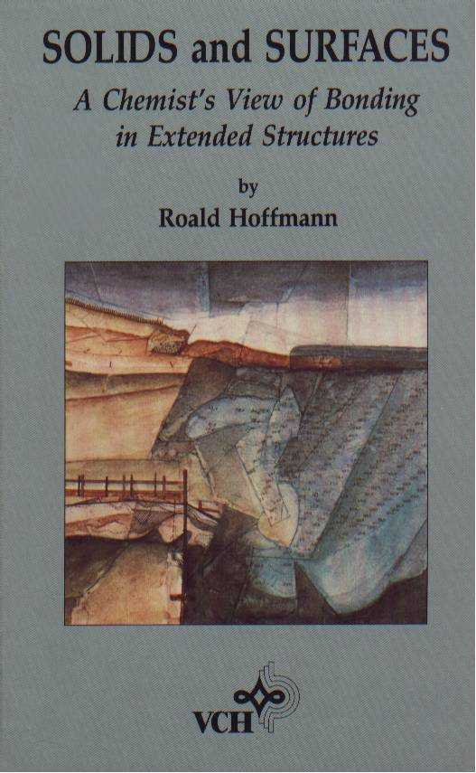
ROALD HOFFMAN
He was Polish-American chemist, born in Polish-Jewish origin
He is a member of the National Academy of Sciences in Boston
In 1981 he received Nobel Prize in Chemistry.

Slide 17
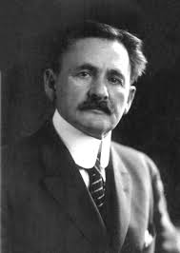
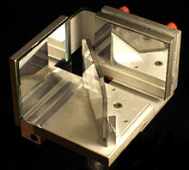
Albert Abraham Michelson
Albert Abraham Michelson was an Americian Physicist of Polish-Jewish origin. Nobel Prize laureate in Physics in 1907 for the construction of interferometer.

Slide 18
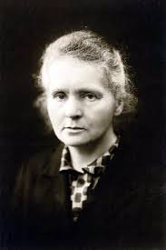
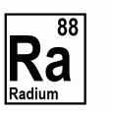
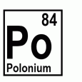
Maria skłodowska-Curie
Maria Skłodowska-Curie was a physicist and a chemist. First Nobel Prize was awared with her husband for discovering the phenomenon of radioactivity. The second Nobel Prize was awarded for discovery of radioactive elements.

Slide 19
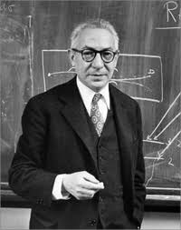
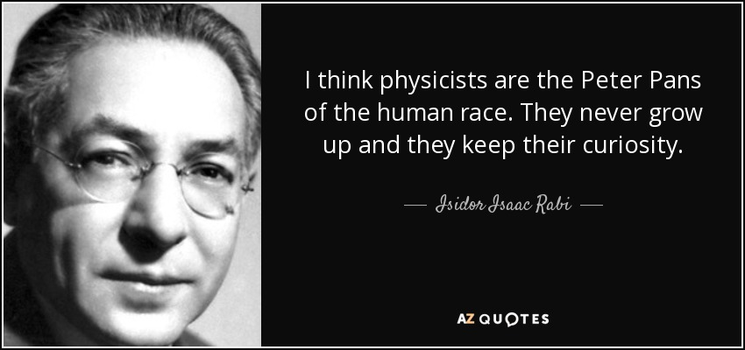
Isidor Isaac rabi
He was an Amercian physicist of Polish-Jewish origin. Nobel Prize winner in physics for the resonant method of observing the mangentic properties of nuclear nuclei.

Slide 20
Nobel prize laureates in ekonomist, FiZJology ald medicine
Andrzej Wiktor Schally
Tadeusz Reichstein
Leonid Hurowicz

Slide 21
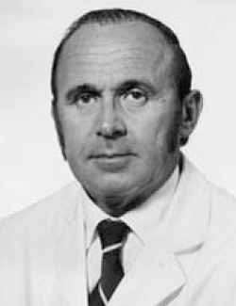
Andrzej schally
Andrzej Schally was endocrinologist also known as Andrew Schally.
Andrew Schally was awarded the Nobel Prize for medicine. He was noted for isolating and synthesizing three hormones that are produced by the region of the brain known as the hypothalamus.

Slide 22
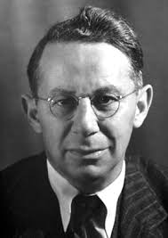
Tadeusz reichstein
Tadeusz Reichstein was a swiss chemist who received the Nobel Prize for Physiology and Medicine.He worked The coveted award for their discoveries concerning hormones of the adrenal cortex.

Slide 23
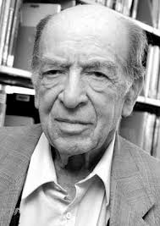
Leonid Hurwicz
He was a Polish-American economist and mathematician.
He shared the 2007 Nobel Memorial Prize in Economic Sciences for work on mechanism design.
Hurowicz is the oldest Nobel Laureate, having received the prize at the age of 90.

Slide 24
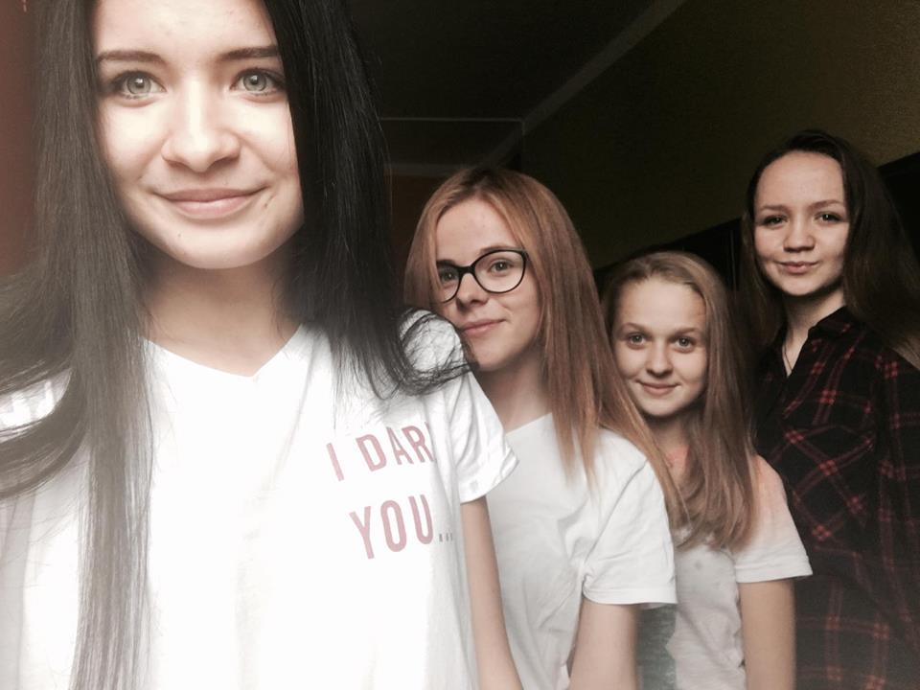
That’s all
Thank you for watched our presentation and waiting for yours.
Żaneta
Karolina
Kamila
Patrycja

