Slide 1
Questionnaire
For Chemistry students

Slide 2
Levels and ages of our students

Slide 3
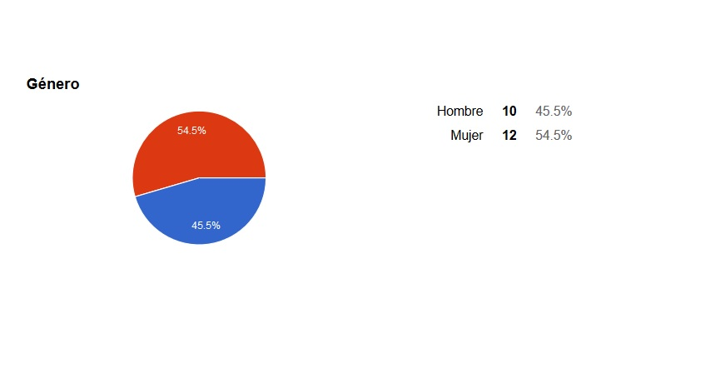
Nationality and gender of our students

Slide 4
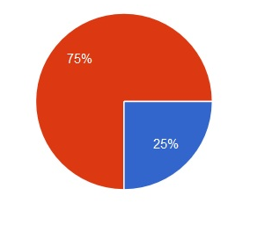
Do you like Chemistry? ❑ Yes ❑ No
Sí 75%
No 25%
Because it is _________________________ (max. two features)

Slide 5
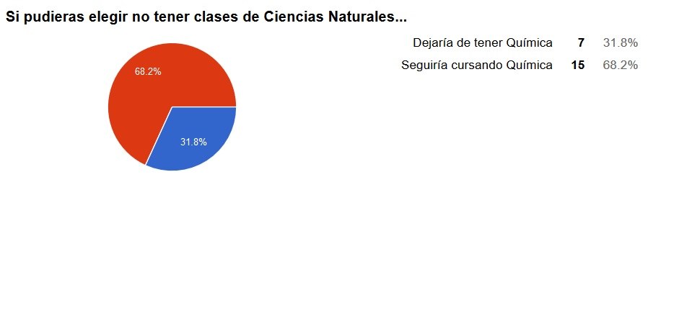
If you were allowed to drop Chemistry, what would you do? ❑ I’d do it ❑ No, I wouldn’t

Slide 6
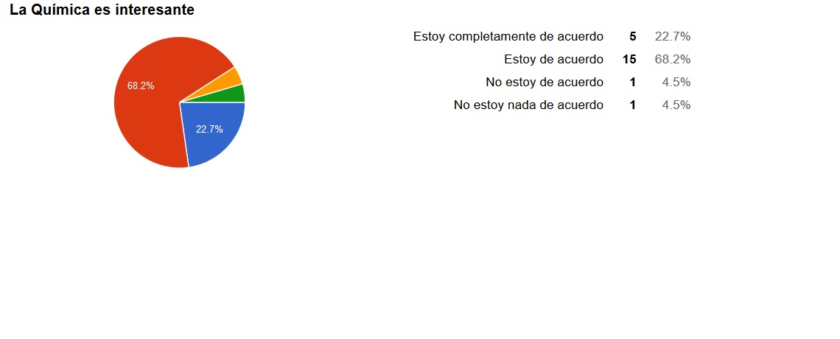
Chemistry is interesting ❑ Strongly agree ❑ Agree ❑ Disagree ❑ Strongly disagree

Slide 7
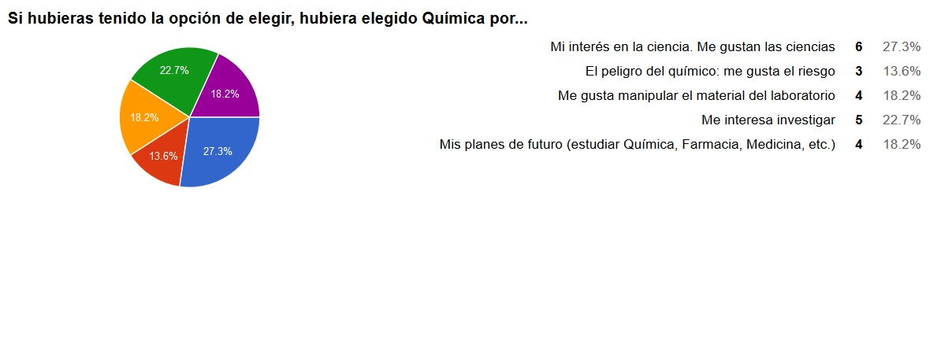
If you had the choice: I’d elect Chemistry class because… Of the interest in science Of the dangerous chemicals. I like the risk Of laboratory equipment which I like Of the research. It is interesting Of my future plans (to study chemistry, pharmacy, medicine etc)

Slide 8
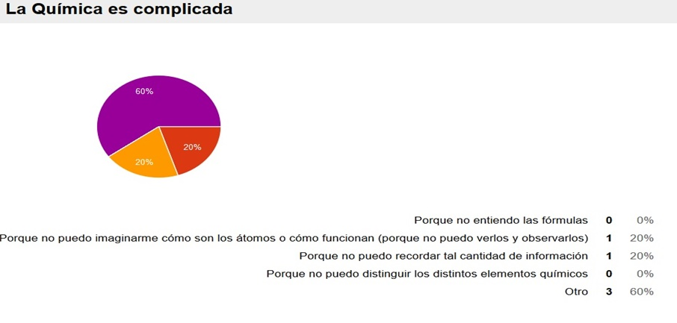
If you choose 1, 2, 3: why is Chemistry too complicated? Because I don’t understand the formula Because I can’t imagine how atoms could exist or work (because we can’t see or watch them) Because I can’t remember so much information Because I can not distinguish different chemicals Other ___________________________________

Slide 9
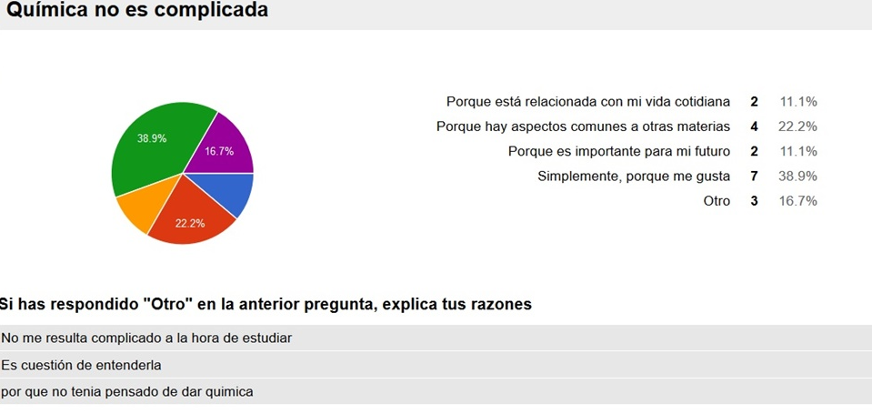
If you choose 4, 5, 6: why isn’t Chemistry complicated? Because there is a relation (is linked) to everyday life Because there are only similarities to other subjects Because it is important for my future Because I simply like it Other ___________________________________

Slide 10
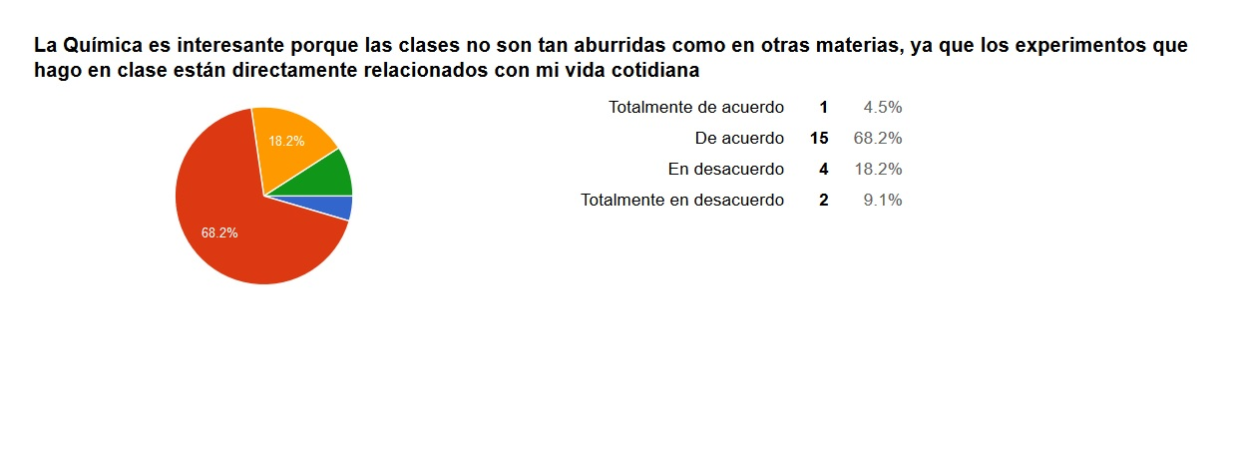
Chemistry is interesting because the lessons aren’t as boring as other subjects due to the relation to everyday life shown in experiments
❑ Strongly agree ❑ Agree ❑ Disagree ❑ Strongly disagree

Slide 11
Do you think Chemistry will be very useful for your future?
❑ Yes ❑ No

Slide 12
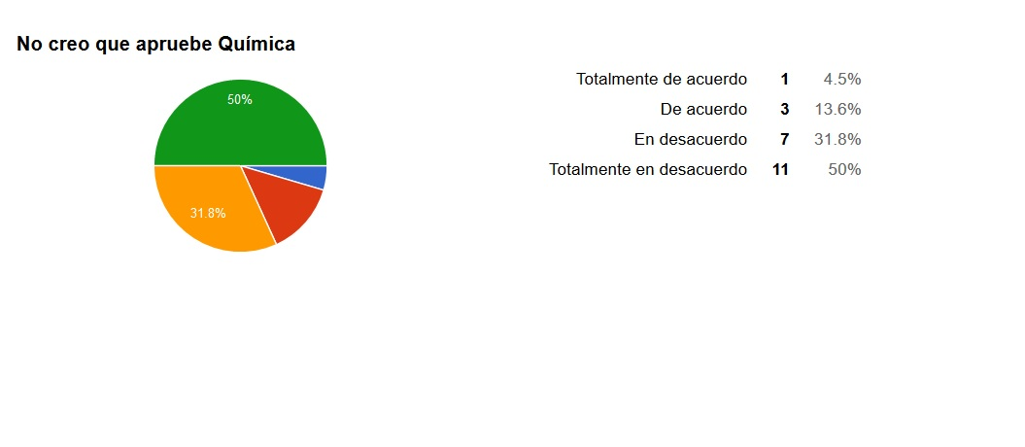
I don’t think I will be successful in Chemistry:
❑ Totally agree ❑ Agree ❑ Disagree ❑ Totally disagree

Slide 13
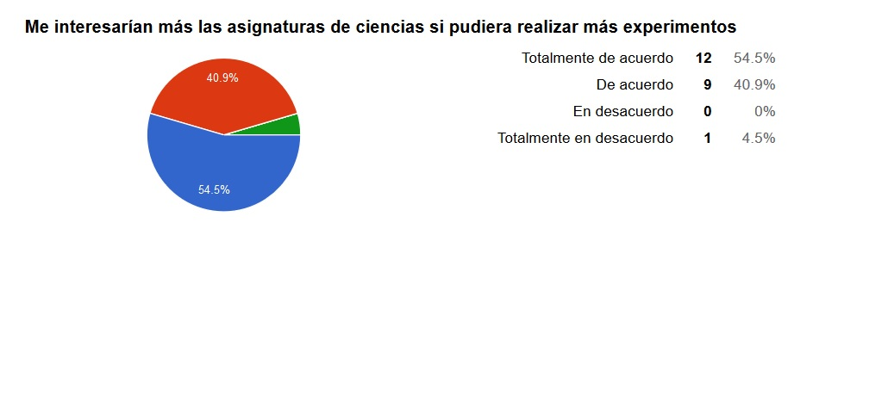
I would be more interested in Science subjects if there were more experiments.
❑ Totally agree ❑ Agree ❑ Disagree ❑ Totally disagree

Slide 14
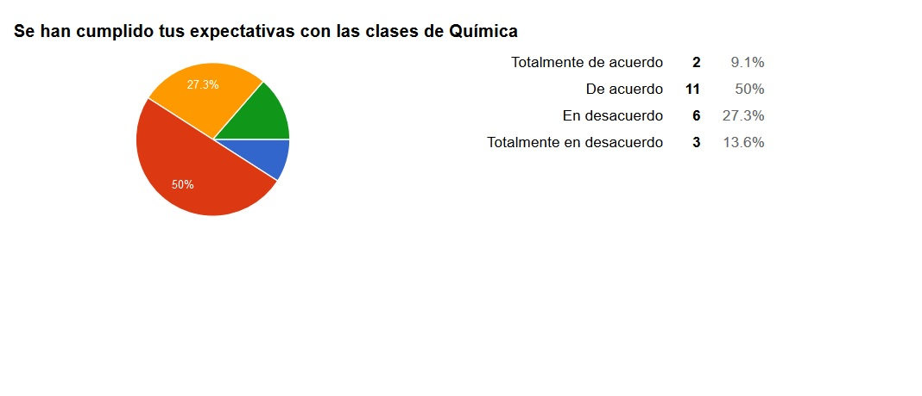
Have your expectations been fulfilled on your Chemistry lessons? (High classes) ❑ Totally agree ❑ Agree ❑ Disagree ❑ Totally disagree

Slide 15
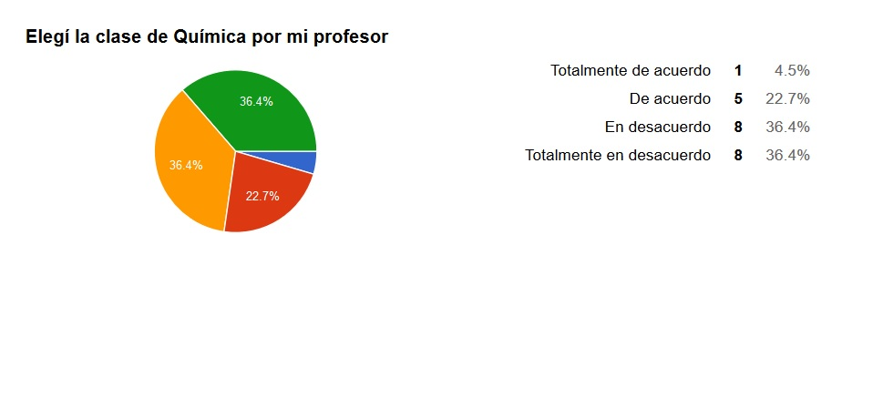
I choose Chemistry because of my teacher (High classes) ❑ Totally agree ❑ Agree ❑ Disagree ❑ Totally disagree

Slide 16
Questionnaire
For Chemistry students

