Slide 1
Questionnaire
Expectations (pre-chemistry classes)

Slide 2
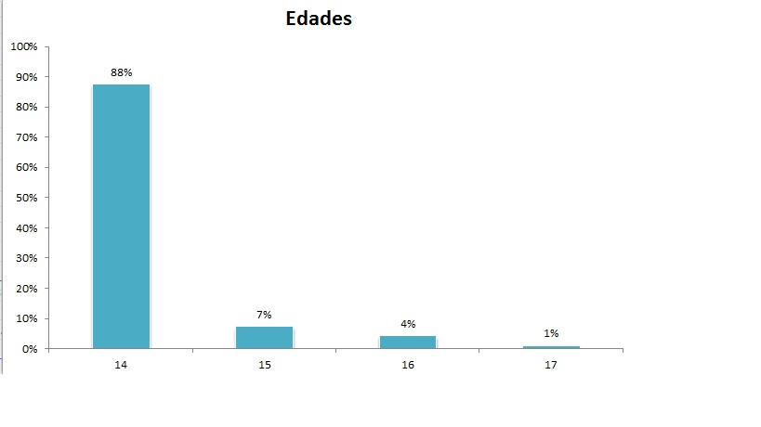
Ages and levels of our students

Slide 3
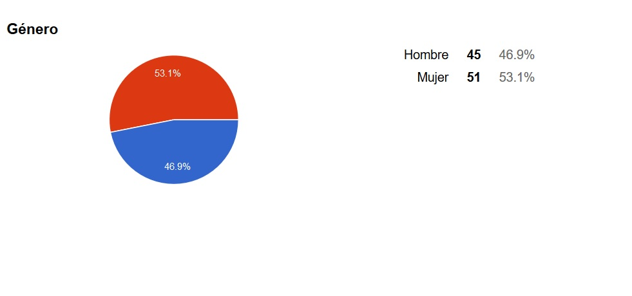
Gender and nationality of our students

Slide 4
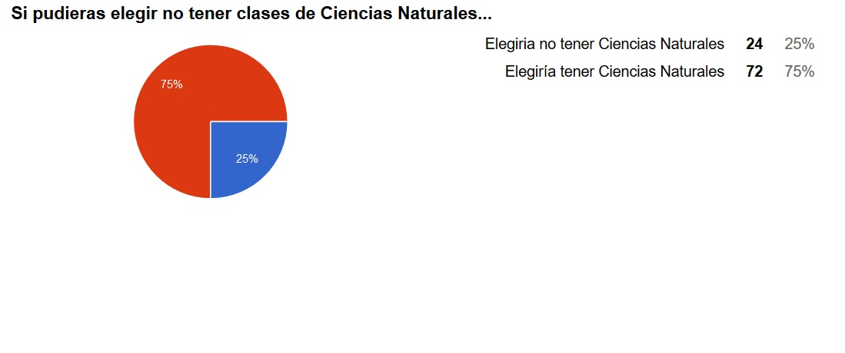
If you were allowed to drop Science, what would you do? ❑ I’d do it ❑ No, I wouldn’t

Slide 5
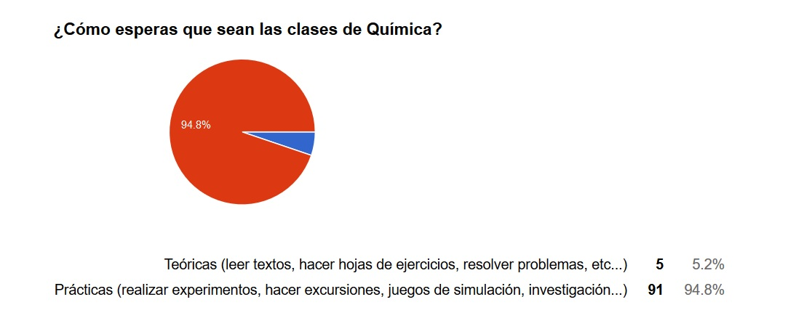
What do you expect from Chemistry lessons to be? ❑ Theoretic (reading texts, doing worksheets, problem solving…) ❑ Practical (experiments, excursions, simulation games, researches…)

Slide 6
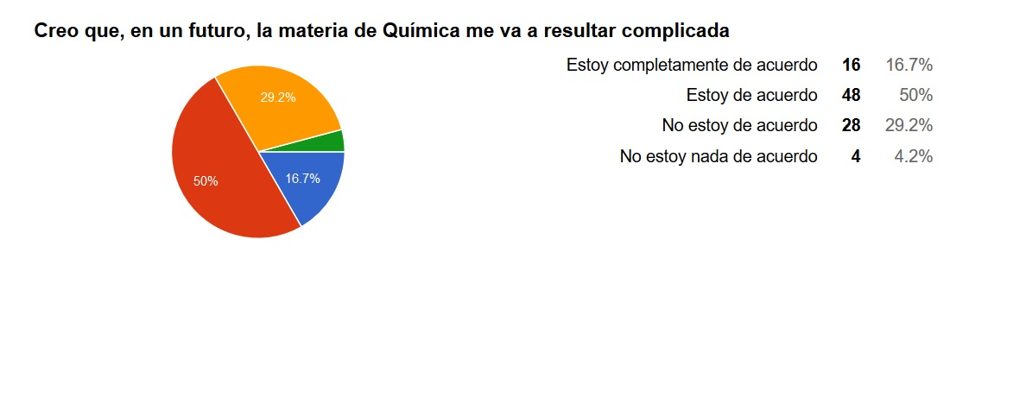
I expect Chemistry to be complicated: ❑ I totally agree ❑ I agree ❑ Disagree ❑ I totally disagree

Slide 7
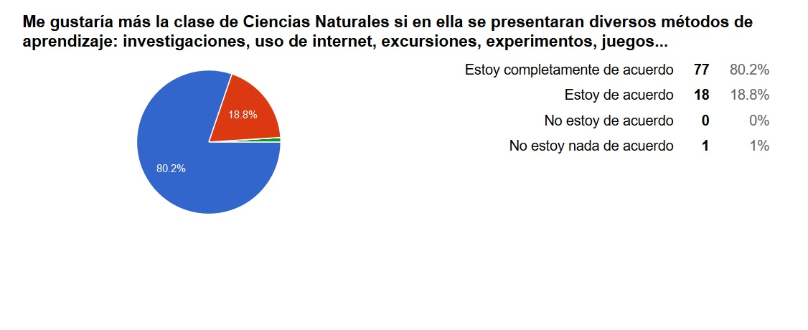
I would like Science more if classes had a variety of methods: research, internet, excursions, experiments, games … ❑ I totally agree ❑ I agree ❑ Disagree ❑ I totally disagree

Slide 8
Questionnaire
Expectations (pre-chemistry classes)

