Slide 1
Slovak sweet pancakes
4.A Julia

Slide 2
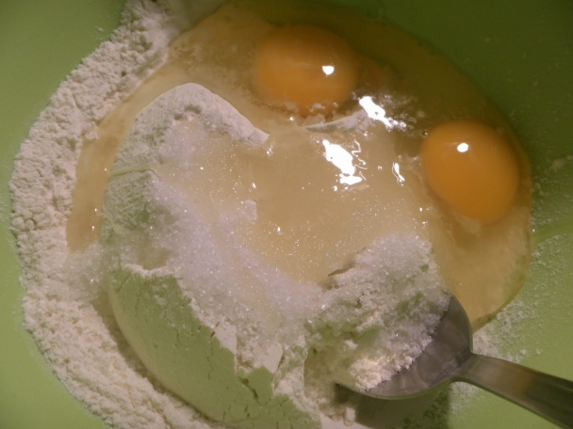
INGREDIENTS
500 ml milk
2eggs
10 g sugar
220 g flour
A little oil

Slide 3
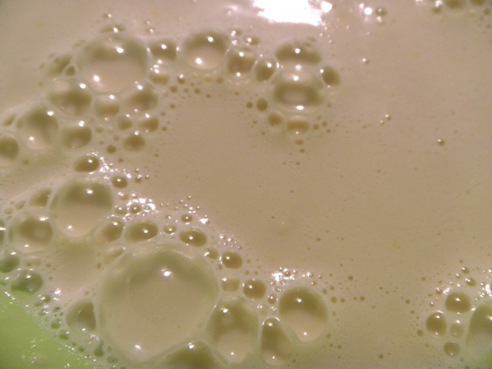
Milk, eggs, sugar, flour mixed together

Slide 4
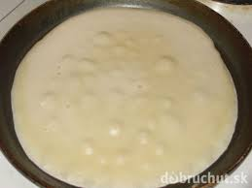
Then pour this one big spoon to pan and fry it with both sides with a little bit oil.

Slide 5
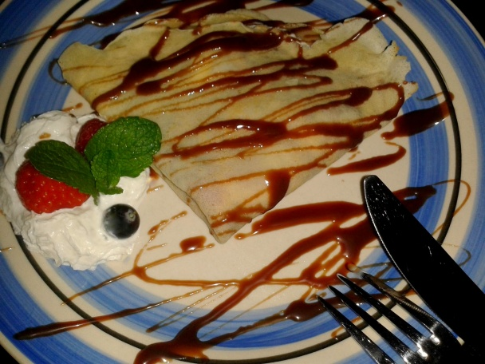
After it you can fill them with jam, cheese, or chocolate with banana.
ENJOY

