Slide 1
Answer to your questions
Lashay Wigginton, Tahrima Tariq, Hannah Clarke :)

Slide 2
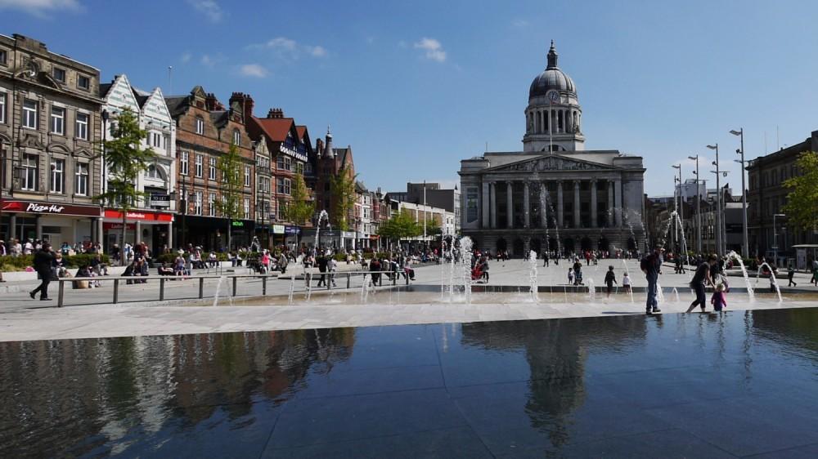
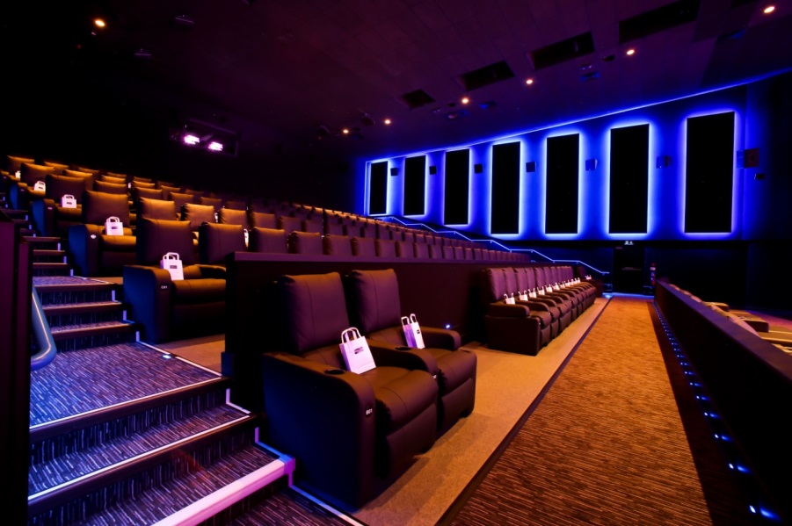
What do you like about your town?
We like our family which is in our town, but also we like to go to Old Market Square. We also like the cinema but also we sometimes like to do ice skating

Slide 3
Are there any world famous people in your city?
There is some famous people in Nottingham including Graham Russell who is an English musician but we don’t know who he his as he is not famous world wide.

Slide 4
What are you favourite subjects?
Our favourite subjects are Maths, Technology, Art, Drama and English.

Slide 5
Do you like e-Twinning?
We do like e-Twinning because we get to meet new people from different countries and it is very interesting to learn different cultures and traditions.

