Slide 1
Answering your Questions
By Aaminah
Aishah
Intu

Slide 2
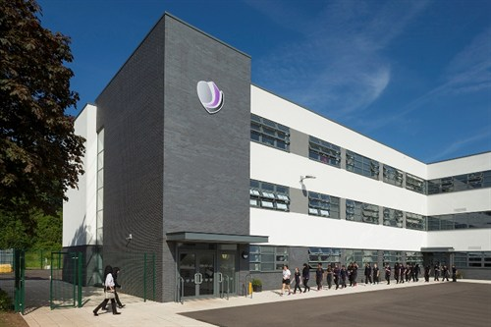
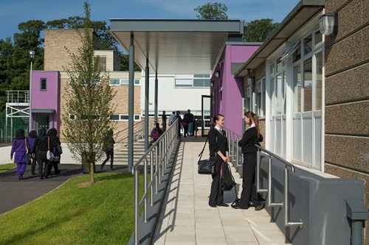
How many students are there?
In our school, there are about 700 students.

Slide 3
How many inhabitants are there?
In Nottingham there are about 321,500

Slide 4
Our school day.
In the morning we have 2 lessons then it is break. At break we eat snacks and we talk to our friends, break lasts for 15 minutes. Next there are another two lessons before lunch. At lunch we eat and drink outside, we also chat to our friends, some people even play sports but these days it is really cold so we usually sit inside in the warmth. Finally we have two more lessons in the afternoon. Then we go home.

