Slide 1
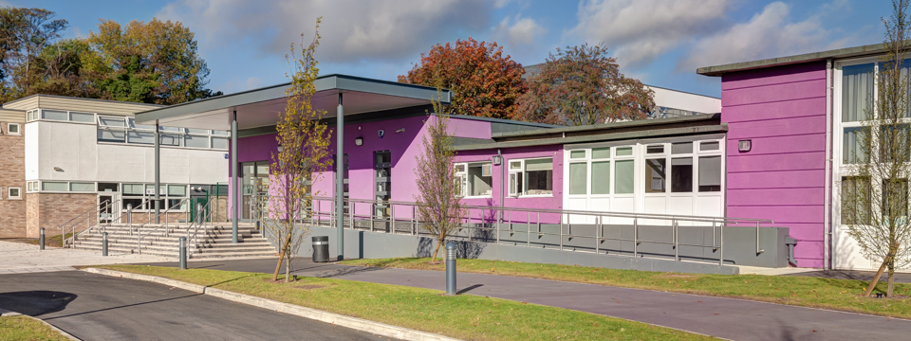
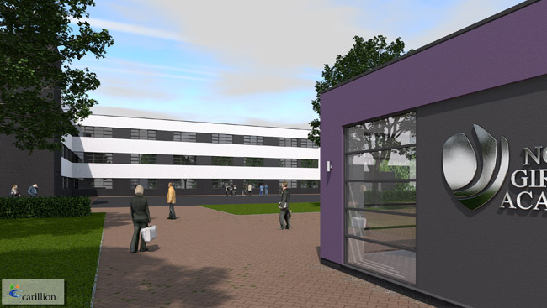
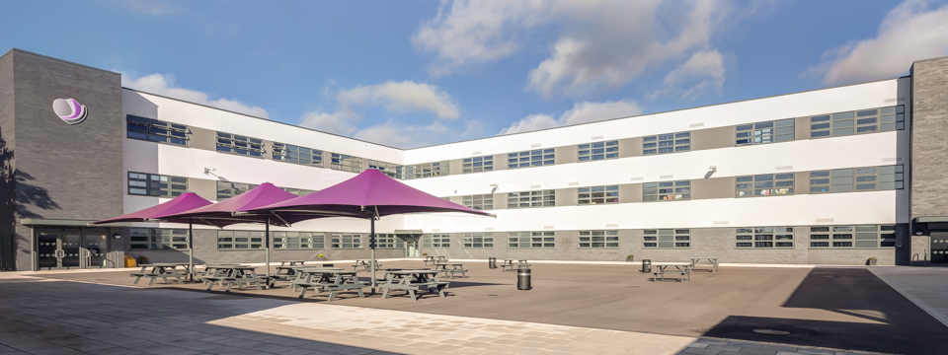
Questions from Spanish people in Spain
By Julia,Monet and Firdaus

Slide 2
What do you do in your free time?
Julia:In my free time I play out with Monet and other friends and I nap.
Monet:In my free time I go to town with Julia and we eat Nando’s
Firdaus:In my free time I watch Jake Paul on Youtube.

Slide 3
How much free time do you have per day?
Julia: About 16 hours.
Monet:About 15 hours
Firdaus: 11 hours

Slide 4
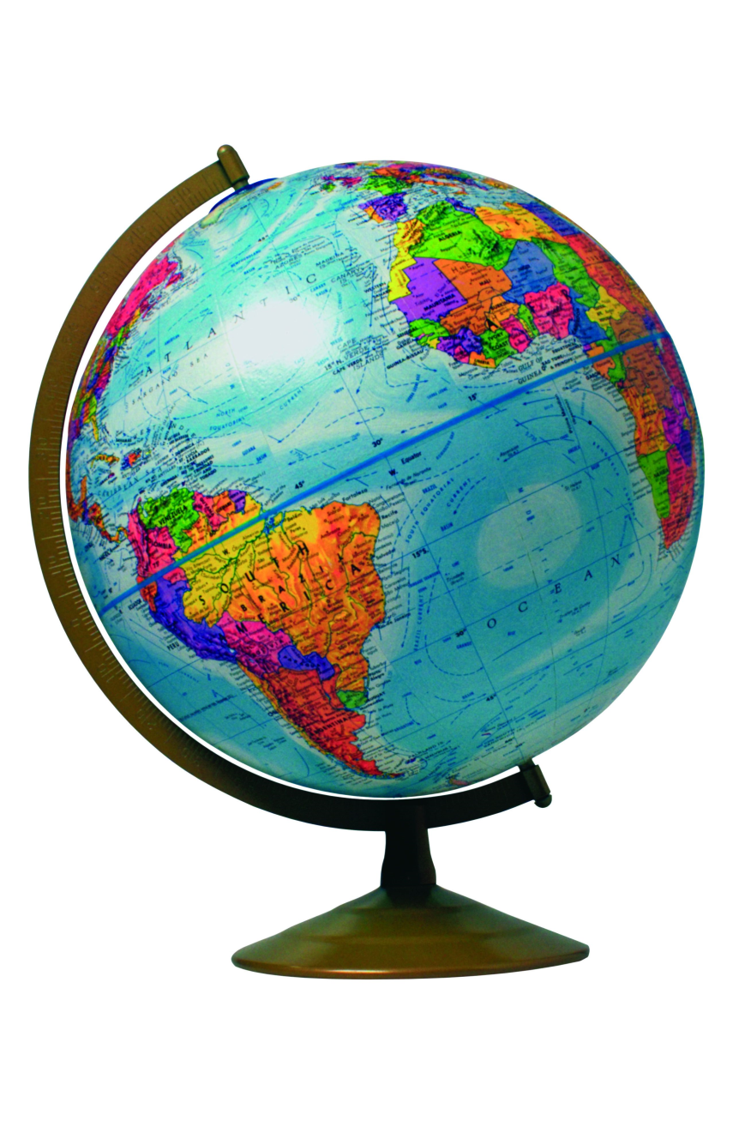
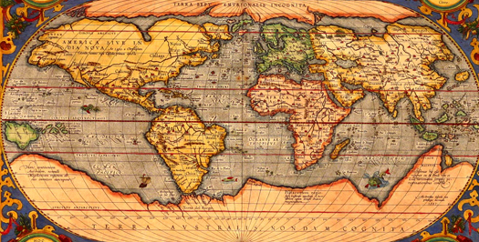
What subject do you like the most?
Julia:History
Monet:History aswell
Firdaus:Geography

Slide 5
How many students are in your class?
In our class there are 22 people.

