Slide 1
Global smiles
Shada,
Alishba and Shahad

Slide 2
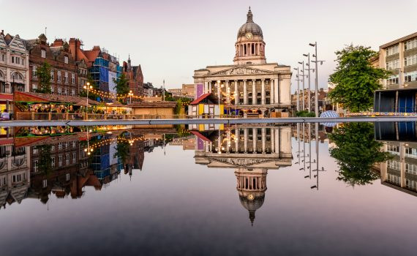
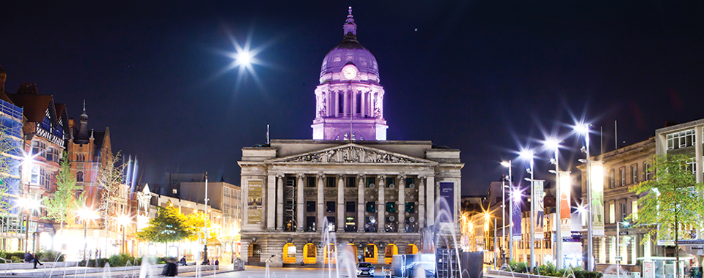
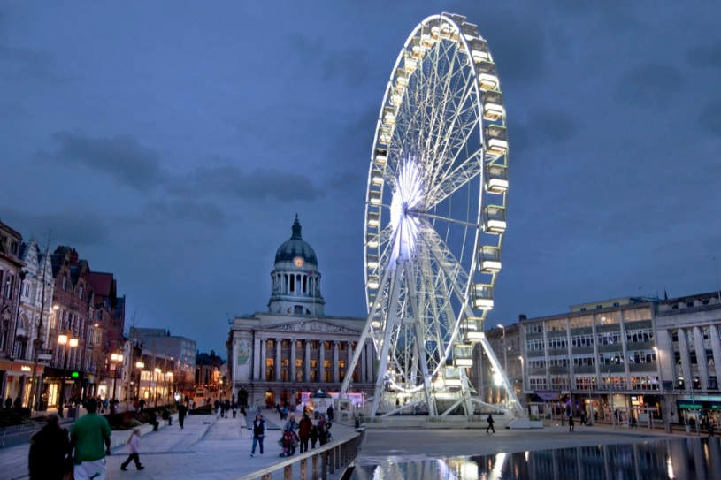
What is the name of your city?
Hello,
We live in Nottingham England.

Slide 3
How is Spanish given to you?
We learn Spanish at school and we get 4 lessons a week. Also, we have a Spanish teacher who teaches us about a lot of Spanish words and as time goes we learn it.

Slide 4
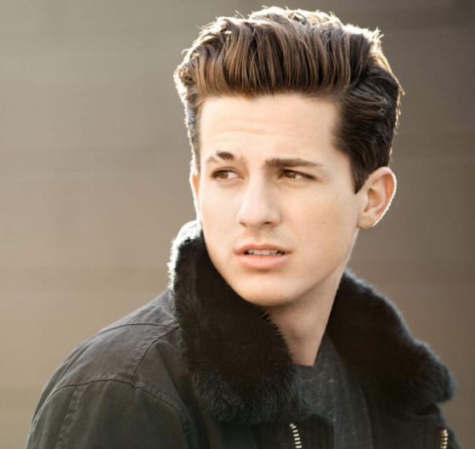
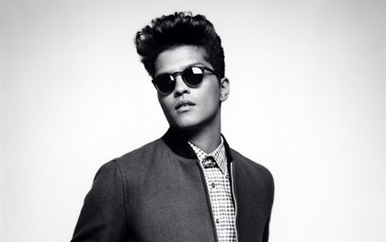
What do you do in your free time?
We play basketball with our friends. We also love to race each other. We always laugh and chat and we like to do silly things. We also like to listen to pop music. Our favourite singers are: Charlie puth, Bruno mars and little mix.

