Slide 1
Our PowerPoint
By Mowaddat, Sana, Iman and Maha

Slide 2
What do you like in your free time?
In my free time I listen to music, watch videos on YouTube and play football.

Slide 3
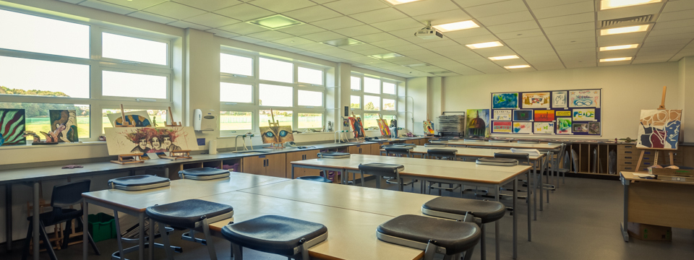
What are your favourite subjects?
Our favourite subjects are Art and PE.

Slide 4
Is Spanish difficult for you?
Sometimes Spanish is difficult but most time it isn’t.

Slide 5
What is your favourite Spanish word?
Yo
Dónde
Qué
Bici

