Slide 1
PINOCCHIO
The story of a puppet becoming a boy

Slide 2
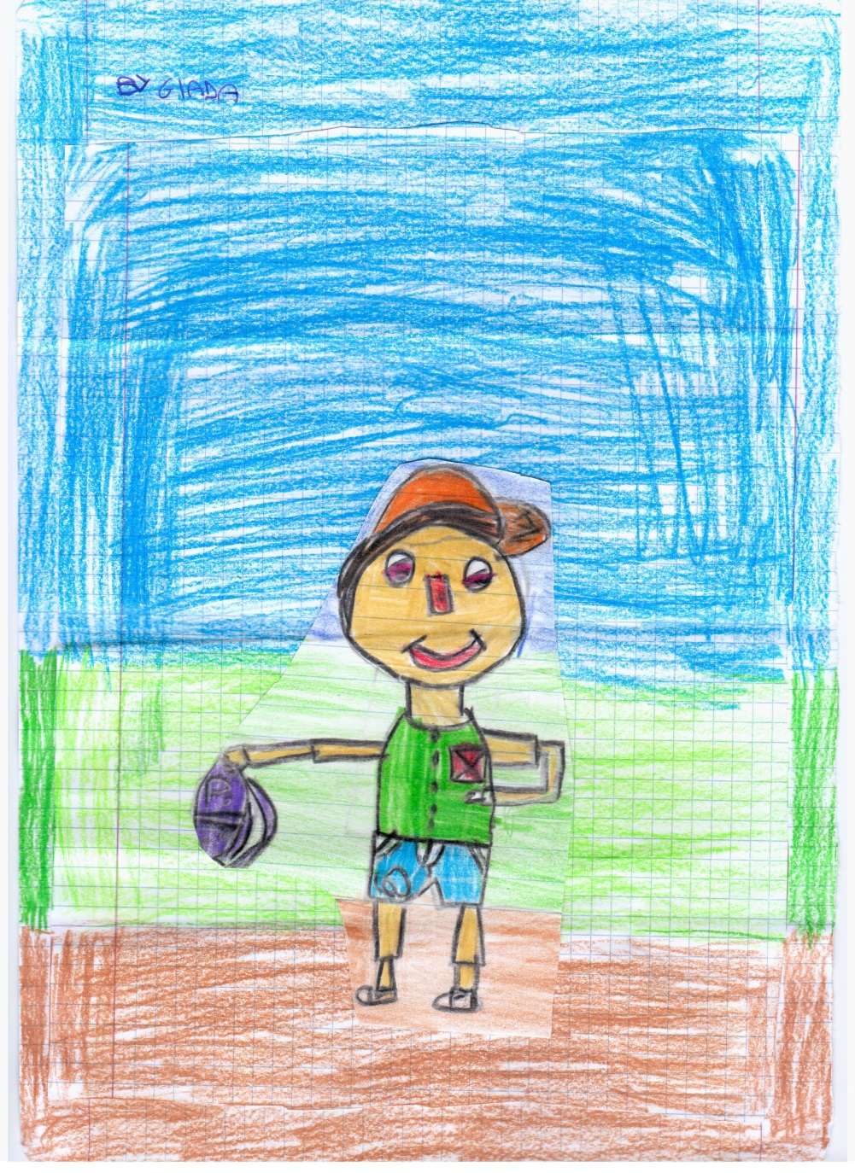
Pinocchio is a puppet; he’s a naughty puppet. He sometimes disobeys his father and lies.
TIPS:
Obey your father
Don’t lie

Slide 3
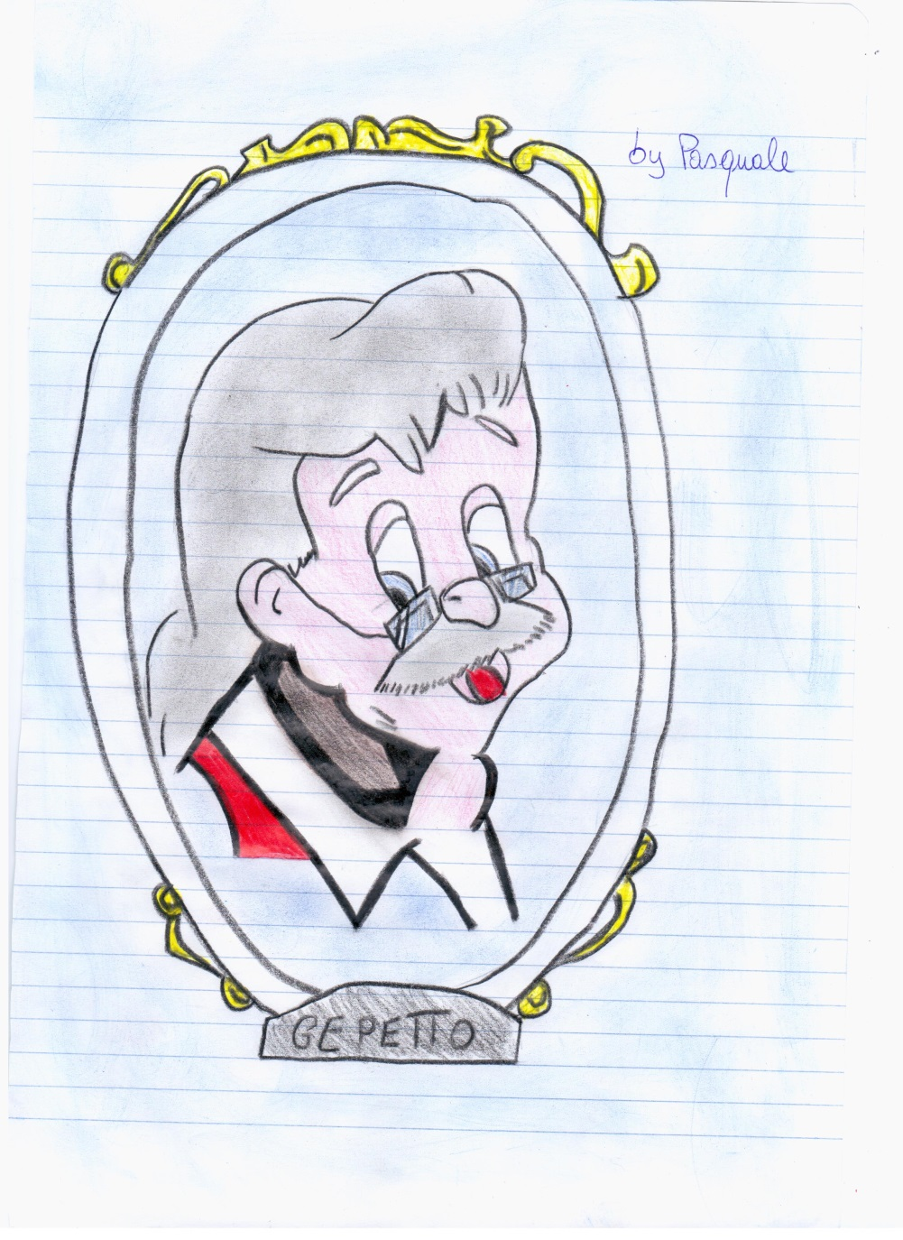
Geppetto makes Pinocchio with a piece of wood. He loves Pinocchio like a father.
TIPS:
Dear Geppetto, be stricter with Pinocchio.

Slide 4
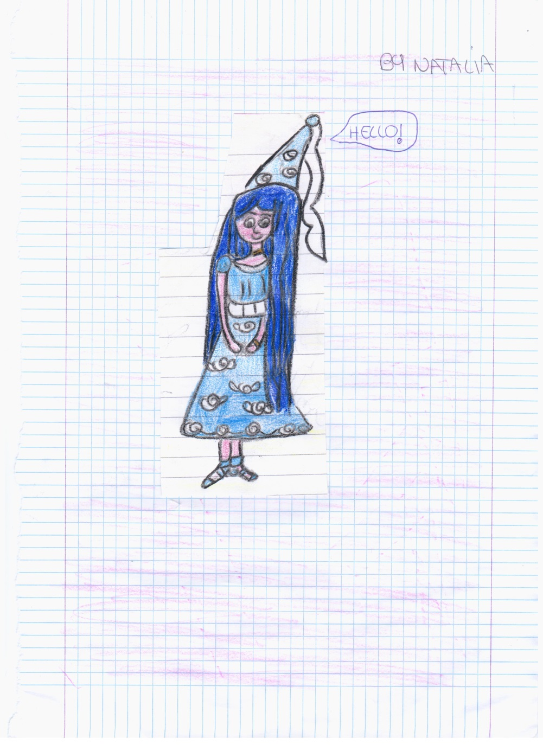
The Blue Fairy loves Pinocchio like a mother.
TIPS:
Trust good people.

Slide 5
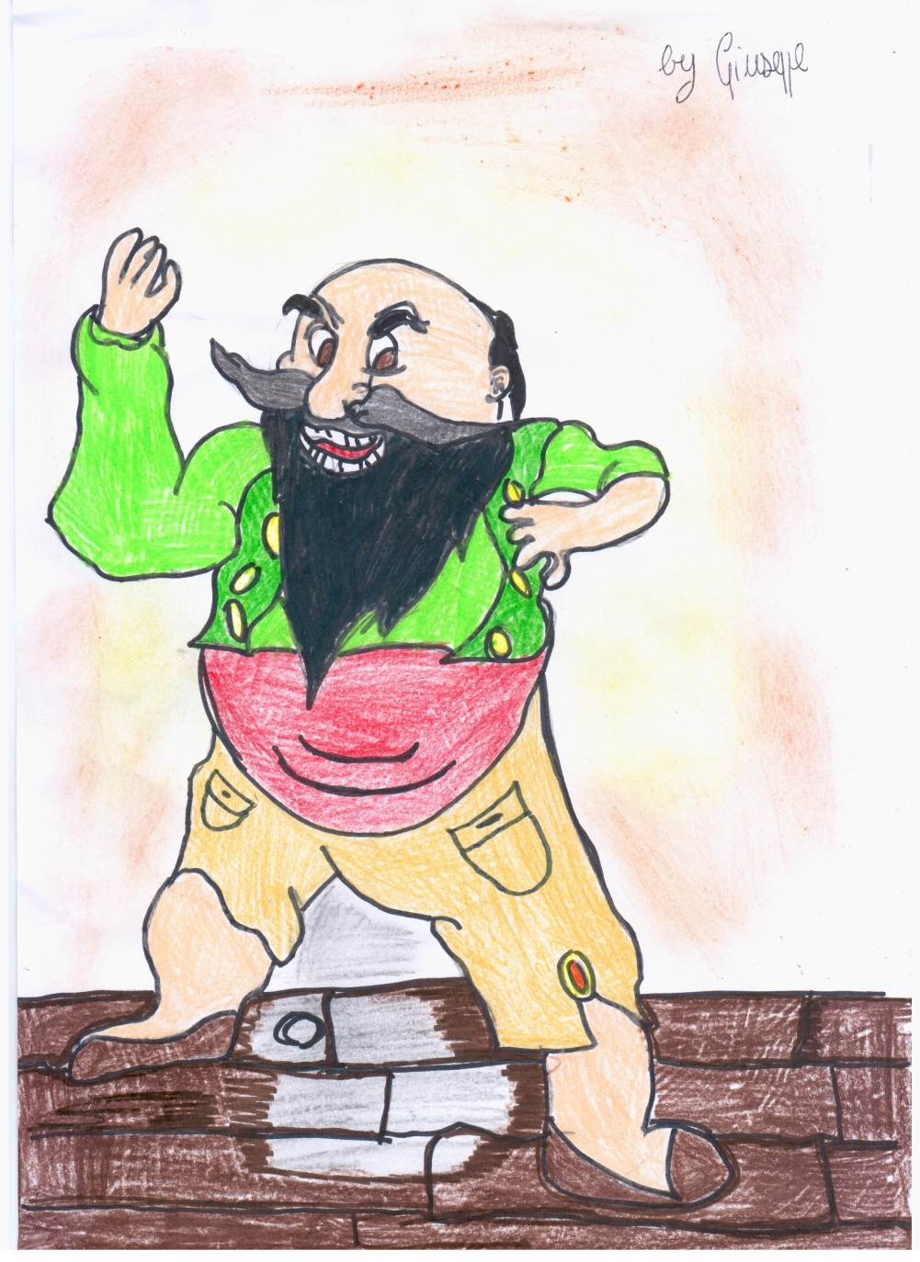
The Fire Eater looks like a bad man but he has a good heart.
TIPS:
Don’t judge people from their appearance.

Slide 6
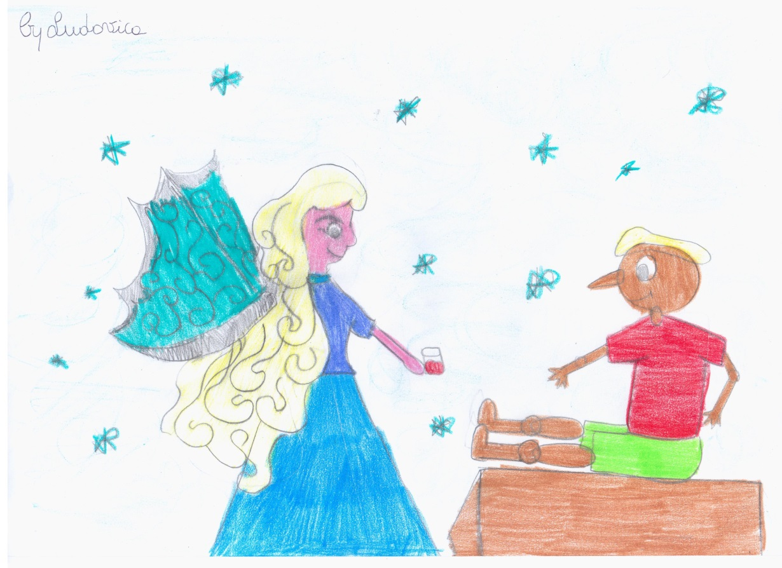
The Blue Fairy’s house is full of love.
TIPS:
Respect who loves you.

Slide 7
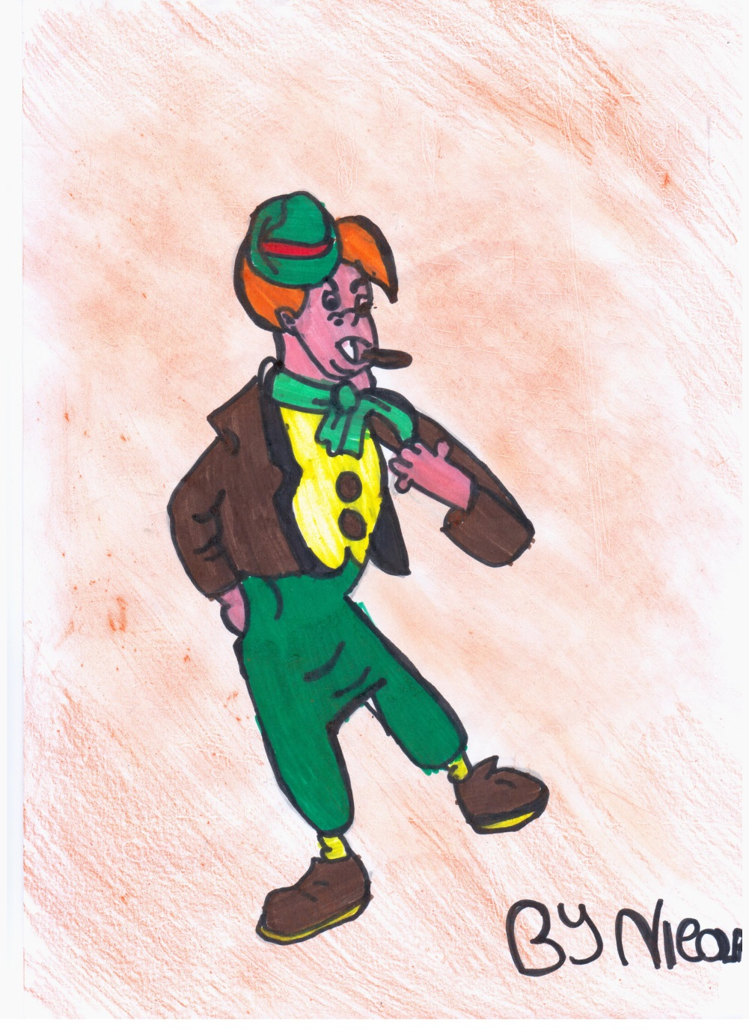
Lampwick likes playing, playing, playing…….
TIPS:
Not only playing but also hard job.

Slide 8
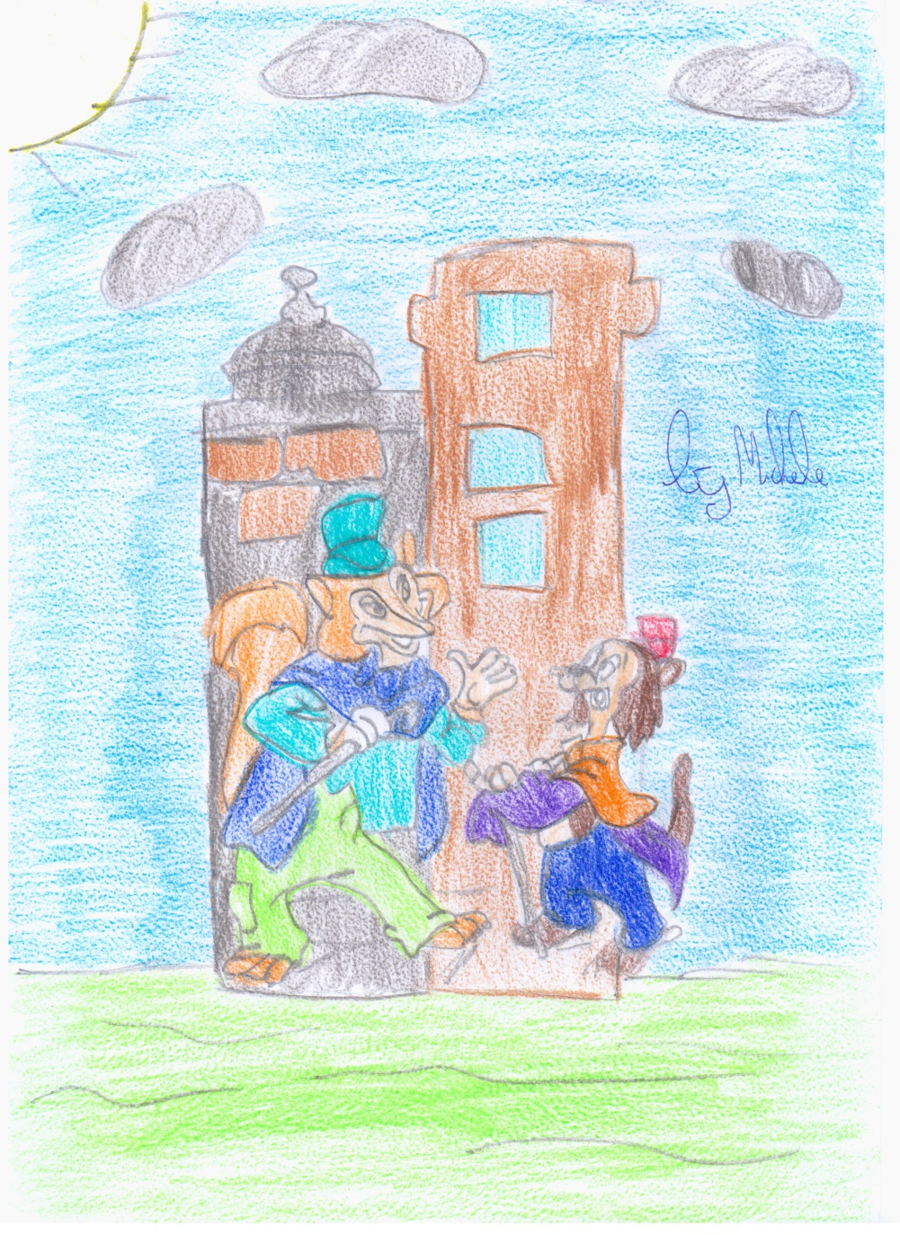
The Cat and the Fox are two thieves. They steal Pinocchio’s money.
TIPS:
Don’t trust unknown people.

Slide 9

Pinocchio finds his father in the Whale.
TIPS:
Don’t leave your father in danger.

Slide 10
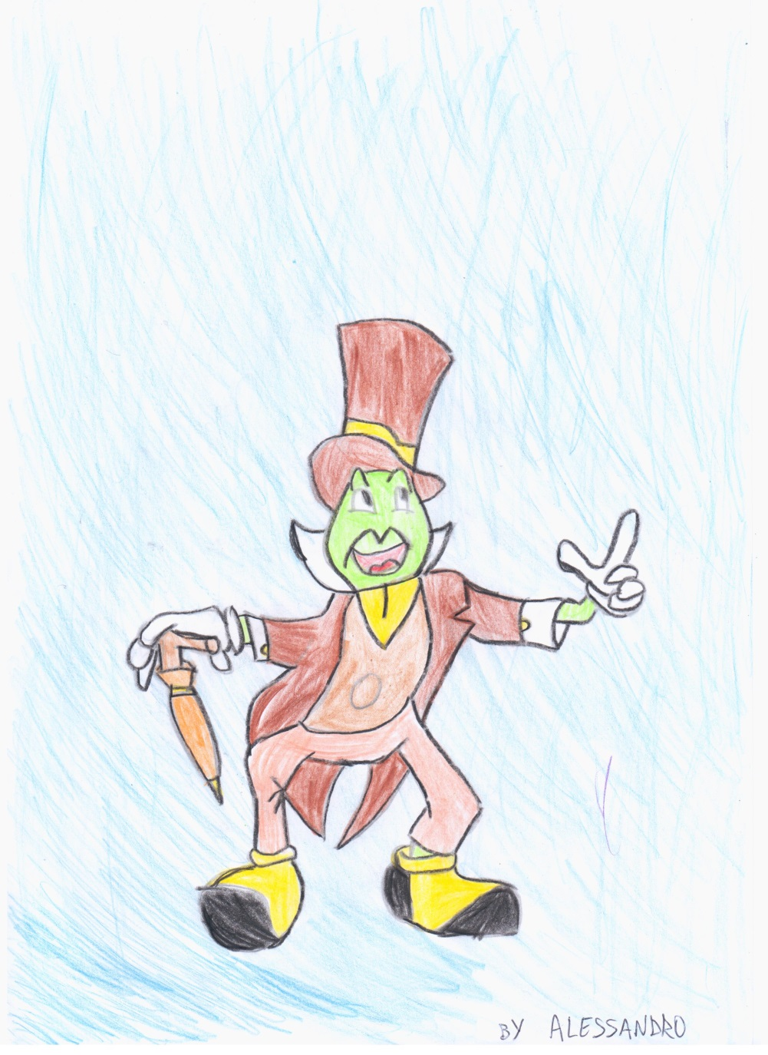
The Cricket gives Pinocchio good advices. He’s Pinocchio’s conscience.
TIPS:
Trust good people.

Slide 11
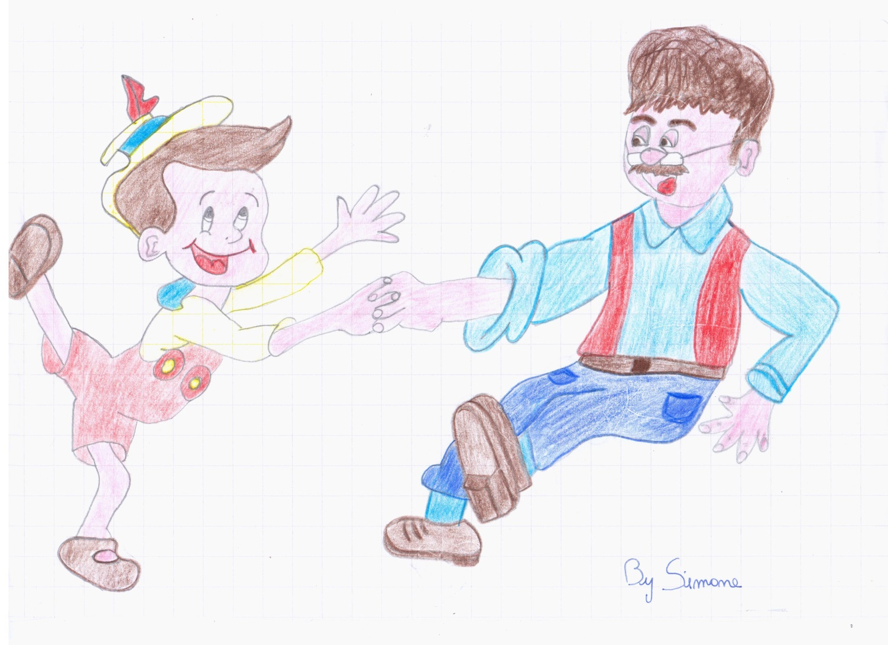
At the end of the story Pinocchio becomes a REAL BOY and respects people loving him .
NOW HE IS HAPPY WITH HIS GOOD FATHER!!!

