Slide 1
PINOCCHIO
The story of a puppet becoming a boy

Slide 2
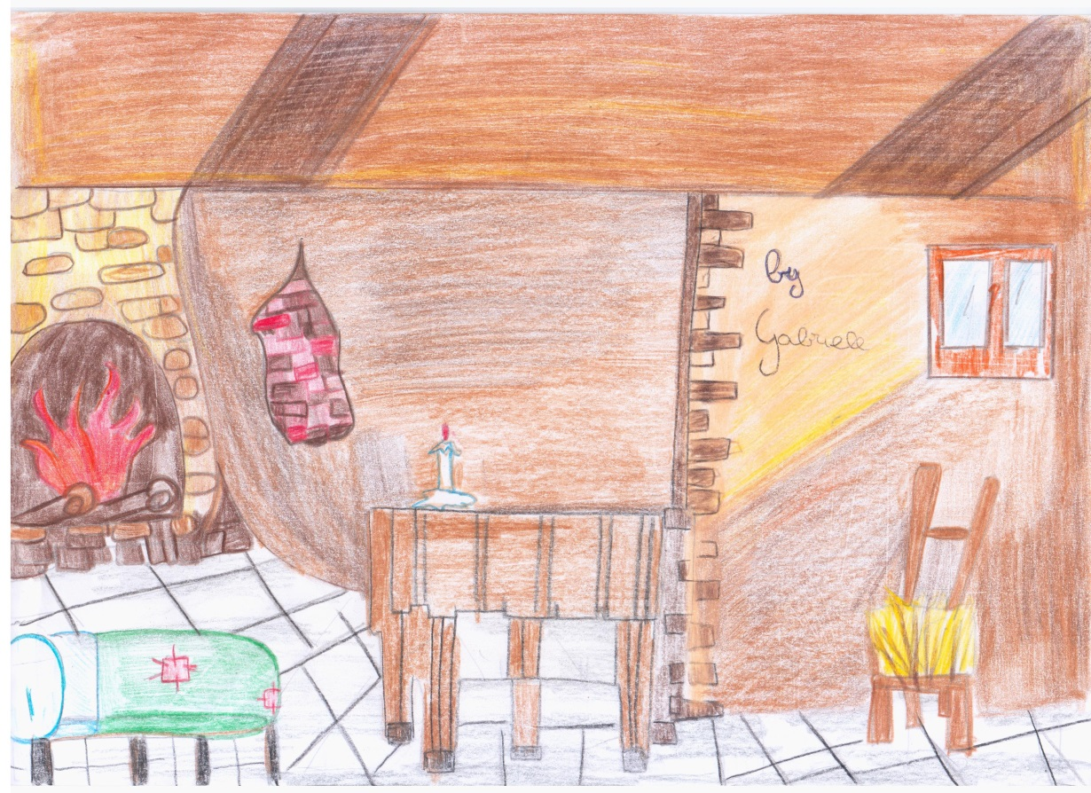
Geppetto’s house is poor but full of love.
TIPS:
Help poor people

Slide 3
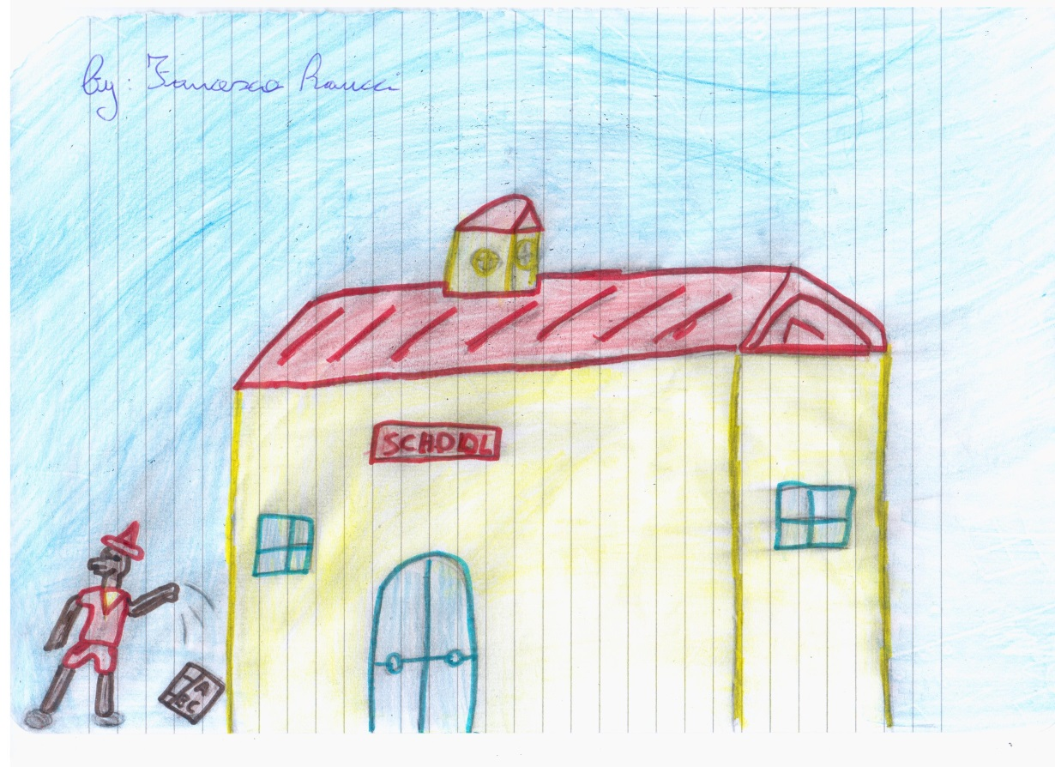
Pinocchio goes to school.
TIPS:
School is very important in your life.

Slide 4
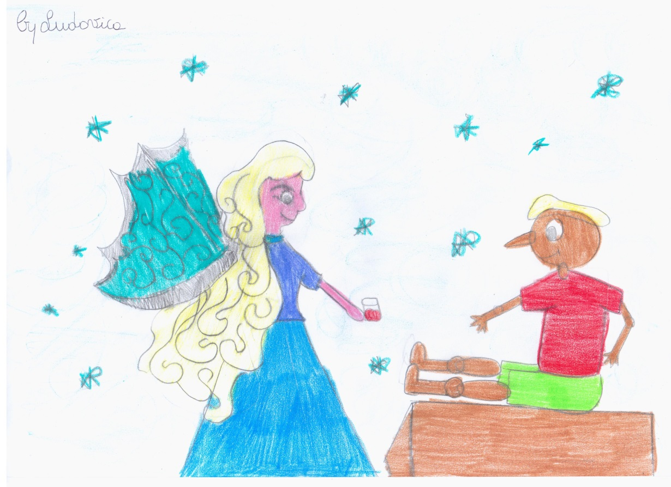
The Blue Fairy’s house is full of love.
TIPS:
Respect who loves you.

Slide 5
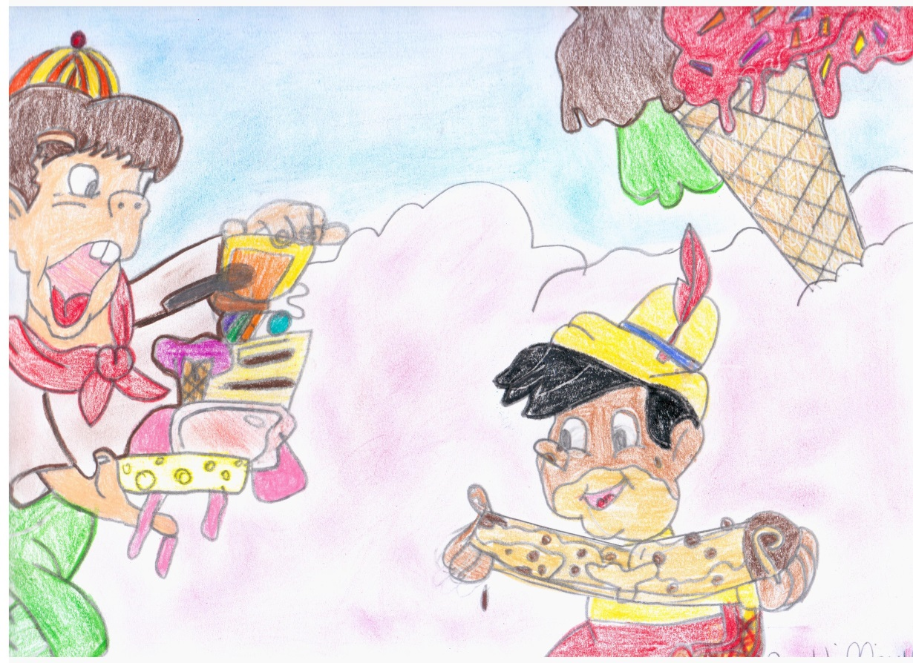
In the Pleasure Island Pinocchio and Lampwick become DONKEYS.
TIPS:
Sometimes you have to say: “NOOOO”

Slide 6
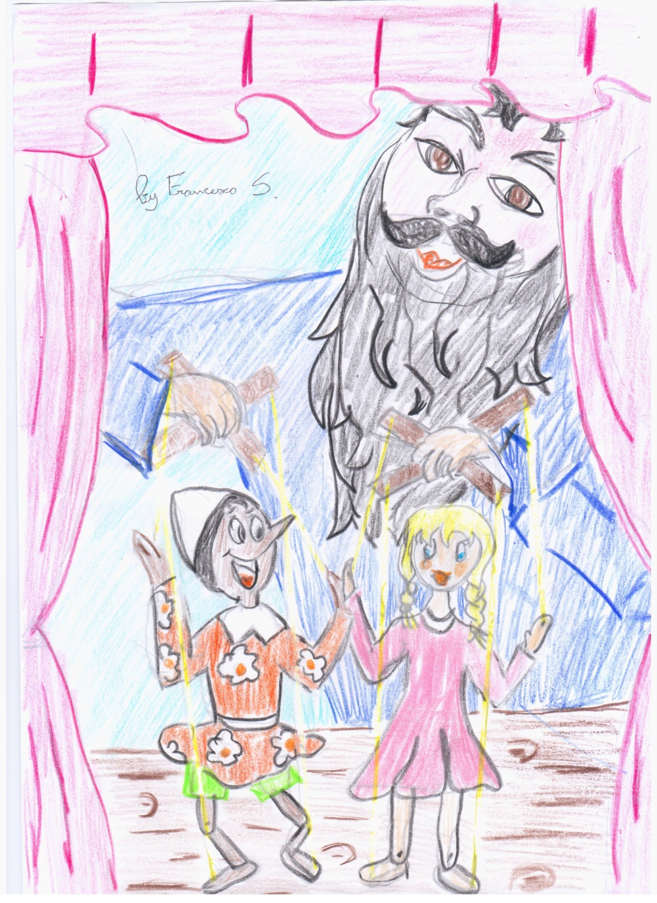
In the puppet theatre Pinocchio realizes he’s just a puppet.
TIPS:
Use your mind.

Slide 7
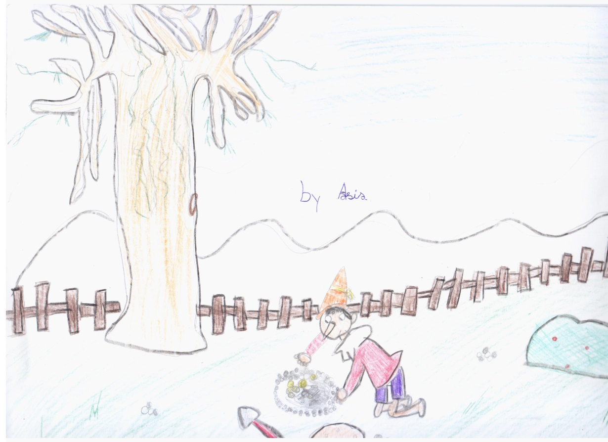
Pinocchio trusts the Cat and the Fox and hides his money in the Field of Miracles.
TIPS:
Don’t believe all what people tell you.

Slide 8
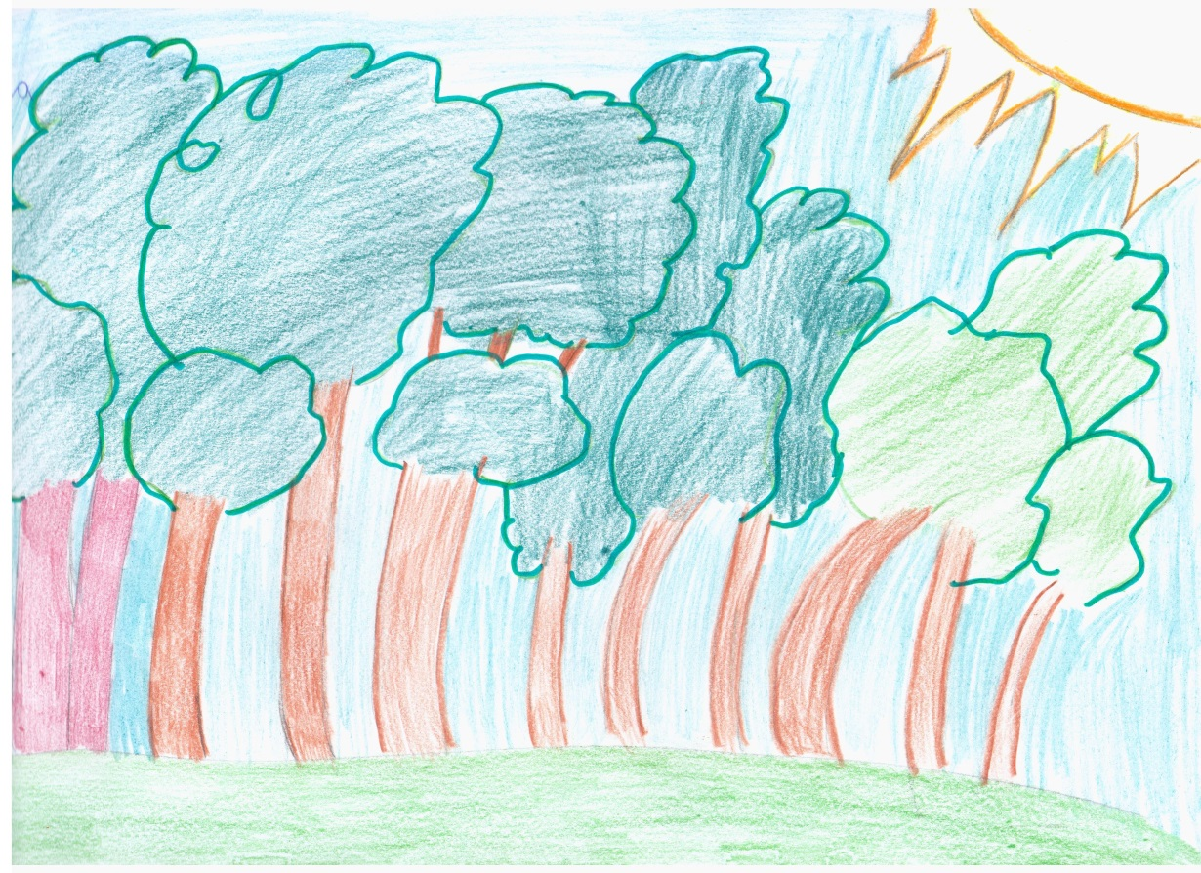
Pinocchio meets the Cat and the Fox in the wood.
TIPS:
Don’t go to dangerous places.

