Slide 1
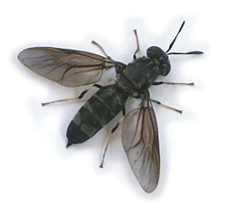
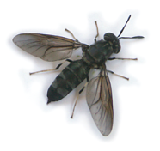
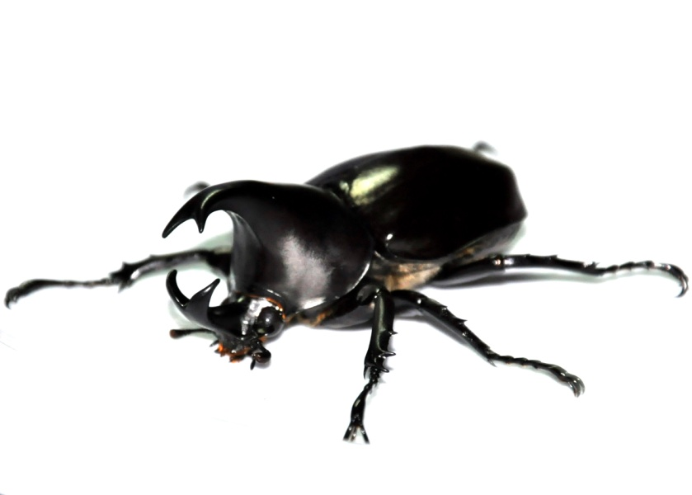
Why novel food ?
Ettore Capri
www.operaresearch.eu

Slide 2
Context to feed in 2015:
7 billion people
20 billion chickens/ 1,4 b cattle/ 1 b sheep....
75 million tons of fish (aquaculture).......
38% of world land use is for AGRICULTURE
70% of total agriculture land use is for feeding livestock
70% of total fresh water use is for agriculture
42 kg of MEAT/ 19 Kg of FISH (average capita food availability)

Slide 3
WHAT TO DO:
JELLFISH
ALGAE
INSECTS

Slide 4
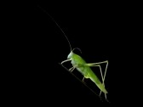
Three reasons for novel food as feed and food:
Good for your nutrition
Good for the environment
Good for local business opportunities

Slide 5
Nutrition:
Protein content comparable to meat and fish
High in good fatty acids
Rich in micronutrients
Environment:
Require less water
Emit fewer greenhouse gasses
Efficient feed conversion rates
Business:
Rapidly growing industry
Entrepreneurship
local Socio-economic benefits

Slide 6
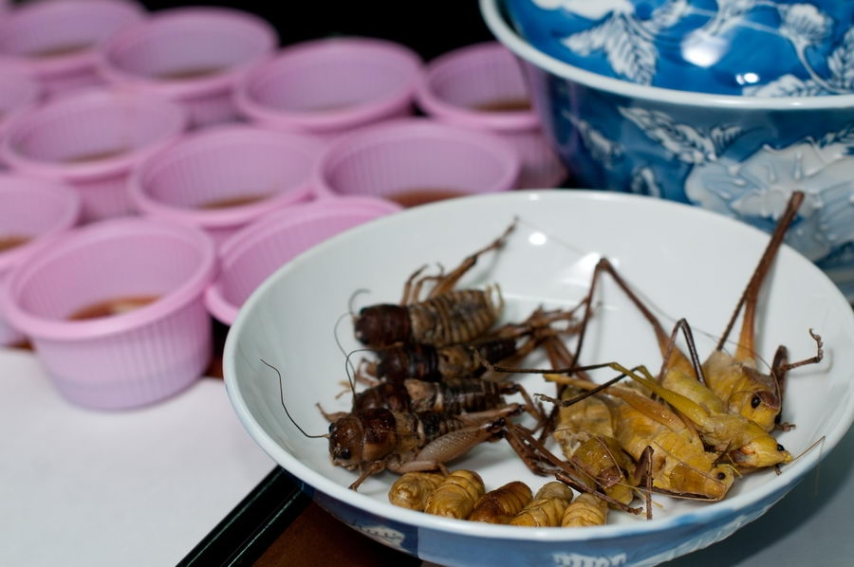

Slide 7
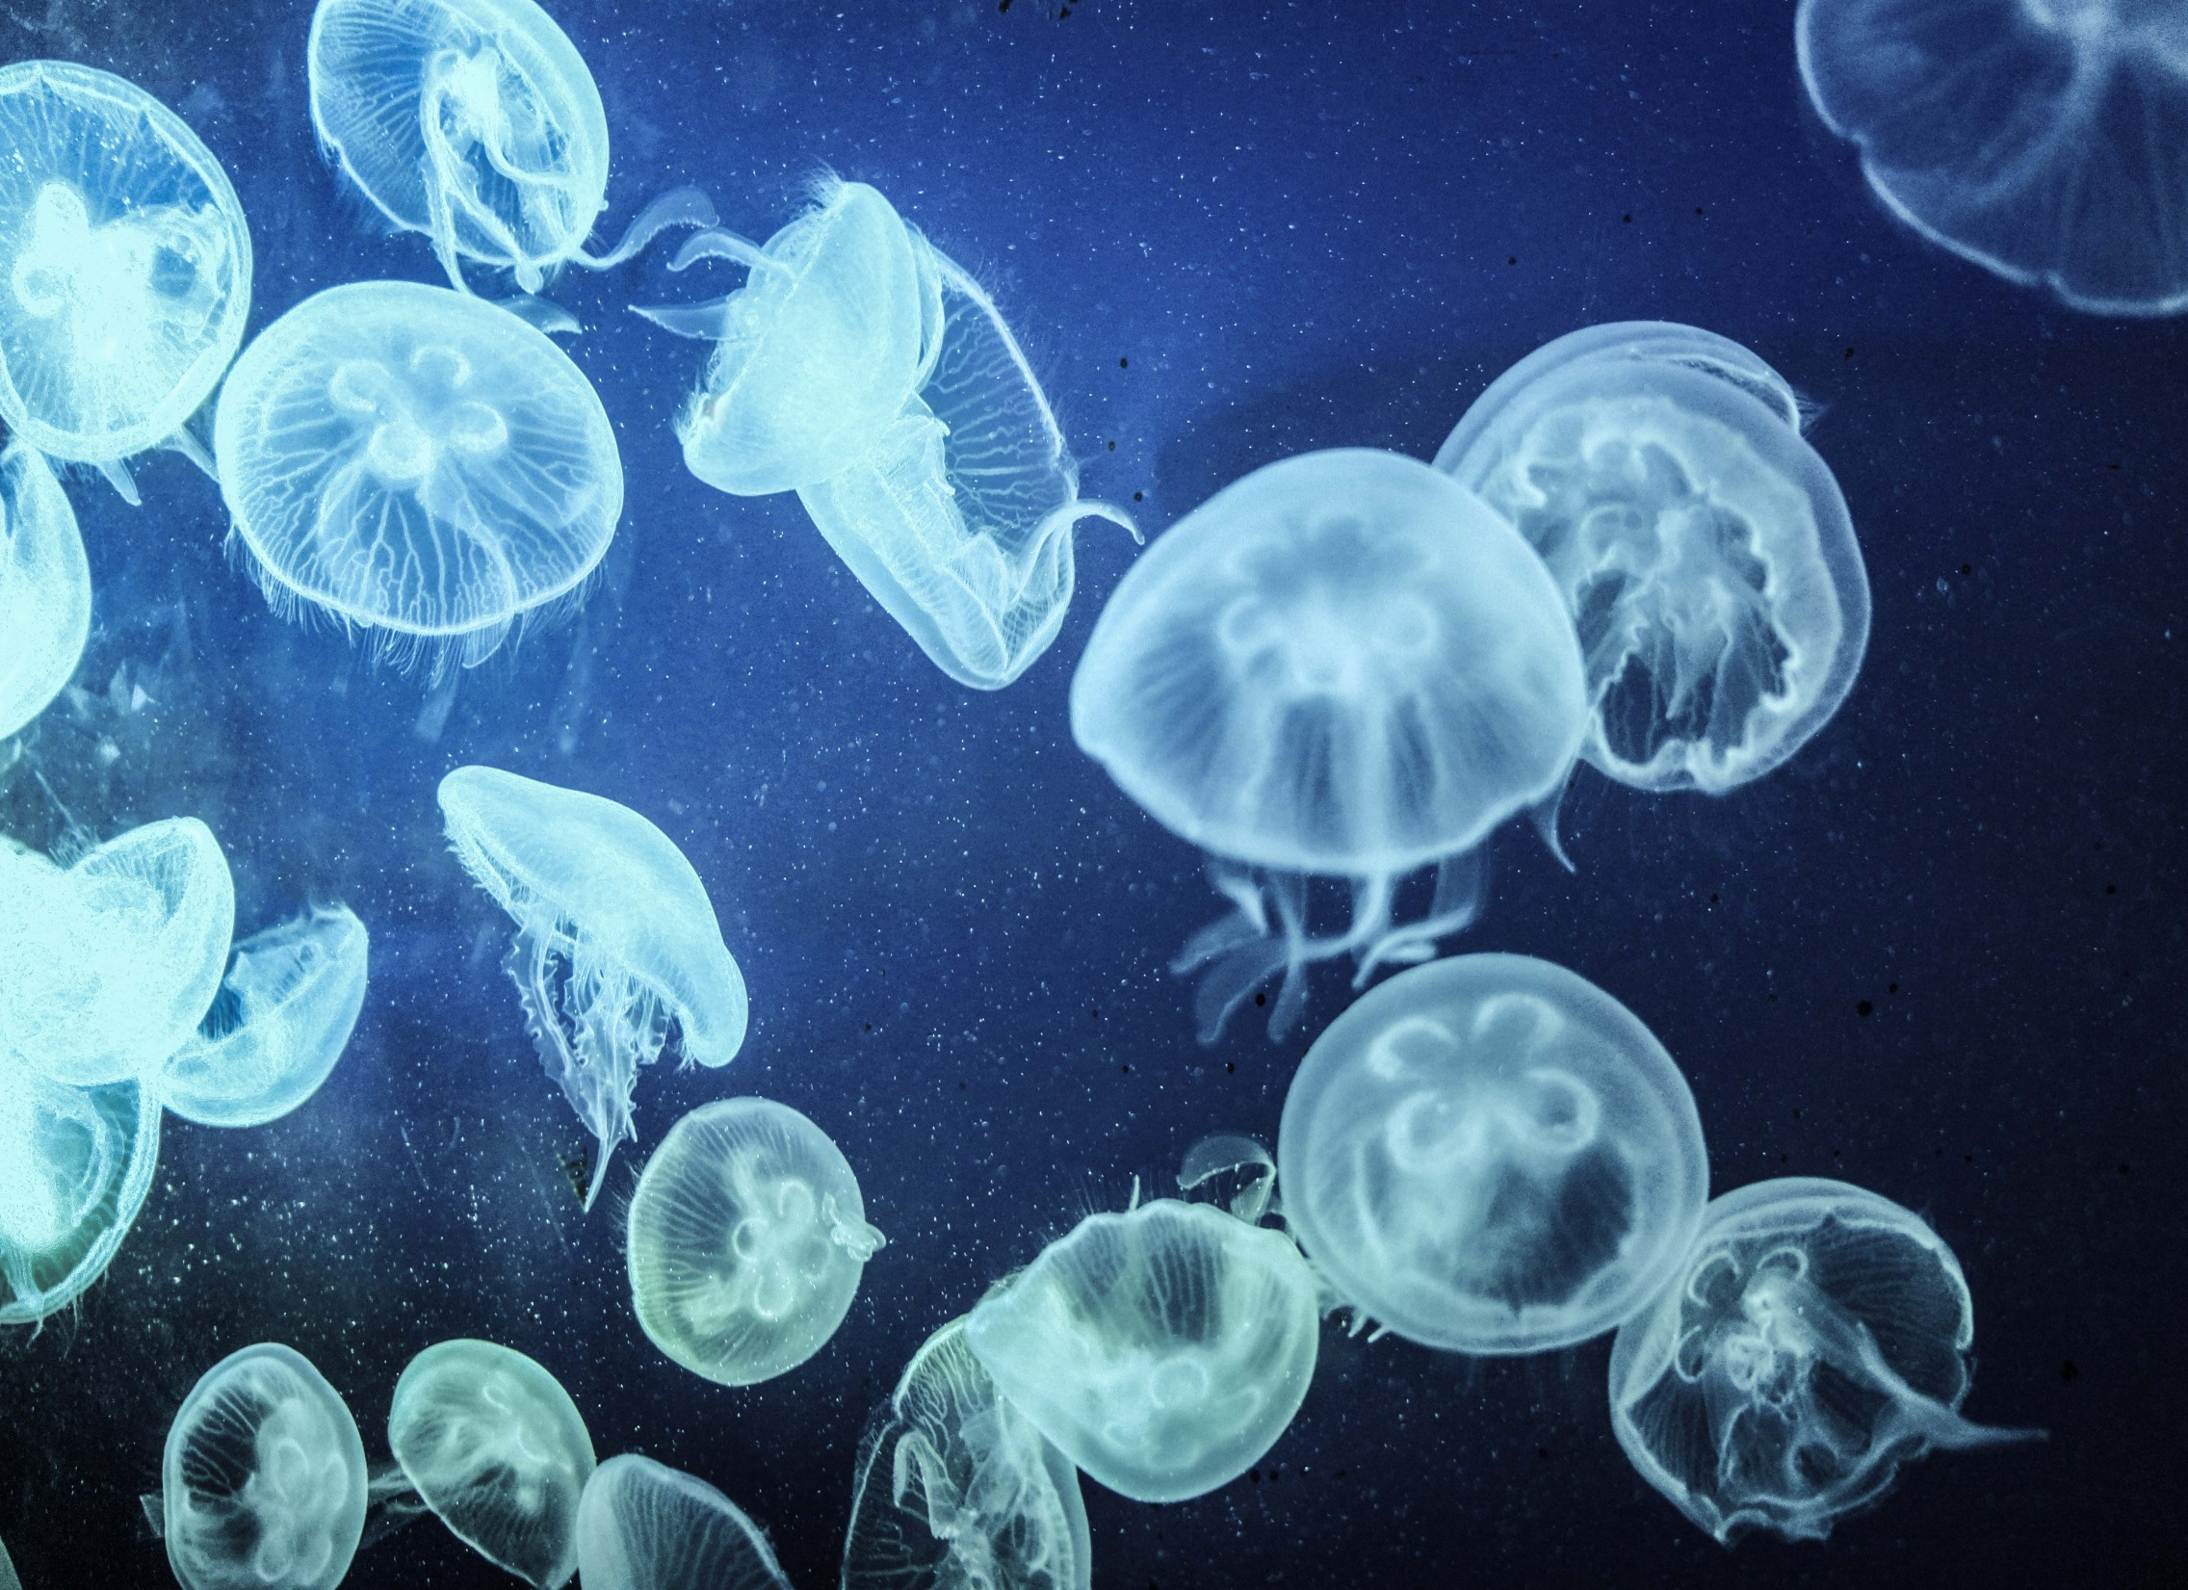

Slide 8
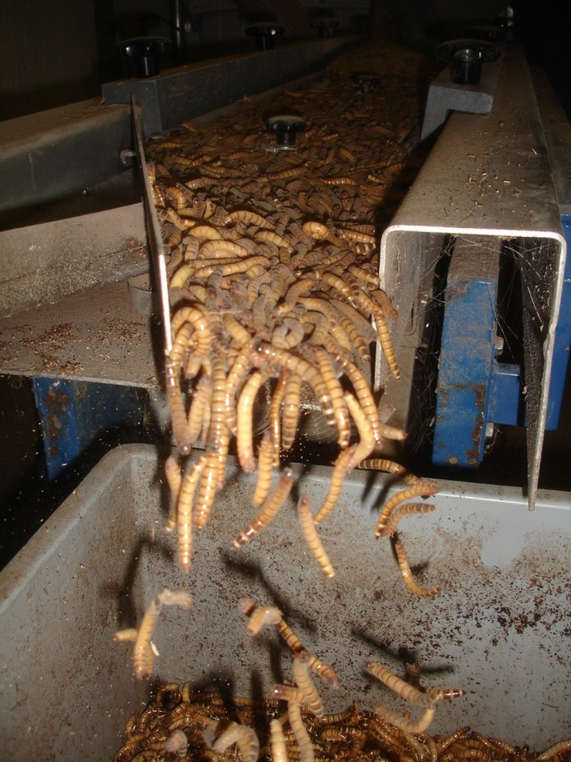
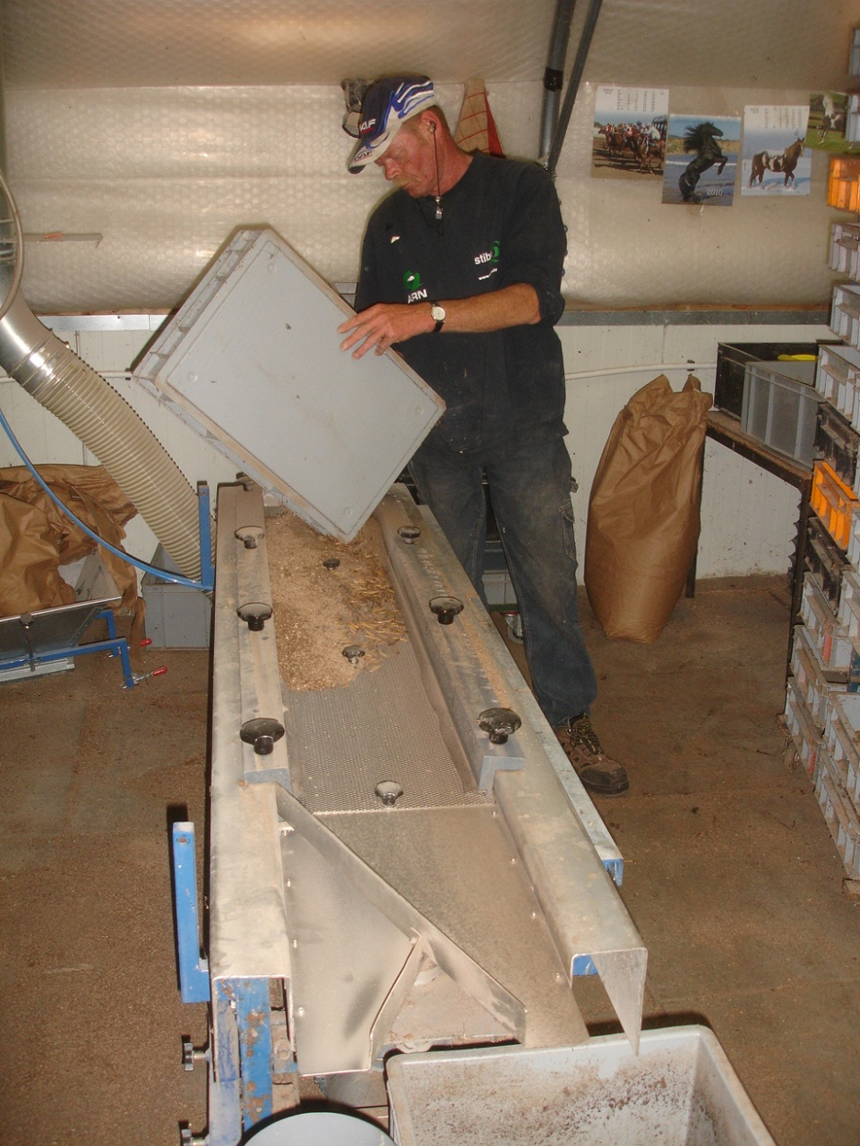
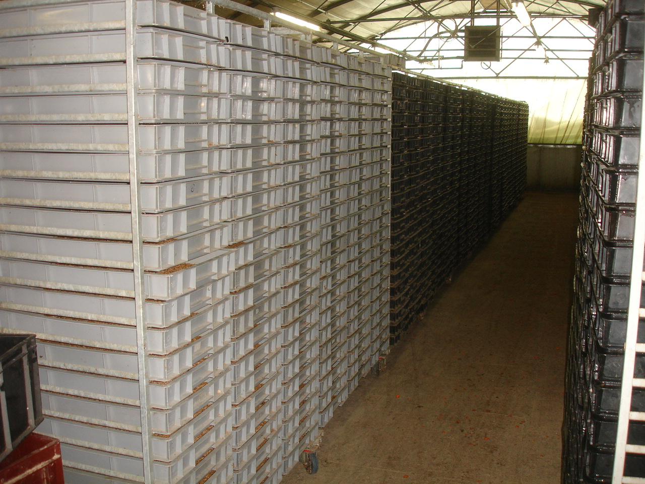

Slide 9
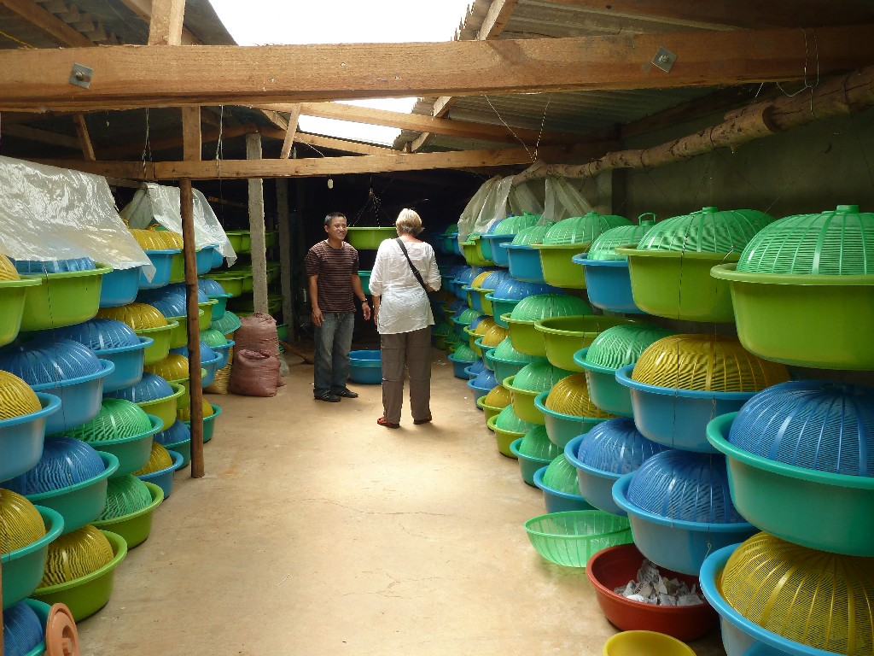
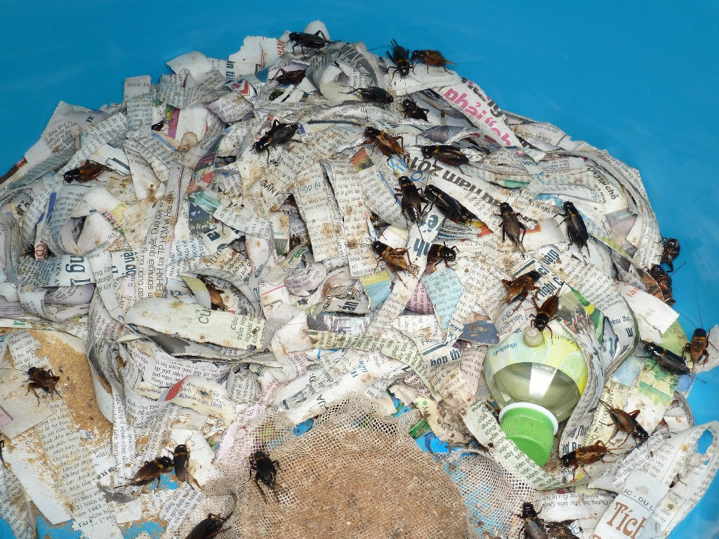
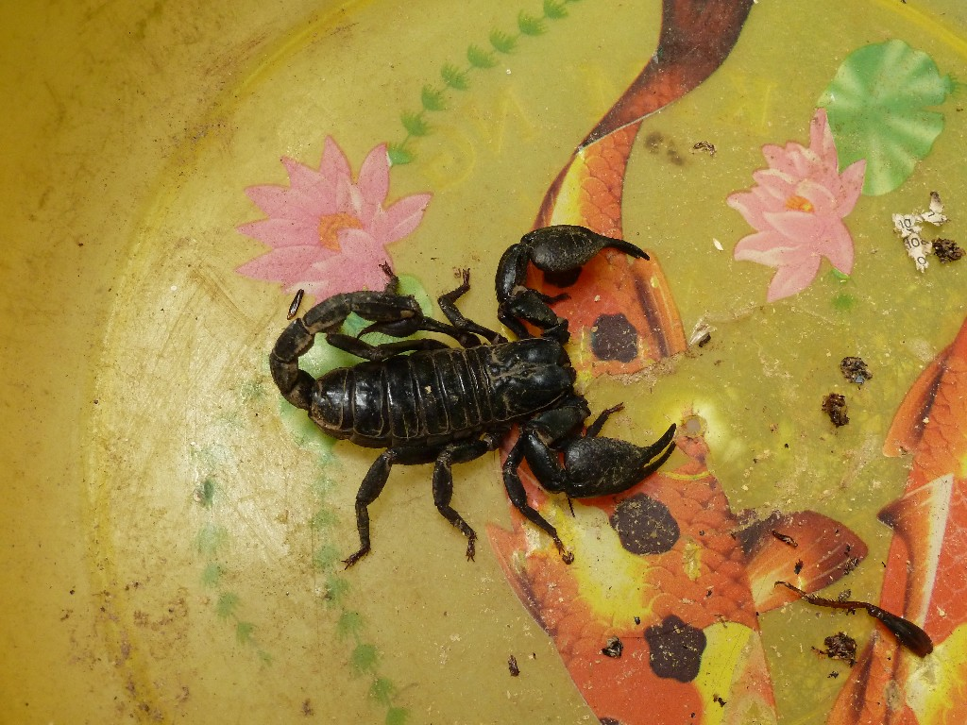

Slide 10
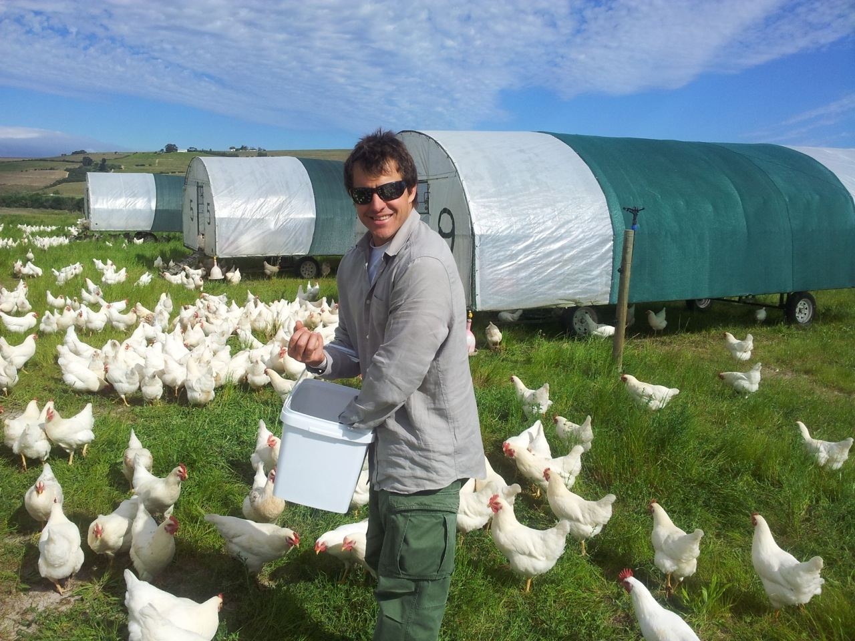
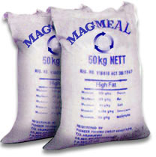

Slide 12
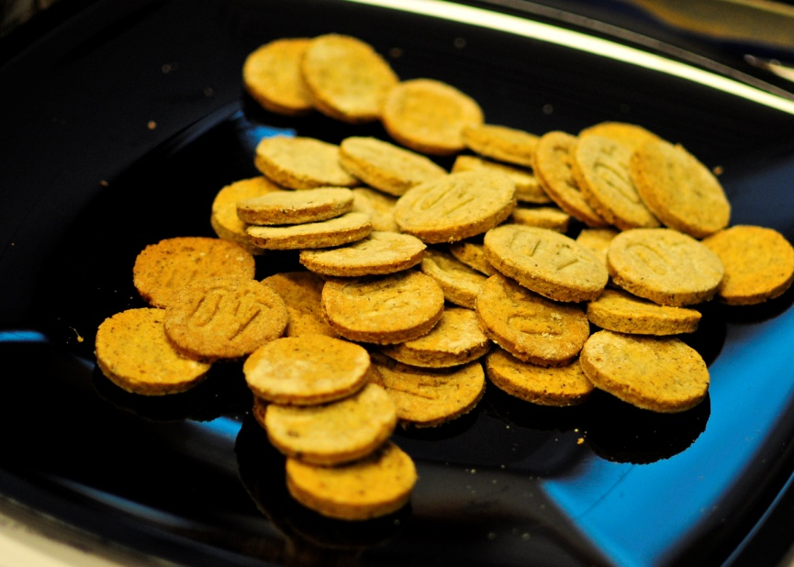
Three reasons why insects, jellfish, algae are not already on our plates in Europe:
No regulatory frameworks explicitly govern insects as food and feed
Limited supply
Disgust factor

Slide 13
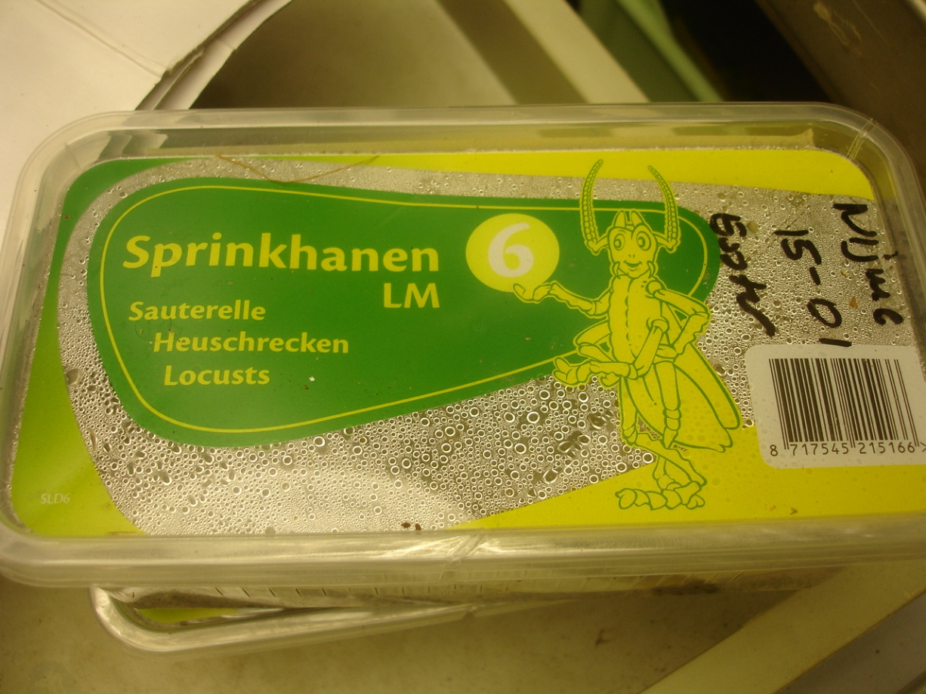
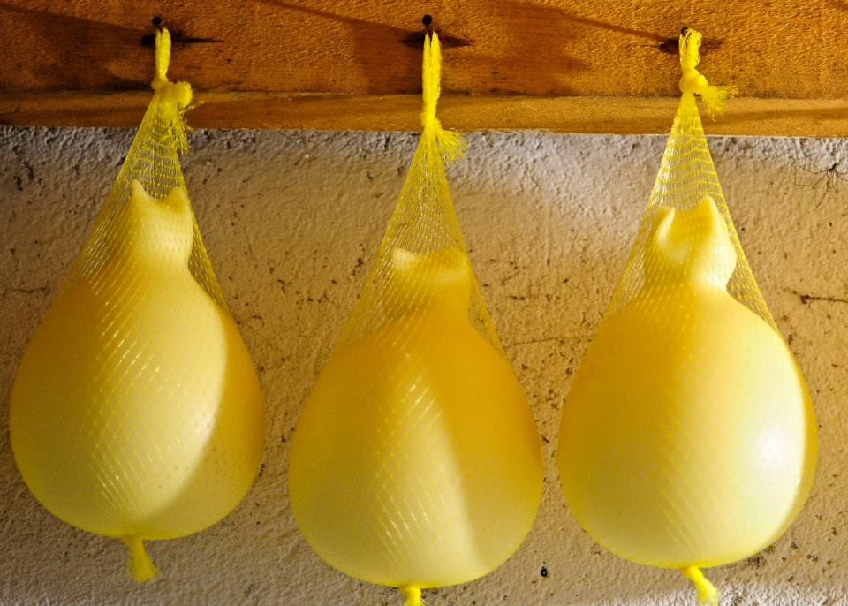
Not explicitly stated within food and feed regulations: not allowed & not forbidden
Few producers for feed and food due to regulatory barriers
Not a part of European food culture

Slide 14
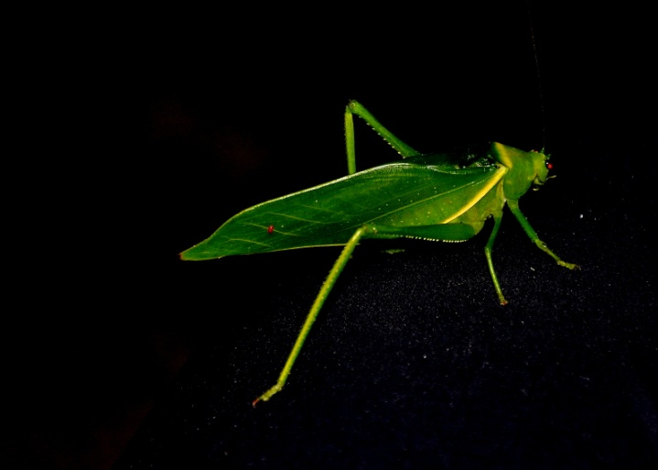
Three of the most urgent actions that need to be taken:
Public awareness raising, networking and information sharing
Knowledge, research & pilot development
Include insects into food and feed legislation

Slide 15
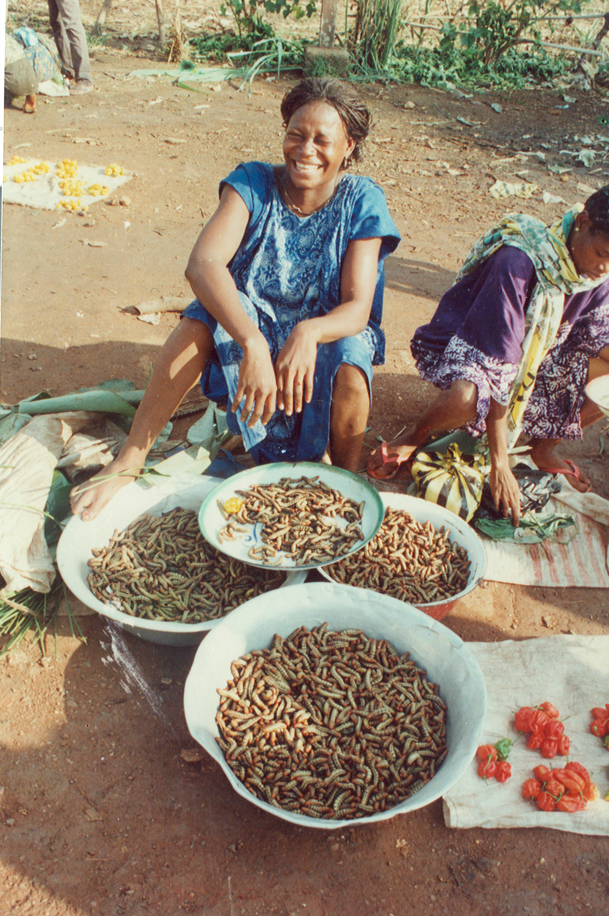
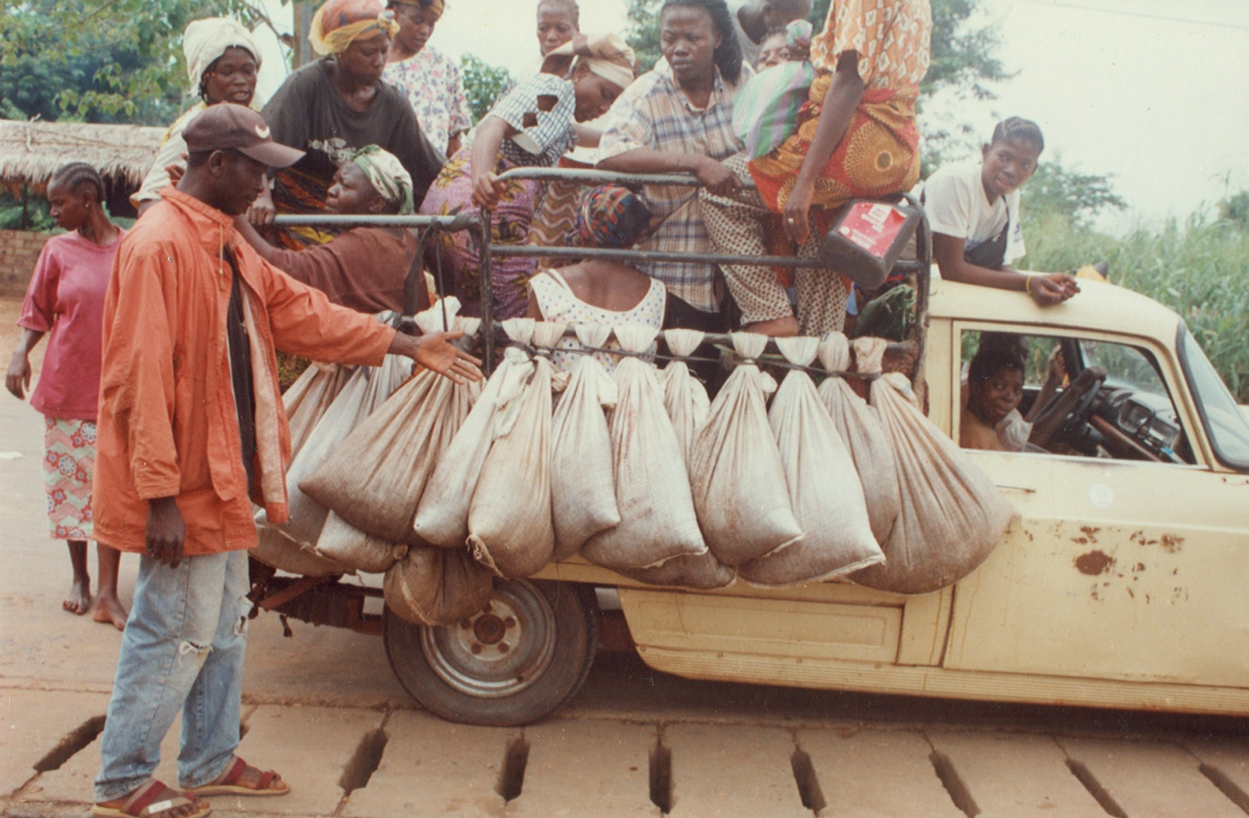
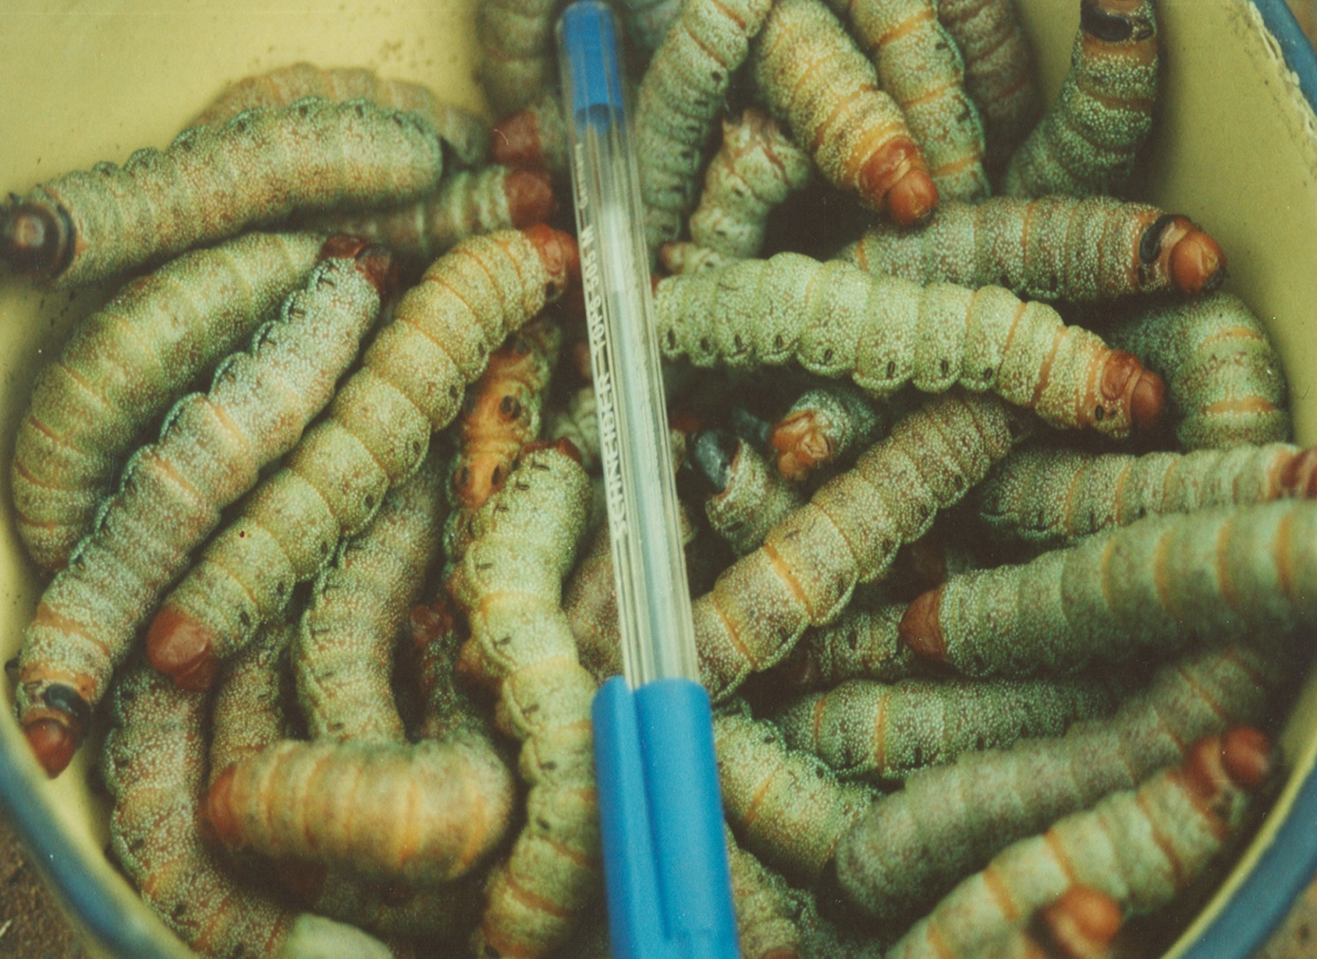

Slide 16
Let’s see some video:
https://vimeo.com/129470280 (edible insects)
https://www.youtube.com/watch?v=Lxr1b1YaUns (edible jellfish)
https://www.youtube.com/watch?v=jJamIjeGMyU (edible algae)
https://www.youtube.com/watch?v=ldGz8kJEMk0 (growing algae)

Slide 17
Thanks for your attention
ettore.capri@unicatt.it
www.operaresearch.eu

