Slide 1
Erasmus+
Fake News in a Fake News Age : Cultivating Media Literacy in the Educational Comunity
Școala Gimnazială ‟Al. I. Cuza ‟, Brăila
Guess the fake news
2019, May 6th- 11th
Norway mobility

Slide 2
ROMANIAN PROCEDURE Five articles from online newspapers were selected. Each article refers to a specific area of interest: Environment, Society, and Lifestyle (annex 1). One of them, article 4 – environment article, was a fake news story and it combined the following characteristics of a typical fake news: the title is pompous there is no writer or other references the time of the story is not accurately stated the story was written with mistakes

Slide 3
RESULTS 29 students ( age 14-15 ) participated to the research 21 of them identified the fake news article. 8 of them said that the article 3 is a fake news article. They justified their opinion ( the teacher suggested to choose 2 answers) 17 of them didn’t believe the specific story because the text refers to an unusually funny/exaggerated story 12 of them didn’t believe the specific story because there is no writer or other references 8 of them didn’t believe the specific story because the time of the story is not accurately stated 8 of them didn’t believe the specific story because the text contains syntax errors 7 have no evidence that is a fake news story but they don’t believe it 6 of them didn’t believe the specific story because the title is pompous They selected the reason as follow: ( the students have circled 1 answer) 15 of them circled the option for fun 8 of them circled the option to disfigure public opinion 4 of them circled the option for profit 2 of them circled the option to misinform

Slide 4
DISCUSSION / CONCLUSIONS The findings revealed that: a. 72% of the students identified the fake news article b. the majority of the students choose the right evidence that justify their selection.(answers F, A,G, E,J in the questionnaire) c. the majority of the students found out the main reasons that this fake news is created (answers A, F in the questionnaire) Before the experiment ,the students were asked to find out real news and fake news on the internet. They found articles from sports, society, lifestyle, or education. The students were informed what the false news are, the reason for their occurrence and what consequences they have in their lives.

Slide 5
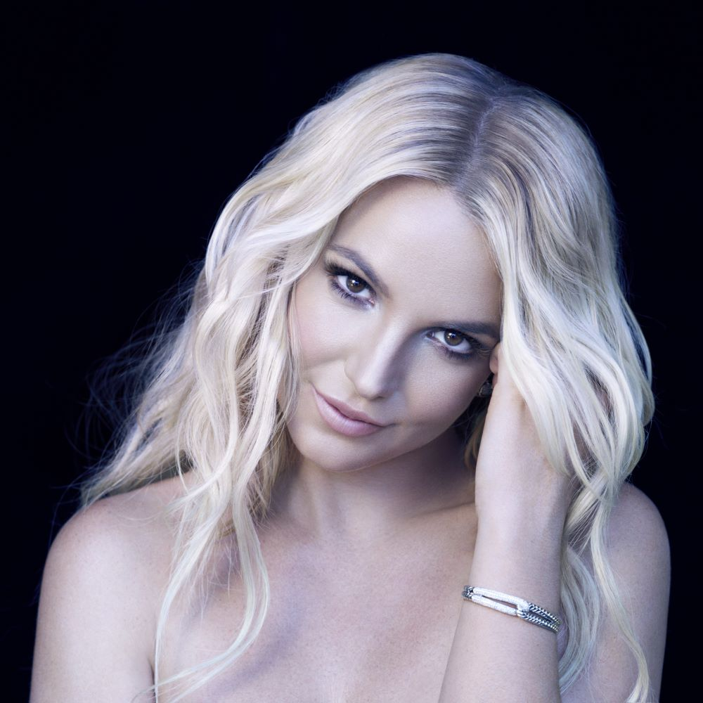
Britney Spears put her Las Vegas show on hold
The 37 year old singer Britney Spears canceled all the shows according to ET.
The reason? Family—more specifically, to take care of her father, Jamie Spears, who was rushed to the hospital in November due to a ruptured colon. After spending 28 days recovering from a "life-threatening illness," Spears was released and expected to make a full recovery, ET said.

Slide 6
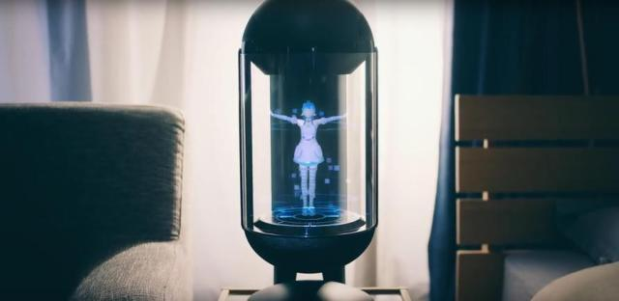
MARRIED WITH A HOLOGRAM
Akihiko Kondo doesn't have the air of a rebel. This year, however, the bespectacled school administrator bucked conventional norms.He married a hologram.
Kondo's November wedding to cyber celebrity Hatsune Miku -- which is not legally recognized -- provoked mixed reactions in Japan and abroad. Some were dumbfounded by his choice of a three-dimensional laser image over a human. Others congratulated him.
informed Tokyo CNN

Slide 7
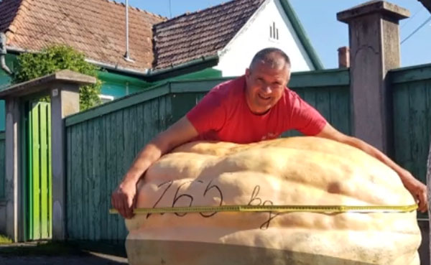
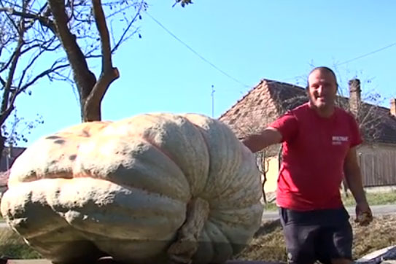
A 265 KILOGRAM PUMPKIN
The largest pumpkin in Romania is in a village in Murgești(Tg. Mureș)! The owner constantly took care of it, watered it and cared for it until it became a real tourist attraction.
Kilyen Karoly (the pumpkin owner ) said : ‟I put on in the morning two buckets of 15 l and in the evening two buckets of 15 l. Without fertilizer, only water.‟

Slide 8
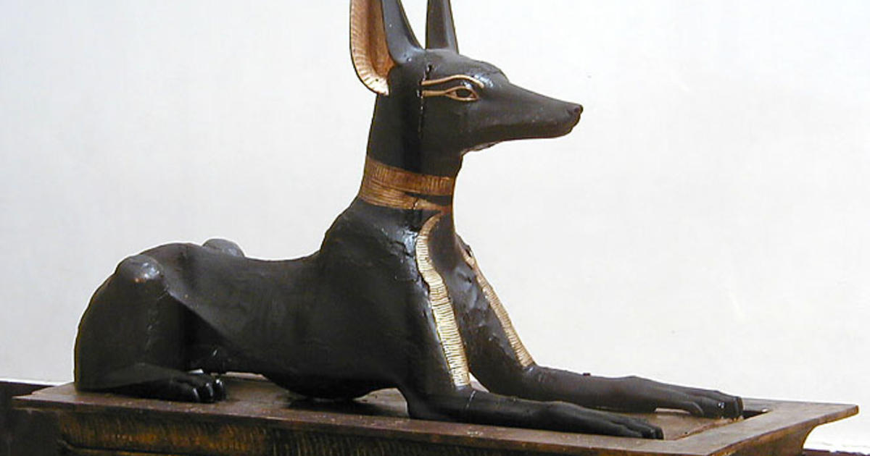
THE MUMMIGIED DOG
There are some thing loggers expact to come across when cutting down trees . Bird’s nests and things stuck in the branches seem like a given – a mummified dog in the center of a tree , however , does not .
But that’s exactly what a team of loggers with the Georgia Kraft Corp found while cutting down a tree in the 1980.That loggers were working on a grove of chestnut oaks in southern Georgia when they found a most unusual sight .

Slide 9
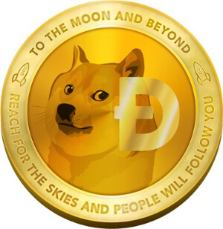
DOGECOIN
DogeCoin was officially introduced on December 6th 2013.
DogeCoin portrays Shiba Inu on its logo.
Dogecoin was created by programmer Billy Markus from Portland, Oregan, who hoped to create a fun cryptocurrency that could reach a broader
Compared with other cryptocurrencies, Dogecoin had a fast initial coin production schedule: 100 billion coins were in circulation by mid-2015.

