Slide 1
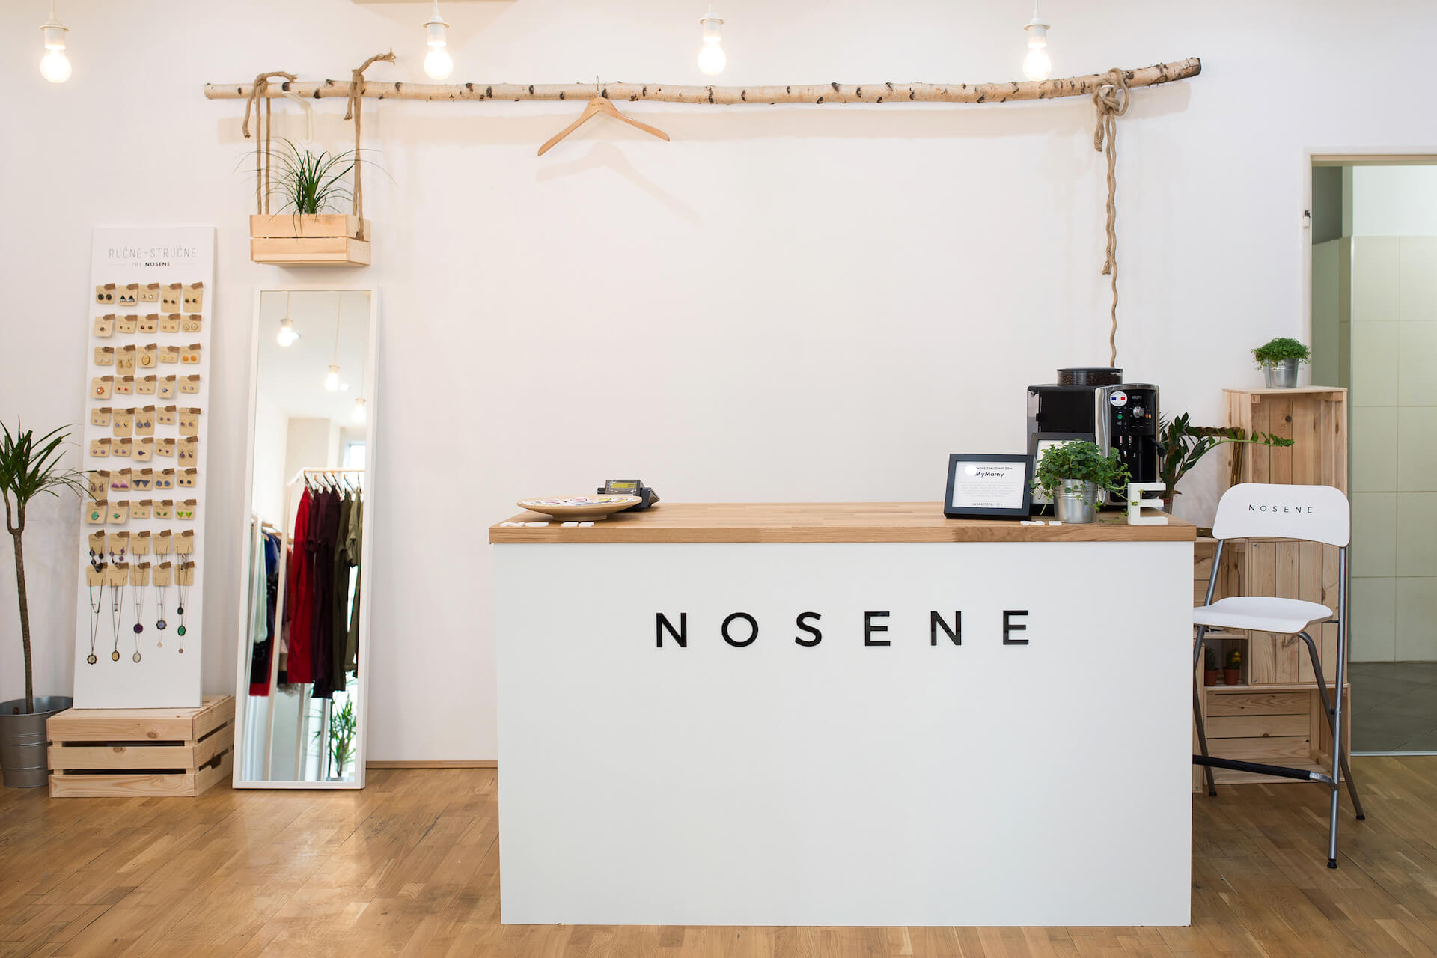
Corporate social responsibility
NOSENE, s. r. o.

Slide 2
How it started?
In 2015, some man called Jakub Ptačin heard about petition against formation of shelter for battered women
at the same period, he was thinking about starting up some secondhand
his idea was bring something new and at the same time different from other secondhands, he wanted to represent nice pieces with style
then, he met Katka Hutyrová and they decided to run bussiness together

Slide 3
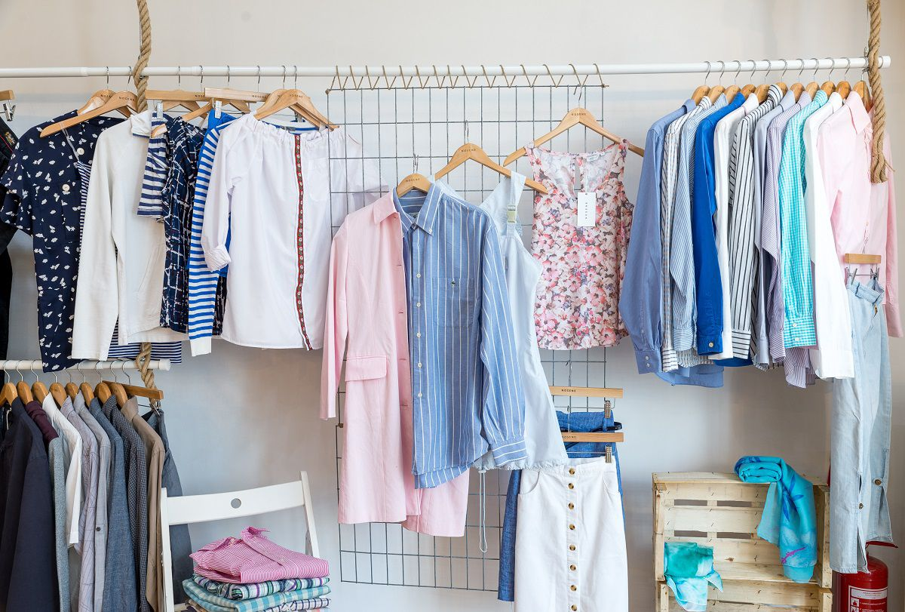
Business plan
react on so many social problems, but mostly on trend called „fastfashion“
besides, selling applied clothing they arrange less appropriate pieces of clothing to new ones
teach customers how to think more ecological about environment
buying every single piece of clothing, customers contribute by 15 % of price for civil association called My Mamy in Prešov
company received a price for good partner of comunity

Slide 4
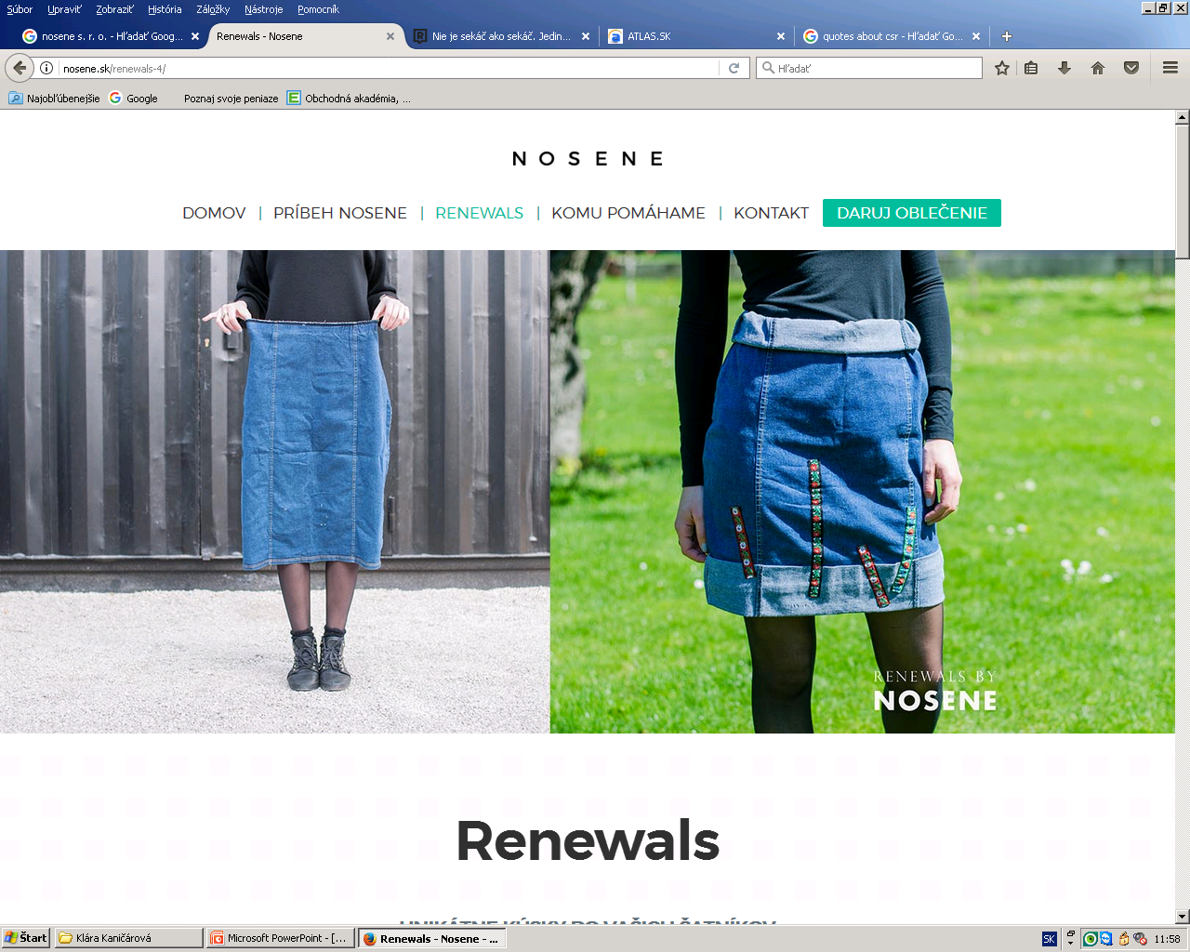
Wonder why?
simple reason, it is something different than the other stores, got idea and help women, which is a good purpose
Also, we are three girls and we are into fashion, when we saw this type of business plan, we knew it is the best for us to choose it
Selling an unique pieces, and when we rolled down their social sites we fall in love with their handmade sweatshirts and shirts
See the difference?

Slide 5
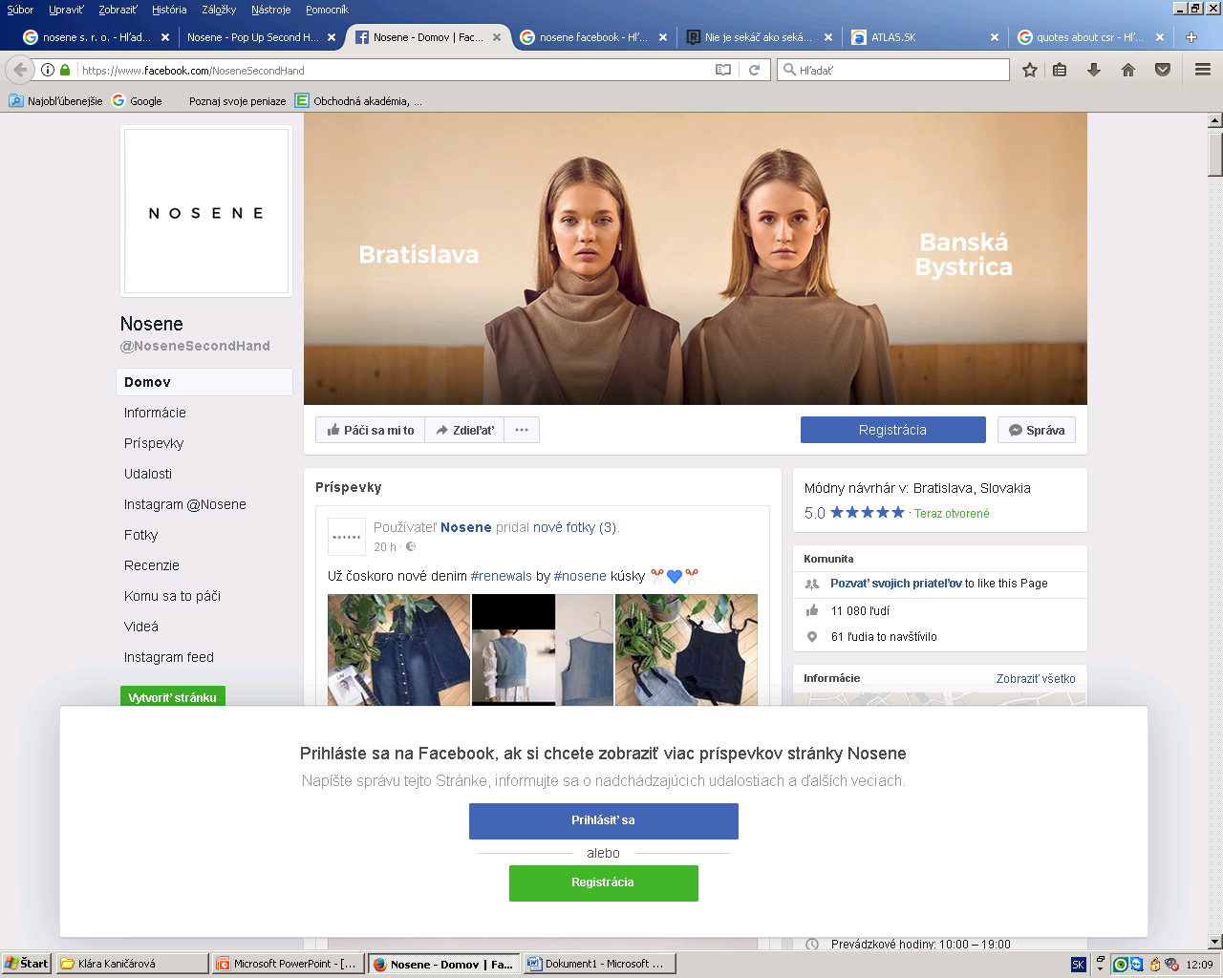
Follow them
Want read more?
http://nosene.sk/

Slide 6
„Business it tough, and the fashion industry is particularly tough.“ Ali Hewson

