Slide 1
Reunion Island
Presentation by students from Poland

Slide 2
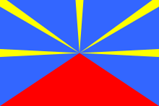
Reunion Island is an island in the Indian Ocean . It is an overseas department and region of France.

Slide 3
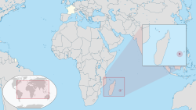
It is located about 550 km (340 mi) east of the island of Madagascar and 175 km southwest of the island of Mauritius.
Population of 858,450
Official language: French
Other language: Reunion Creole
Currency: Euro
Main cities: Saint-Denis (the department capital),
Saint-Paul, Saint- Pierre

Slide 4
THE CLIMATE OF REUNION iSLAND
It is humid and tropical.
In Réunion there are two distinct seasons, defined by the rainfall :
a rainy season from January to March, during which most of the year's rain falls;
a dry season from May to November.

Slide 5
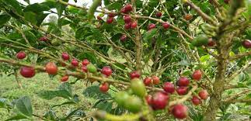
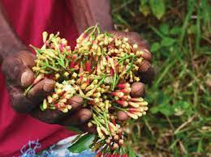
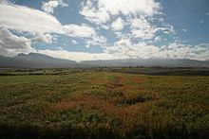
Typical plants grown on the island
Coffee , clove
Sugar cane

Slide 6
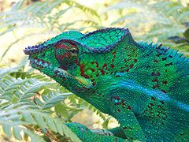
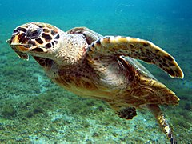
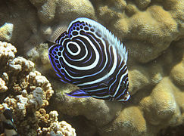
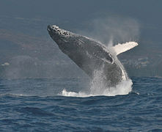
Reunion Island wildlife and beaches
A

Slide 7
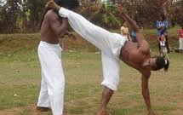
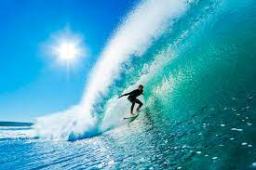
Popular sports
Moringue – a combat sport
surfing

Slide 8
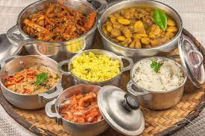
Typical food
People here eat rice, curry, rougail, and civets.

Slide 9
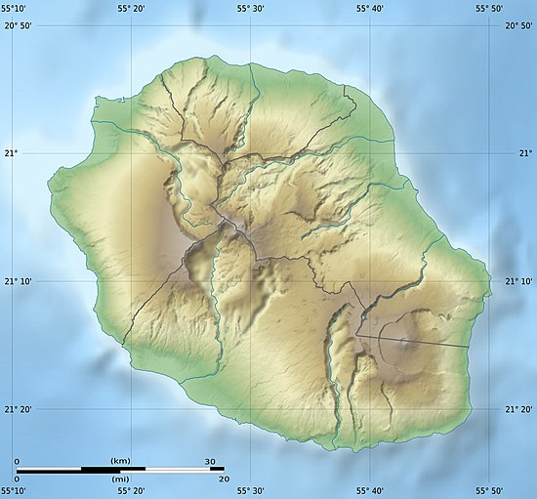
Reunion Island

