Slide 1
SAINT ROSALIA
ANTUN KANIŽLIĆ

Slide 2
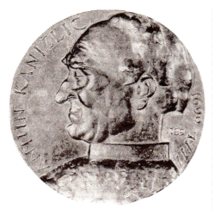
Antun Kanižlić – Jesuit from Požega, was educated in Trnava in Slovakia

Slide 3
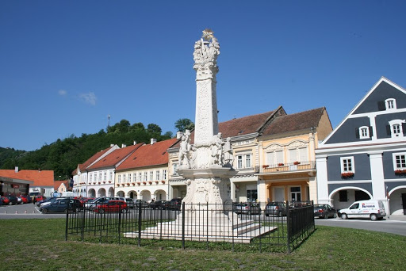
Kanižlić got inspiration to write a religious poem in order to arouse the hope of salvation from the plague

Slide 5
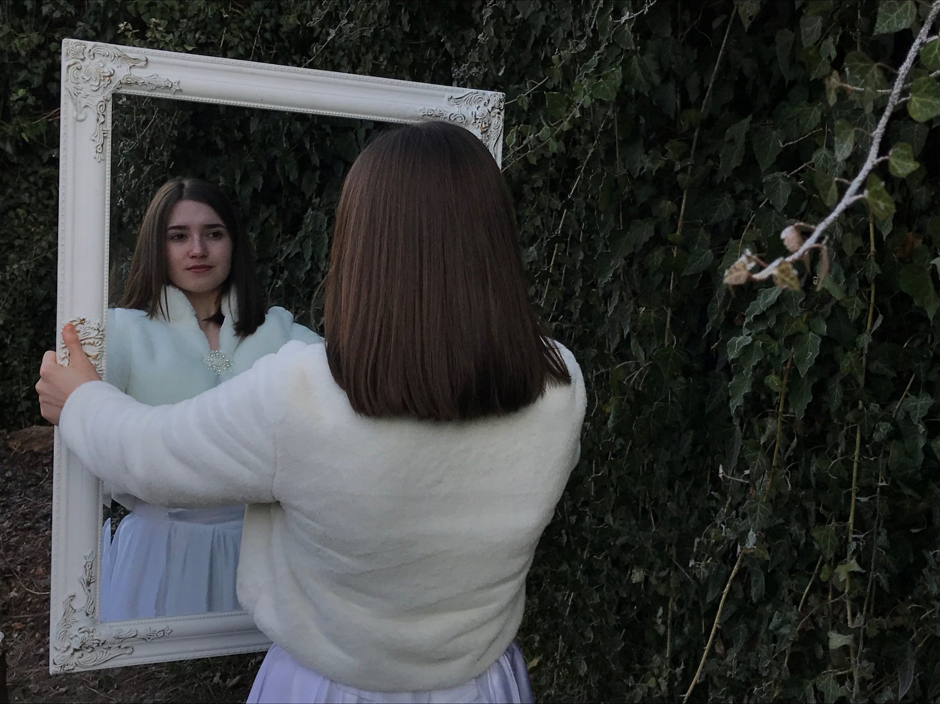

Slide 7
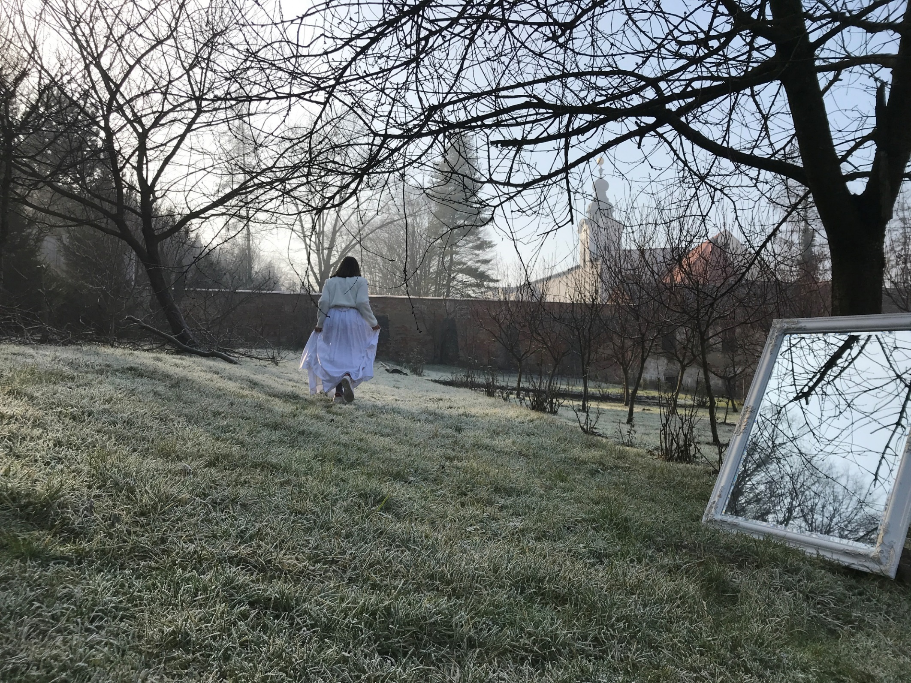

Slide 9
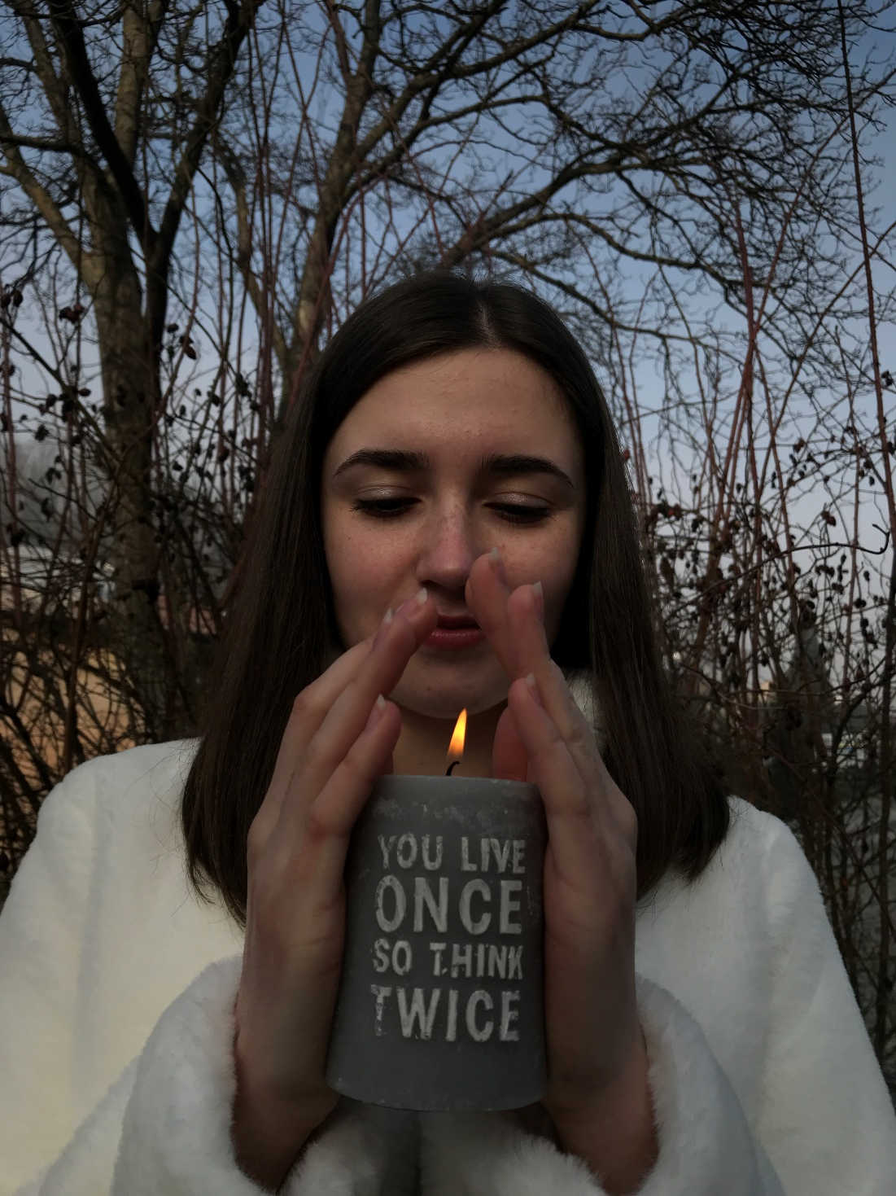

Slide 10
Photos were taken by Marijana Jugović and Mia Puljić
Model is Ivona Dražić
All photos were taken in Požega (in the garden of the convent of the Sisters of Mercy)
For the costume we thank our town theater

